Slide 1
Electronic-Know Your Customer (E-KYC)
Team Members
1.Menakaa S U [711715104039]
2.Suwetha B [711715104063]
3.Mohammed Thansir A [711715104040]
Facultyguide : Industrial guide :
Name:Mr Suseendran S Name:Mrs.Pavithra
Assistant professor Designation
Department of CSE
Department of CSE, KGiSL Institute of Technology, Coimbatore

Slide 2
Abstract
Electronic-Know Your Customer(E-kyc) processing is basically a time consuming and excruciating process because each employees personal details have to be checked manually, cross checked, send for approval and so on. The entire process take time and is prone to errors due to multiple levels of human scrutiny. Generating the KYC for every employees can be handed over to a RPA solution which can do this activity automatically and without even any manual intervention during the process.The system is planned to be built using UI path studio and triggered using UiPath Robot.
Department of CSE, KGiSL Institute of Technology, Coimbatore

Slide 3
Area Introduction-Existing system
There is no existing system to generate the E-KYC. Usually each candidate’s informations are collected and is stored in the Excel sheet. Then each candidate’s informations are filled in the KYC form. This process is fully done with the manual intervention, which takes much time to fill each form.
Department of CSE, KGiSL Institute of Technology, Coimbatore

Slide 4
Proposed System
Proposed System is planned to implement using the RPA tools. The business file(i.e.Excel sheet) is given as the input to the bot. Separate template has been generated to write the candidates personal details. The informations which are stored in the Excel sheet has been read and is written in the word template. Then the word template has been exported to pdf. The pdf files has been stored in the separate folder, so that the pdf can be used whenever is it necessary. Separate website has been created to fill the form automatically. Then the submitted form has been stored in separate folder and the link is being given to the agent for their verification.
Department of CSE, KGiSL Institute of Technology, Coimbatore

Slide 5
Literature Review
Drawbacks of existing methods
It takes much time to fill the form for each candidates. Sometimes we may also fill the form incorrectly.
Advantages of proposed system
When the business file(i.e.Excel Sheet) is given as the input, the bot will automatically write the data in the word template and the word template is being converted to pdf. Then the website has been created to upload the files and then the files are send to the agent for their verification.
Department of CSE, KGiSL Institute of Technology, Coimbatore

Slide 6
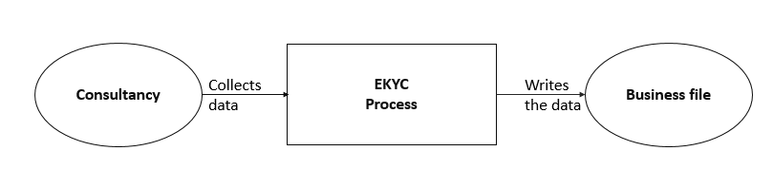
Architectural Design Data Flow diagram-Level 0
Department of CSE, KGiSL Institute of Technology, Coimbatore

Slide 7
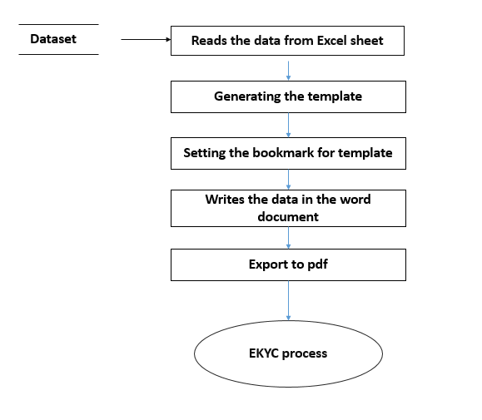
Data Flow diagram-Level 1

Slide 8
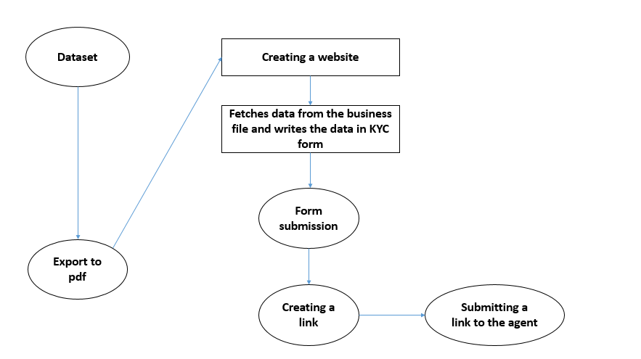
Data Flow diagram-Level 2

Slide 9
Module Splitup
Module 1 : Collecting Candidates details
Module 2 : PDF Automation
Module 3 : Creating a website to upload the files
Module 4 : E-mail automation
Department of CSE, KGiSL Institute of Technology, Coimbatore

Slide 10
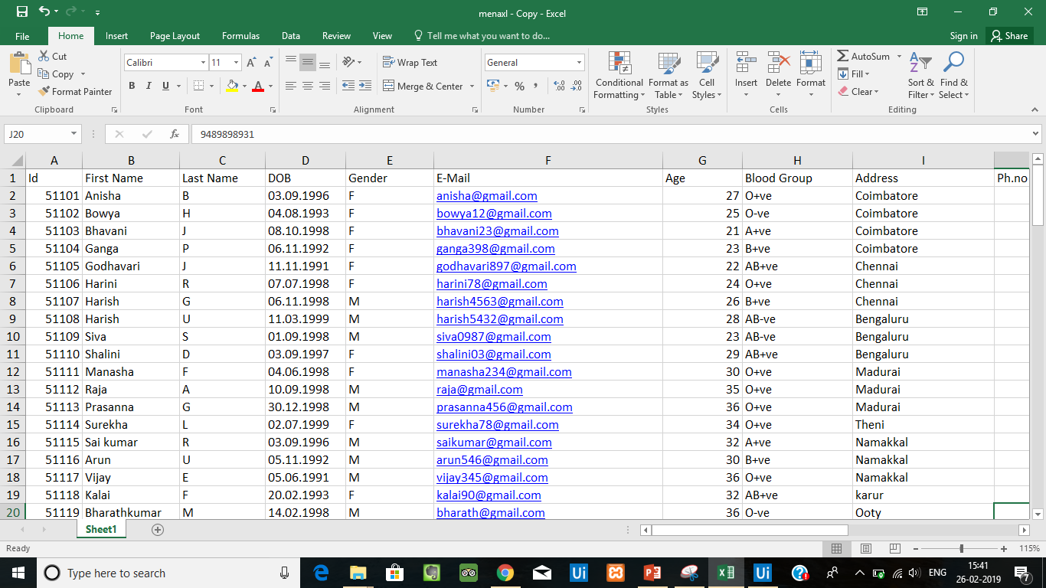
snapshots

Slide 11
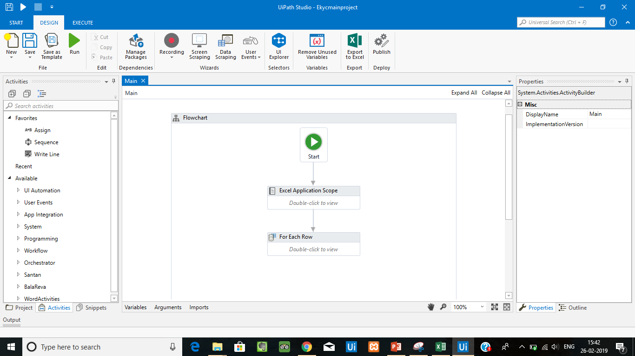

Slide 12
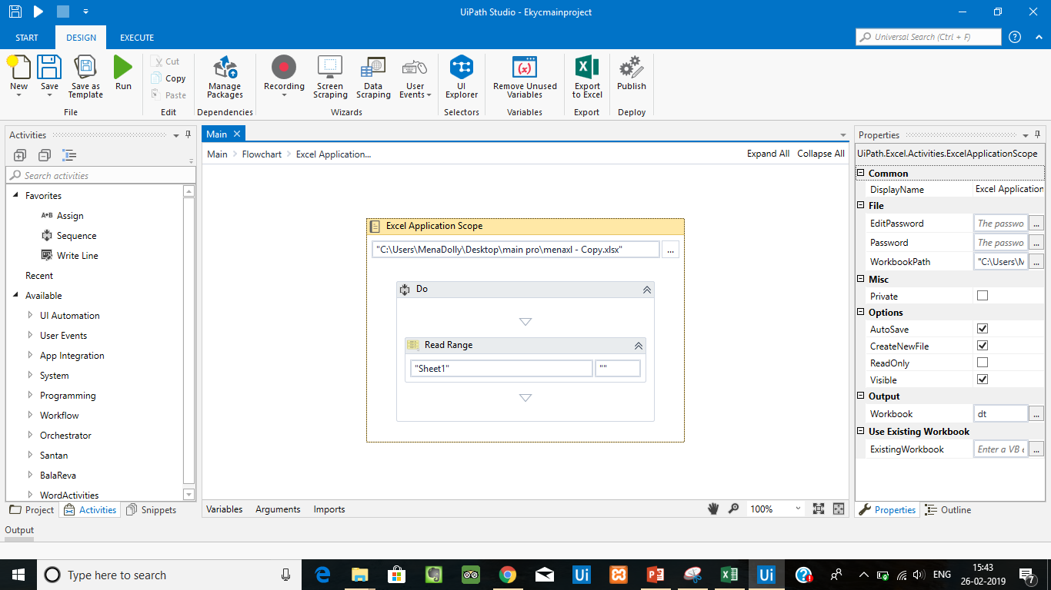

Slide 13
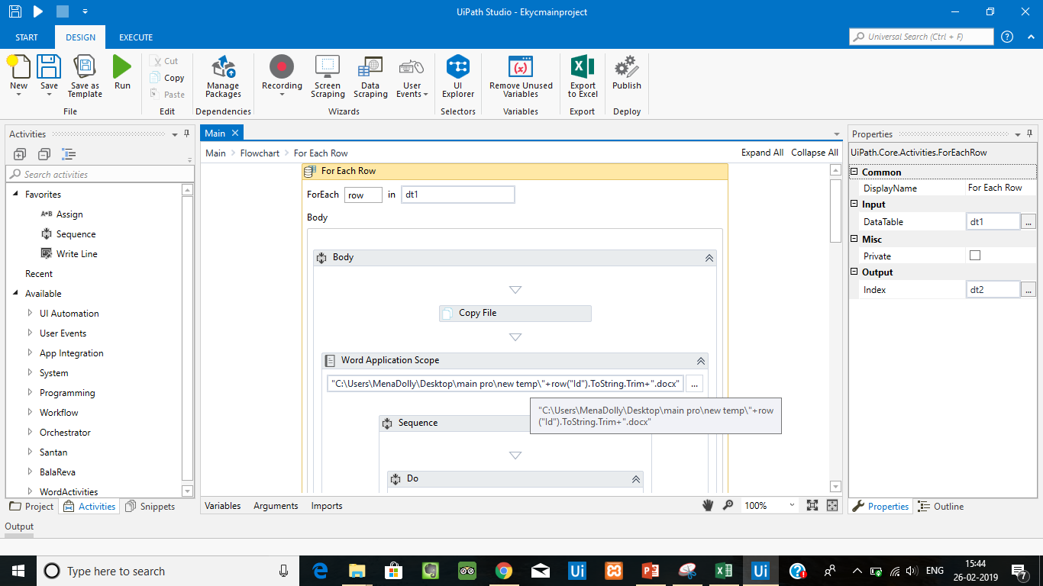

Slide 14
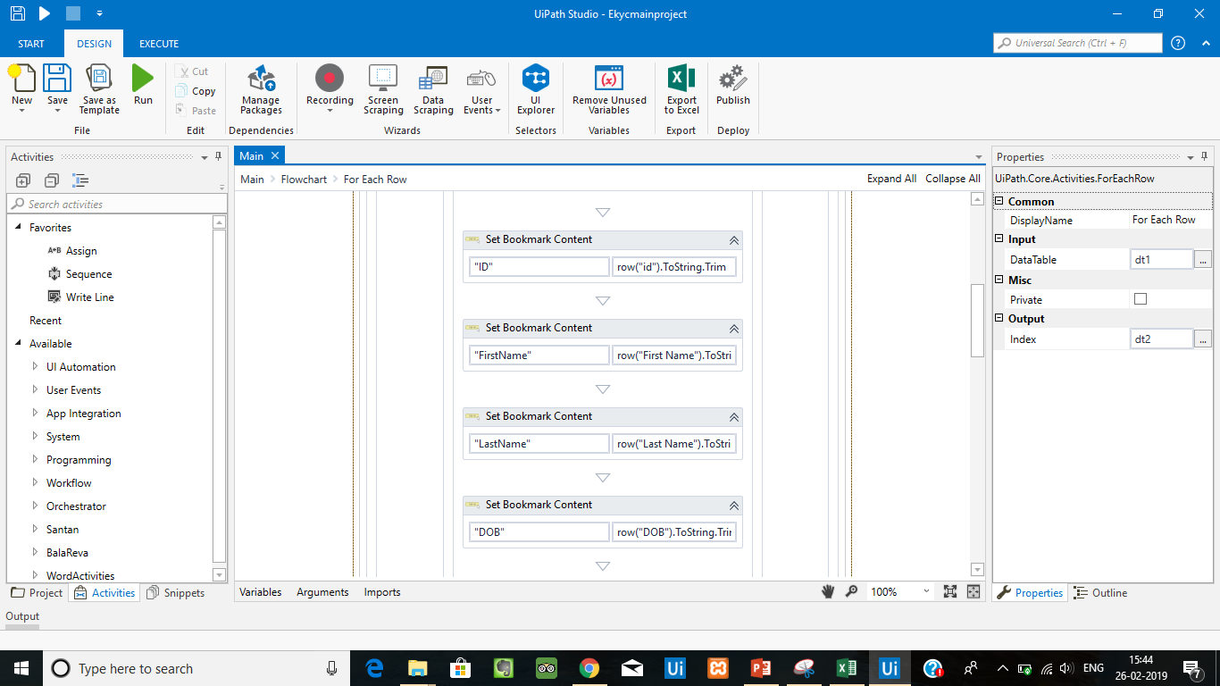

Slide 15
Thank You

