Slide 1



IT5117 · PROGRAMMING ESSENTIALS FOR AI
Daily Rainfall
Estimation &
Weather Analysis
for Anuradhapura, Sri Lanka
Sithum Wickramanayaka
Student No: 269214N
MSc in Artificial Intelligence (Batch 19)
University of Moratuwa

Slide 2

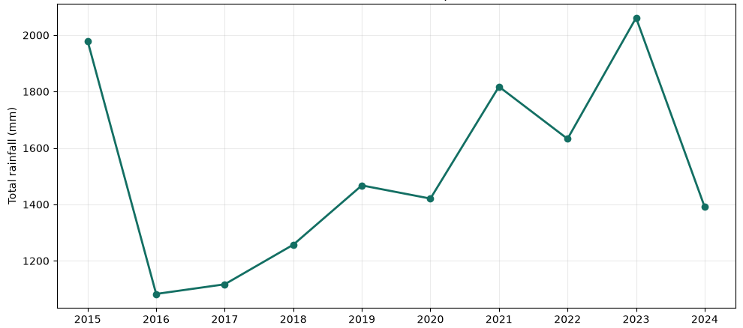

Rainfall variability makes agricultural planning difficult.
Decision Context
Seasonal rainfall is uneven, and extreme events remain difficult to predict.
Farmers and planners need local evidence to make informed decisions.
Agricultural Importance
Seasonal rainfall directly affects crop timing, irrigation scheduling, water storage capacity, and weather preparation.
The primary analysis objective is to estimate daily rainfall and identify key local patterns.
Annual data demonstrates substantial year-to-year variation, motivating the need for consistent historical analysis.

Slide 3

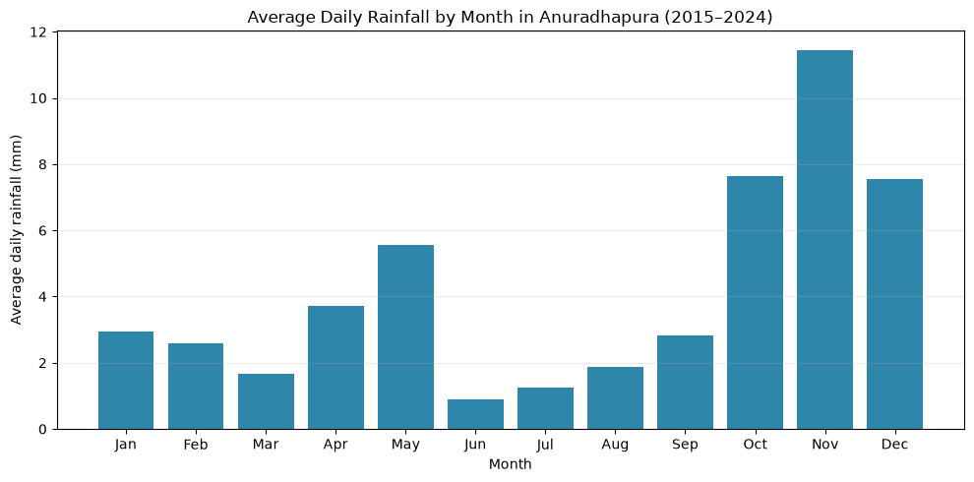
Ten Years of Data Show a Clear Rainfall Season
NASA POWER Agroclimatology Parameters
Dataset: 3,653 complete daily records (no missing −999 values) sourced from NASA POWER.
Scope: Covers 2015 to 2024, including 15 weather measurement variables with no personal data.
Target Variable: PRECTOTCORR (mm/day) utilized for estimation.
Seasonality: Monthly analysis reveals a clear seasonal pattern, with November experiencing the highest average daily rainfall at ~11.45 mm.
Key Meteorological Variables Analyzed
Pressure
Specific Humidity
Cloud Amount
Wind Direction
Dew Point

Slide 4

METHODOLOGY WORKFLOW
Two-Stage Modelling
Separates Rainfall Occurrence from Rainfall Amount
01
02
03
01 / PREPARATION
Prepare Trustworthy Data
The workflow begins by validating the 15 variables. It creates calendar, lag, and rolling-rainfall features utilizing past days only to ensure leakage-safe features.
The output is a clean 3,653-row table. Training covers the period from 2015 to 2022.
02 / EVALUATION
Primary Regression
The main solution compares Linear Regression, Random Forest, and Gradient Boosting models on the chronological 2023–2024 test set.
The output provides rainfall estimates and residuals for error and variance analysis.
03 / TWO-STAGE EXTENSION
Rainfall Occurrence & Amount
The extension separates the question of whether it rains from the amount. It first classifies rain of ≥1 mm. If detected, it estimates the amount using conditional regression.
The output includes a validated confusion matrix and the estimated rainfall amount.

Slide 5
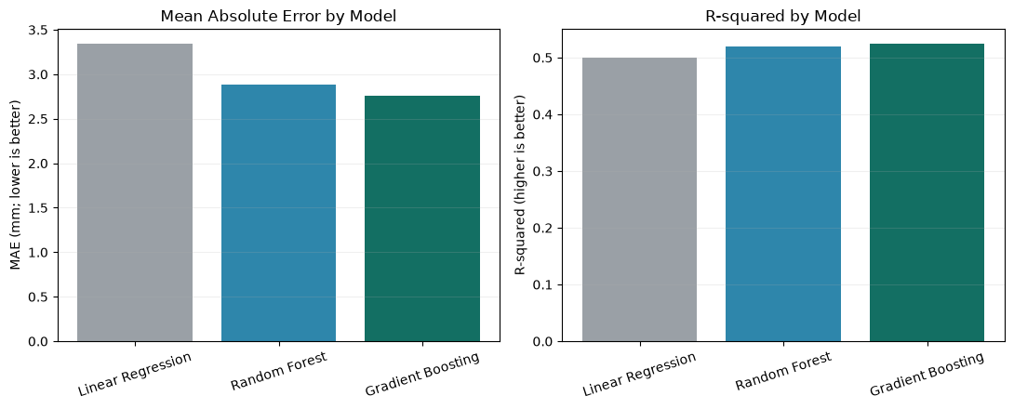
Gradient Boosting is the strongest main model.
Chronological Evaluation
Achieved a mean absolute error (MAE) of 2.756 mm on unseen 2023–2024 data.
Root Mean Squared Error (RMSE) is 6.602 mm, and the R² value is 0.524.
Why it remains the main model
Demonstrated the best MAE among the three evaluated regressors.
Possesses the appropriate complexity for the module.
Evaluates rain occurrence separately and estimates amount via conditional regression on rainy days.
MEAN ABSOLUTE ERROR (MAE)
2.756 mm
ROOT MEAN SQUARED ERROR (RMSE)
6.602 mm
COEFFICIENT OF DETERMINATION (R²)
0.524

Slide 6
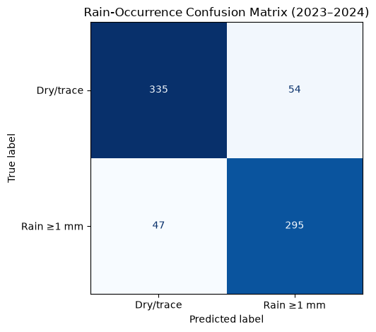
Rainfall Detection & Estimation Performance
Evaluation of the two-stage model over 731 test days reveals 86.2% classification accuracy
PREDICTED CLASS
Rain Classification
PRECISION
0.845
Positive predictive value
RECALL
0.863
Sensitivity of detection
F1-SCORE
0.854
Harmonic mean measure
Amount Estimation
MEAN ABSOLUTE ERROR
2.754 mm
Average deviation amount
R² COEFFICIENT
0.530
Goodness-of-fit metric
Regression metrics are conditional on true positive occurrences.
DRY / TRACE
RAINY
TRUE NEGATIVE
335
Correct Dry/Trace Days
FALSE POSITIVE
54
False Rain Alerts
ACTUAL CLASS
FALSE NEGATIVE
47
Missed Rainy Days
TRUE POSITIVE
295
Correct Rainy Days

Slide 7
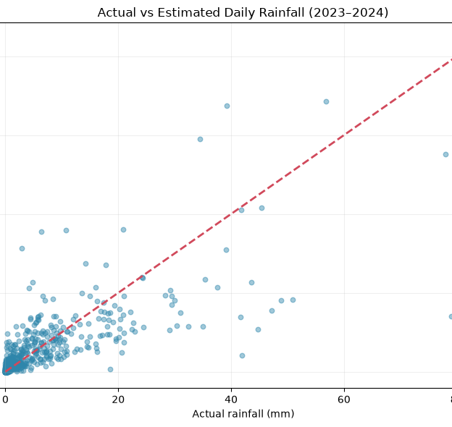
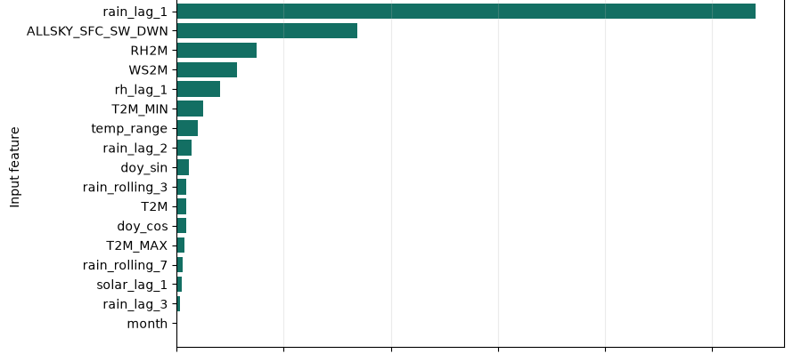
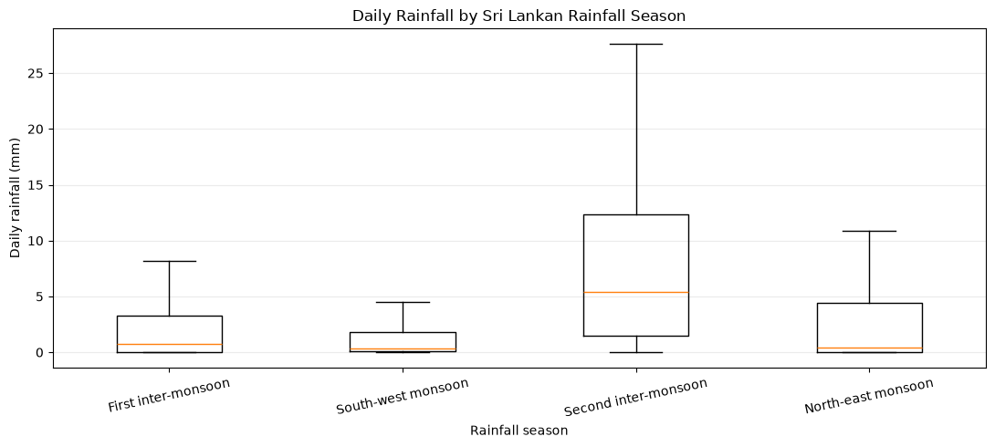
Additional Charts Explain Model Behaviour

Slide 8
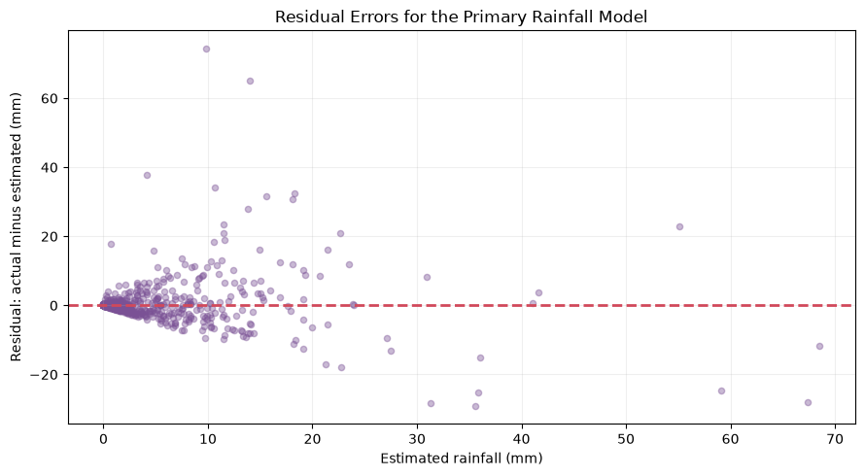
Extreme rainfall remains the model’s main limitation.
What the errors show:
Residuals concentrate near zero on low-rainfall days.
Rare heavy events create much larger errors, showing difficulty with extremes.
Functions as an estimator rather than an operational forecast.
Future Improvements:
Utilize verified rainfall measurements from local weather stations.
Integrate real weather forecast data for genuine predictive capability.
Practical Conclusion:
The project is highly useful for historical analysis and current-day estimation. A key limitation is that NASA POWER provides gridded data, not direct station data, meaning heavy rainfall needs further work.

Slide 9
Data Sources & Acknowledgements
Data Source & Documentation
[1] NASA POWER Project Daily API documentation
power.larc.nasa.gov/docs/services/api/temporal/daily/
[2] NASA POWER Project Parameter dictionary
power.larc.nasa.gov/parameters/
Data Request & Context
[3] NASA POWER dataset request (Anuradhapura · 2015–2024 · AG community)
power.larc.nasa.gov/api/...format=CSV
[4] Department of Census and Statistics, Sri Lanka (Area and climate information)
statistics.gov.lk/abstract2024/chapter1
Model Documentation
[5] Gradient Boosting Regressor (scikit-learn)
scikit-learn.org/stable/...GradientBoostingRegressor.html
[6] Random Forest Regressor (scikit-learn)
scikit-learn.org/stable/...RandomForestRegressor.html
[7] Random Forest Classifier (scikit-learn)
scikit-learn.org/stable/...RandomForestClassifier.html
Acknowledgement
The dataset was downloaded from NASA POWER.

Slide 10
Thank you

