Slide 1

UNIVERSITY OF MORATUWA
Sri Lankan Vehicle Price Prediction
Seven-model comparison with probabilistic price prediction
Sithum Wickramanayaka
Student number 269214N
MSc in Artificial Intelligence
IT5514 Applied Machine Learning
Notes:
Introduce yourself, your student number, university, degree and module. State the project title, then move to the overview.

Slide 2
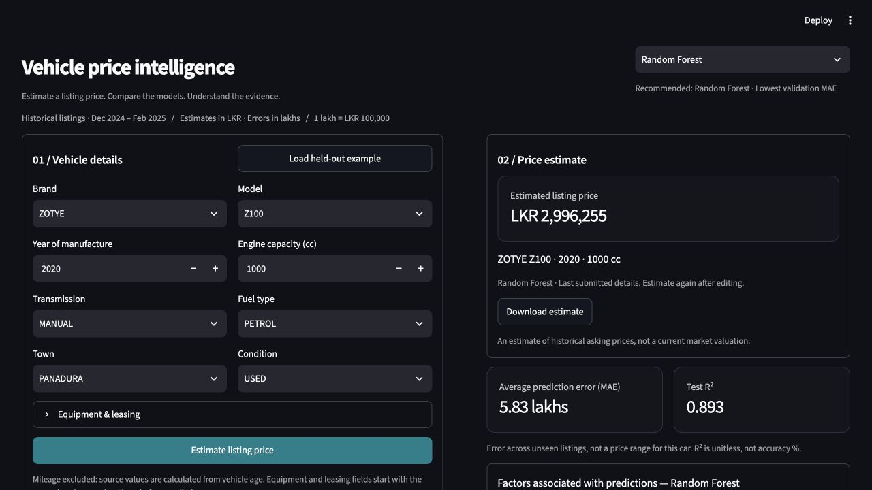



Project overview
Goal
Compare price errors and assess predictive uncertainty
Scope
NGBoost probabilistic regression and six benchmark approaches
Interface
A Streamlit app for single-vehicle price inference
Historical asking prices
Not verified sales or current market valuations
Notes:
This project predicts advertised vehicle prices in Sri Lanka using tabular listing information. It extends the Random Forest and XGBoost activity into a seven-model comparison. The goal is to compare approaches carefully and offer an interface for single-vehicle inference. These are historical asking prices, not verified sales or current market valuations. I will briefly explain the data and method, demonstrate the app, then discuss results and limitations. Source: reports/final_report.md. Screenshot: docs/screenshots/price-estimation.png, earlier interface capture with the same Random Forest result.

Slide 3
Dataset and preparation
9,788
18
13
Source and preparation
Kaggle v3 by Prasad Nirmal, from Ikman.lk and Riyasewana.com
Listings from Dec 2024 to Feb 2025
Year and engine capacity plus 11 categorical fields
Mileage excluded: it is calculated as (2025 − year) × 11,000
1 lakh = LKR 100,000
rows in source CSV
duplicates removed
predictors
1,061
42.5
120
vehicle model labels*
median price, lakhs*
95th percentile, lakhs*
* Training-only exploration
Notes:
Dataset publisher Prasad Nirmal provides version 3 on Kaggle and identifies Ikman.lk and Riyasewana.com as sources. Source URL: https://www.kaggle.com/datasets/prasadnirmal/srilankan-second-vehiclecar-price-dataset . Source CSV has 9,788 rows, 18 duplicates removed, and no rows rejected by target/date/year checks. The publisher already preprocessed the dataset, so we cannot reconstruct original missingness. Numeric predictors are manufacture year and engine capacity. Categories include brand, model, transmission, fuel, town, condition, leasing and equipment. Mileage is a calculated proxy, so we excluded it. Training-only exploration found a long price tail and many rare categories (rare categories and expensive outliers motivate categorical models and error analysis). Prices use lakhs internally, with 1 lakh equal to LKR 100,000. Imputation and encoding are fit only on training folds. Source: reports/eda_summary.json, categorical_profile.csv and final_report.md.

Slide 4
Seven models, one evaluation
Model | Approach
Random Forest | Averaged trees
XGBoost | Regularized boosting
CatBoost | Native categorical inputs
LightGBM | Histogram boosting
NGBoost | Mean and scale of price
Ridge | Regularized linear model
Stacking | RF + XGBoost with Ridge
Temporal train / test split
5,285
4,073
Train to 23 Jan Test from 24 Jan
2025
411 earlier matching rows purged
1 listing reserved for the demo
3 temporal validation folds
Lowest mean validation MAE selects the model. Preprocessing is fitted inside each fold.
Sri Lankan Vehicle Price Prediction | IT5514 Applied Machine Learning
Notes:
The seven candidates share the same partitions. Data contains 9,788 source rows, 18 exact duplicates removed, 5,285 train, 4,073 test, 411 earlier matches purged and one reserved demonstration listing. Stacking uses RF and XGBoost only, with a scaled Ridge meta-model trained on inner temporal out-of-fold predictions. NGBoost remains a separate candidate. Bounded searches do not establish exhaustive optimization. Source: saved reports/metrics/model_comparison.csv and experiment metadata.

Slide 5
NGBoost probabilistic regression
Probabilistic prediction within a seven-model study
NGBoost learns the mean and scale of a Normal price distribution using shallow trees and natural-gradient updates.
Configuration | Value
Tree depth | 3
Minimum leaf size | 10
Learning rate | 0.03
Rounds tested | 100 / 200 / 300
Selected rounds | 300
Training objective: negative log-likelihood
Selection criterion: validation MAE
Displayed estimate: distribution mean
The same temporal partitions and leakage controls apply. The Normal distribution is an explicit modelling assumption.
Sri Lankan Vehicle Price Prediction | IT5514 Applied Machine Learning
Notes:
NGBoost is the probabilistic method in the seven-model comparison. Random Forest, XGBoost, CatBoost, LightGBM, Ridge and stacking provide benchmarks. Explain that natural gradients account for the geometry of distribution parameters. Preprocessing uses fold-fitted imputation and dense one-hot encoding with rare-category pooling. The grid was fixed before inspecting NGBoost test results. No test-driven retuning was performed. Source: Duan et al. (2020), https://proceedings.mlr.press/v119/duan20a.html ; project reports/interpretations/ngboost_study.md.

Slide 6
Live demo: one vehicle, different models
1
Load the held-out example
2
Estimate with Random Forest
3
Switch to NGBoost and compare
4
Open model explanations
Example: ZOTYE Z100, 2020, 1000 cc, Random Forest estimate LKR 2,996,255
Open live Streamlit application
Notes:
DEMO BREAK, maximum two minutes. Open https://sri-lanka-vehicle-price-prediction.streamlit.app/ before presenting and ensure your account is signed in. Keep localhost ready as fallback. 0–25 seconds: select Random Forest and Load held-out example. Explain that this example was excluded from training and testing. 25–55 seconds: click Estimate listing price and identify the LKR estimate and the held-out example error. Explain that test MAE is an average across many listings, not an interval for this vehicle. 55–90 seconds: switch to XGBoost or Stacking, click Estimate again, and point out updated price, metrics and feature importance. Switching loads saved models and does not retrain. 90–120 seconds: open Compare models & data and briefly show Dataset explorer for raw/processed data. Return to the results slide at 5:50. If the app fails, explain the screenshot and move on rather than troubleshooting. Demonstrate NGBoost on the same example, then open its explanation panel and compare MAE. NGBoost predicts about LKR 4,929,350. The app shows the mean estimate; interval coverage and width are evaluation results, not guaranteed price ranges.

Slide 7
Random Forest leads on validation MAE
5.83 lakhs
RF test MAE
79.7% below median baseline
8.58 lakhs
NGBoost test MAE
Distributional outputs add uncertainty analysis
Lower MAE is better. XGBoost has the lowest test RMSE (14.24) and highest test R² (0.896).
Sri Lankan Vehicle Price Prediction | IT5514 Applied Machine Learning
Notes:
Comparison uses all seven saved results. Random Forest validation MAE is 7.148 lakhs, NGBoost 9.435. RF test MAE 5.830 versus median baseline 28.67 is about 79.7% lower. NGBoost test MAE 8.581 does not improve point accuracy. XGBoost has slightly lower test RMSE and higher R² than RF, but the predefined selection rule is validation MAE. These later comparisons remain exploratory because the historical test set was already examined. Source: reports/metrics/model_comparison.csv. All chart values are in lakhs.

Slide 8
NGBoost results and uncertainty
Random Forest remains the validation-based recommendation
Model | Validation MAE | Test MAE | Test RMSE | Test R²
Random Forest | 7.15 | 5.83 | 14.44 | 0.893
NGBoost | 9.43 | 8.58 | 16.45 | 0.861
MAE and RMSE in lakhs. R² is unitless.
89.9%
33.61 lakhs
2.4%
Coverage of nominal
90% intervals
Mean interval width
Wide uncertainty
Intervals with negative
lower bounds
Historical test results are exploratory. Later independent data is needed for calibration.
Sri Lankan Vehicle Price Prediction | IT5514 Applied Machine Learning
Notes:
All seven models appear in the main evaluation table in Section 6 of the report. NGBoost test MAE 8.5809168, RMSE 16.4456751, R² 0.8613987, validation MAE 9.4345638. Training MAE 8.2042482; validation fold SD 0.4608017. Coverage 0.8993371, mean interval width 33.6136755 lakhs, negative lower bound fraction 0.0240609; test NLL 3.74147 in lakh units. Coverage alone is insufficient because intervals are wide. The app shows the mean prediction, not a guaranteed interval. Sources: reports/metrics/model_comparison.csv and ngboost_distribution.json. The historical test set had already been examined before the seven-model comparison.

Slide 9
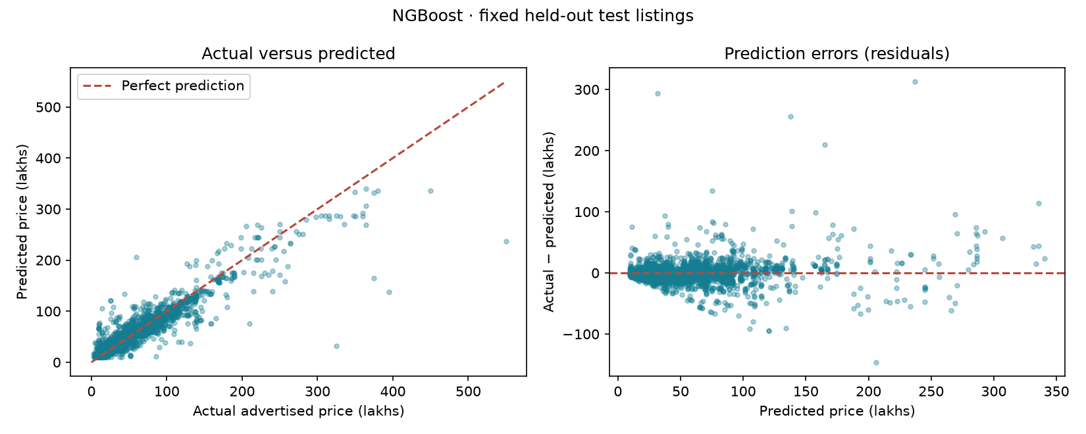
NGBoost prediction diagnostics
Near the diagonal: closer predictions
Below the diagonal: underestimation
Residual = actual − predicted
Large distances from zero reveal failures
Sri Lankan Vehicle Price Prediction | IT5514 Applied Machine Learning
Notes:
NGBoost test MAE is 8.58 lakhs and RMSE is 16.45 lakhs. Larger RMSE indicates some large errors. Training MAE is 8.20 lakhs; a small training-test difference does not establish future validity. The mean residual is −0.19 lakhs and maximum absolute error is 313.17 lakhs. Each point is a historical test listing. The cloud is dense at lower prices, while isolated points show failures. Positive residuals mean underestimation, negative residuals mean overestimation. Source: reports/figures/diagnostics_ngboost.png and reports/interpretations/interpretation_ngboost.md.

Slide 10
Explaining NGBoost predictions
Year and brand have the highest permutation importance
Average responses over 256 training vehicles. Varying one input can create unrealistic vehicle combinations; these curves describe associations.
Rare vehicles and uneven regional coverage need human review and fresh evaluation.
Sri Lankan Vehicle Price Prediction | IT5514 Applied Machine Learning
Notes:
Permutation importance increases test MAE by 18.73 lakhs for manufacture year, 7.13 for brand, 5.94 for engine capacity and 5.27 for transmission. These are global reliance measures, not causal or individual explanations. PDP uses 256 training-background vehicles and the training 5th–95th percentile grids: 1986–2018 and 650–2000 cc. Average predicted prices move from 27.28 to 94.33 lakhs and 48.66 to 84.69 lakhs. Correlations and unsupported combinations may distort the curves. Open the NGBoost explanation panel during the demo. Do not treat estimates as current valuations or eligibility decisions. Sources: reports/importance/ngboost_partial_dependence.csv, feature_importance_ngboost.csv, and reports/interpretations/ngboost_study.md.

Slide 11





Limitations and next steps
Next steps
Historical asking prices
Reused test set
Not verified sales or current valuations
Previously examined; comparisons remain exploratory
Collect fresh future listings with verified IDs and real mileage
Freeze the model
Evaluate once
Rare vehicles
Source preprocessing
Large errors for some expensive listings
Publisher cleaning cannot be fully reconstructed
Random Forest leads on validation MAE. NGBoost adds distributional outputs that need fresh calibration.
Notes:
Data covers historical advertisements and source preprocessing is not fully reconstructable. Most importantly, the historical test set was examined earlier, so later comparisons remain exploratory even though selection uses validation. Rare cars remain difficult. Next work is fresh future listings with verified IDs and real mileage, followed by evaluation of the frozen model. Summarize: the project delivers reproducible comparison, saved models and a working frontend, with RF the validation-based recommendation. Close with the distinction between point-error performance and distributional information.

Slide 12
Thank you
Questions and discussion
Sithum Wickramanayaka | 269214N
sri-lanka-vehicle-price-prediction.streamlit.app
Notes:
Thank the lecturer and audience. Invite questions. Keep the app open in another window for any demonstration requested during discussion.

