Slide 1
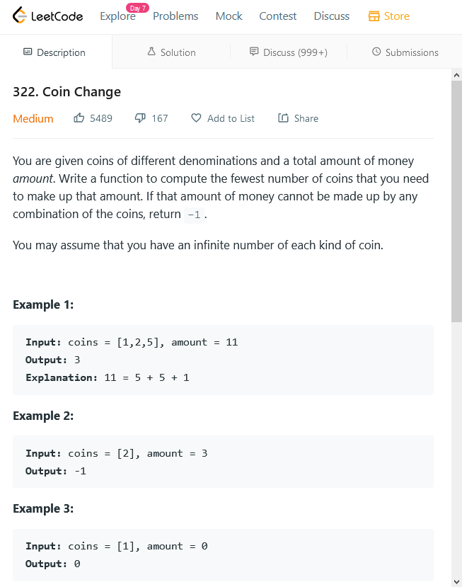
Leetcode 322. Coin Change
Concepts and Problem understanding
Recursion theory
Java Implementation
Complexities

Slide 2


Coin Change

Slide 3


Coin Change
$5
$2
$5
$1
$2
$5
$1
$2
$5
$1
$2
$5
$1
$2
$5
$1
$2
$5
$1
$2
$5
$1
$2
$5
$1
$2
$5
$1
$2
$1

Slide 4
Coin Change
Coins = [ 1, 2, 5]
Amount = 11
Minimum num of coins
Option 1 : [ 1, 1, 1, 1, 1, 1, 1, 1, 1, 1] 11
Permutations
Option 2 : [ 1, 2, 2, 2, 2, 2] 6
Option 3 : [ 2, 1, 2, 2, 2, 2] 6
Option 4 : [ 2, 2, 1, 2, 2, 2] 6
Option 5 : [ 2, 2, 2, 1, 2, 2] 6
Option 6 : [ 2, 2, 2, 2, 1, 2] 6
Option 4 : [1, 1, 2, 2, 5] 5
Option 5 : [1, 5, 5] 3

Slide 5
Lesson Learned Summary
Problems

Slide 6
References
Leetcode Problems and Coding Problems Links
322. Coin Change, https://leetcode.com/problems/coin-change/
Chapter 4 Recursion, http://www.openbookproject.net/books/pythonds/Recursion/toctree.html
Coin change problem, slide 19, https://www2.cs.duke.edu/courses/summer13/compsci230/restricted/lectures/L09-10.pdf
Images References
Icons, https://www.flaticon.com/

