Slide 1
COMP 1511 , UNSW
Technical Learning Reflection
Week -1
15 – 19 February 2021

Slide 2
COMP1511 – Week 1 Technical Learning Summary
Binary System – 1 and 0
Data types
Integer – 32 bits
Double – 64 bits
Variables and variables declaration
int answer_two = 88;
constants
printf , scanf, &input
%d, %f
Decision
If

Slide 3
COMP1511 – Week 1 Technical Learning Summary
Last Minute C Programming Preprocessor Directives Tutorial, Exam Tray, https://www.examtray.com/tutorials/last-minute-c-programming-preprocessor-directives-tutorial
What happens when you type gcc, https://medium.com/@419/what-happens-when-you-type-gcc-main-c-88c5932cf063
https://fresh2refresh.com/c-programming/c-function/c-library-functions/
https://www.techonthenet.com/c_language/index.php
Data types
https://www.knowprogram.com/c-programming/data-types-in-c-language/
https://www.tutorialspoint.com/cprogramming/c_data_types.htm
Random Number Generator , https://mathbits.com/MathBits/CompSci/LibraryFunc/rand.htm

Slide 4
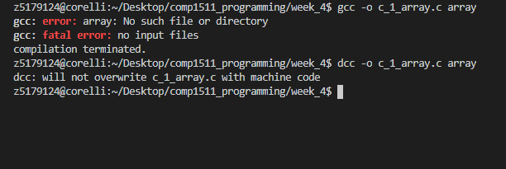
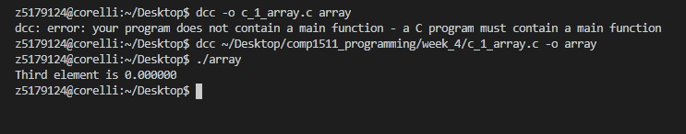
Error with both gcc and dcc
Error with both gcc and dcc
There is a main function, but it says that there is no main function.
Full file path to compile
When I use full file path, it does compile.
Notes:
Hi all,
I have been using vs code and vlab and have never had any issue with compiling the .c files until this afternoon.
This happened after I create a repo on github and push the code to github. I have tried both gcc and dcc compilers.
The file is in the correct folder.
I have tried the followings:
Is –l to ensure the file is in my correct folder.
Reboot my computer
Reinstall Cygwin and VS code
When I use full file path (as per Stack overflow advice) , it does compile. There is no need for me to use the full file path previously.
Same command dcc –o c_1_array.c array gives me two different error message.
The first one is in the screenshot above.
Second one is dcc: will not overwrite c_1_array.c with machine code.

