Slide 1
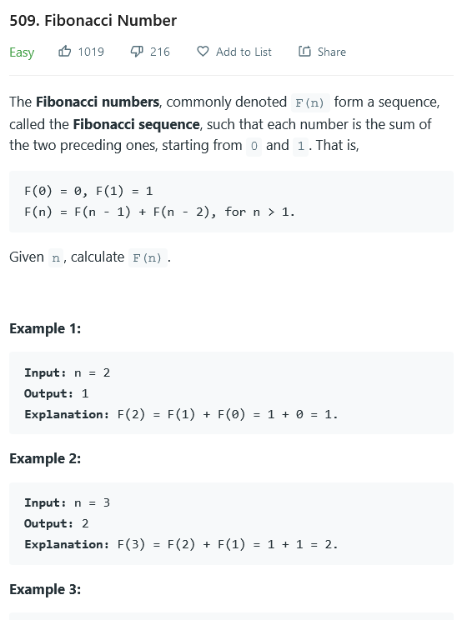
Leetcode
509 Fibonacci Number
256 Add Digits
Recursive Algorithm Structure
Recusive tree visualisation
Call Stack visualisation
Recursive Approaches

Slide 2
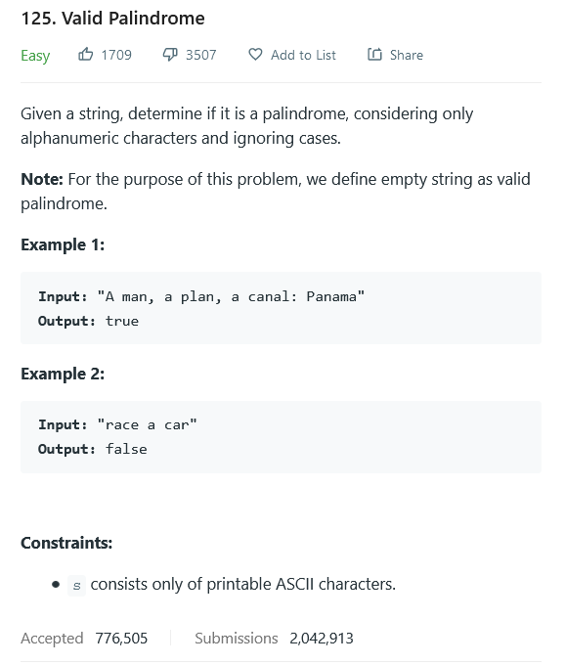
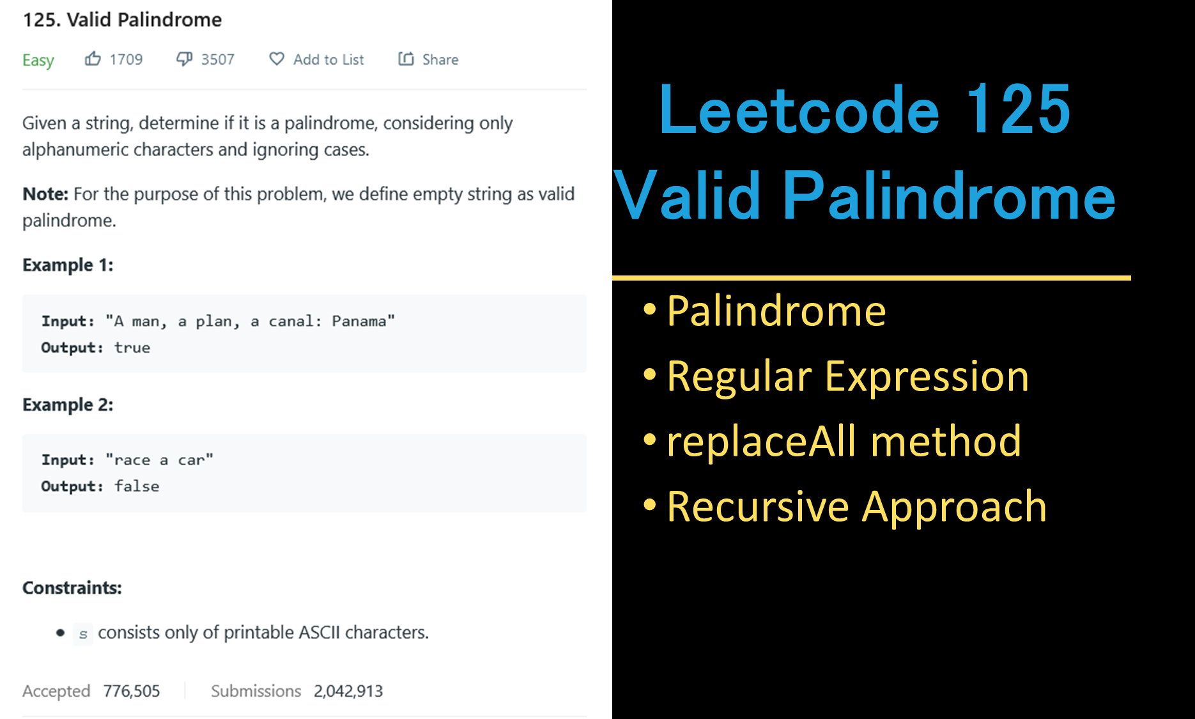
Leetcode 125
Valid Palindrome
Palindrome
Regular Expression
replaceAll method
Recursive Approach

Slide 3
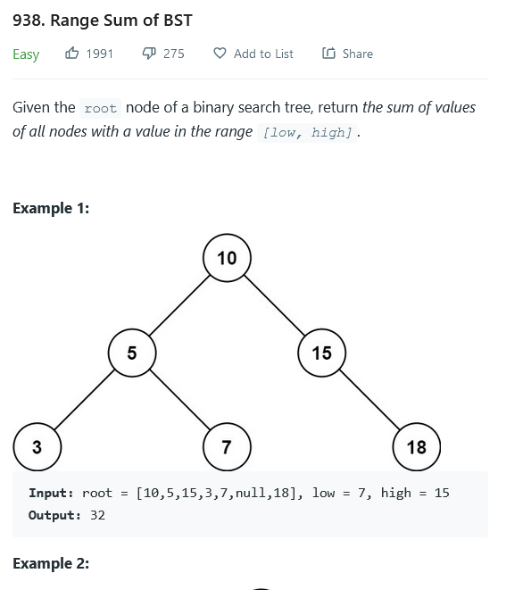
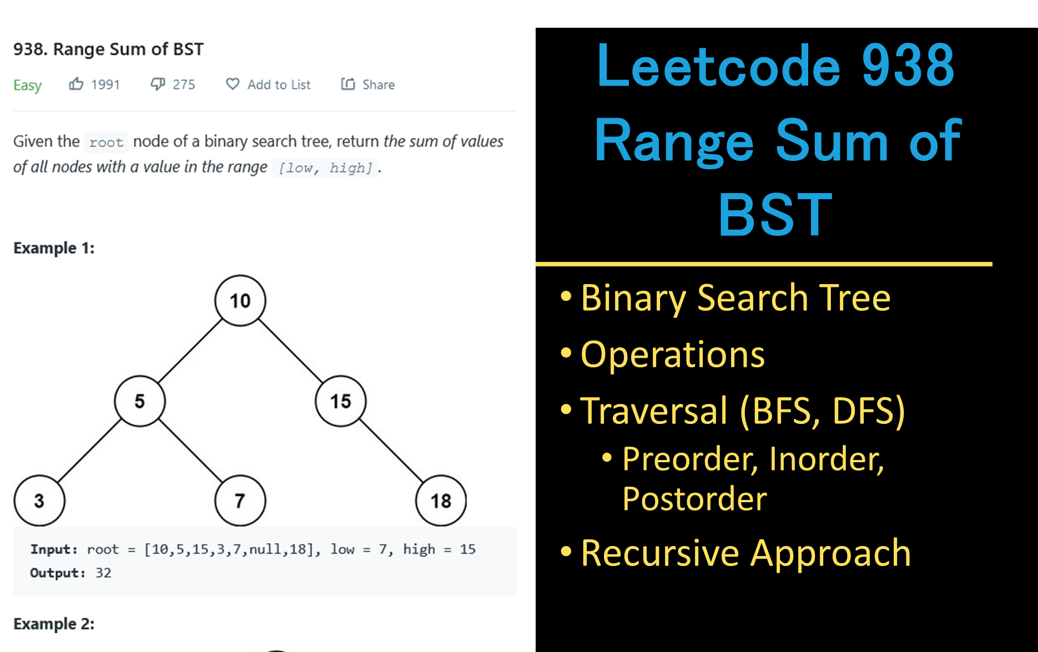
Leetcode 938
Range Sum of BST
Binary Search Tree
Operations
Traversal (BFS, DFS)
Preorder, Inorder, Postorder
Recursive Approach

Slide 4
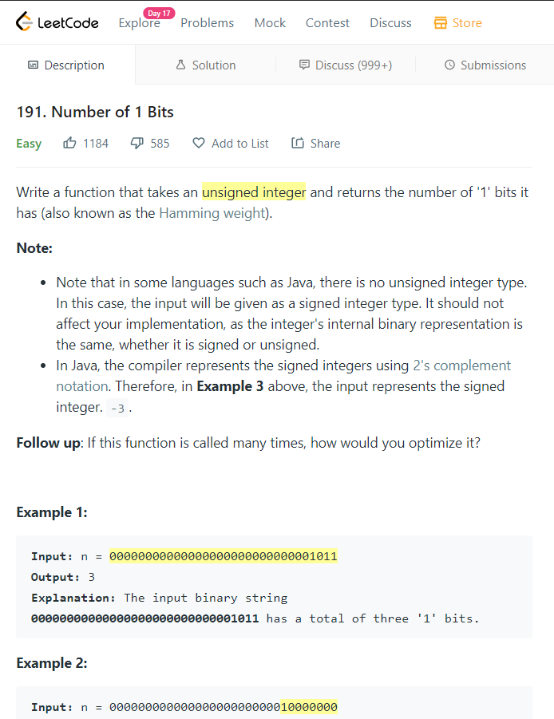
Leetcode 191. Number of 1 Bits
Signed vs Unsigned
Two Complement
Hamming Weight
Bitwise Operations: AND <<
Approach 1 (Naïve)
Approach 2 (Brian Kernighan’s Algorithm)

