Slide 1
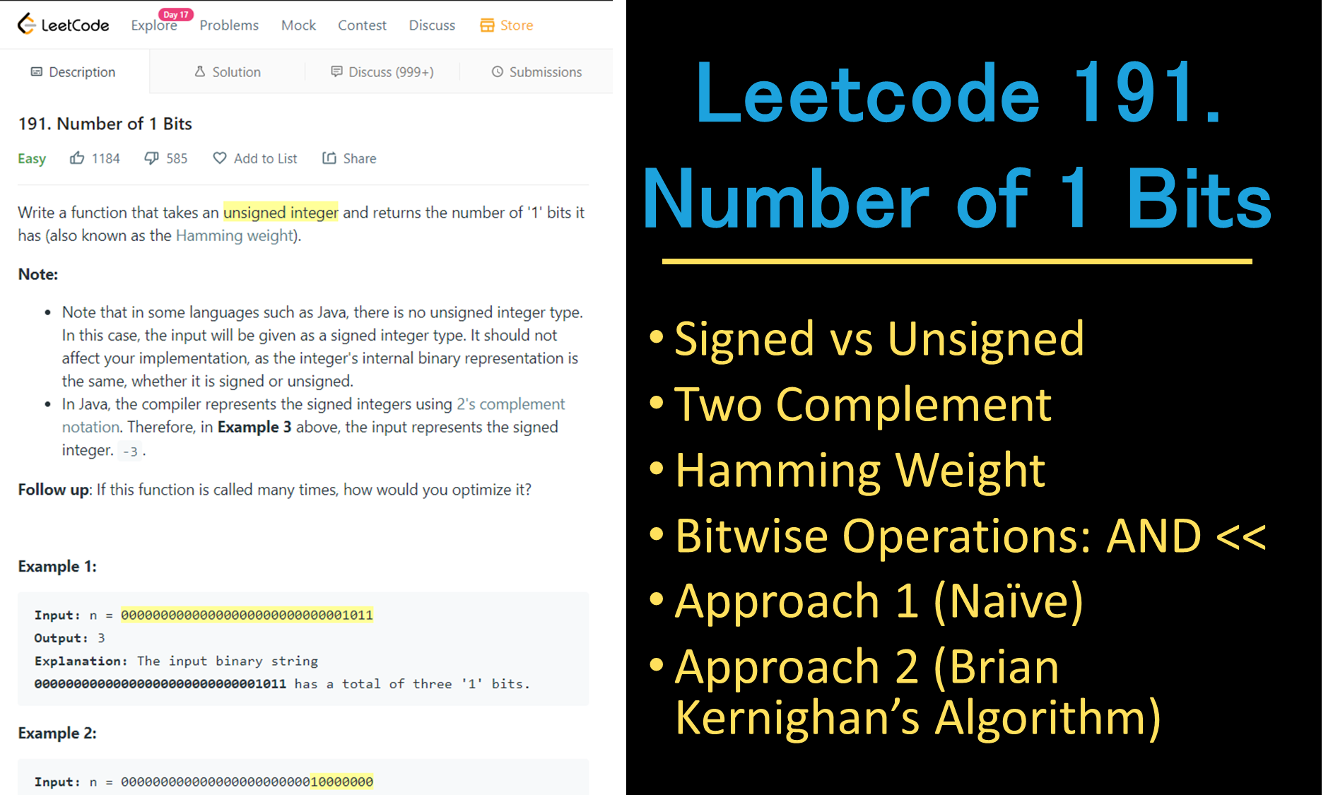
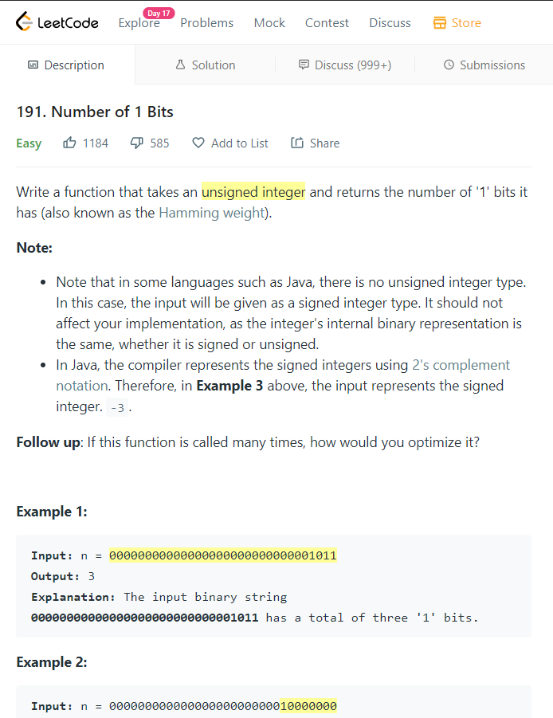
Leetcode 191. Number of 1 Bits
Signed vs Unsigned
Two Complement
Hamming Weight
Bitwise Operations: AND <<
Approach 1 (Naïve)
Approach 2 (Brian Kernighan’s Algorithm)

