Slide 1
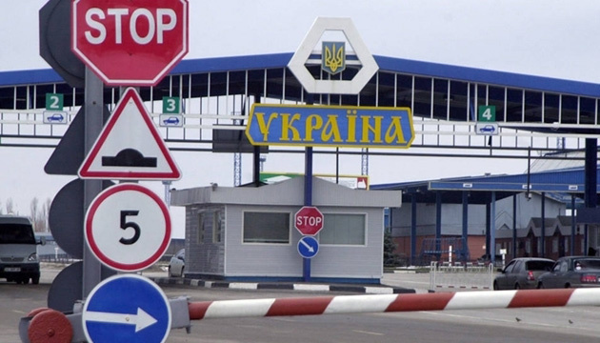
THEME:
CUSTOMS
Prepared by:
Sukhanov Denis Yuriyovich

Slide 2
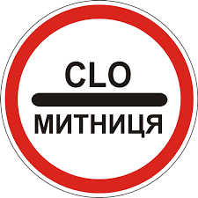
CUSTOMS
Is a system of public authorities of the country that provides for the collection of customs duties and control over the transportation of items, including goods, animals and dangerous items, across its border.

Slide 3
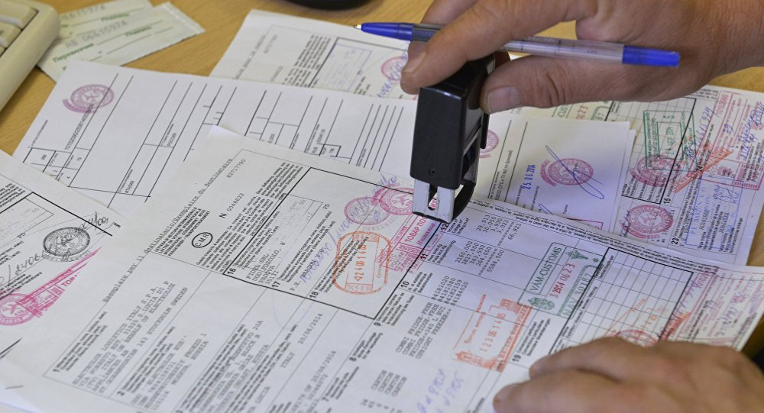
Customs is subject to the State Fiscal Service Of Ukraine
Customs subordinates to the State Fiscal Service
Of Ukraine.
Customs is a legal entity, there must be a balance,
sure of the bodies appointed by the service, first and a form on the image of the State Emblem of Ukraine and with its name
adheres to the Constitution of Ukraine, the Customs Code
Ukraine, other regulatory actions and representatives,
which is confirmed by the DFS order.

Slide 4
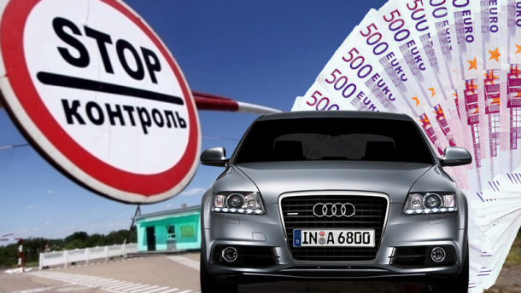
Customs operates throughout the territory of Ukraine
In settlements, at railway stations, at airports,
seaports and river ports and other sites within the area
activities of the customs, if necessary, create its separate
structural units (customs posts).
Customs post is a customs body that is a part of
Customs as a separate structural unit and in its area
activity ensures the fulfillment of the tasks assigned to customs
service of Ukraine.

Slide 5
Main tasks and Functions:
direct implementation of customs, control over compliance with all
legal and natural persons of the customs legislation of Ukraine
affairs;
application of tariff and non-tariff measures in accordance with the laws of Ukraine
regulation, complete and timely collection of taxes, fees (other
mandatory payments) when moving goods and vehicles through
customs border of Ukraine or customs procedures;
taking measures to protect the interests of consumers of goods, preventing imports
to the territory of Ukraine and release into free circulation of defective goods and goods cause damage to the environment and do not comply with existing ones Ukraine standards and requirements.

Slide 6
THE END OF PRESENTATION
THANK YOU FOR ATTENTION

