Slide 1
MelanomaNet
Explainable Deep Learning for Skin Lesion Classification
Sukhrobbek Ilyosbekov
CS 7180 Advanced Perception | Northeastern University | December 2025

Slide 2
Problem Summary
Melanoma: Deadliest form of skin cancer
  Responsible for majority of skin cancer deaths
Early detection critical: 99% vs <30% survival rate
  Localized vs. metastatic disease outcomes
Deep learning achieves dermatologist-level accuracy
  CNNs match/exceed expert performance in studies
Clinical adoption limited due to 'black box' problem
  Clinicians cannot verify AI reasoning
  No connection to familiar clinical criteria (ABCDE)
Goal: Accurate classification WITH clinically meaningful explanations
  Bridge the gap between AI predictions and clinical workflow

Slide 3
Key Related Work
Deep Learning for Dermatology
Explainability & Uncertainty
• Esteva et al. (2017): CNN matches dermatologist accuracy
• ISIC Challenges: Standardized benchmarks
• EfficientNet ensembles: Top ISIC performance
• Focus on accuracy, limited interpretability
• GradCAM/GradCAM++: Visual attention heatmaps
• TCAV (Kim et al.): Concept Activation Vectors
• MC Dropout: Bayesian uncertainty estimation
• Epistemic vs. Aleatoric decomposition

Slide 4
Key Insights
Multi-modal explainability framework
  Four mechanisms: GradCAM++, ABCDE, FastCAV, MC Dropout
  Each addresses different aspects of interpretability
Clinical alignment with ABCDE criteria
  Automated extraction of clinical features dermatologists use
  Quantitative scores + risk stratification
Uncertainty ≠ Confidence
  100% confident predictions can still have high uncertainty
  Decompose into epistemic (model) and aleatoric (data) components
Concept-based explanations via FastCAV
  Learn concept vectors in feature space
  TCAV scores show which concepts support/oppose predictions

Slide 5
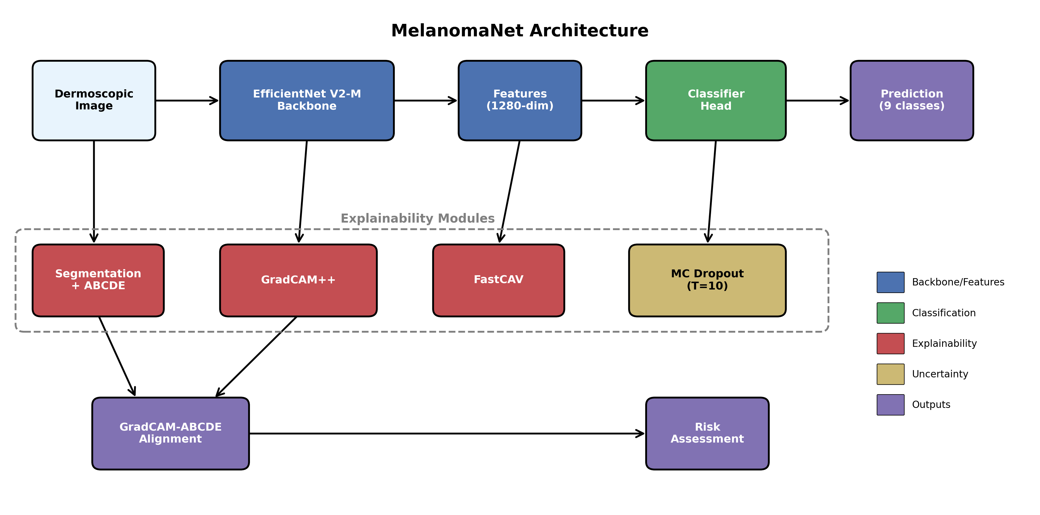
System Architecture
EfficientNet V2-M backbone with four explainability modules

Slide 6
Four Explainability Modules
Visual & Clinical Explanations
Concept & Uncertainty
• GradCAM++: Attention heatmaps
• ABCDE Analysis:
• - Asymmetry: Compare lesion halves
• - Border: Contour irregularity
• - Color: K-means clustering (k=6)
• - Diameter: Maximum extent in pixels
• FastCAV: Concept vectors via SGD
• - TCAV scores: +supports, -opposes
• MC Dropout Uncertainty:
• - 10 stochastic forward passes
• - Epistemic: model uncertainty
• - Aleatoric: data uncertainty

Slide 7
Classification Performance
Dataset: ISIC 2019 - 25,331 images, 9 classes
  MEL (Melanoma), NV (Nevus), BCC (Basal cell carcinoma), AK (Actinic keratosis)
  BKL (Benign keratosis), DF (Dermatofibroma), VASC (Vascular), SCC (Squamous cell carcinoma), UNK (Unknown)
  70% train / 15% val / 15% test split
Overall Accuracy: 85.61%
  Precision: 86.00%, Recall: 85.61%
Weighted F1 Score: 85.64%
Strong performance despite 50:1 class imbalance
  NV dominates at 50.83%, DF only 0.94%
Per-class: NV F1=0.91, BCC F1=0.89, MEL F1=0.77
  Melanoma: Precision 81%, Recall 75%

Slide 8
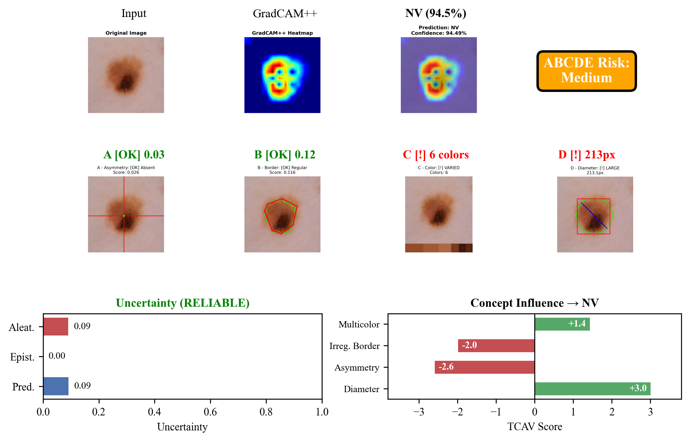
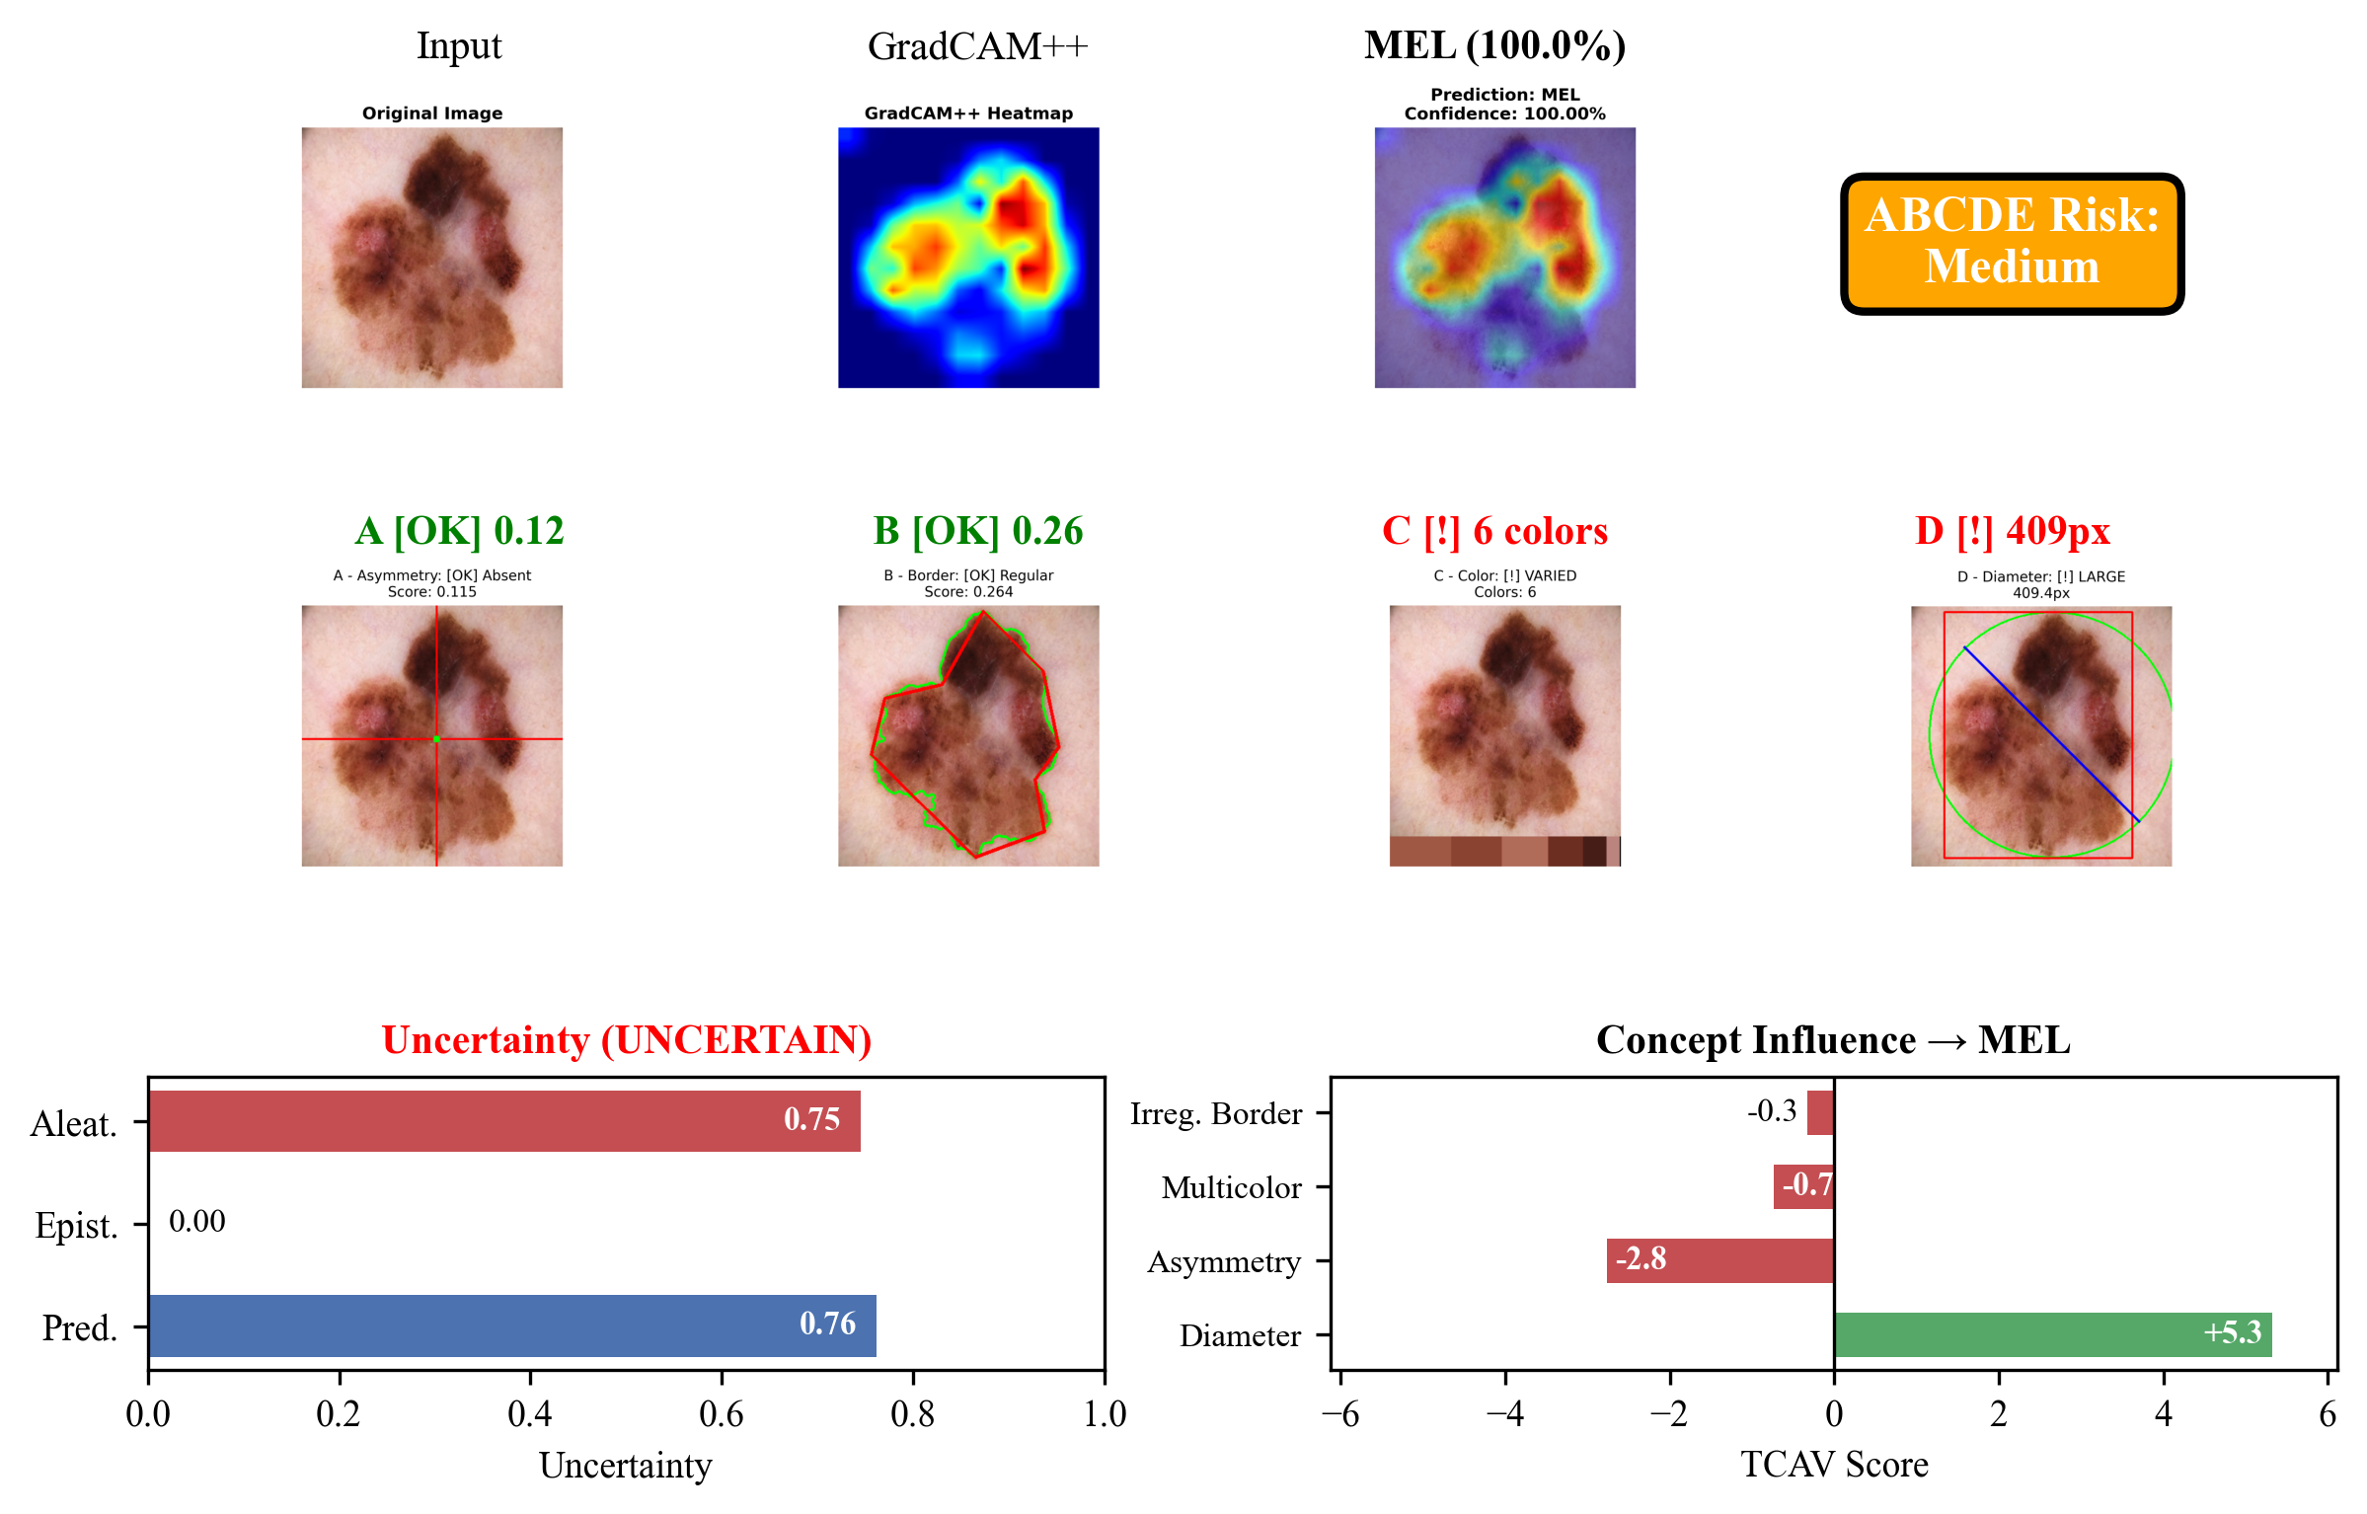
Sample Inference Outputs
Benign Nevus - RELIABLE (94.49% conf)
Melanoma - UNCERTAIN (100% conf, high aleatoric)

Slide 9
Thank You!
Questions?
Code available at
https://github.com/suxrobgm/explainable-melanoma

