Slide 1
Freelancing Platform
Anish Baniya
Suyan Thapa

Slide 2
Introduction
Connecting Freelancers and Businesses: A web-based platform that connects freelancers with businesses seeking specialized services, streamlining the hiring process and service management.
Diverse Service Offerings: Provides a unified marketplace for freelancers across various fields (design, development, writing, digital marketing, etc.) to advertise their skills and for clients to search, filter, and manage projects based on ratings and reviews.

Slide 3
Objectives
To implement the reliable payment gateways.
Improve the existing UI.

Slide 4
Functional Requirement
User Registration and Authentication
User Profiles
Job Posting
Payment Integration

Slide 5
Non-Functional Requirement
Performance
User Scalability
Usability
Maintainability
Security and Data Privacy

Slide 6
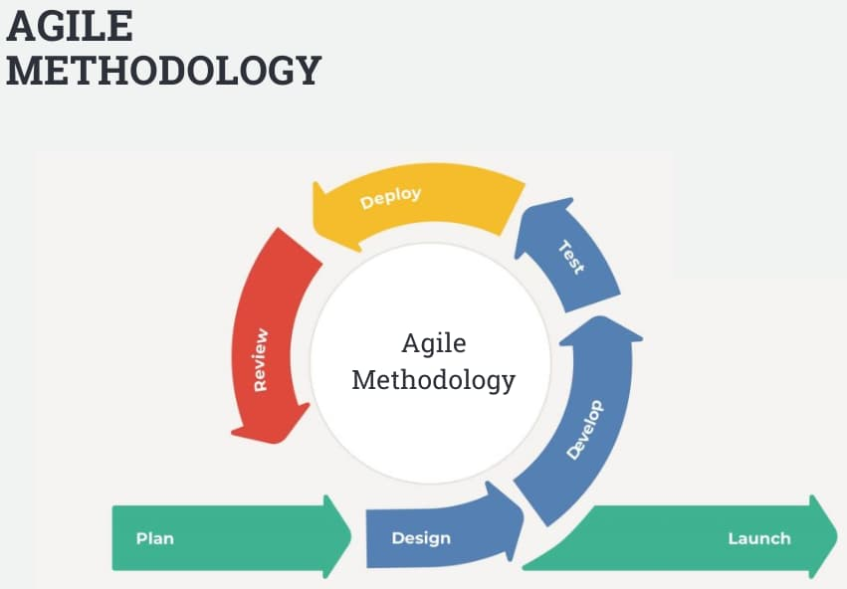
Methodology
Reference : InterQualitybg

Slide 7
Sprints:
Sprint 1:
Plan
Developing Basic Features
Sprint 2:
Design and Implement the Freelancer Profile
Sprint 3:
Integrate Payment Gateway
Sprint 4:
Add job posting functionality
Sprint 5:
Final Testing
Fix Bugs
Deployment

Slide 8
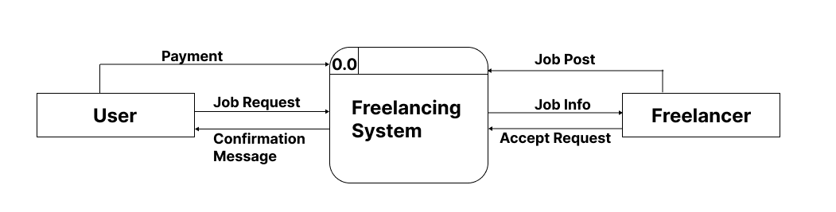
DFD Level -0

Slide 9
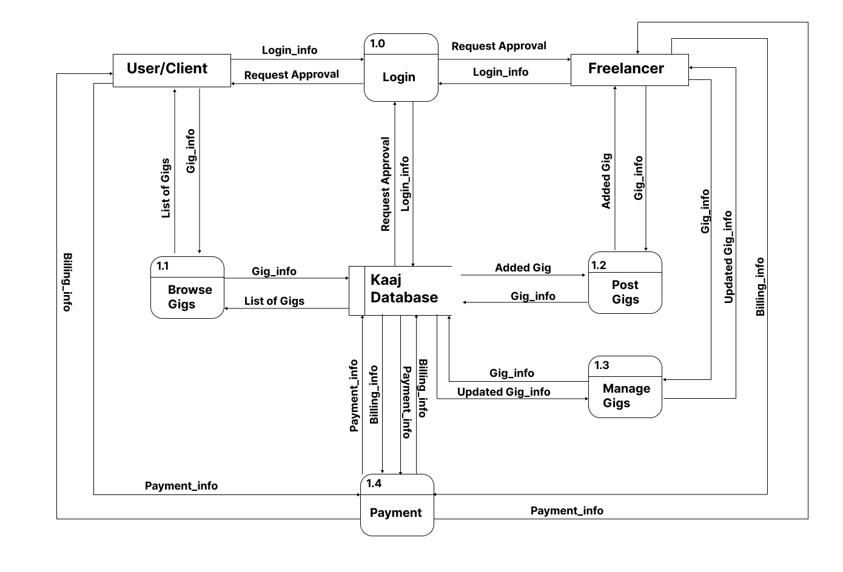
DFD Level -1

Slide 10
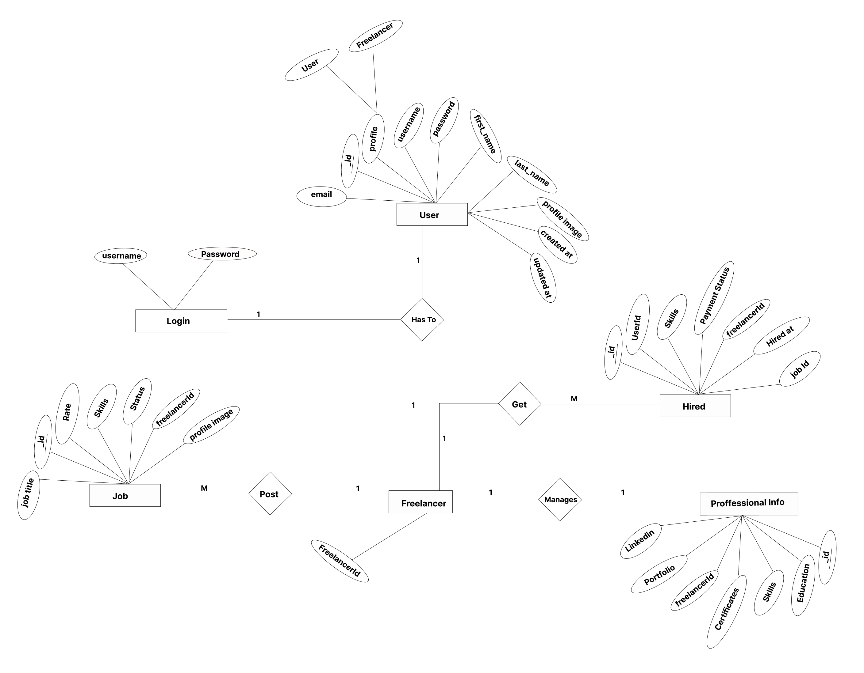
ER DIAGRAM

Slide 11
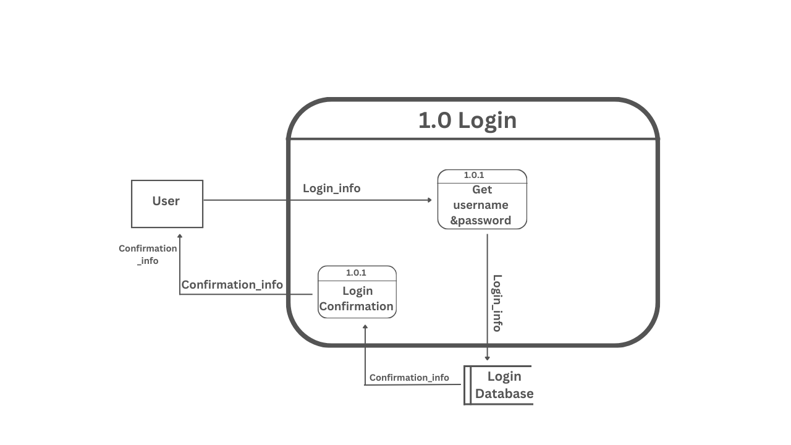
DFD Level -2

Slide 12
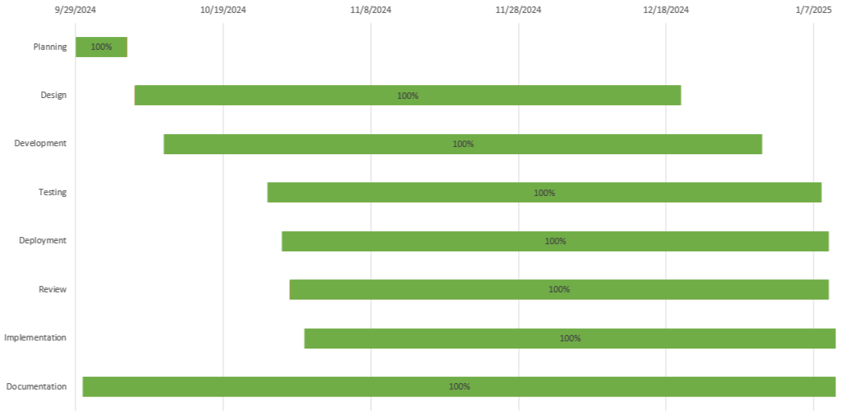
ER DIAGRAM

Slide 13
Thank You!

