Slide 1
Freelancing Platform
Anish Baniya
Suyan Thapa

Slide 2
Introduction to Kaaj
Connecting Freelancers and Businesses
Diverse Service Offerings

Slide 3
Objectives
To implement the reliable payment gateways.
Improve the existing UI.

Slide 4
Functional Requirement
User Registration and Authentication
User Profiles
Job Posting
Payment Integration

Slide 5
Non-Functional Requirement
Performance
User Scalability
Usability
Maintainability
Security and Data Privacy

Slide 6
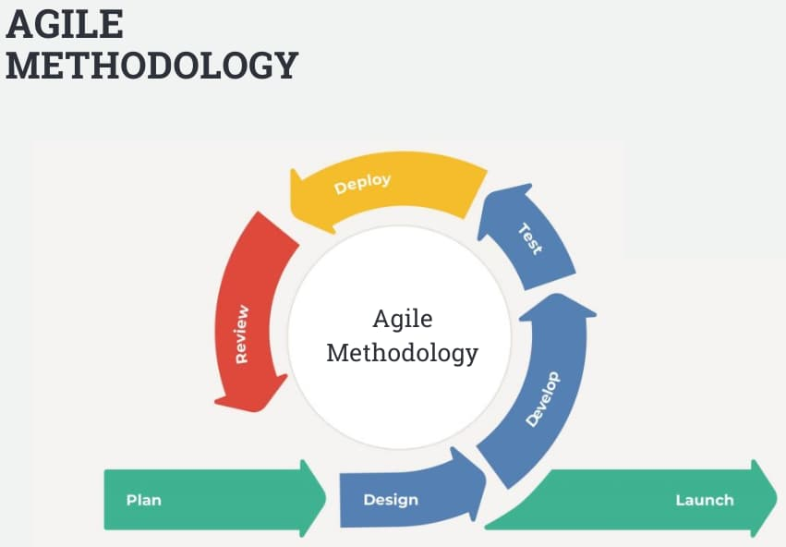
Methodology
Reference : InterQualitybg

Slide 7
Sprints:
Sprint 1:
Plan
Developing Basic Features
Sprint 2:
Design and Implement the Freelancer Profile
Sprint 3:
Integrate Payment Gateway
Sprint 4:
Add job posting functionality
Sprint 5:
Final Testing
Fix Bugs
Deployment

Slide 8
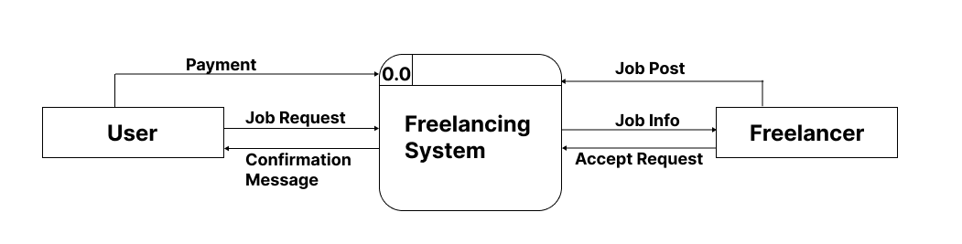
DFD Level -0

Slide 9
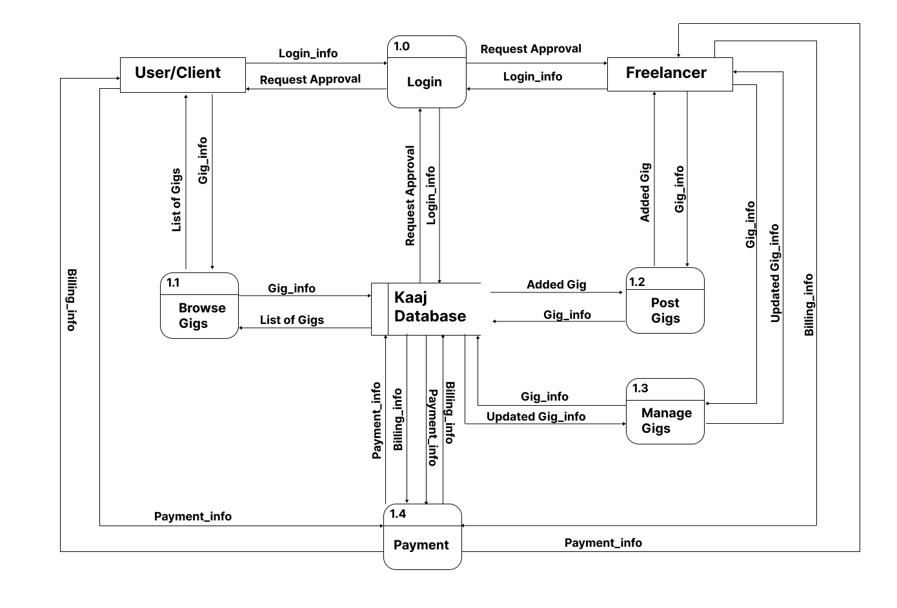
DFD Level -1

Slide 10
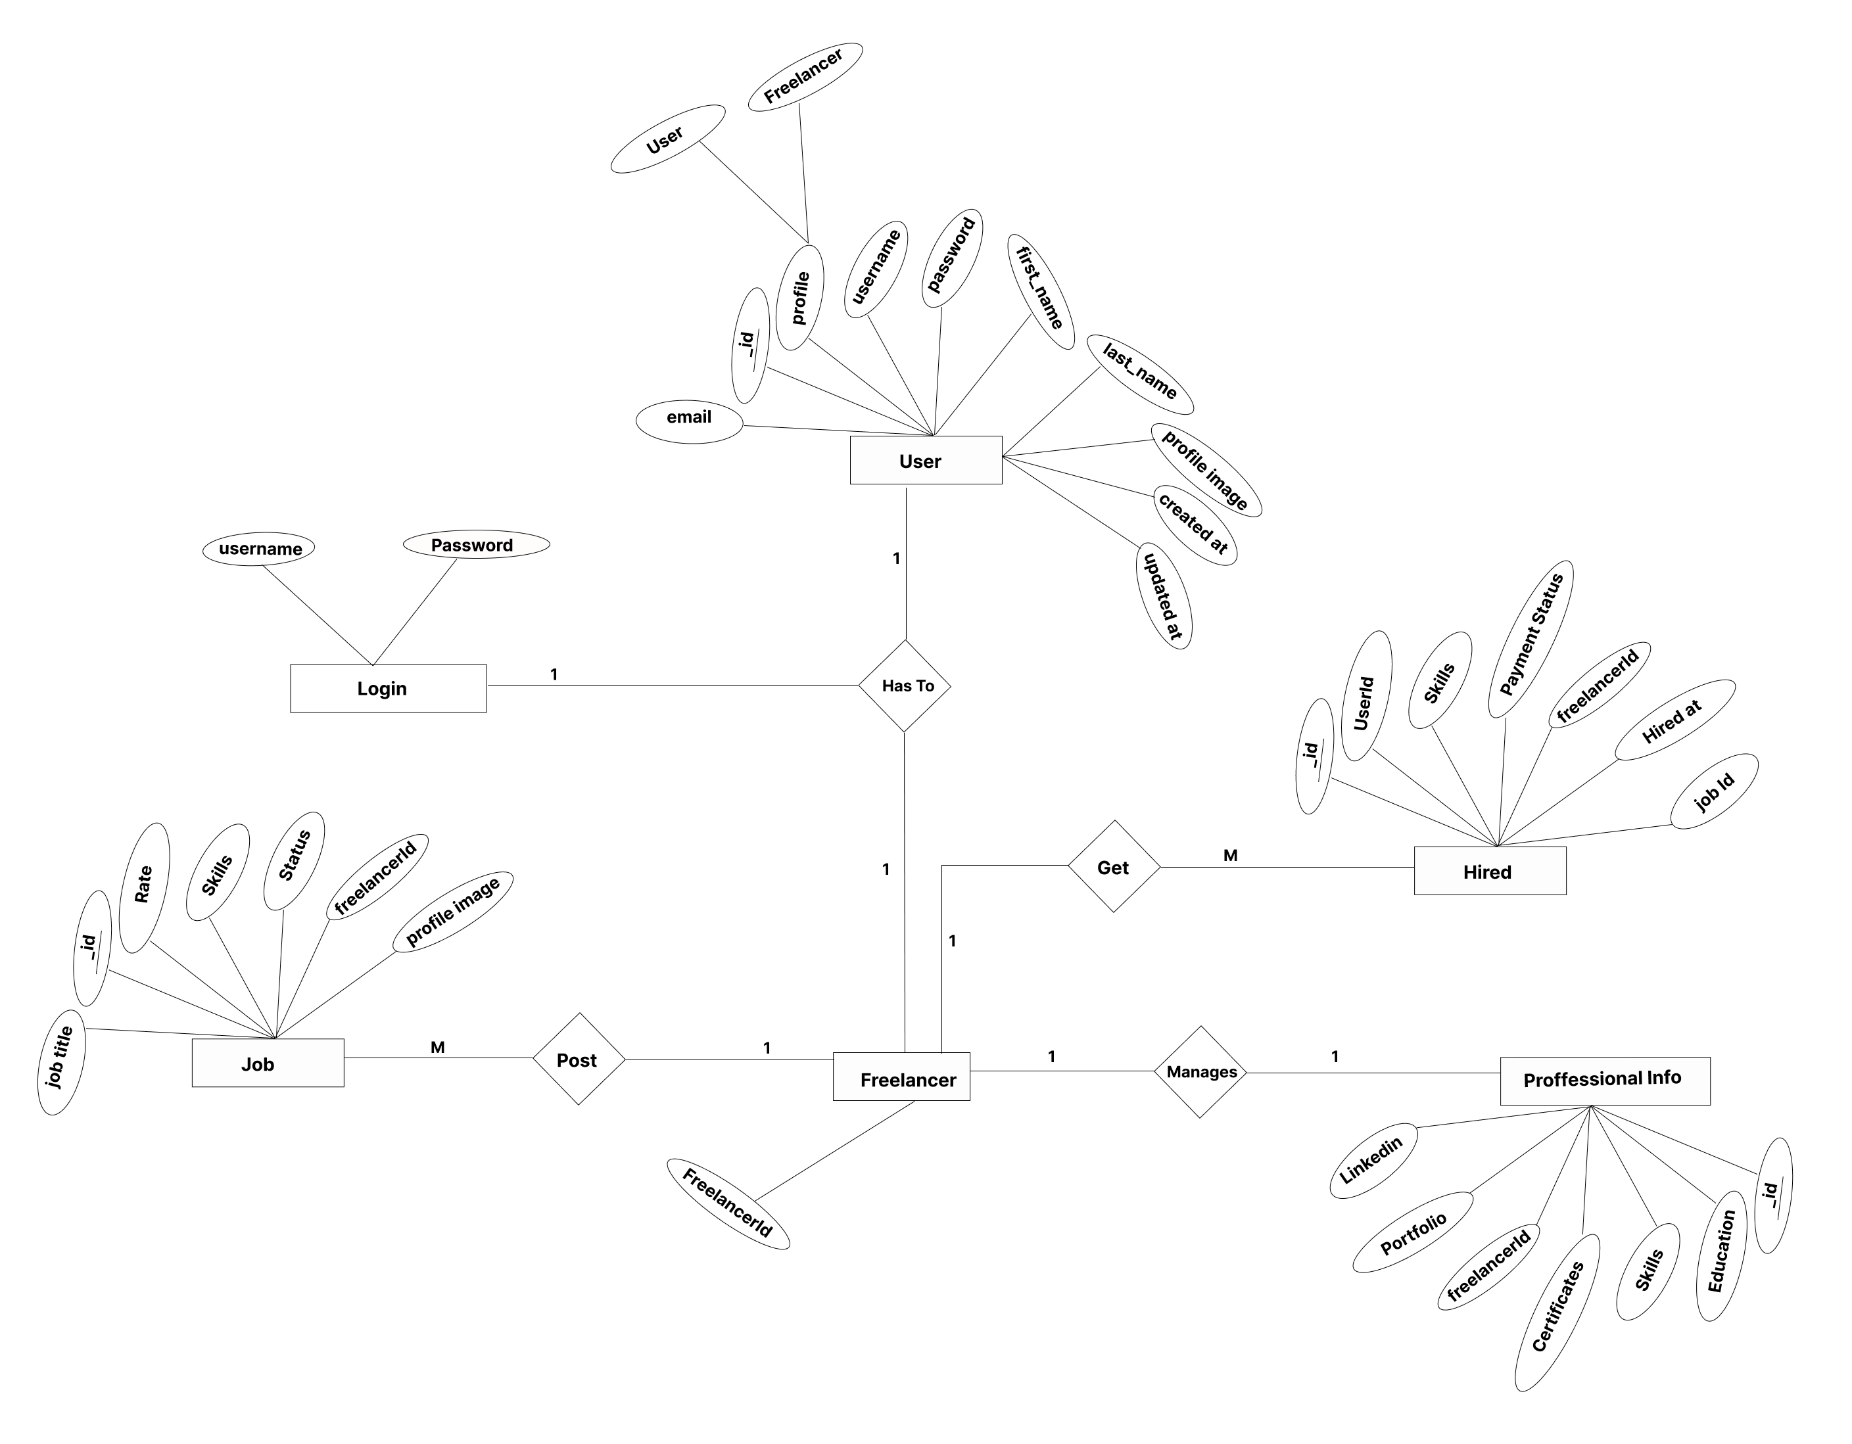
ER DIAGRAM

Slide 11
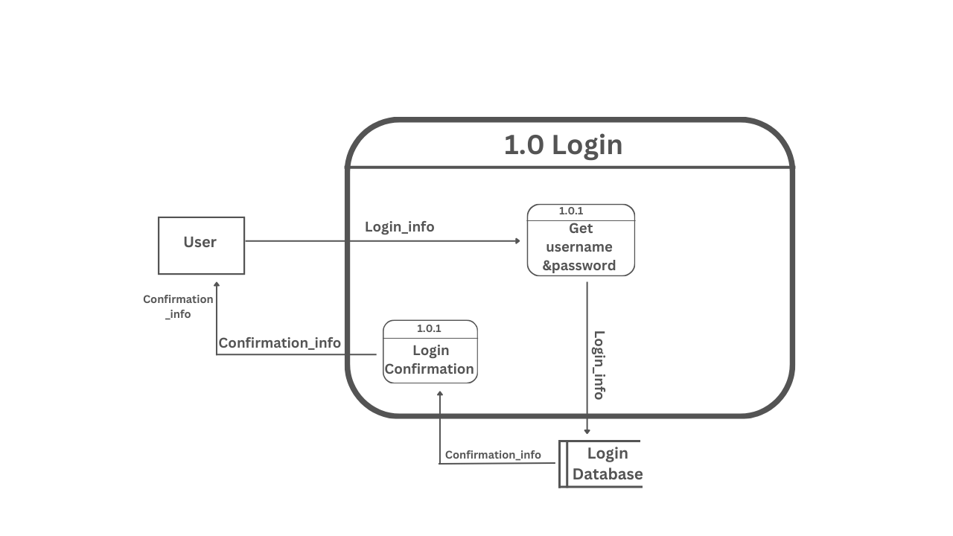
DFD Level -2

Slide 12
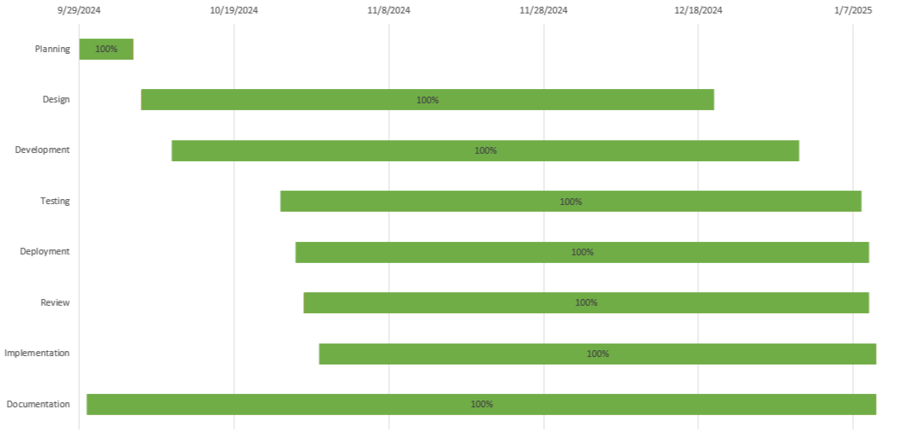
ER DIAGRAM

Slide 13
Thank You!

