Slide 1
Freelancing Platform
Anish Baniya
Suyan Thapa

Slide 2
Introduction
Connecting Freelancers and Businesses: A web-based platform that connects freelancers with businesses seeking specialized services, streamlining the hiring process and service management.
Diverse Service Offerings: Provides a unified marketplace for freelancers across various fields (design, development, writing, digital marketing, etc.) to advertise their skills and for clients to search, filter, and manage projects based on ratings and reviews.

Slide 3
Objectives
To implement the reliable payment gateways.
Improve the existing UI.

Slide 4
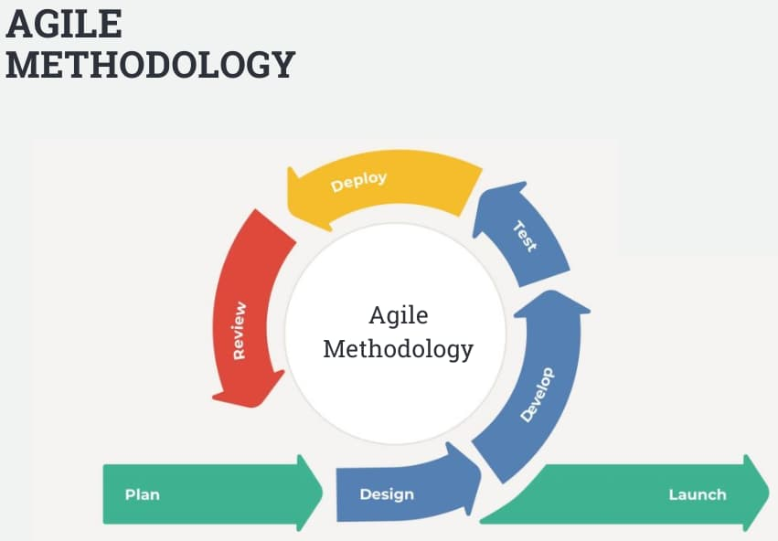
Methodology
Reference : InterQualitybg

Slide 5
Sprints:
Sprint 1:
Plan
Developing Basic Features
Sprint 2:
Design and Implement the Freelancer Profile
Sprint 3:
Integrate Payment Gateway
Sprint 4:
Add job posting functionality
Sprint 5:
Final Testing
Fix Bugs
Deployment

Slide 6
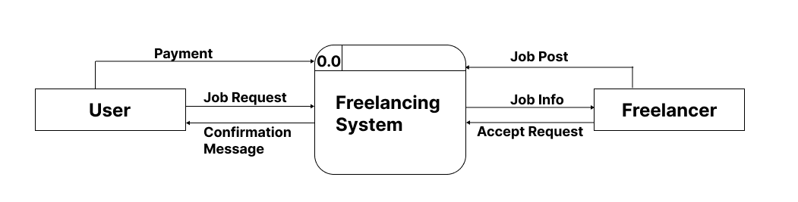
DFD Level -0

Slide 7
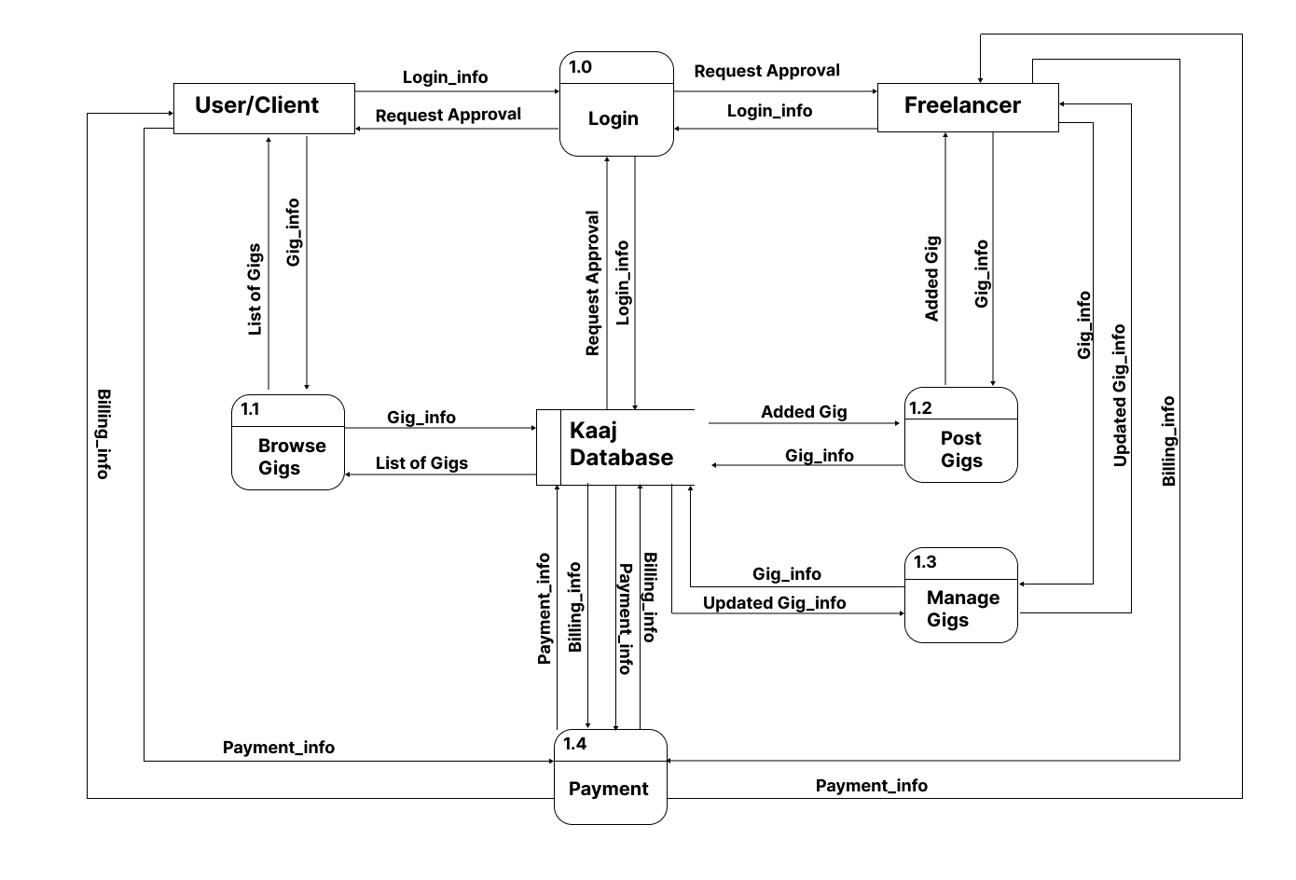
DFD Level -1

Slide 8
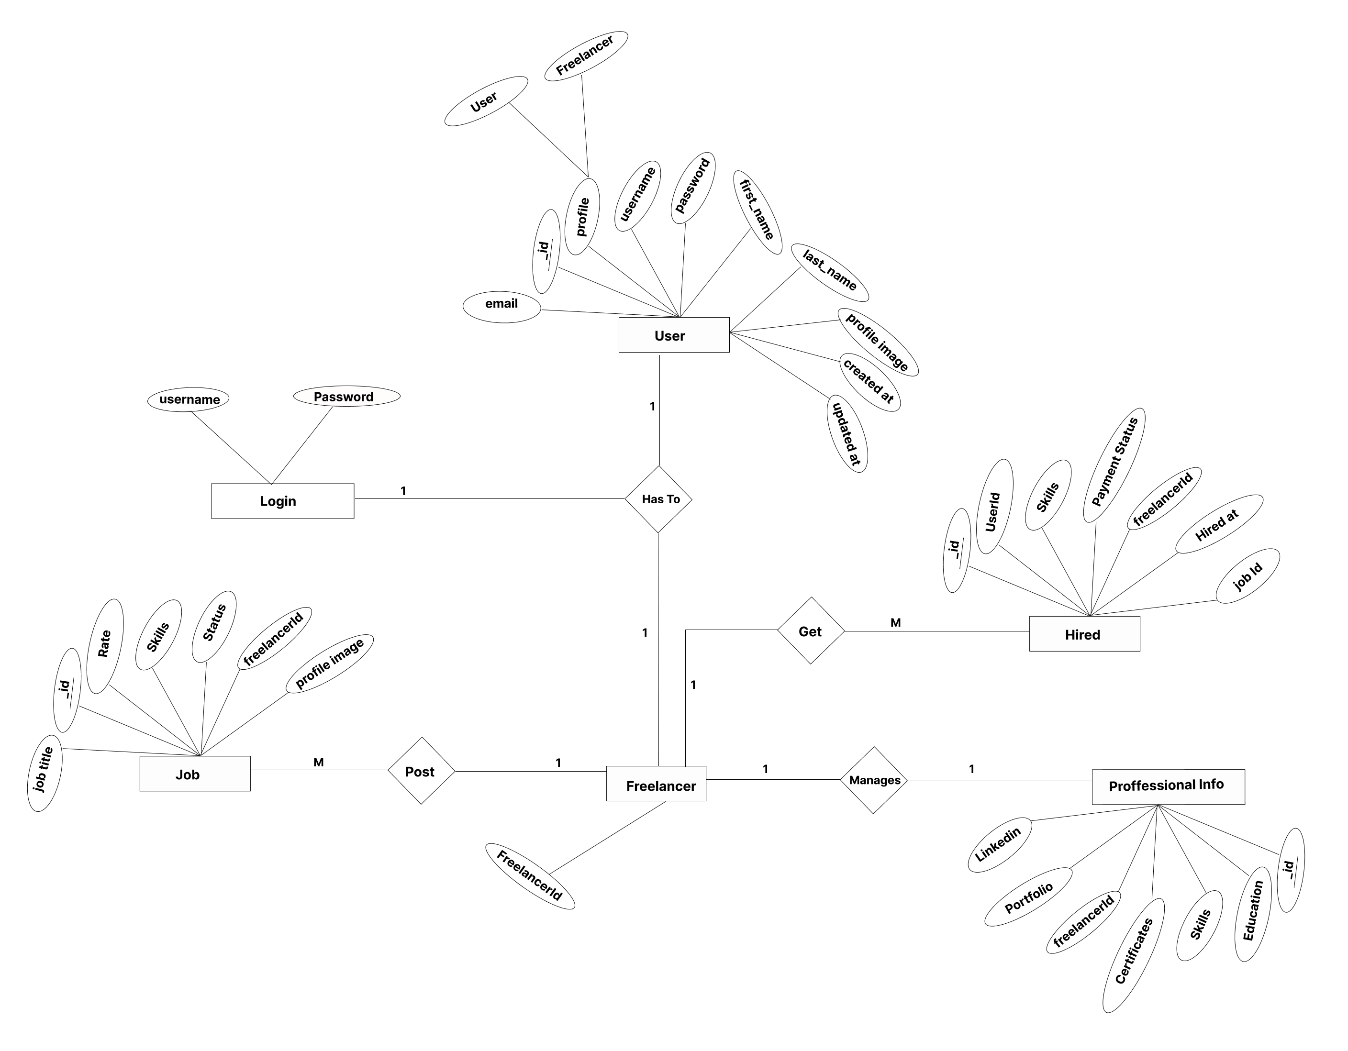
ER DIAGRAM

Slide 9
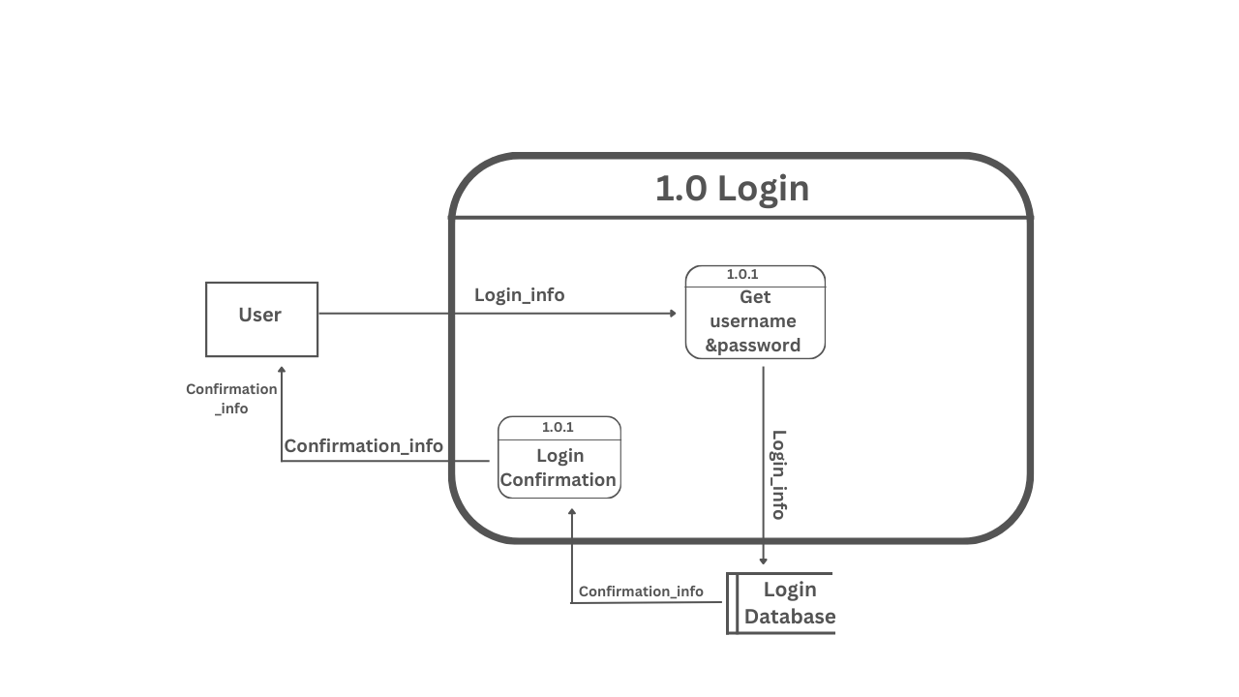
DFD Level -2

Slide 10
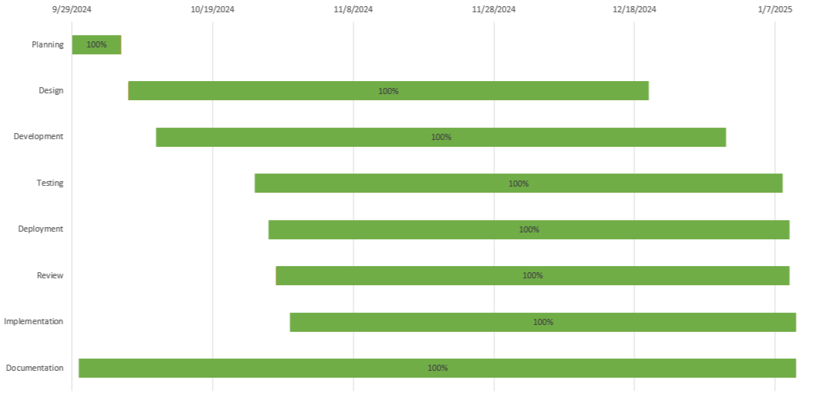
ER DIAGRAM

Slide 11
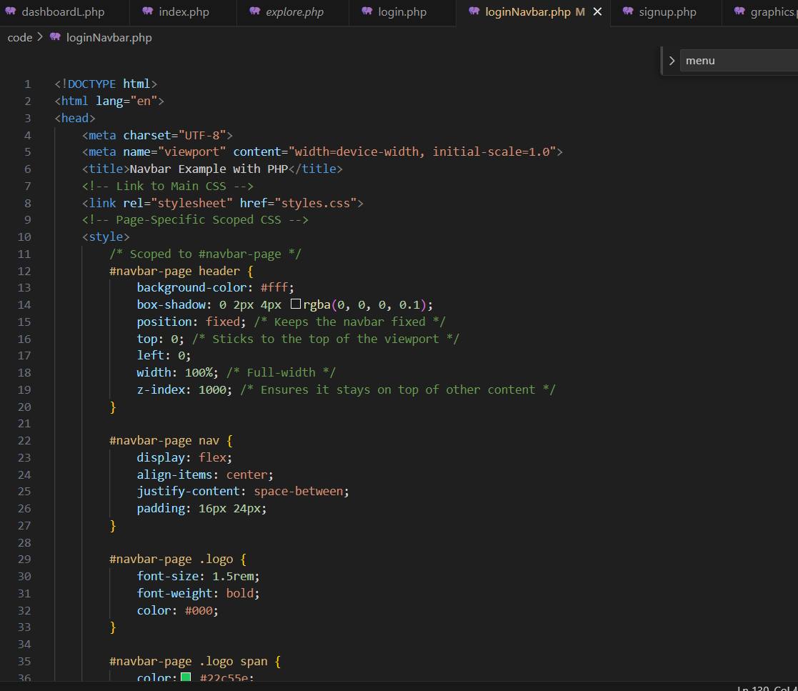
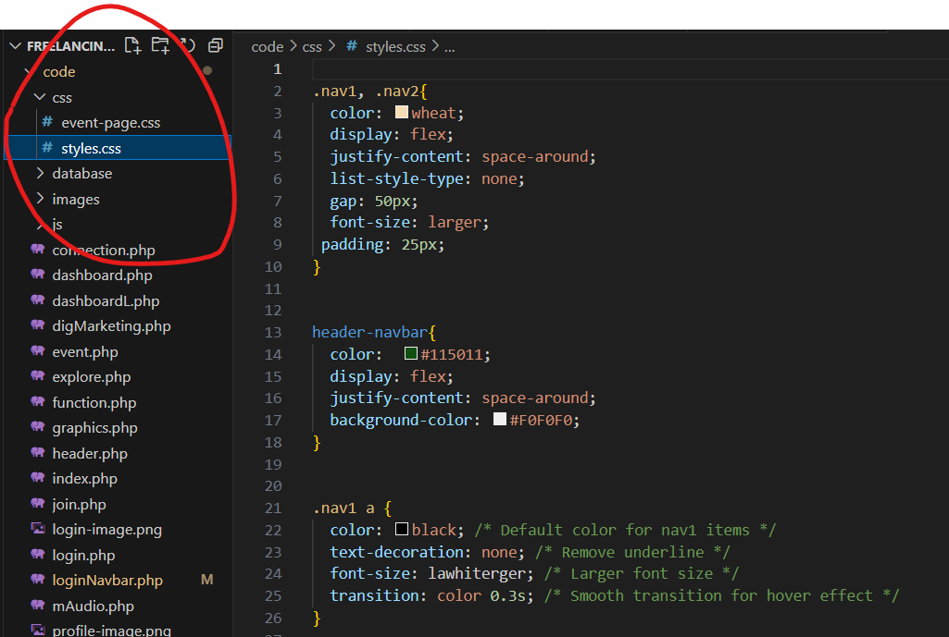
CSS issue faced
One CSS file for all pages
CSS within same page

Slide 12
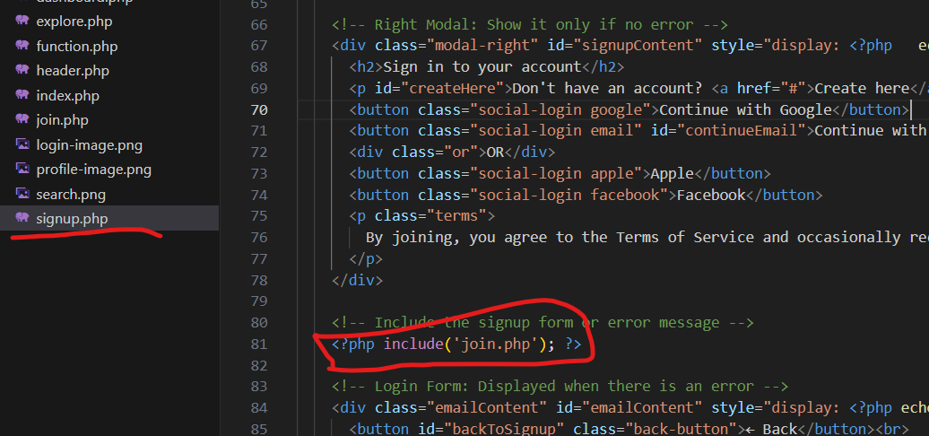
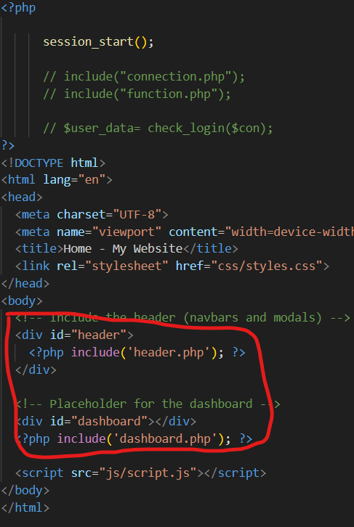
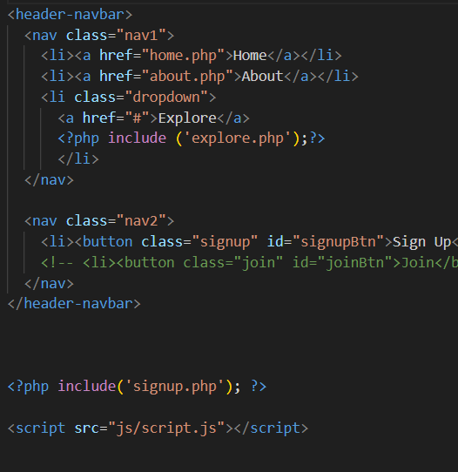

Slide 13
One file connected to multiple files
Index.php
Header.php
Signup.php

Slide 14
Thank You!

