Slide 1
Freelancing Platform
Anish Baniya
Sabin Gurung
Suyan Thapa

Slide 2

Why ‘Freelancing Platform’ as our project?
Personal Interest/Experience
Growth Opportunities
Nepali Payment gateway
Reference : WebLink Nepal

Slide 3
Introduction
Connecting Freelancers and Businesses: A web-based platform that connects freelancers with businesses seeking specialized services, streamlining the hiring process and service management.
Diverse Service Offerings: Provides a unified marketplace for freelancers across various fields (design, development, writing, digital marketing, etc.) to advertise their skills and for clients to search, filter, and manage projects based on ratings and reviews.

Slide 4
Problem Statement
Lack of Nepali Payment Gateways:
The absence of integration with popular Nepali payment gateways like Khalti and eSewa limits the ease of transactions for local freelancers and clients, creating barriers to efficient payments within the domestic market.
Limited Local Freelance Marketplaces: The scarcity of dedicated freelance platforms catering specifically to the Nepali market restricts opportunities for local talent and businesses, forcing them to rely on global platforms that may not address region-specific needs.

Slide 5


Other existing Freelancing Platform
Upwork
What’s difference with our platform?
Fiverr
Nepali Payement Gateway like Esewa, Khalti and many more.
Reference : Writer’s Hive Media
Reference : Seed Formations

Slide 6
Objectives
To implement the reliable local payment gateways.

Slide 7
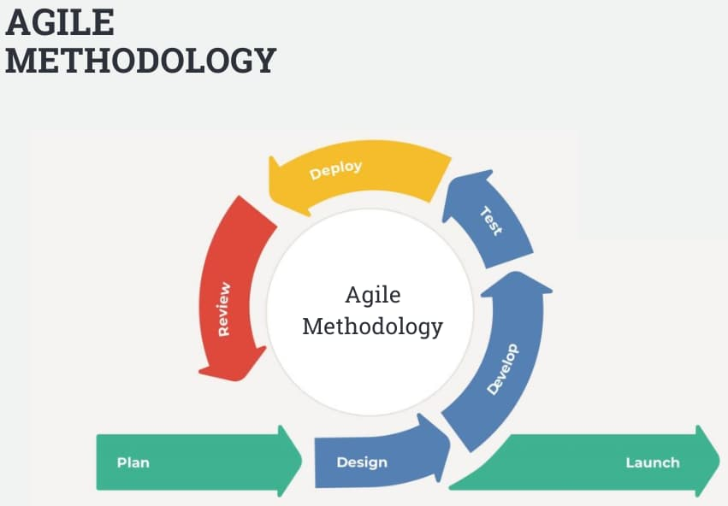
Methodology
Reference : InterQualitybg

Slide 8
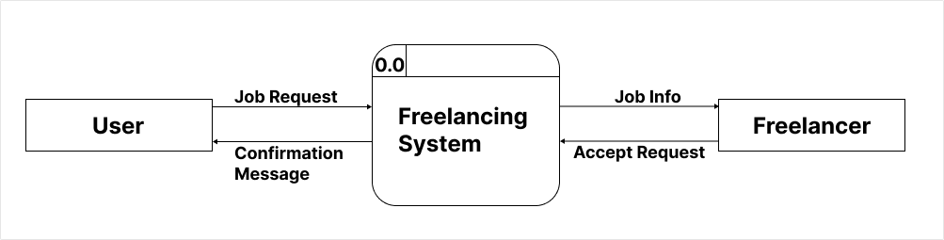
DFD Level -0

Slide 9
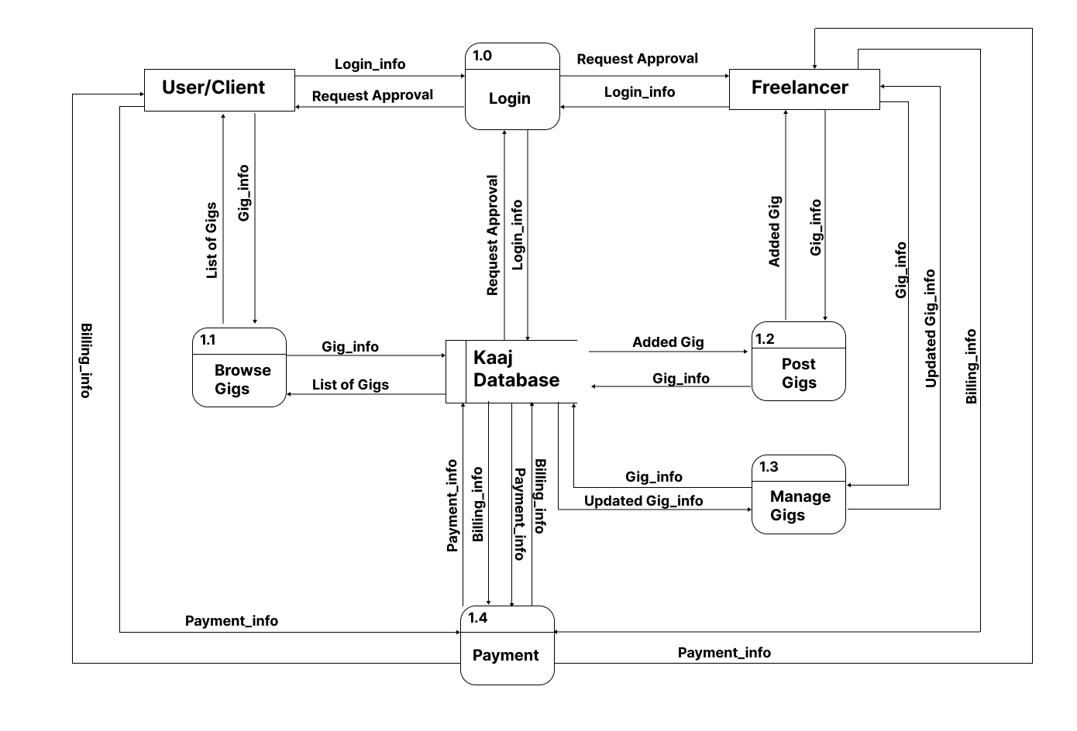
DFD Level -1

Slide 10
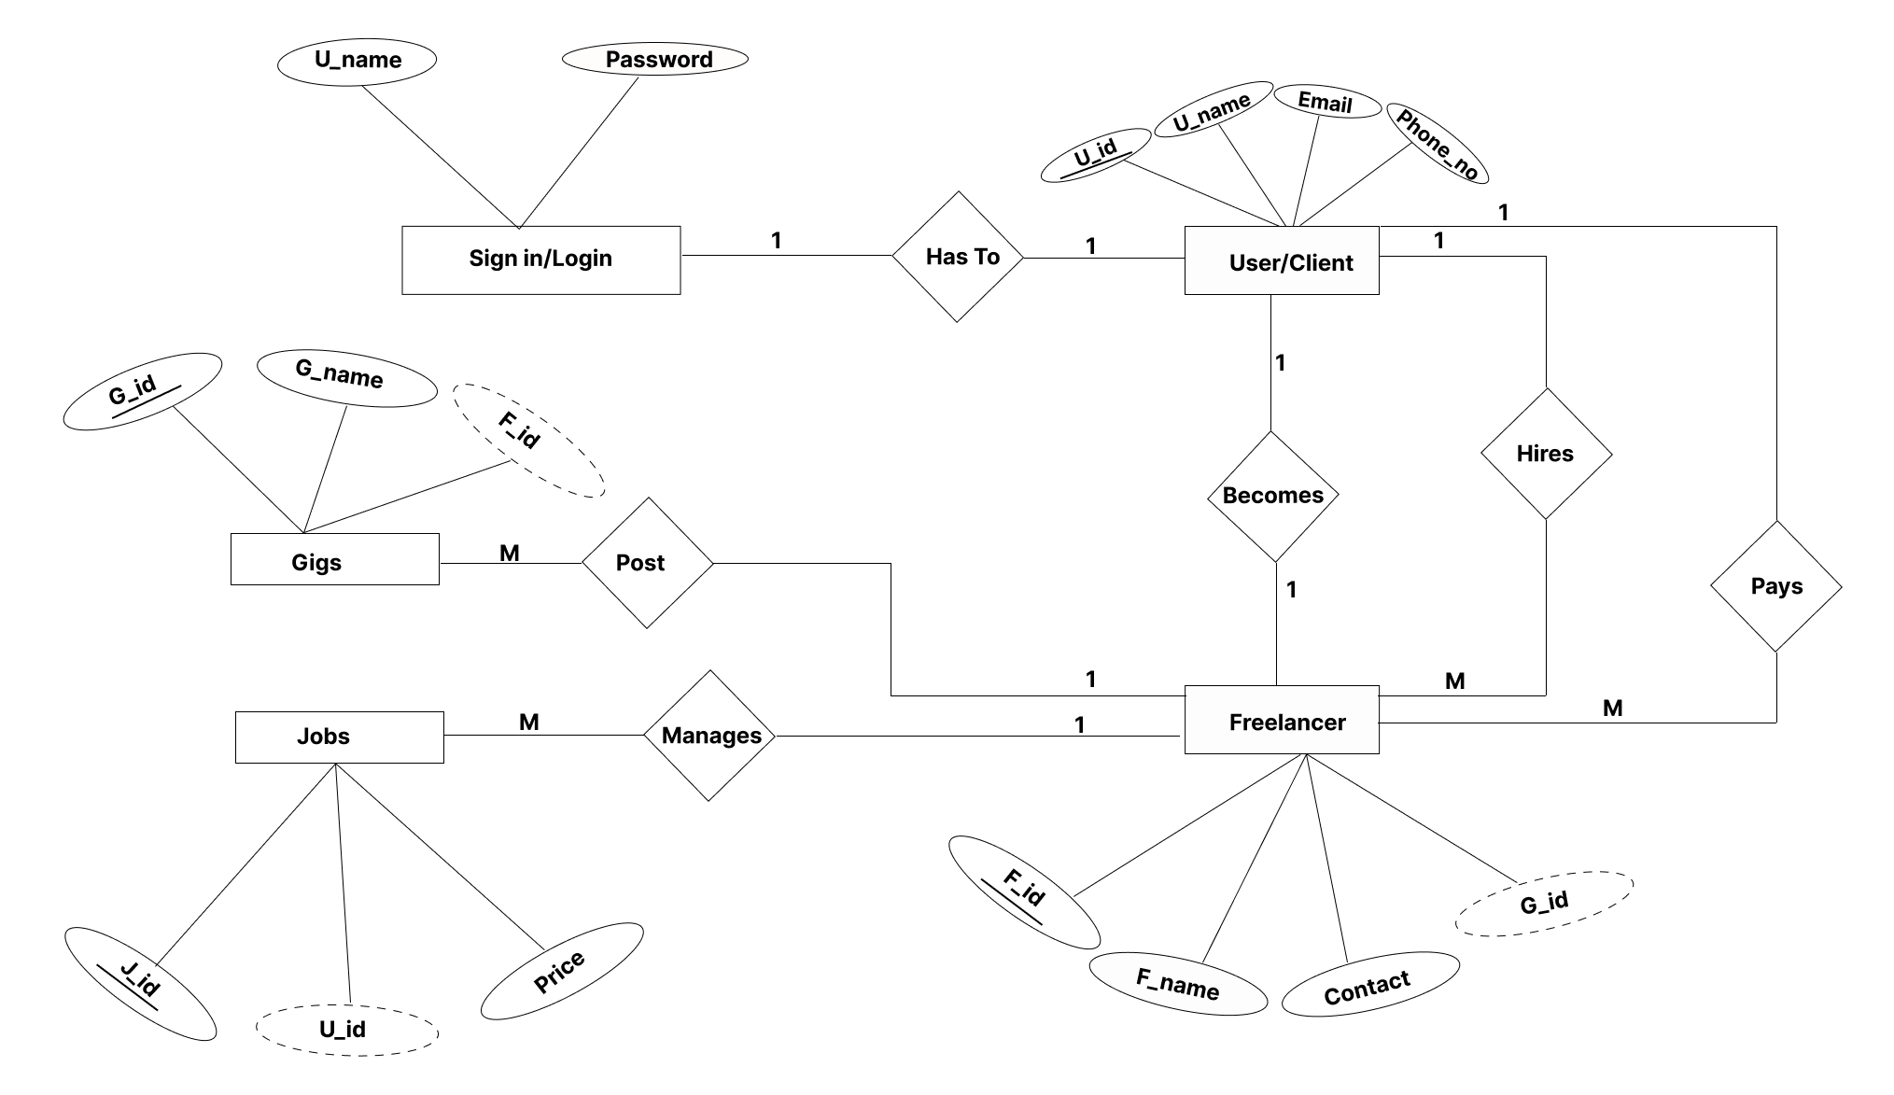
DFD Level -1

Slide 11
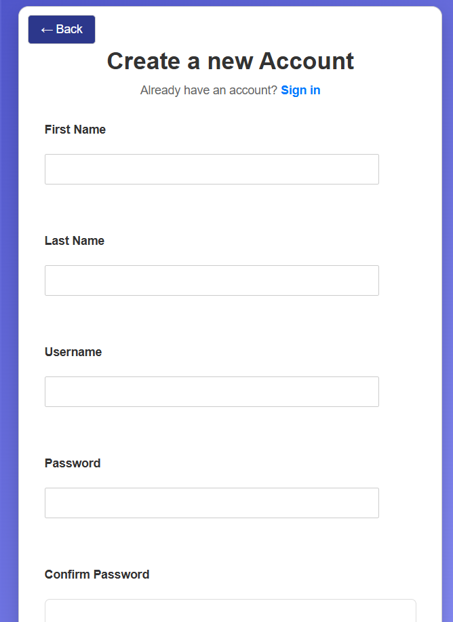
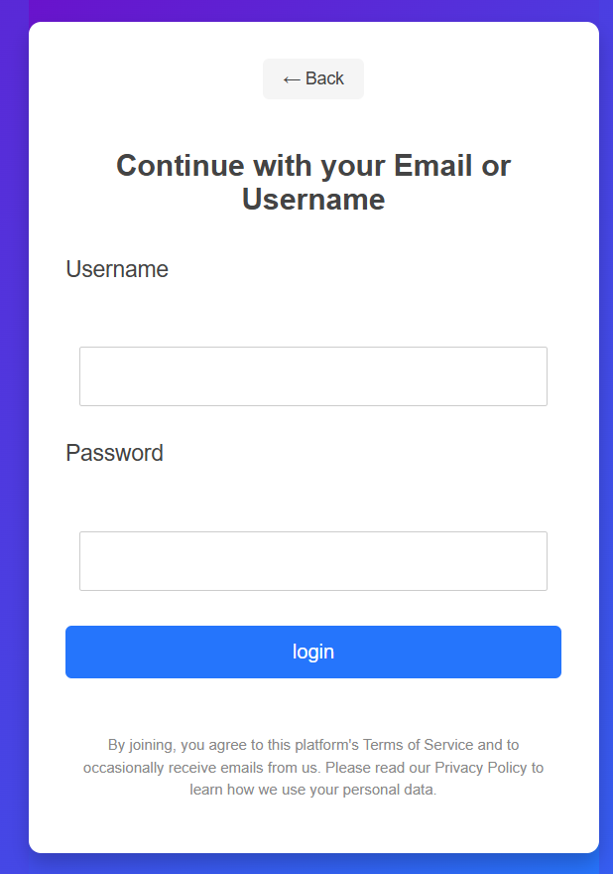
Login Authentication - Completed
Signup Section
Login Section

Slide 12

Communnity Events – Frontend Completed

Slide 13

User Dashboard – Frontend

Slide 14
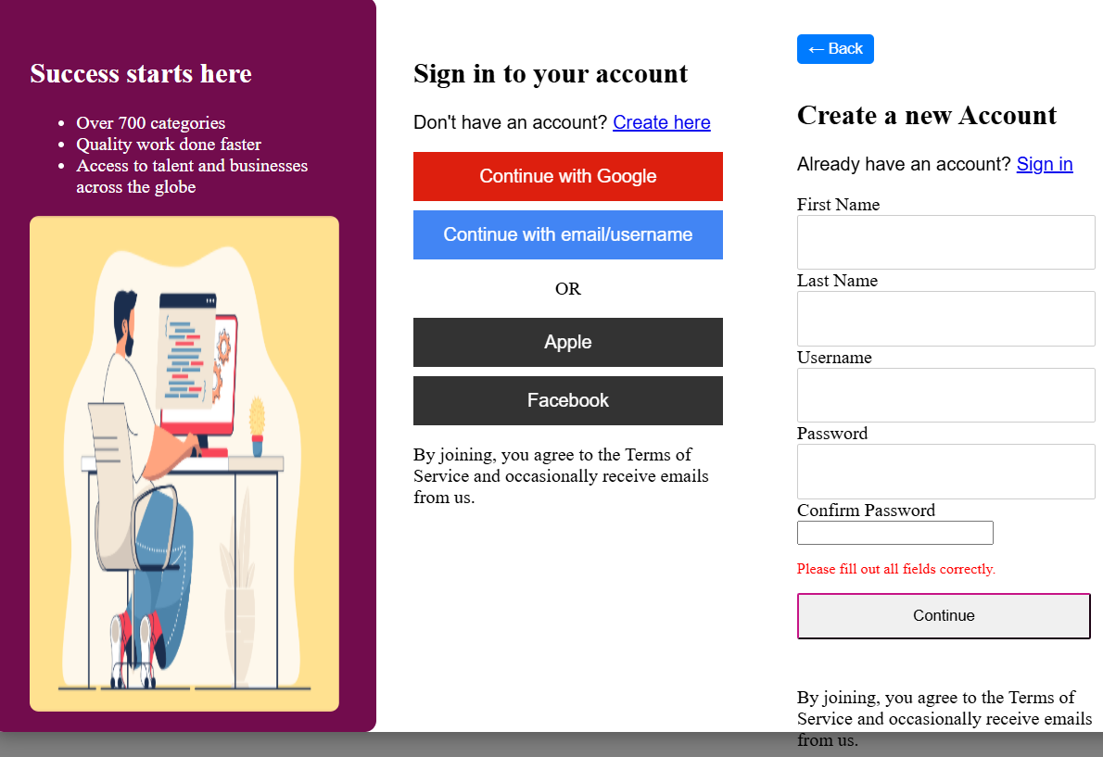
Login Problem Faced
Solved by creating separate page for signup and login rather than creating on same page
MODAL DESIGN ISSUES

Slide 15
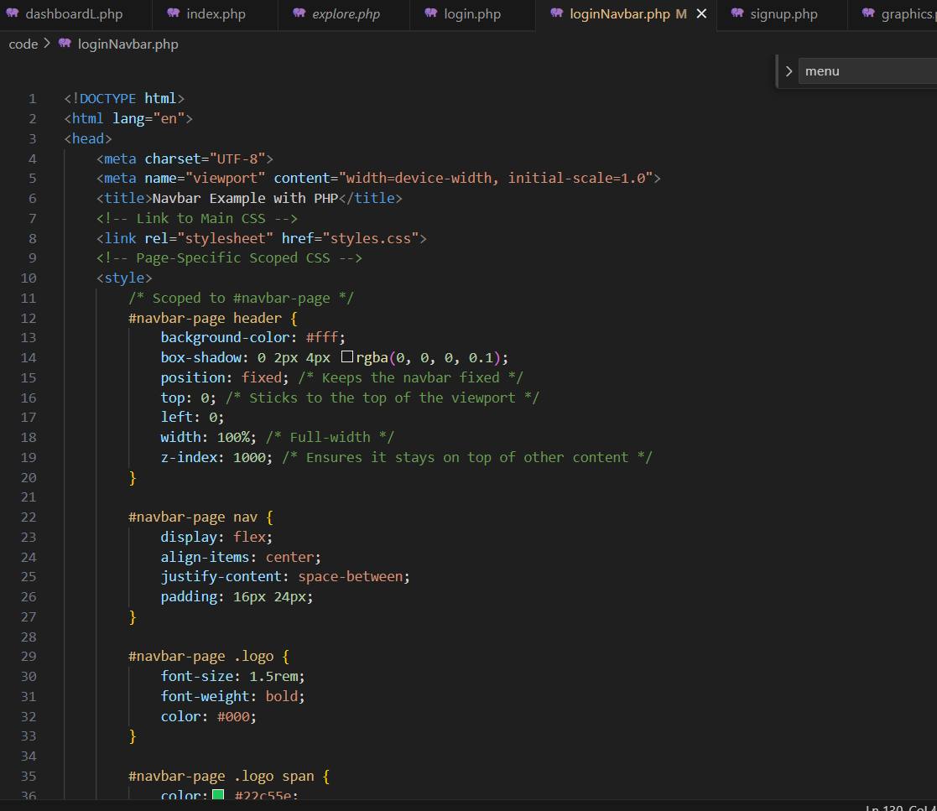
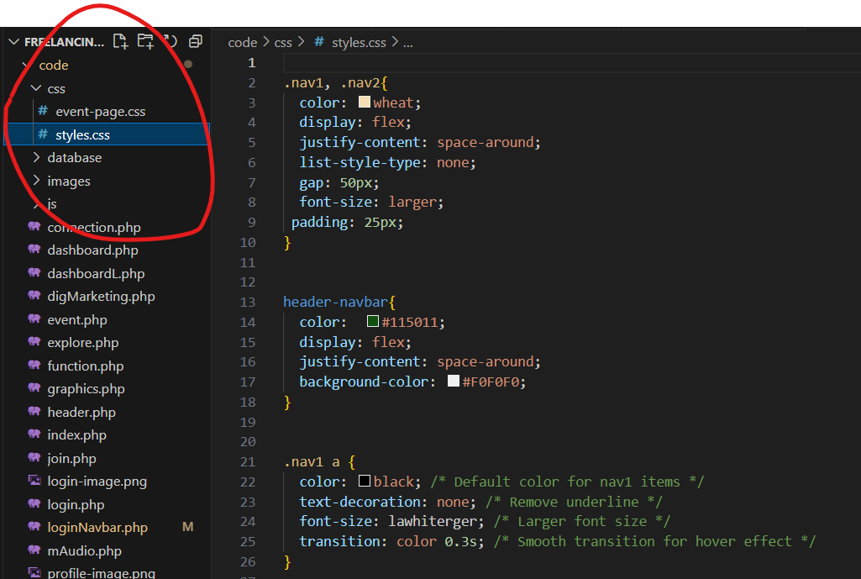
CSS issue faced
One CSS file for all pages
CSS within same page

Slide 16
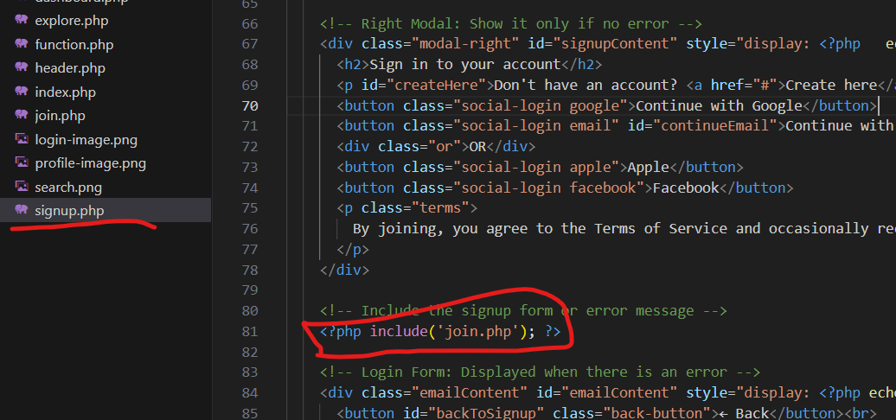
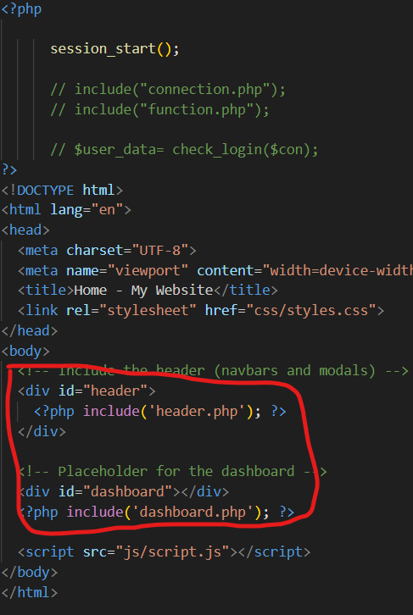
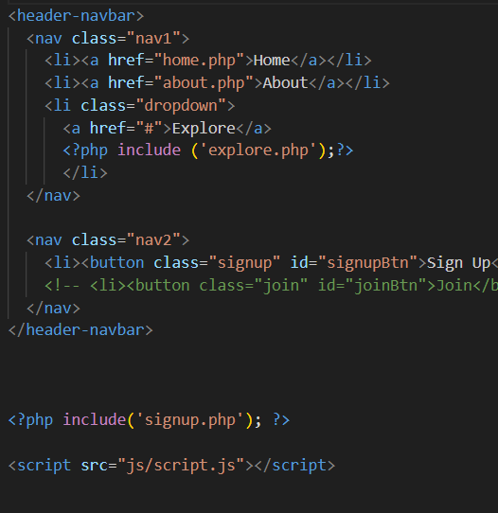

Slide 17
One file connected to multiple files
Index.php
Header.php
Signup.php

Slide 18
More to go
Payment Gateway
Functionality for Buyer and Seller

