Slide 1
Class 2 Software Processes
An overview of conventional software process models

Slide 2
Objectives
To introduce software process models
To describe three generic process models and when they may be used
To describe outline process models for requirements engineering, software development, testing and evolution

Slide 3
The software process
A structured set of activities required to develop a software system
Specification;
Design;
Validation;
Evolution.
A software process model is an abstract representation of a process. It presents a description of a process from some particular perspective.

Slide 4
Generic software process models
The waterfall model
Separate and distinct phases of specification and
development.
Evolutionary development
Specification, development and validation are interleaved.
Component-based software engineering
The system is assembled from existing components.
There are many variants of these models e.g. formal development where a waterfall-like process is used but the specification is a formal specification that is refined through several stages to an implementable design.

Slide 5
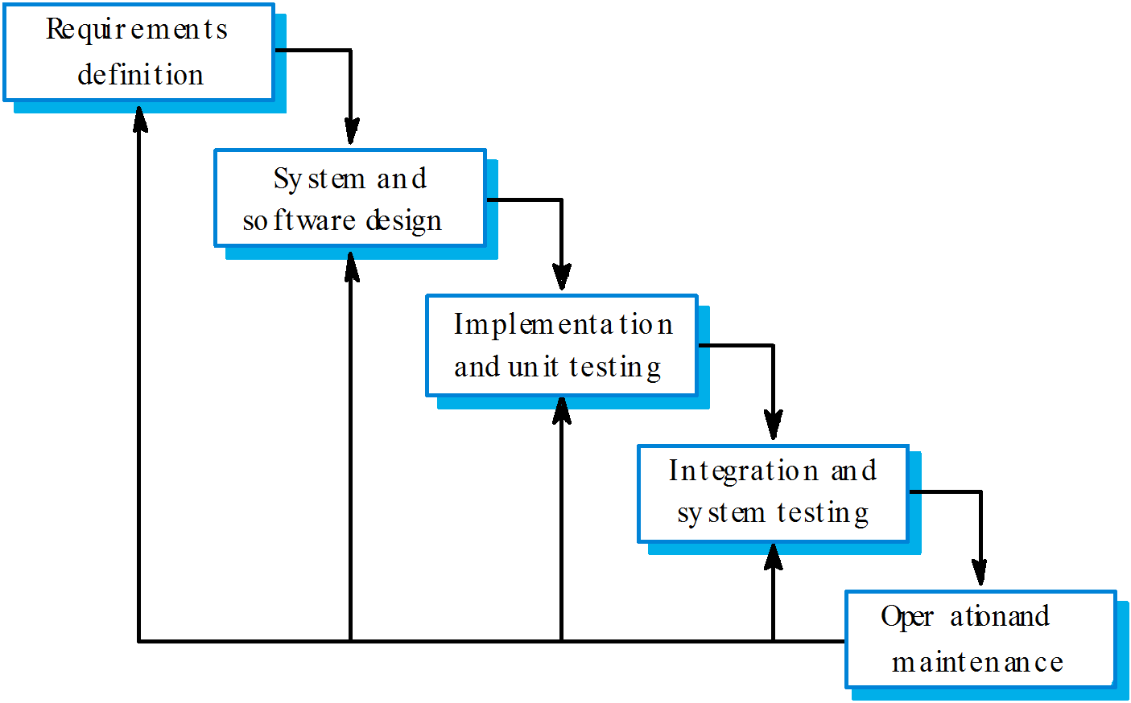
Waterfall model

Slide 6
Waterfall model phases
Requirements analysis and definition
System and software design
Implementation and unit testing
Integration and system testing
Operation and maintenance
The main drawback of the waterfall model is the difficulty of accommodating change after the process is underway. One phase has to be complete before moving onto the next phase.

Slide 7
Waterfall model problems
Inflexible partitioning of the project into distinct stages makes it difficult to respond to changing customer requirements.
Therefore, this model is only appropriate when the requirements are well-understood and changes will be fairly limited during the design process.
Few business systems have stable requirements.
The waterfall model is mostly used for large systems engineering projects where a system is developed at several sites.

Slide 8
Evolutionary development
Exploratory development
Objective is to work with customers and to evolve a final system from an initial outline specification. Should start with well-understood requirements and add new features as proposed by the customer.
Throw-away prototyping
Objective is to understand the system requirements. Should start with poorly understood requirements to clarify what is really needed.

Slide 9
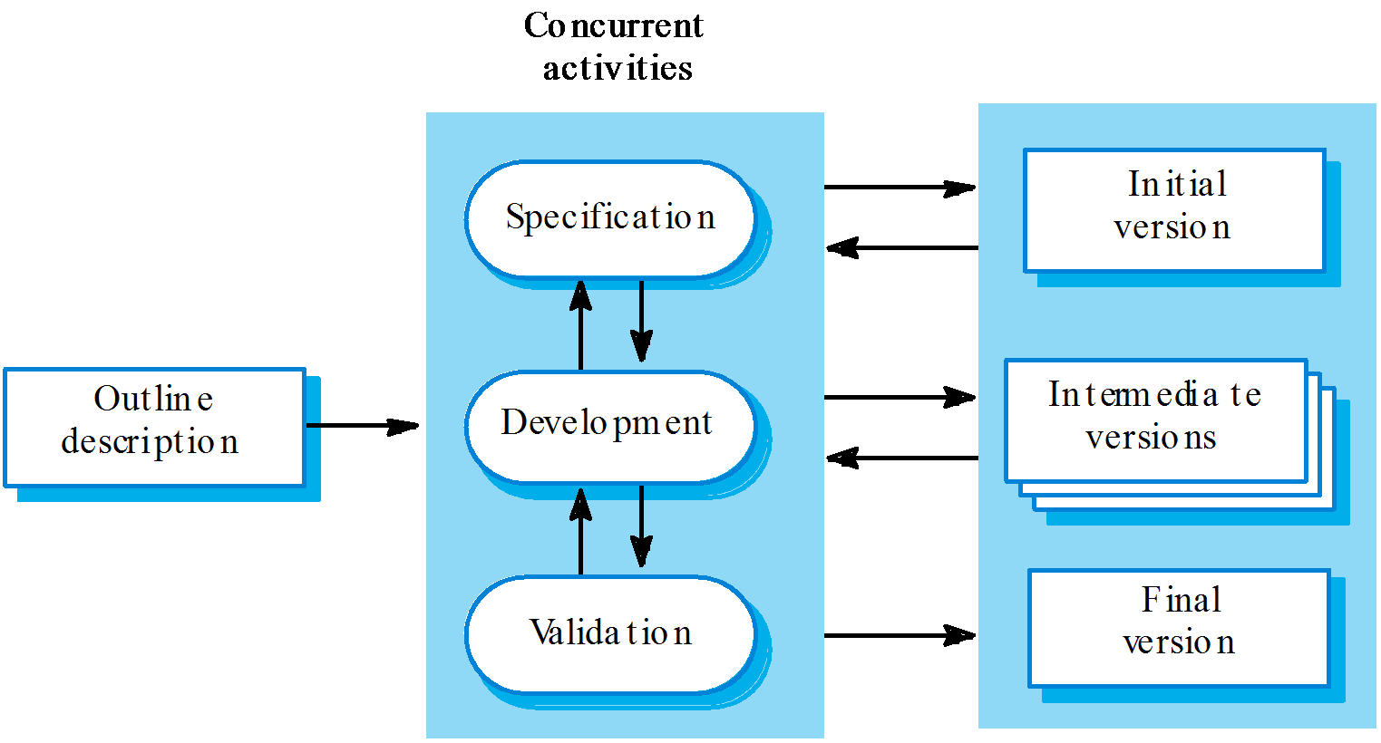
Evolutionary development

Slide 10
Evolutionary development
Problems
Lack of process visibility;
Systems are often poorly structured;
Special skills (e.g. in languages for rapid prototyping) may be required.
Applicability
For small or medium-size interactive systems;
For parts of large systems (e.g. the user interface);
For short-lifetime systems.

Slide 11
Component-based software engineering
Based on systematic reuse where systems are integrated from existing components or COTS (Commercial-off-the-shelf) systems.
Process stages
Component analysis;
Requirements modification;
System design with reuse;
Development and integration.
This approach is becoming increasingly used as component standards have emerged.

Slide 12
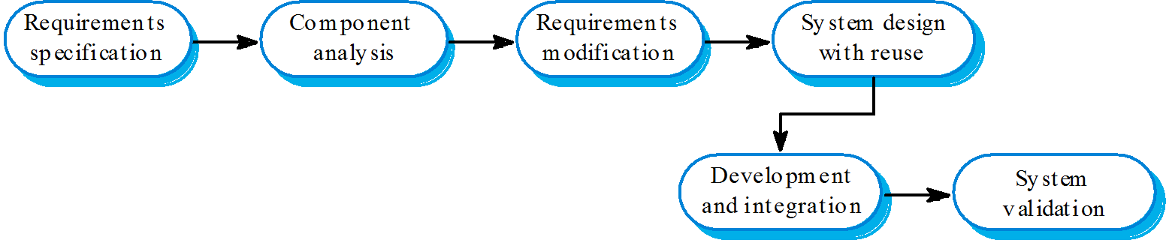
Reuse-oriented development

Slide 13
Process iteration
System requirements ALWAYS evolve in the course of a project so process iteration where earlier stages are reworked is always part of the process for large systems.
Iteration can be applied to any of the generic process models.
Two (related) approaches
Incremental delivery;
Spiral development.

Slide 14
Incremental delivery
Rather than deliver the system as a single delivery, the development and delivery is broken down into increments with each increment delivering part of the required functionality.
User requirements are prioritised and the highest priority requirements are included in early increments.
Once the development of an increment is started, the requirements are frozen though requirements for later increments can continue to evolve.

Slide 15
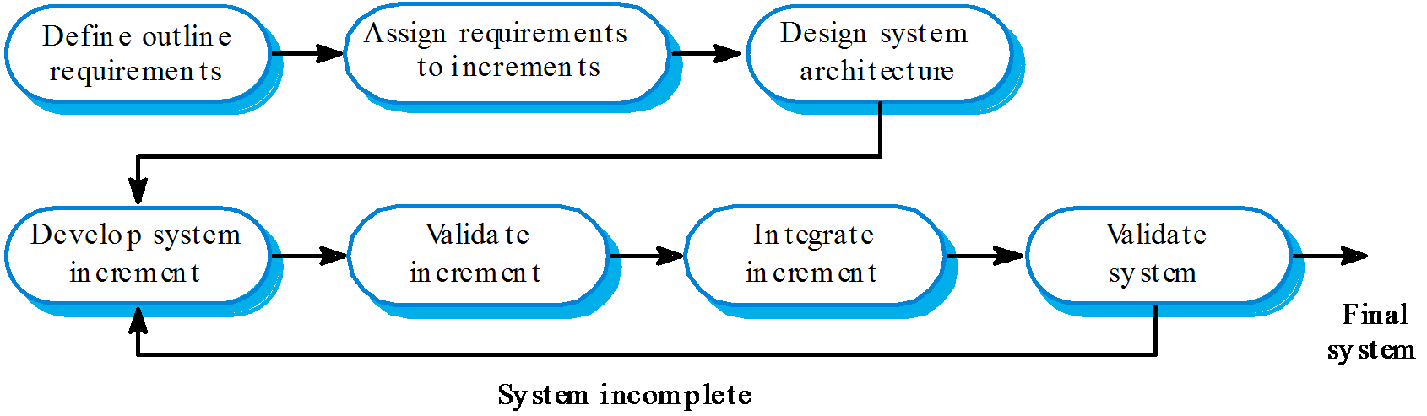
Incremental development

Slide 16
Incremental development advantages
Customer value can be delivered with each increment so system functionality is available earlier.
Early increments act as a prototype to help elicit requirements for later increments.
Lower risk of overall project failure.
The highest priority system services tend to receive the most testing.

Slide 17
Spiral development
Process is represented as a spiral rather than as a sequence of activities with backtracking.
Each loop in the spiral represents a phase in the process.
No fixed phases such as specification or design
- loops in the spiral are chosen depending on what is required.
Risks are explicitly assessed and resolved throughout the process.

Slide 18
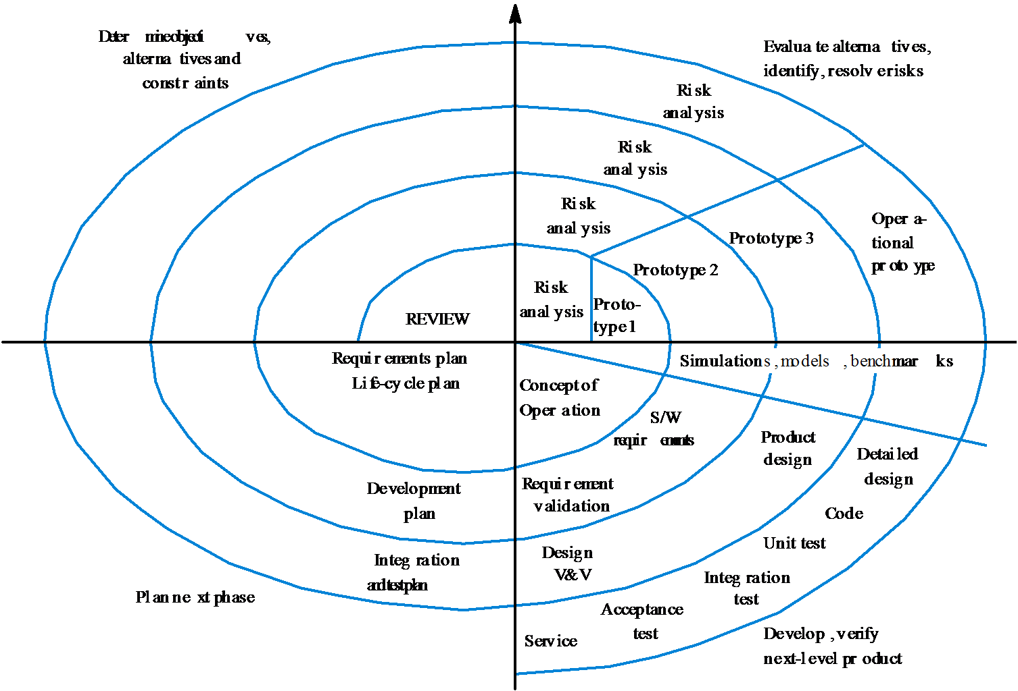
Spiral model of the software process

Slide 19
Spiral model sectors
Objective setting
Specific objectives for the phase are identified.
Risk assessment and reduction
Risks are assessed and activities put in place to reduce the key risks.
Development and validation
A development model for the system is chosen which can be any of the generic models.
Planning
The project is reviewed and the next phase of the spiral is planned.

Slide 20
Process activities
Software specification
Software design and implementation
Software validation
Software evolution

Slide 21
Software specification
The process of establishing what services are required and the constraints on the system’s operation and development.
Requirements engineering process
Feasibility study;
Requirements elicitation and analysis;
Requirements specification;
Requirements validation.

Slide 22
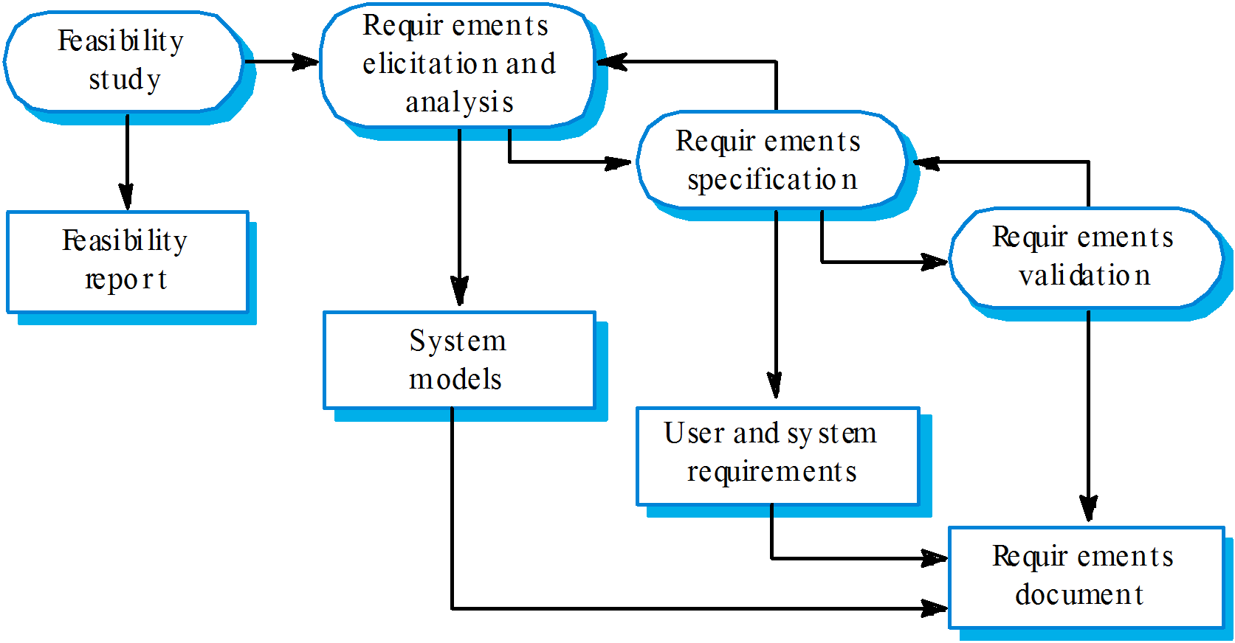
The requirements engineering process

Slide 23
Software design and implementation
The process of converting the system specification into an executable system.
Software design
Design a software structure that realises the specification;
Implementation
Translate this structure into an executable program;
The activities of design and implementation are closely related and may be inter-leaved.

Slide 24
Design process activities
Architectural design
Abstract specification
Interface design
Component design
Data structure design
Algorithm design

Slide 25
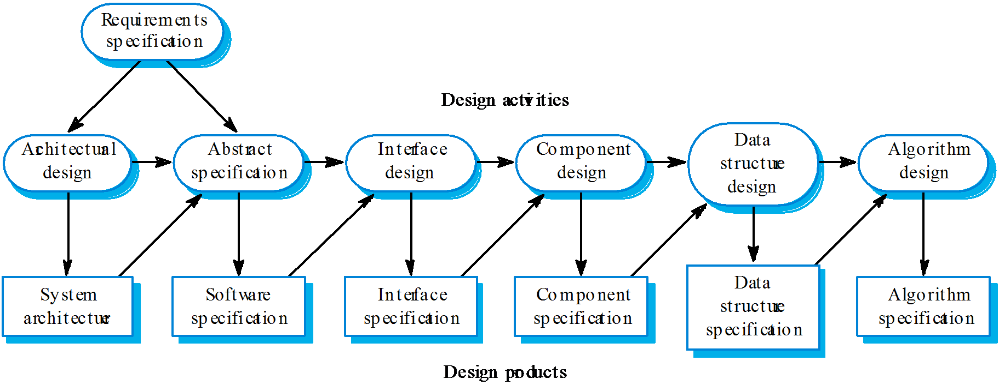
The software design process

Slide 26
Structured methods
Systematic approaches to developing a software design.
The design is usually documented as a set of graphical models.
Possible models
Object model;
Sequence model;
State transition model;
Structural model;
Data-flow model.

Slide 27
Programming and debugging
Translating a design into a program and removing errors from that program.
Programming is a personal activity - there is no generic programming process.
Programmers carry out some program testing to discover faults in the program and remove these faults in the debugging process.

Slide 28
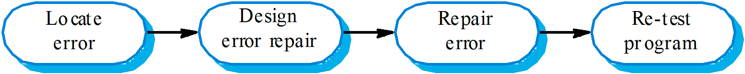
The debugging process

Slide 29
Software validation
Verification and validation (V & V) is intended to show that a system conforms to its specification and meets the requirements of the system customer.
Involves checking and review processes and system testing.
System testing involves executing the system with test cases that are derived from the specification of the real data to be processed by the system.

Slide 30
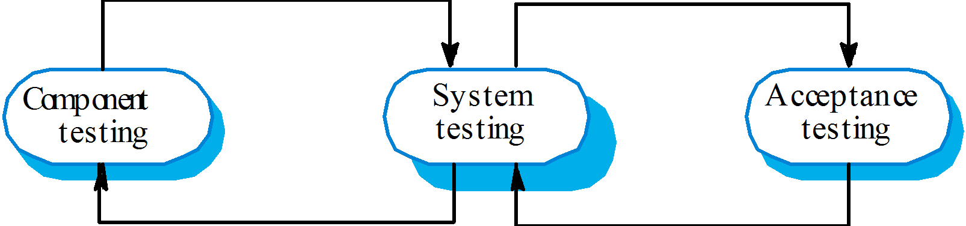
The testing process

Slide 31
Testing stages
Component or unit testing
Individual components are tested independently;
Components may be functions or objects or coherent groupings of these entities.
System testing
Testing of the system as a whole. Testing of emergent properties is particularly important.
Acceptance testing
Testing with customer data to check that the
system meets the customer’s needs.

Slide 32
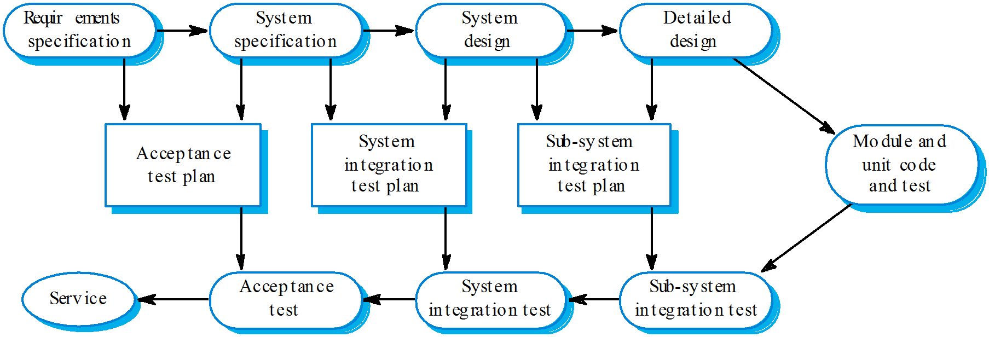
Testing phases

Slide 33
Software evolution
Software is inherently flexible and can change.
As requirements change through changing business circumstances, the software that supports the business must also evolve and change.
Although there has been a demarcation between development and evolution (maintenance) this is increasingly irrelevant as fewer and fewer systems are completely new.

Slide 34
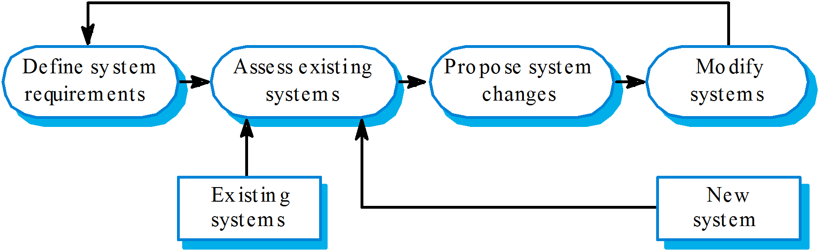
System evolution

