Slide 1





NETWORKING PROJECT 2 | CISCO PACKET TRACER
Corporate Wireless Setup
Secure staff Wi-Fi with a separate, isolated network for smart devices
Notes:
Hello everyone, I'm Harsh Vishwakarma. And I'm Suyash Yadav. Today we're presenting our project, Corporate Wireless Setup, built in Cisco Packet Tracer.

Slide 2

Problem and objectives
THE BRIEF
InnoConn, a tech startup, is setting up a new office.
Staff Wi-Fi
Separate IoT network
WPA2-PSK (AES) access for employee laptops.
Own SSID, subnet and NAT boundary for smart devices.
It needs an internal wireless network for employee laptops and a separate, secure connection for smart devices. Every wireless client must be able to reach the Main-Server.
Central server
Automatic addressing
Static Main-Server with HTTP, reachable by every client.
DHCP leases for wireless clients, static IPs for infrastructure.
Notes:
InnoConn needs staff Wi-Fi plus a separate secure IoT network, and both must reach the Main-Server.

Slide 3
Network topology
Main-Server
192.168.1.10/24 | HTTP on
Wired backbone
Server, switch and both routers share the 192.168.1.0/24 LAN.
Fa0 - Fa0/1
Office-Switch
Cisco 2960-24TT
Two wireless networks
Fa0/2 - LAN port
Fa0/3 - Internet port
InnoConn-Staff and InnoConn-IoT, each with its own SSID and key.
Staff-Router
WRT300N | LAN 192.168.1.1
Smart-Router
WAN 192.168.1.2
LAN 192.168.2.1
Why two routers
Wi-Fi WPA2-PSK
Wi-Fi WPA2-PSK
The WRT300N supports one SSID, so a second router gives smart devices their own subnet behind NAT.
Staff clients (4)
3 laptops, tablet | 192.168.1.x
IoT clients (4)
2 phones, webcam, thermostat
Notes:
The Main-Server connects to a 2960-24TT switch, which connects to two WRT300N routers. The Staff-Router uses a LAN port; the Smart-Router uses its Internet port. Two subnets: 192.168.1.0/24 for staff and server, 192.168.2.0/24 for smart devices.

Slide 4
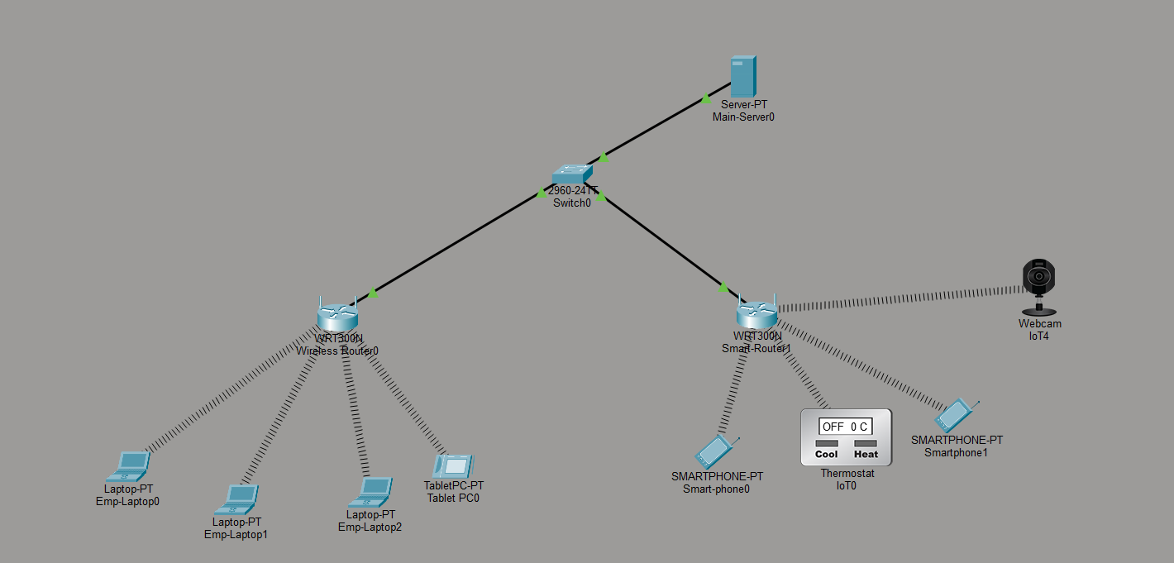
Packet Tracer topology
Server, switch and two routers, with 3 laptops, a tablet, 2 smartphones, a webcam and a thermostat connected wirelessly.
Notes:
This is the real topology built in Packet Tracer. The Staff-Router carries three laptops and a tablet; the Smart-Router carries two smartphones, a webcam and a thermostat.

Slide 5
IP addressing plan
SUBNET A | STAFF + SERVER
SUBNET B | IOT DEVICES
192.168.1.0/24
192.168.2.0/24
Gateway 192.168.1.1 | DHCP .100 to .149
Gateway 192.168.2.1 | DHCP .100 to .149
Device | Interface | IP address | Mask | Assigned
Main-Server | Fa0 | 192.168.1.10 | 255.255.255.0 | Static
Staff-Router | LAN | 192.168.1.1 | 255.255.255.0 | Static, DHCP server
Smart-Router | WAN (Internet) | 192.168.1.2 | 255.255.255.0 | Static
Smart-Router | LAN | 192.168.2.1 | 255.255.255.0 | Static, DHCP server
Staff clients (laptops, tablet) | Wireless | 192.168.1.100+ | 255.255.255.0 | DHCP
IoT clients (phones, webcam, thermostat) | Wireless | 192.168.2.100+ | 255.255.255.0 | DHCP
Notes:
Static addresses stay below .100 and the DHCP pools start at .100, so leases never collide with infrastructure addresses.

Slide 6

Configuration summary
Main-Server
Staff-Router
Smart-Router
Static IP
192.168.1.10/24
Gateway
192.168.1.1
HTTP service
On
Cable
Fa0 to Switch Fa0/1
Router IP
192.168.1.1/24
DHCP
On, from .100, 50 users
SSID
InnoConn-Staff
Security
WPA2-PSK, AES
Channel
6
Uplink
Switch Fa0/2 to LAN port
WAN
Static 192.168.1.2/24
LAN
192.168.2.1/24, NAT
DHCP
On, from .100, 50 users
SSID
InnoConn-IoT
Security
WPA2-PSK, AES, own key
Channel
1
Notes:
Server: static 192.168.1.10 with HTTP on. Staff-Router: gateway 192.168.1.1 with DHCP from .100, SSID InnoConn-Staff on channel 6 with WPA2-PSK AES. Smart-Router: static WAN 192.168.1.2, LAN 192.168.2.1 with NAT, SSID InnoConn-IoT on channel 1 with a different passphrase.

Slide 7
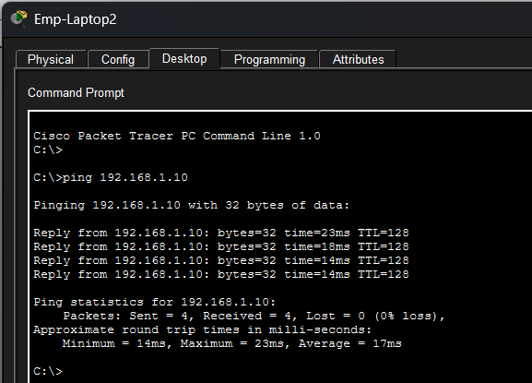
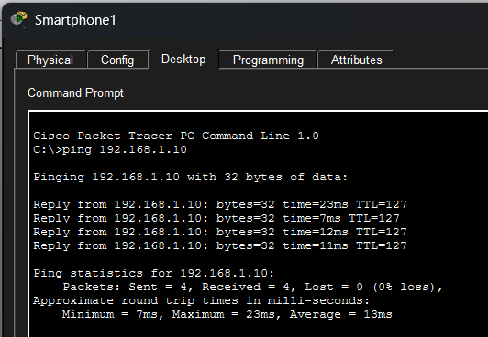
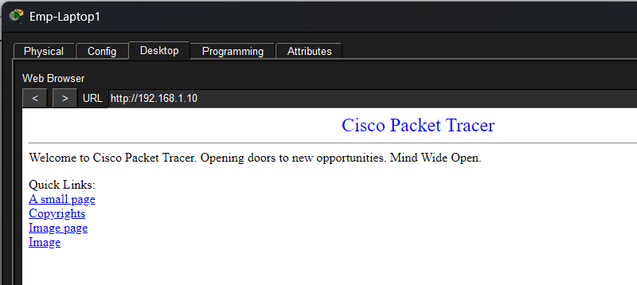
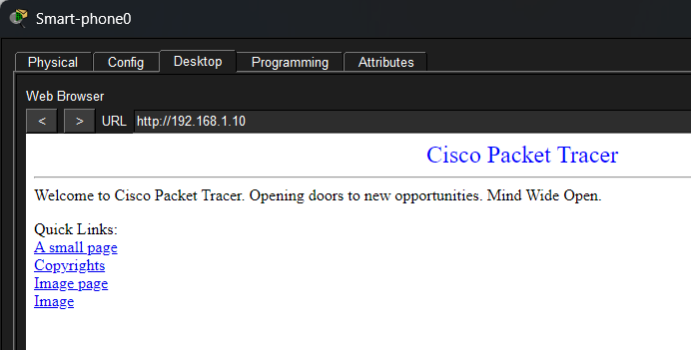
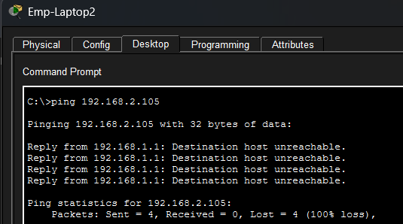
Testing and security proof
Test | Expected
Emp-Laptop to Server ping 192.168.1.10 | 0% loss
Smart-Phone to Server ping 192.168.1.10 | 0% loss
Emp-Laptop to Gateway ping 192.168.1.1 | Reply
Emp-Laptop web page http://192.168.1.10 | Page loads
Smart-Phone web page http://192.168.1.10 | Page loads
Staff to IoT isolation ping 192.168.2.105 | Unreachable
Staff to IoT: Destination host unreachable
Pings and web pages from both networks; bottom: staff to IoT ping is unreachable (isolation proof)
Notes:
Ping and HTTP from both clients reach the server. The staff to IoT ping returns destination host unreachable, which proves the isolation.

Slide 8
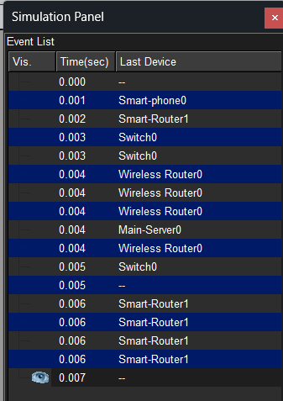
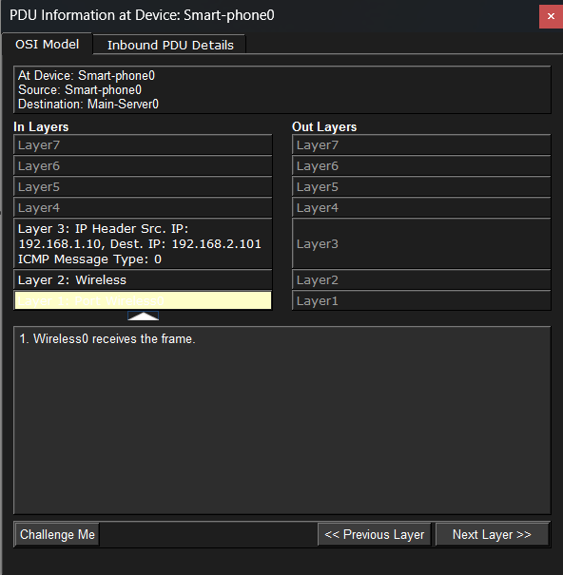
Simulation mode: packet path
Smart-phone0
192.168.2.x
Smart-Router
NAT to 192.168.1.2
Office-Switch
Fa0/3 to Fa0/1
Main-Server
192.168.1.10
Steps followed
Switch to Simulation mode and filter for ICMP and HTTP.
Send a ping from Smart-phone0 to Main-Server0.
Press Capture / Forward and follow each hop.
Open the PDU details to read source and destination IPs.
Event list for the ping from Smart-phone0 to Main-Server0 and the OSI view of the reply at Wireless Router0
Notes:
In Simulation mode you can follow the ICMP and HTTP packets from the Smart-Phone through the Smart-Router and switch to the server, and back.

Slide 9



Conclusion and future scope
RESULT
FUTURE SCOPE
Wireless clients on both networks reach the Main-Server by ping and HTTP.
VLANs
One SSID per VLAN on access points instead of a second router.
Both networks use WPA2-PSK with AES on separate SSIDs.
WPA2-Enterprise
Per-user authentication with a RADIUS server.
NAT keeps smart devices isolated from the staff network.
Monitoring and ACLs
Syslog, SNMP and explicit allow rules between networks.
Thank you
Notes:
We built a secure wireless office network with DHCP, WPA2 encryption and separated staff and IoT networks. In future we could use VLANs and WPA2-Enterprise with RADIUS. Thank you for watching.

