Slide 1

MINOR PROJECT EVEN 2020
Group Members-
Suyash Verma (17103052)
Akash Soni (17103029)
Vaibhav Mishra (17103346)
TOPIC -
AUTONOMOUS CAR USING DEEP LEARNING

Slide 2
Outline -
PROBLEM STATEMENT
ABSTRACT
OBJECTIVES
TECHNOLOGY USED
PROJECT STRUCTURE
LITERATURE REVIEW
BACKGROUND STUDY AND FINDINGS
TRAFFIC SIGN RECOGNITION
LANE DETCTION SYSTEM
REFERENCES

Slide 3
Problem Statement
Recently the number of vehicles on the road has been increased enormously thanks to the technological achievement of the motor industry and very precisely the availability of motor vehicles at very low rates. With this remarkable growth of vehicles on the road there is an enormous increase in the road accidents as well and the ignorance of traffic signs is considered as the major cause.
Nearly 1.25 million people dies of road accident yearly and about 20-50 million are injured or disabled. DoT researchers estimates that fully autonomous vehicles could reduce the traffic fatalities by up to 94 percent by eliminating those accidents that are caused by Human errors.

Slide 4
Solution
Cars with automated technology have sensors that never lose vigilance. “They are always looking for pedestrians. They are always looking for edge of the road. They are always watching the car in front. They don’t become distracted or drunk, and I think that’s really the main reason why most experts would say that there is definite possibility that automation can significantly reduce those Human error caused fatal crashes”.
The biggest problem automated vehicles solve is that human beings are not well suited to travelling at high speeds. As speed increases, our time and distance perception degrades. We do not have sufficient range of lateral vision and no rear vision. We are limited in on ability to focus and process data and we tend to focus on one thing at a time (which leads to distraction from the task of driving). In short, we make mistakes behind the wheel and these mistakes are primary cause in more than 90% of accidents.
5/24/2020

Slide 5
Objectives
In our Minor Project II we are trying to solve the most important two problems of an Autonomous car
1. Traffic Sign Recognition and
2. Lane detection
In this Project we have implemented Traffic sign recognition system using Convolutional neural network and Automatic Lane detection system using Computer Vision techniques via opencv

Slide 6
The complete Project is divided into two parts –
Traffic Sign Recognition System
Autonomous Lane Detection

Slide 7
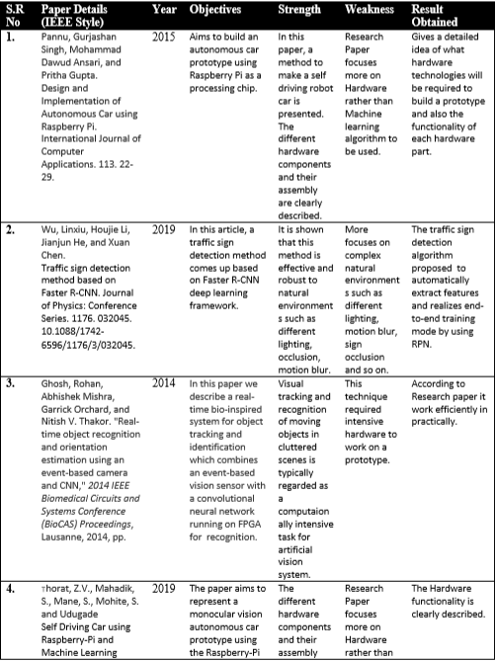
Literature Review

Slide 8
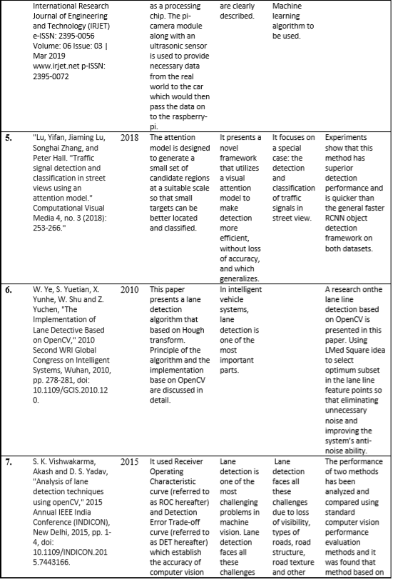

Slide 9
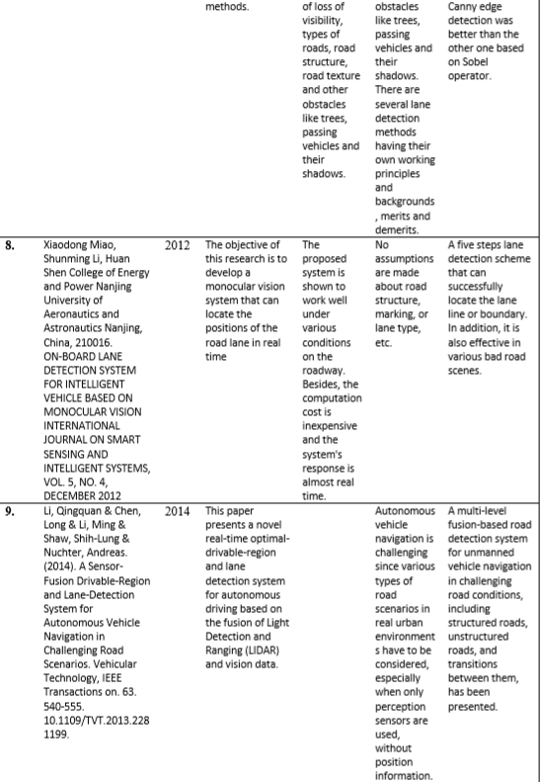

Slide 10
Background Study and Findings
CNN image classifications take an input image, process it and classify it under certain categories. Each input image will pass it through a series of convolution layers with filters. Pooling, fully connected layers (FC) and apply Softmax function to classify an object with probabilistic values between 0 and 1. The below figure is a complete flow of CNN to process an input image and classifies the objects based on values.
CNN have following layers –
1) Convolution Layer
2) ReLU Layer
3) Pooling Layer
4) Fully Connected Layer

Slide 11
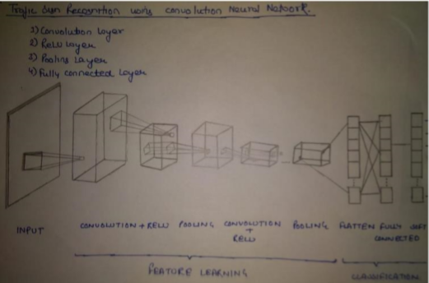

Slide 12
Algorithm -
Classification with artificial neural networks is a very popular approach to solve pattern recognition problems. A neural network is a mathematical model based on connected via each other neural units artificial neurons similarly to biological neural networks. Typically, neurons are organized in layers, and the connections are established between neurons from only adjacent layers. The input low-level feature vector is put into first layer and, moving from layer to layer, is transformed to the high-level features vector. The output layer neurons amount is equal to the number of classifying classes. Thus, the output vector is the vector of probabilities showing the possibility that the input vector belongs to a corresponding class. Each Convolutional layer consists of a set of trainable filters and computes dot productions between these filters and layer input to obtain an activation map. These filters are also known as kernels and allow detecting the same features in different locations.

Slide 13
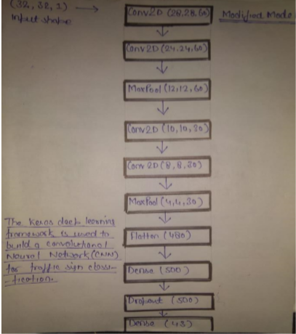

Slide 14
Above Table describes our developed network architecture. The architecture consists of several Convolutional layers, fully connected layers, softmax layer. All Convolutional layers have parameter stride equal to 1. This parameter determines the stride of the convolution sliding window, so layers with parameter stride greater than 1 also combine the pooling operation. The softmax layer normalizes the previous layer output so that its output contains probabilities of belonging to recognizable classes for the original input image.

Slide 15
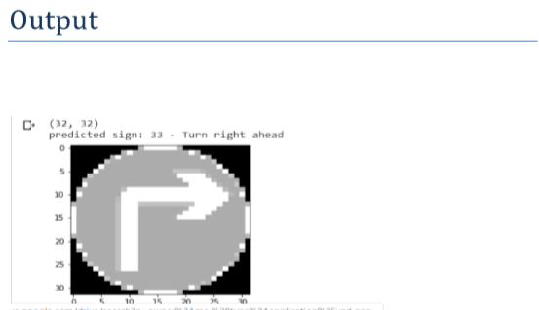
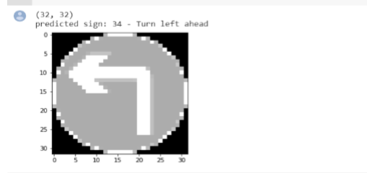

Slide 16
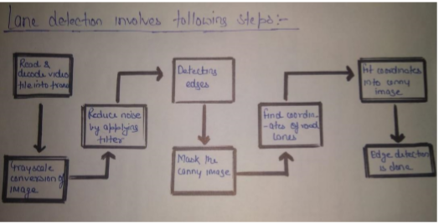
Autonomous Lane Detection
Autonomous Driving Car is one of the most disruptive innovations in AI. Fuelled by Deep Learning algorithms, they are continuously driving our society forward and creating new opportunities in the mobility sector. An autonomous car can go anywhere a traditional car can go and does everything that an experienced human driver does. But it’s very essential to train it properly. One of the many steps involved during the training of an autonomous driving car is lane detection

Slide 17
Decoding video file: After the capturing has been initialized every video frame is decoded (i.e. converting into a sequence of images).
Grayscale conversion of image: The video frames are in RGB format, RGB is converted to grayscale because processing a single channel image is faster than processing a three-channel colored image.
Reduce noise: Noise can create false edges, therefore before going further, it’s imperative to perform image smoothening. Gaussian filter is used to perform this process.
Canny Edge Detector: It computes gradient in all directions of our blurred image and traces the edges with large changes in intensity.
Region of Interest: This step is to take into account only the region covered by the road lane. A mask is created here, which is of the same dimension as our road image. Furthermore, bitwise AND operation is performed between each pixel of our canny image and this mask. It ultimately masks the canny image and shows the region of interest traced by the polygonal contour of the mask.
Hough Line Transform: The Hough Line Transform is a transform used to detect straight lines. The Probabilistic Hough Line Transform is used here, which gives output as the extremes of the detected lines.

Slide 18
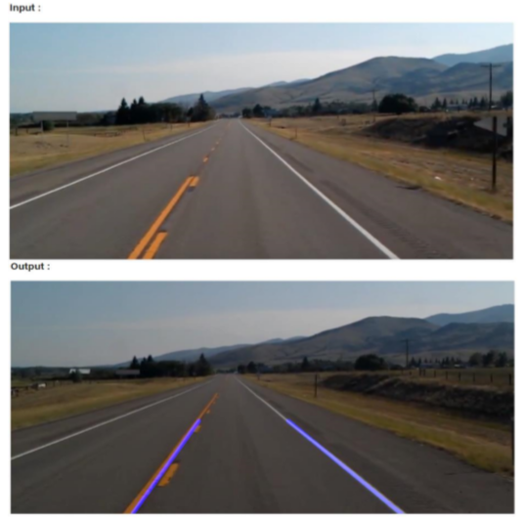

Slide 19
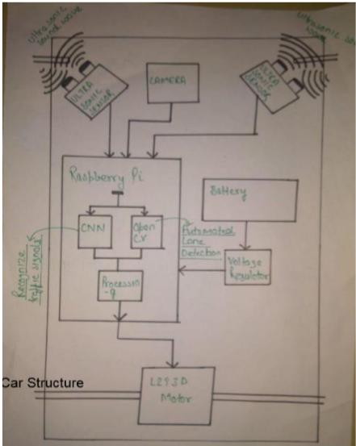
Conclusion
An autonomous car can be built with some extra hardware and Traffic recognition system and Automatic Lane detection system integrated within Raspberry pi. Below is the Structure of a simple autonomous car.

Slide 20
Reference
1. Pannu, Gurjashan Singh, Mohammad Dawud Ansari, and Pritha Gupta. Design and Implementation of Autonomous Car using Raspberry Pi. International Journal of Computer Applications. 113. 22-29.
2. Wu, Linxiu, Houjie Li, Jianjun He, and Xuan Chen. Traffic sign detection method based on Faster R-CNN. Journal of Physics: Conference Series. 1176. 032045. 10.1088/1742-6596/1176/3/032045.
3. Ghosh, Rohan, Abhishek Mishra, Garrick Orchard, and Nitish V. Thakor.Real-time object recognition and orientation estimation using an event-based camera and CNN. In 2014 IEEE Biomedical Circuits and Systems Conference Proceedings (pp. 544-547). IEEE.
4. Thorat, Z.V., Mahadik, S., Mane, S., Mohite, S. and Udugade, ASelf Driving Car using Raspberry-Pi and Machine Learning International Research Journal of Engineering and Technology (IRJET) e-ISSN: 23950056 Volume: 06 Issue: 03 | Mar 2019 p-ISSN: 2395-0072

Slide 21
5. "Lu, Yifan, Jiaming Lu, Songhai Zhang, and Peter Hall. "Traffic signal detection and classification in street views using an attention model." Computational Visual Media 4, no. 3 (2018): 253-266."
6. W. Ye, S. Yuetian, X. Yunhe, W. Shu and Z. Yuchen, "The Implementation of Lane Detective Based on OpenCV," 2010 Second WRI Global Congress on Intelligent Systems, Wuhan, 2010, pp. 278-281, doi: 10.1109/GCIS.2010.120.
7. S. K. Vishwakarma, Akash and D. S. Yadav, "Analysis of lane detection techniques using openCV," 2015 Annual IEEE India Conference (INDICON), New Delhi, 2015, pp. 1-4, doi: 10.1109/INDICON.2015.7443166.
8. ON-BOARD LANE DETECTION SYSTEM FOR INTELLIGENT VEHICLE BASED ON MONOCULAR VISION Xiaodong Miao, Shunming Li, Huan Shen College of Energy and Power Nanjing University of Aeronautics and Astronautics Nanjing, China, 210016. INTERNATIONAL JOURNAL ON SMART SENSING AND INTELLIGENT SYSTEMS, VOL. 5, NO. 4, DECEMBER 2012

Slide 22
9. Li, Qingquan & Chen, Long & Li, Ming & Shaw, Shih-Lung & Nuchter, Andreas. (2014). A Sensor-Fusion Drivable-Region and Lane-Detection System for Autonomous Vehicle Navigation in Challenging Road Scenarios. Vehicular Technology, IEEE Transactions on. 63. 540-555. 10.1109/TVT.2013.2281199.
10. Varghese, Jaycil Z., and Randy G. Boone. "Overview of autonomous vehicle sensors and systems." In International Conference on Operations Excellence and Service Engineering, pp. 178-191. 2015.

