Slide 1

Deepfake Detection
Team members:
Rajat Purohit -2513101
Suyash Shirodkar- 2513102
Vishakh Anant - 2513110

Slide 2

Problem Statement
To Develop a model capable of detecting artificially altered videos and classify them as real and fake

Slide 3
Objectives
To train a deep learning model (EfficientNet-B0) for binary classification.
To accurately classify facial images as Real or Fake.
To evaluate model performance using training, validation, and test data.
To develop an automated system capable of identifying deepfake facial content.

Slide 4

Introduction
Deepfakes pose threats to privacy, security, and the credibility of digital content.
To address this challenge, our project focuses on building a deep learning model capable of detecting fake faces.
Using extracted face frames from the FaceForensics++ dataset, we train an EfficientNet-B0 classifier to distinguish between real and fake facial images

Slide 5
Dataset Overview
FaceForensics++
1000 original videos
1000 fake videos (200 each of DeepFakes, Face2Face, FaceSwap, FaceShifter, NeuralTextures)
Single subject speaking in controlled environments.

Slide 6

Model Selection
Why Model Selection Was Necessary
Different CNN architectures vary in accuracy, speed, and computational cost
Deepfake detection requires a balance between performance and efficiency
Several models were tested on 50% of the dataset for 20 epochs

Slide 7
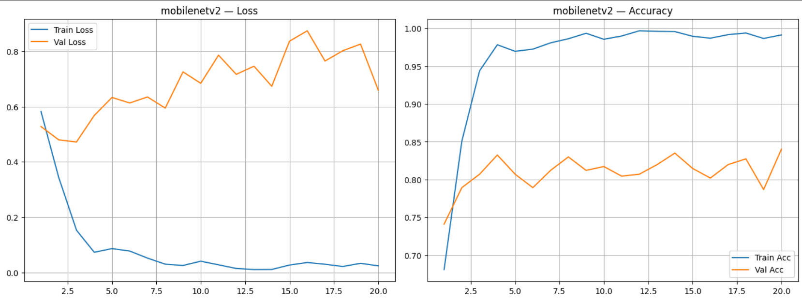
MobileNetV2
Lightweight, fast
Moderate validation accuracy: 79–80%
Struggles with complex facial artifacts

Slide 8
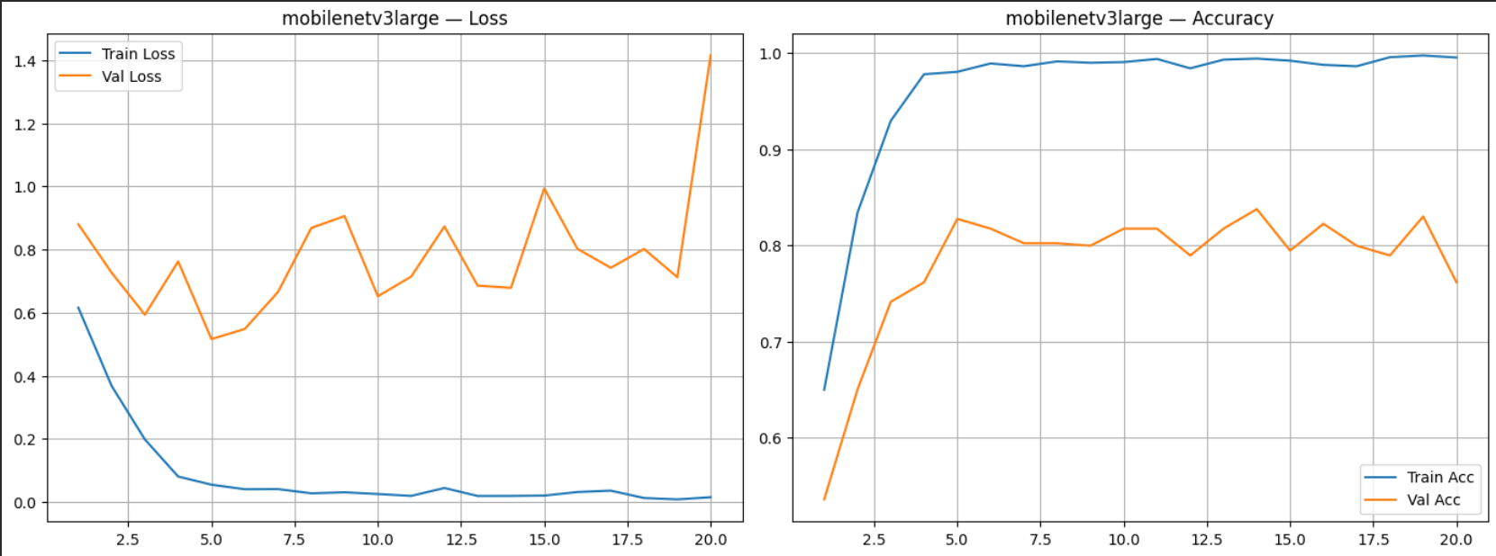
MobileNetV3-Large
Improved architecture over V2
Validation accuracy: 80–81%
Still not robust enough for subtle manipulations

Slide 9
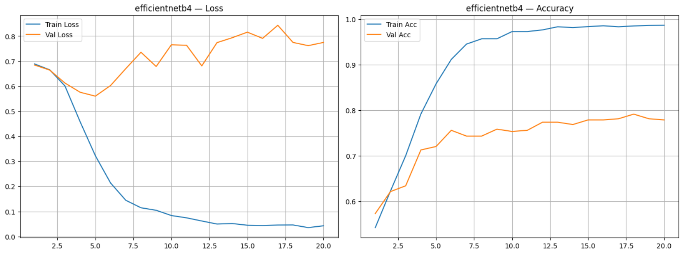
EfficientNet-B4
Large and computationally heavy
Validation accuracy: 77–79%
Overparameterized for this dataset
Slow convergence

Slide 10
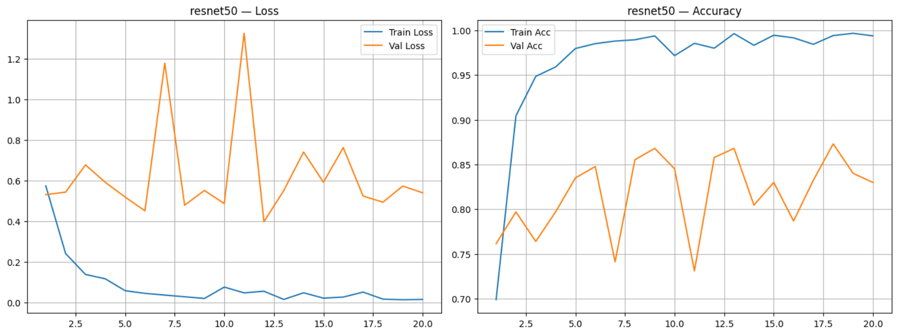
ResNet-50
Strong feature extraction via residual learning
Validation accuracy: 83–86%
High computational and memory cost

Slide 11
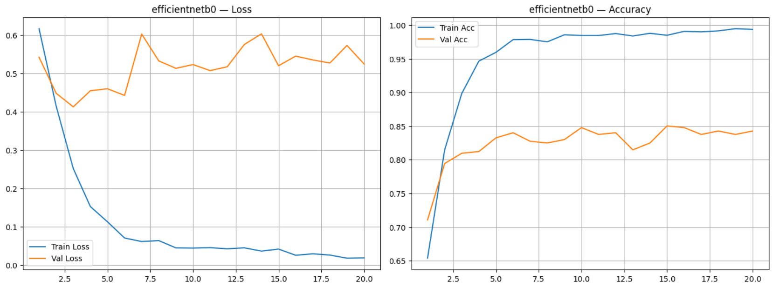
EfficientNet-B0
Lightweight yet powerful
Validation accuracy: 83–85%
Best balance of speed and accuracy
Stable training curves

Slide 12
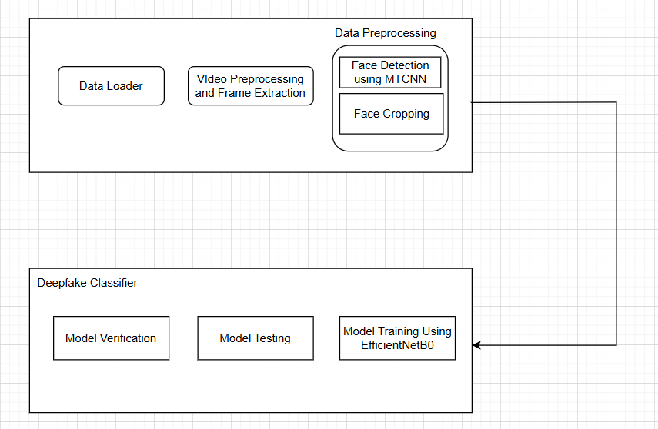
Model Architecture

Slide 13

Data Preprocessing
Preprocessing Steps
Video decoding (OpenCV) & color conversion (BGR to RGB).
Fixed number of evenly spaced frames extracted.
face detected, cropped, resized, and normalized.

Slide 14
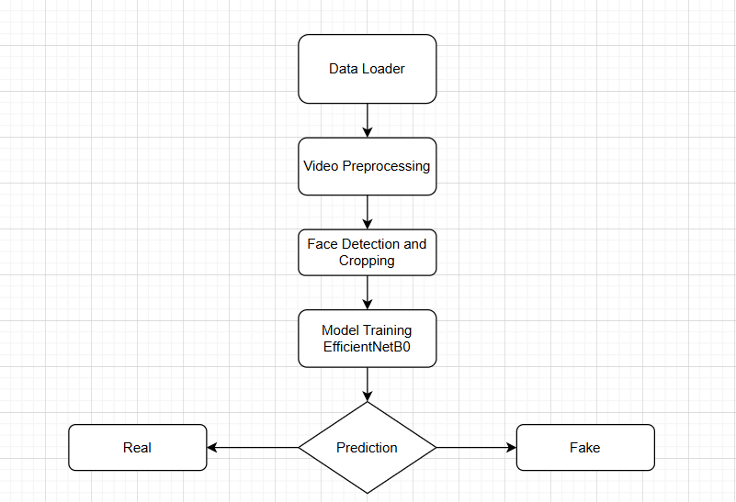
Model Training Workflow
Processed face images are used to train the EfficientNet-B0 classifier, chosen for its strong performance-to-efficiency ratio.
Data Loading using a data loader.
Normalization and tensor conversion applied.
Images fed into EfficientNet-B0.
Classification loss computed using cross-entropy.
Weights updated via backpropagation.

Slide 15
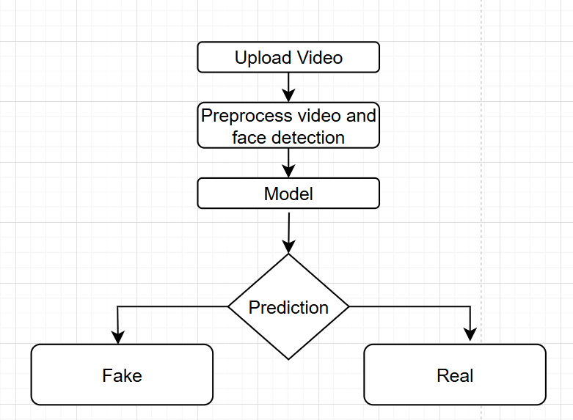
Model Testing & Verification
Once trained, the model is evaluated on unseen face images, and predictions are manually verified for reliability.
Evaluation Metrics
Accuracy
Precision
Recall
F1-score
Confusion matrix
Verification Process
Misclassified samples visually inspected.
Facial regions examined.
Differences between predicted and ground-truth labels analyzed.

Slide 16
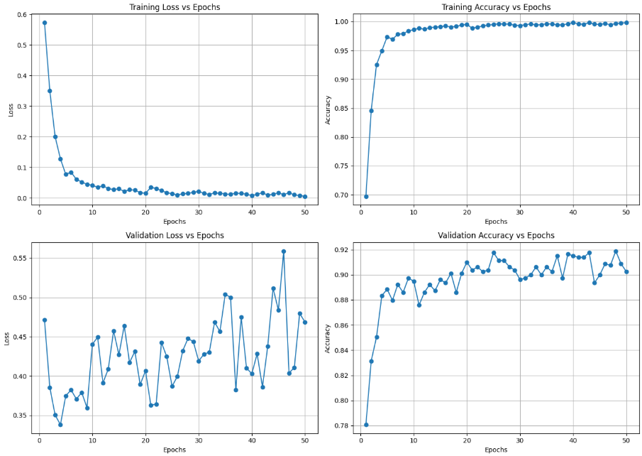
Results
Accuracy And Loss Curves for Training and Validation dataset

Slide 17
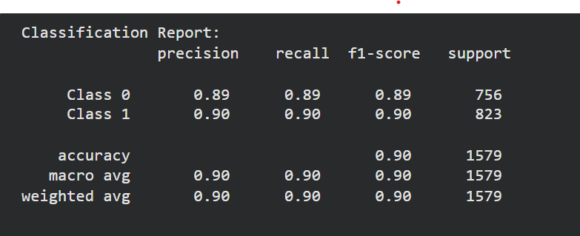
Results
Classification Report & Testing Accuracy

Slide 18
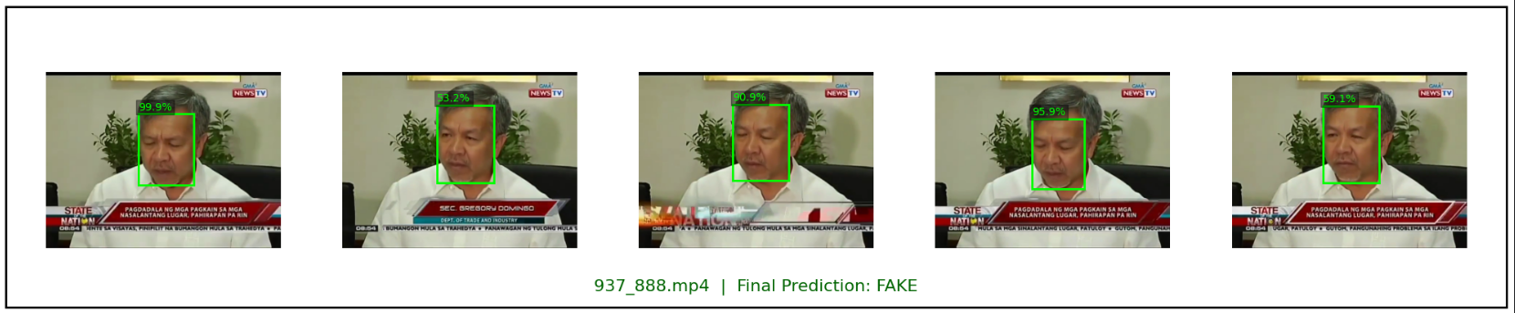
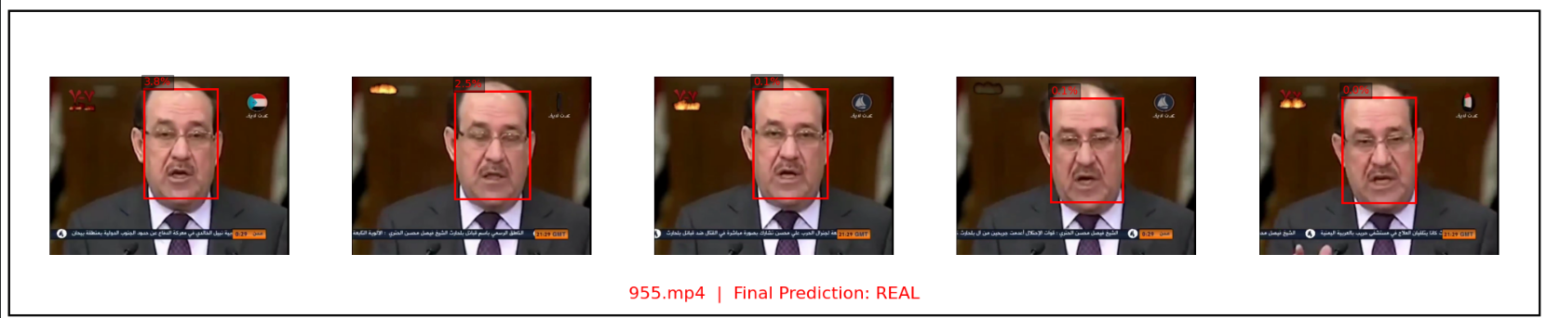
Results

Slide 19
Demo

Slide 20

Challenges
Video Processing
Hardware Limitations
Selecting The Model

Slide 21
Thank You

