Slide 1
Statistics for Data Science
WELCOME TO THIS SESSION
BEFORE WE START:
MAKE SURE YOUR INTERNET WORKS
PLEASE BE ON MUTE
MAKE SURE MY SCREEN IS VISIBLE
Please Ping Ur NAME EMP ID SBU

Slide 2
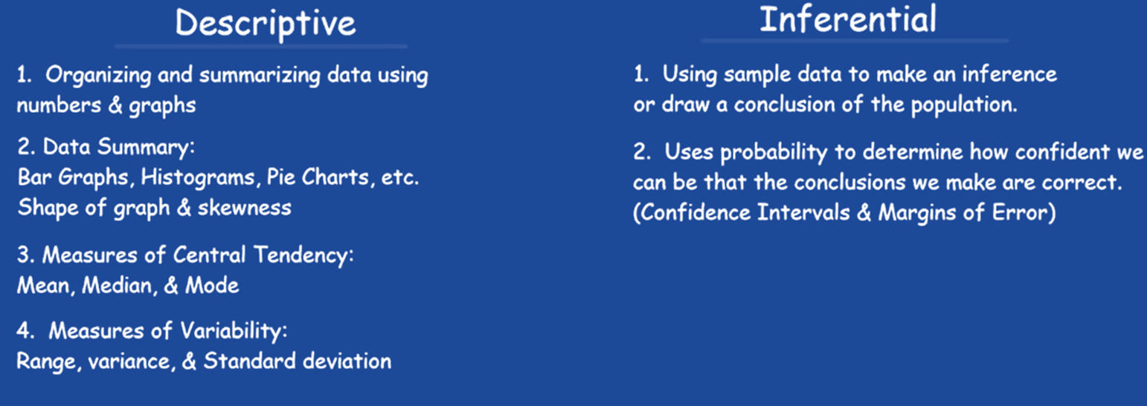
STATISTICS
Statistics is the discipline that concerns the collection, organization, analysis, interpretation and presentation of data
Statistics deals with every aspect of data, including the planning of data collection in terms of the design of surveys and experiments

Slide 3
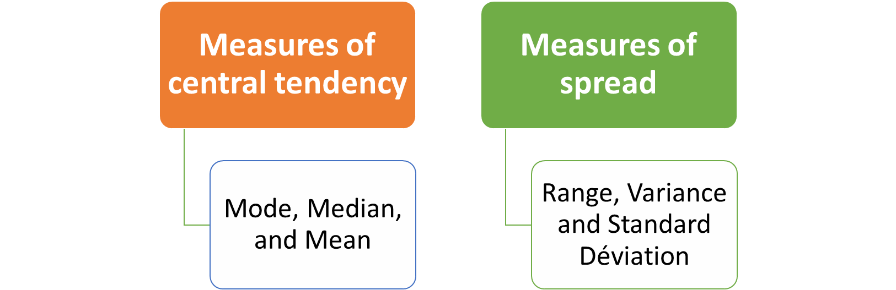
DESCRIPTIVE STATISTICS
Descriptive statistics is the term given to the analysis of data that helps describe, show or summarize data in a meaningful way such that, for example, patterns might emerge from the data
Descriptive statistics do not, however, allow us to make conclusions beyond the data
General type of stats that are used to describe data

Slide 4
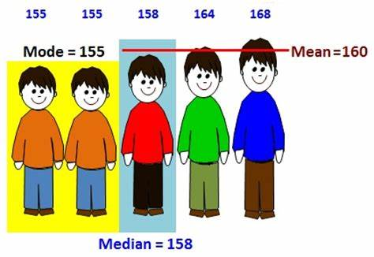
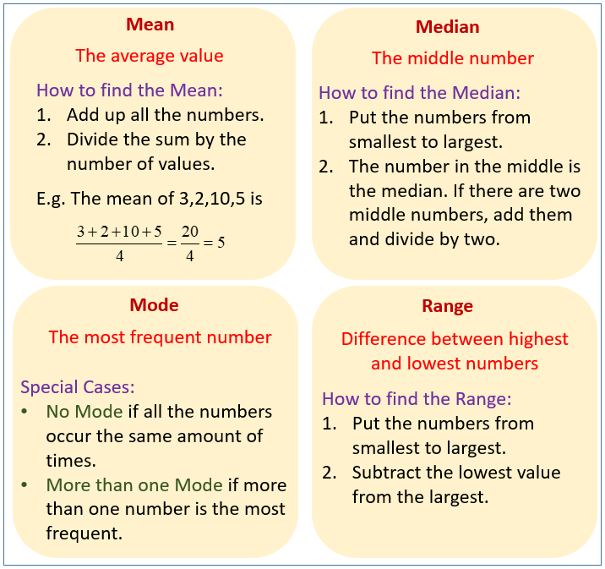
STATISTICS & PROBABILITY
Descriptive Statistics

Slide 5
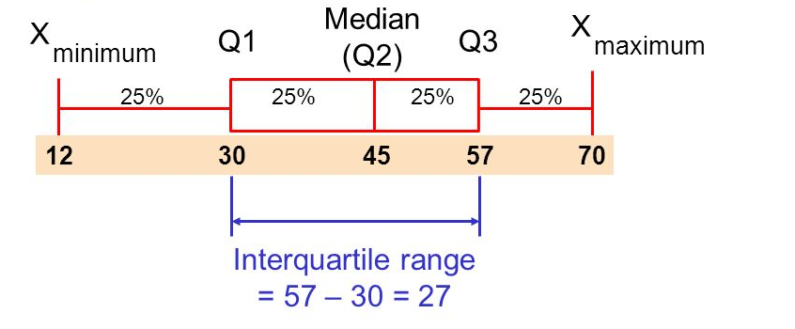
Five Number Summary
STATISTICS & PROBABILITY

Slide 6

DESCRIPTIVE STATISTICS
An Illustration:
Which Group is Smarter?
Class A--IQs of 13 Students
102 115
128 109
131 89
98 106
140 119
93 97
110
Class B--IQs of 13 Students
127 162
131 103
96 111
80 109
93 87
120 105
109
Each individual may be different. If you try to understand a group by remembering the qualities of each member, you become overwhelmed and fail to understand the group.

Slide 7
DESCRIPTIVE STATISTICS
Which group is smarter now?
Class A--Average IQ Class B--Average IQ
110.54 110.23
They’re roughly the same!

Slide 8
Median
Class A--IQs of 13 Students
89
93
97
98
102
106
109
110
115
119
128
131 140
Median = 109
(six cases above, six below)

Slide 9
Median
If the first student were to drop out of Class A, there would be a new median:
89
93
97
98
102
106
109
110
115
119
128
131
140
Median = 109.5
109 + 110 = 219/2 = 109.5
(six cases above, six below)

Slide 10
Median
The median is unaffected by outliers, making it a better measure of central tendency, better describing the “typical person” than the mean when data are skewed.
All of Us
PM/ outlier

Slide 11
Median
If the recorded values for a variable form a symmetric distribution, the median and mean are identical.
In skewed data, the mean lies further toward the skew than the median.
Symmetric
Skewed
Mean
Mean
Median
Median

Slide 12

Mode
The most common data point is called the mode.
The combined IQ scores for Classes A & B:
80 87 89 93 93 96 97 98 102 103 105 106 109 109 109 110 111 115 119 120
127 128 131 131 140 162
It is possible to have more than one mode!
mode!

Slide 13
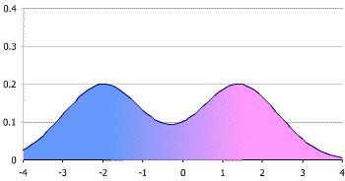
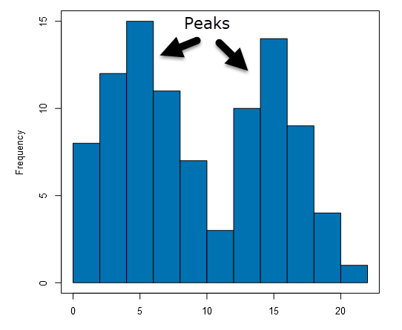
Mode
It may mot be at the center of a distribution.
Data distribution on the right is “bimodal”

Slide 14
Mode
It may give you the most likely experience rather than the “typical” or “central” experience.
In symmetric distributions, the mean, median, and mode are the same.
In skewed data, the mean and median lie further toward the skew than the mode.
Skewed
Symmetric
Median
Mean
Mode
Mode
Median
Mean

Slide 15
Range
To get the range for a variable, you subtract its lowest value from its highest value
Class A--IQs of 13 Students
102 115
128 109
131 89
98 106
140 119
93 97
110
Class A Range = 140 - 89 = 51
Class B--IQs of 13 Students
127 162
131 103
96 111
80 109
93 87
120 105
109
Class B Range = 162 - 80 = 82

Slide 16
Interquartile Range
A quartile is the value that marks one of the divisions that breaks a series of values into four equal parts.
The median is a quartile and divides the cases in half
25th percentile is a quartile that divides the first ¼ of cases from the latter ¾.
75th percentile is a quartile that divides the first ¾ of cases from the latter ¼.
The interquartile range is the distance or range between the 25th percentile and the 75th percentile. Below, what is the interquartile range?
25%
25%
25% of cases
25% of cases
0 250 500 750 1000

Slide 17
Variance
A measure of the spread of the recorded values on a variable. A measure of dispersion.
The larger the variance, the further the individual cases are from the mean.
The smaller the variance, the closer the individual scores are to the mean.
Mean
Mean

Slide 18
Variance
Variance is a number that at first seems complex to calculate.
Calculating variance starts with a “deviation.”
A deviation is the distance away from the mean of a case’s score.
Yi – Y-bar
If the average person’s car costs $20,000, my deviation from the mean is - $14,000!
6K - 20K = -14K

Slide 19
Variance
The deviation of 102 from 110.54 is? Deviation of 115?
Class A--IQs of 13 Students
102 115
128 109
131 89
98 106
140 119
93 97
110
Y-bar_{A} = 110.54

Slide 20
Variance
The deviation of 102 from 110.54 is? Deviation of 115?
102 - 110.54 = -8.54 115 - 110.54 = 4.46
Class A--IQs of 13 Students
102 115
128 109
131 89
98 106
140 119
93 97
110
Y-bar_{A} = 110.54

Slide 21
Variance
We want to add these to get total deviations, but if we were to do that, we would get zero every time. Why?
We need a way to eliminate negative signs.
Squaring the deviations will eliminate negative signs...
A Deviation Squared: (Yi – Y-bar)²
Back to the IQ example,
A deviation squared for 102 is: of 115:
(102 - 110.54)² = (-8.54)² ⁼ 72.93 (115 - 110.54)² = (4.46)² = 19.89

Slide 22
Variance
If you were to add all the squared deviations together, you’d get what we call the
“Sum of Squares.”
Sum of Squares (SS) = Σ (Yi – Y-bar)²
SS = (Y1 – Y-bar)² + (Y2 – Y-bar)² + . . . + (Yn – Y-bar)²

Slide 23
Variance
Class A, sum of squares:
(102 – 110.54)² + (115 – 110.54)² +
(126 – 110.54)² + (109 – 110.54)² +
(131 – 110.54)² + (89 – 110.54)² +
(98 – 110.54)² + (106 – 110.54)² +
(140 – 110.54)² + (119 – 110.54)² +
(93 – 110.54)² + (97 – 110.54)² +
(110 – 110.54) = SS = 2825.39
Class A--IQs of 13 Students
102 115
128 109
131 89
98 106
140 119
93 97
110
Y-bar = 110.54

Slide 24
Variance
The last step…
The approximate average sum of squares is the variance.
SS/N = Variance for a population.
SS/n-1 = Variance for a sample.
Variance = Σ(Yi – Y-bar)² / n – 1

Slide 25
Standard Deviation
To convert variance into something of meaning, let’s create standard deviation.
The square root of the variance reveals the average deviation of the observations from the mean.
s.d. = Σ(Yi – Y-bar)²
n - 1

Slide 26
Standard Deviation
Larger s.d. = greater amounts of variation around the mean.
For example:
19 25 31 13 25 37
Y = 25 Y = 25
s.d. = 3 s.d. = 6
s.d. = 0 only when all values are the same (only when you have a constant and not a “variable”)
If you were to “rescale” a variable, the s.d. would change by the same magnitude—if we changed units above so the mean equaled 250, the s.d. on the left would be 30, and on the right, 60
Like the mean, the s.d. will be inflated by an outlier case value.

Slide 27
A Simple Example
Weights of 10 people : 17,41,45,22,22,8,10,33,38
Arranged values : 8,10,17,22,22,33,38,41,45
Minimum=
(First Quartile)Q1=
(Third Quartile)Q3=
Maximum=
IQR(Q3-Q1) =
S.d:
Range =
Mean =
Mode =
Median =

Slide 28
A Simple Example
Weights of 10 people : 17,41,45,22,22,8,10,33,38
Arranged values : 8,10,17,22,22,33,38,41,45
Minimum=8 Q1=17
(First Quartile)Q1=17,
(Third Quartile)Q3=38
Maximum=45
IQR(Q3-Q1) = 21
S.d: 12.786953227392
Range = 37
Mean = 26.22
Mode = 22
Median = 22

