Slide 1
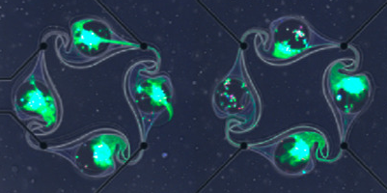


Reinforcement learning and biological networks
Stephan J. Ihle
Eric and Wendy Schmidt AI-Postdoctoral Fellowship
Biological Science Department
Physical Science Department
Data Science Institute University of Chicago

Slide 2
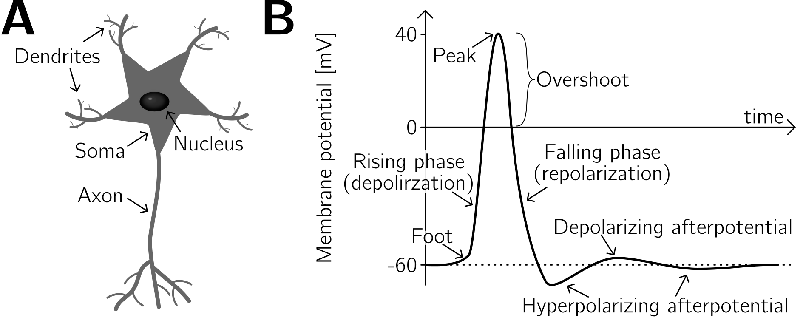
How neurons work
Adapted: Plosney and Barr, Springer Science, 2007
Hille, Biophysical journal, 1992

Slide 3
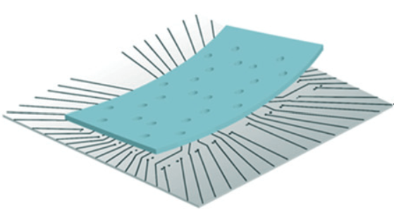
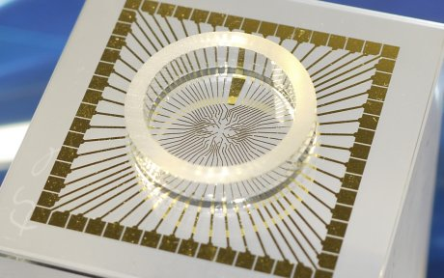
Culturing neurons in a dish
Microelectrode array for
neuronal recording
Microstructure to constrain growth
multichannelsystems.com
Forró et al., Biosensors and Bioelectronics, 2018

Slide 4
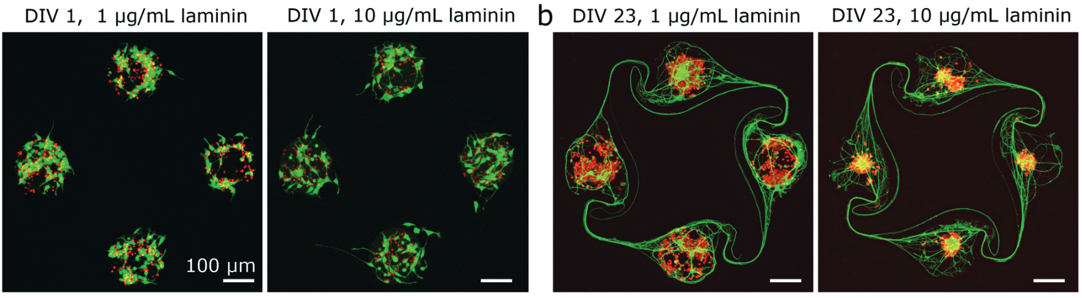
Culturing neurons in a dish
Girardin et al., Lab on a Chip, 2022

Slide 5
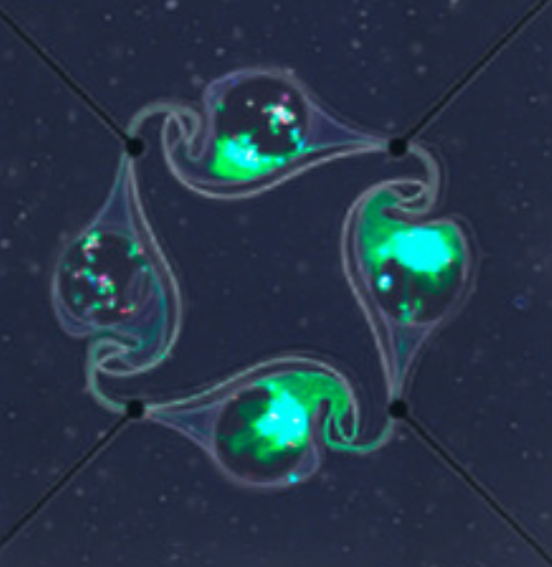
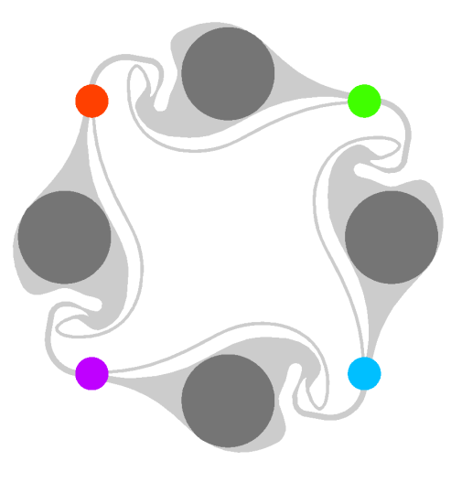
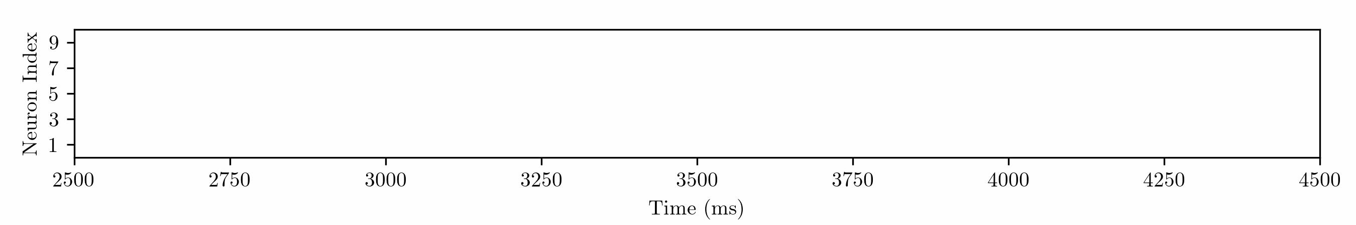
Measuring neuronal activity
Ihle et al. 2022

Slide 6
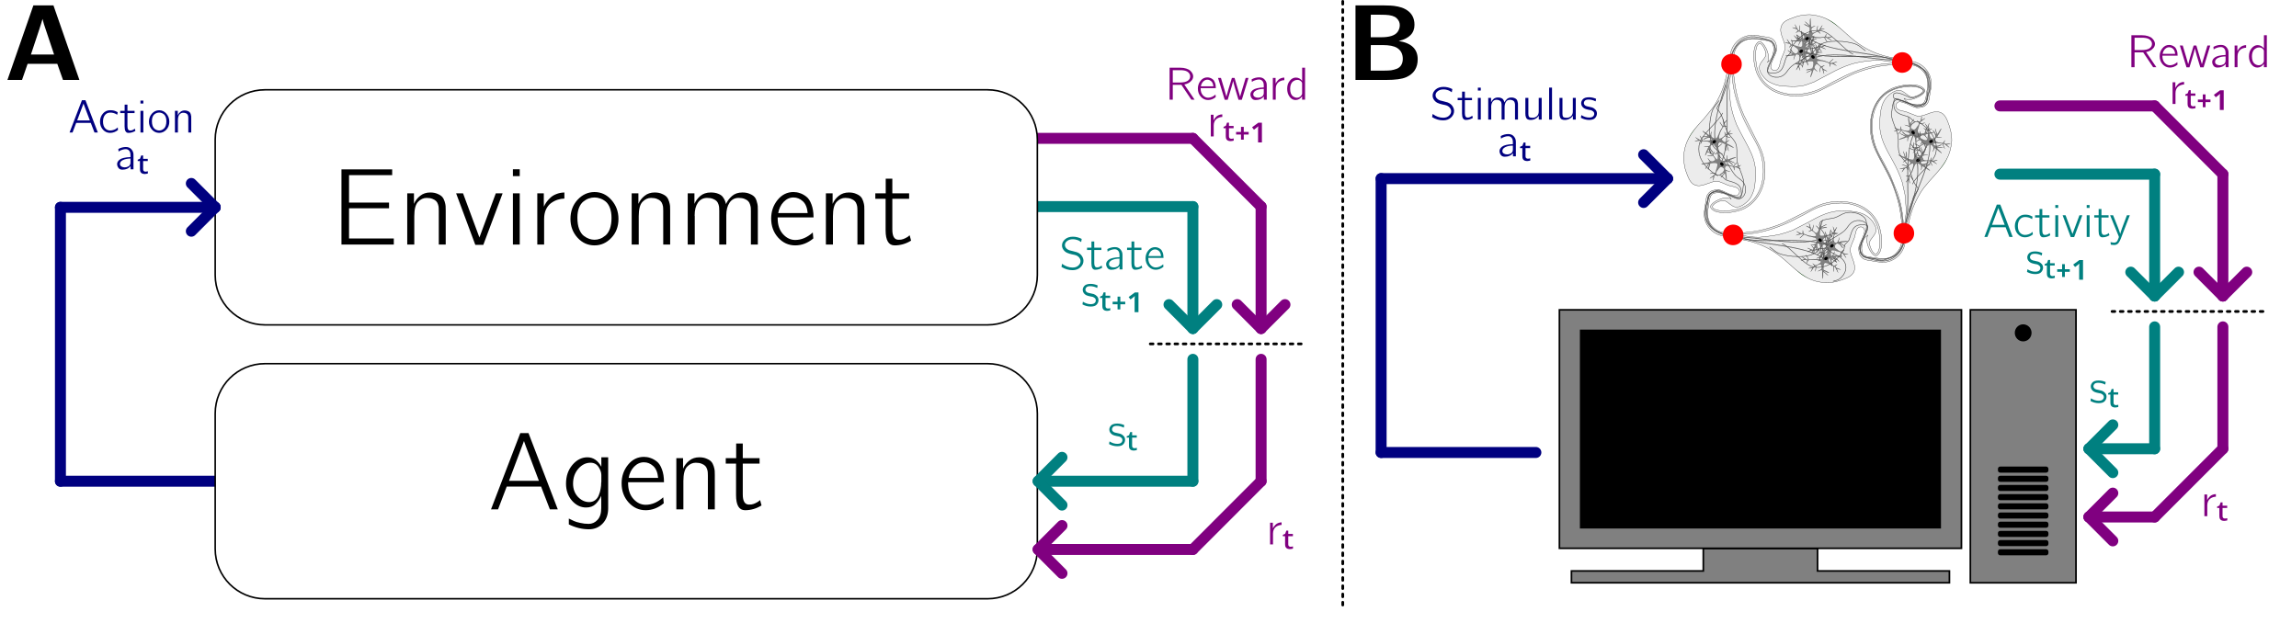
Reinforcement learning
The network is stimulated every 250 ms

Slide 7
What actions should you use?
1
2
You have up to 5 slots per action.
Each slot can have value 0 (no stimulus), or numbers 1,2,3,4
4
3
Example pattern:
1 | 0 | 4 | 3 | 4
Elec 1
Elec 2
Elec 3
Elec 4
Advice:
Especially at the beginning, do not use all 5 slots, but only the last 1,2, or 3

Slide 8
What states should you use?
There are different state functions.
Reward functions can be static (easier) or dynamic (harder). Dynamic functions need to be trained on the data but contain in general more useful information.
There exists 2 jupyter notebook examples with these two types of functions.
Attention:
Your state representation may not be complete
Your state is not necessarily Markovian
Bonus task:
Write your own state function (you will likely perform much better)
Can you figure out an approach to use the spiking activity directly as a state?

Slide 9
What reward function should you use?
1
2
Linear reward:
+1 if 2 spikes are clockwise (and Δt < 5 ms)
-1 if 2 spikes are counter - clockwise (and Δt < 5 ms)
4
3
+1
+1
+1
+1
+1
-1
0
0
0
+1
+1
-1
Elec 1
Elec 2
Elec 3
Total: 5
Elec 4
time
0
5
10
15
20
Bonus task:
Write your own reward function (you will likely perform much better)

Slide 10
Your final score:
Send me your code by 5pm on XX/XX: ihles@uchicago.edu
We will run your code directly on our setup. It will run for exactly 2 hours on a network (28800 actions). The final score will be your average reward over the last 30 min of this time period (7200 actions).
For the reward function, we are using: “linear_reward()”
Todo: 8 min presentation
Scoring criteria

Slide 11
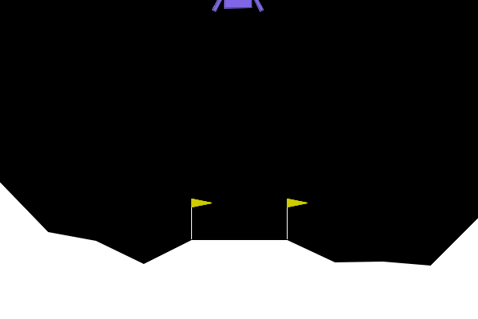
Important consideration: Use RL gymnasium
https://gymnasium.farama.org/index.html

Slide 12
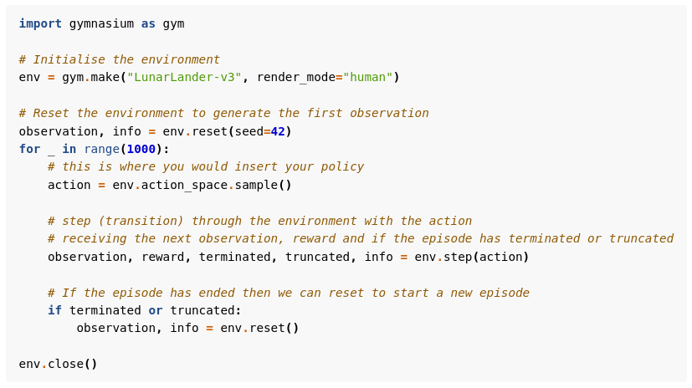
Important consideration: Use RL gymnasium
https://gymnasium.farama.org/index.html

Slide 13
Important consideration: We are data limited
At the end, you will have 28800 stimulation events (actions) in total (of which your performance is judged on the last 7200).
Action space size:
5⁵ = 3125 Action space is huge for RL
Rule of thumb:
Use small networks!
Number of weights in network should be sqrt(samples) →170
Use experience replay:
https://deeplizard.com/learn/video/Bcuj2fTH4_4
https://arxiv.org/abs/2007.06700

Slide 14
Important consideration: We are time critical
Stim.
Rec.
Process.
Recv.
Prediction
Sending
Stim.
time
0 ms
10 ms
30 ms
50 ms
100 ms
200 ms
250 ms
Stimulation:
Requires 10 ms
Recording:
We look at 20 ms of neuronal activity
Processing:
Spike detection / clustering takes 20 ms
Receiving data:
From laboratory computer to RCC (50 ms)
Prediction:
You have roughly 100 ms to decide on your next action
Sending data:
From RCC to laboratory computer (50 ms)
Use 1 network to decide on your next action and (at least) one network for training!
Why/how to use multiple networks: https://pytorch.org/tutorials/intermediate/reinforcement_q_learning.html

Slide 15
Happy Hacking!
Questions?

