Slide 1



Reinforcement learning and biological networks
Stephan J. Ihle
Eric and Wendy Schmidt AI-Postdoctoral Fellowship
Biological Science Department
Physical Science Department
Data Science Institute University of Chicago

Slide 2
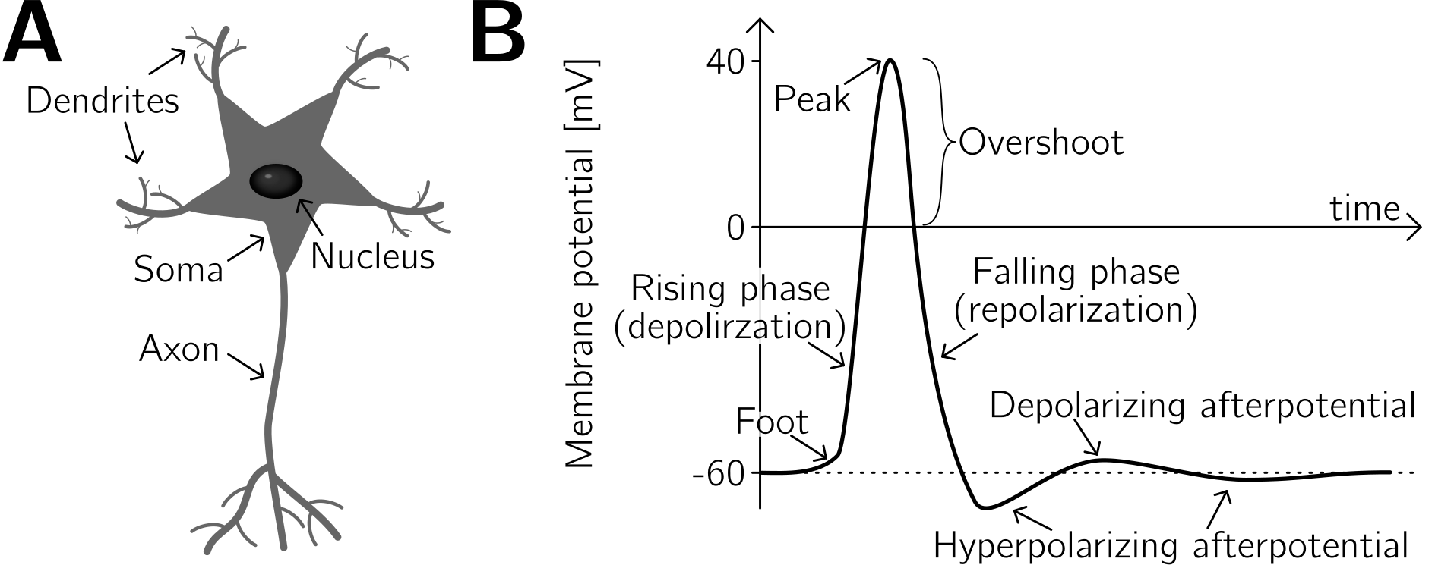
How neurons work
Adapted: Plosney and Barr, Springer Science, 2007
Hille, Biophysical journal, 1992

Slide 3
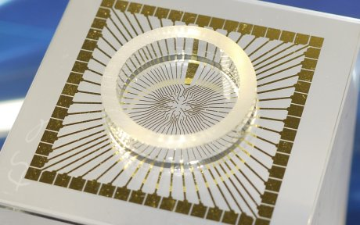
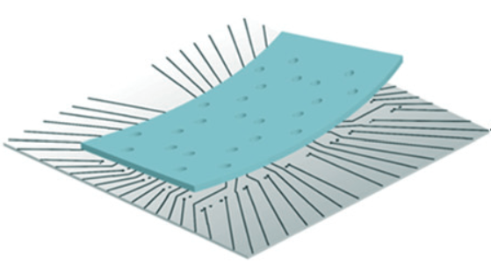
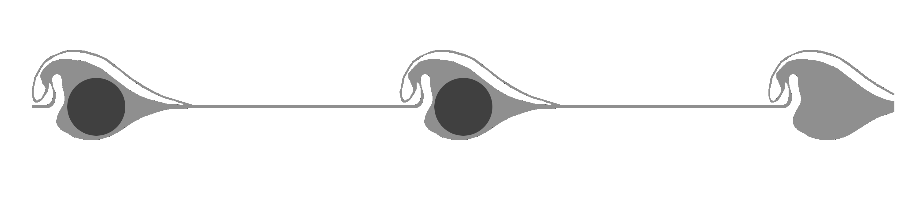
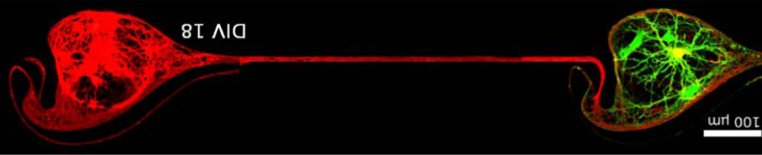
Culturing neurons in a dish

Slide 4
Looking at spiking activity

Slide 5
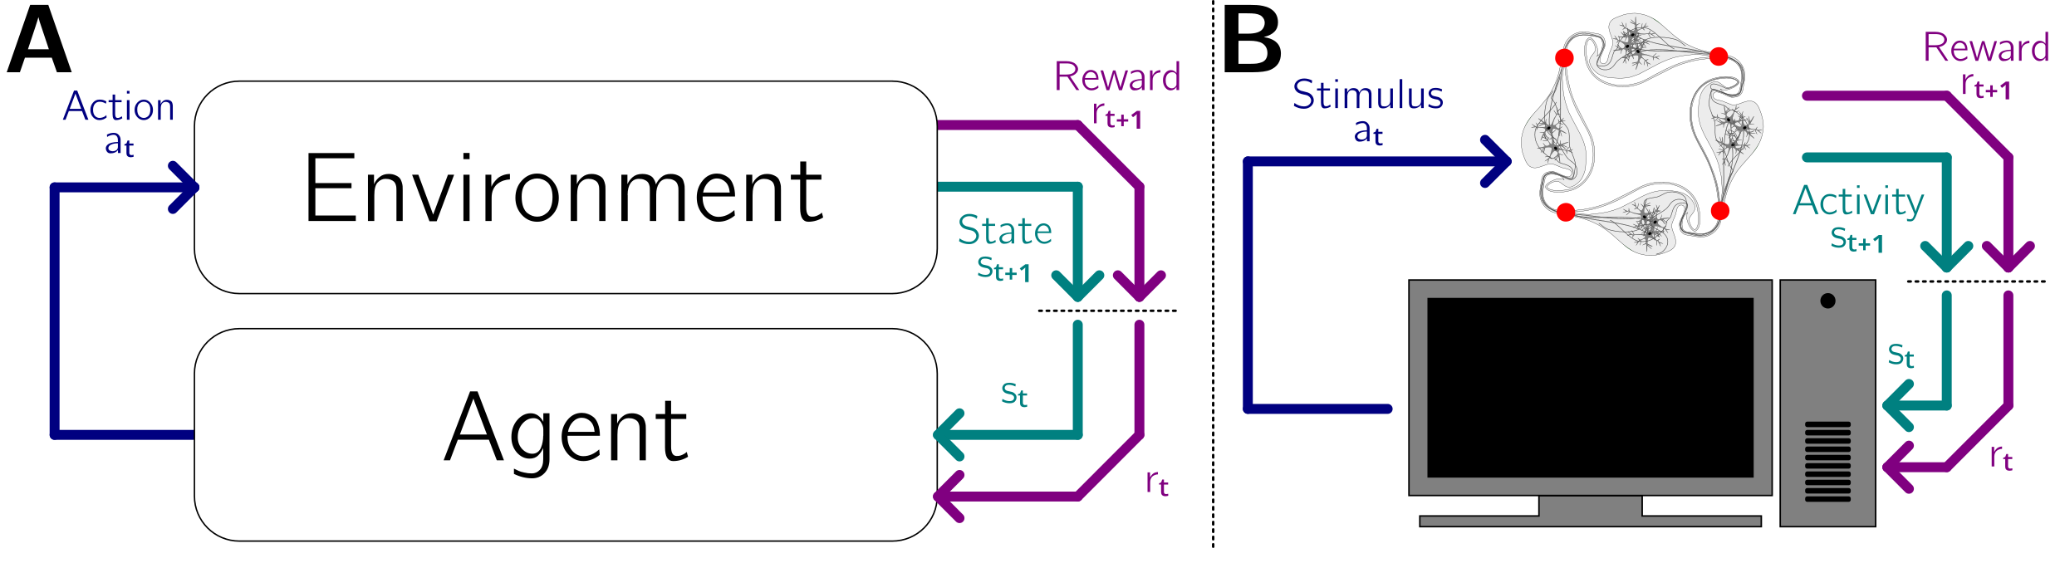
Reinforcement learning
The network is stimulated every 250 ms

