Slide 1

DEPARTMENT OF COMPUTER SCIENCE ( Session : January – May 2016 )
PROJECT REPORT ON COURT CASE DATABASE

Slide 2
SUBMITTED BY:
Ankit D Prabhu (01FB14ECS034)
Ashutosh Singh (01FB14ECS049)
Chetan Agarwal(01FB14ECS058)
PROGRAM : B.TECH. – CSE SEMESTER: IV SECTION: A

Slide 3
DESCRIPTION:
Court case database system has been designed by us to make the judicial study easier, it can be used to access details about the case, the client involved, the attorneys as defence and prosecutor, the court in which the case is pending and the judge presiding over the court.

Slide 4
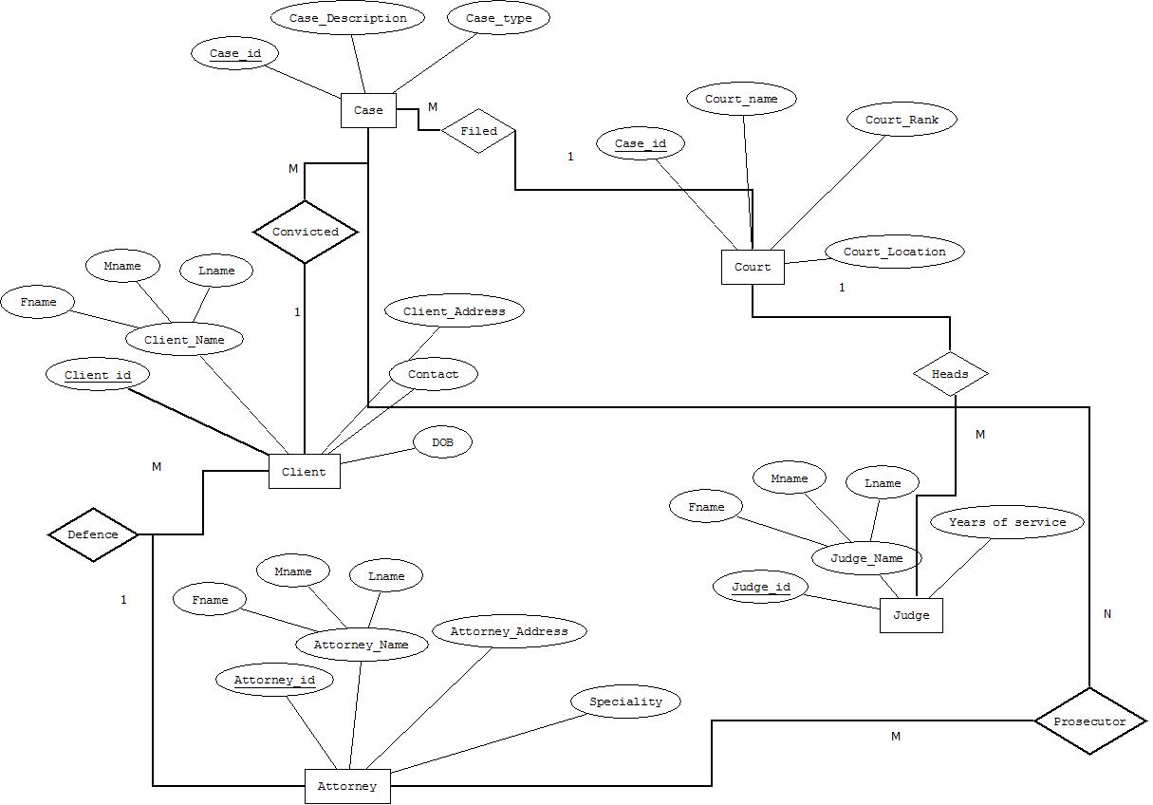
ER-DIAGRAM:-

Slide 5
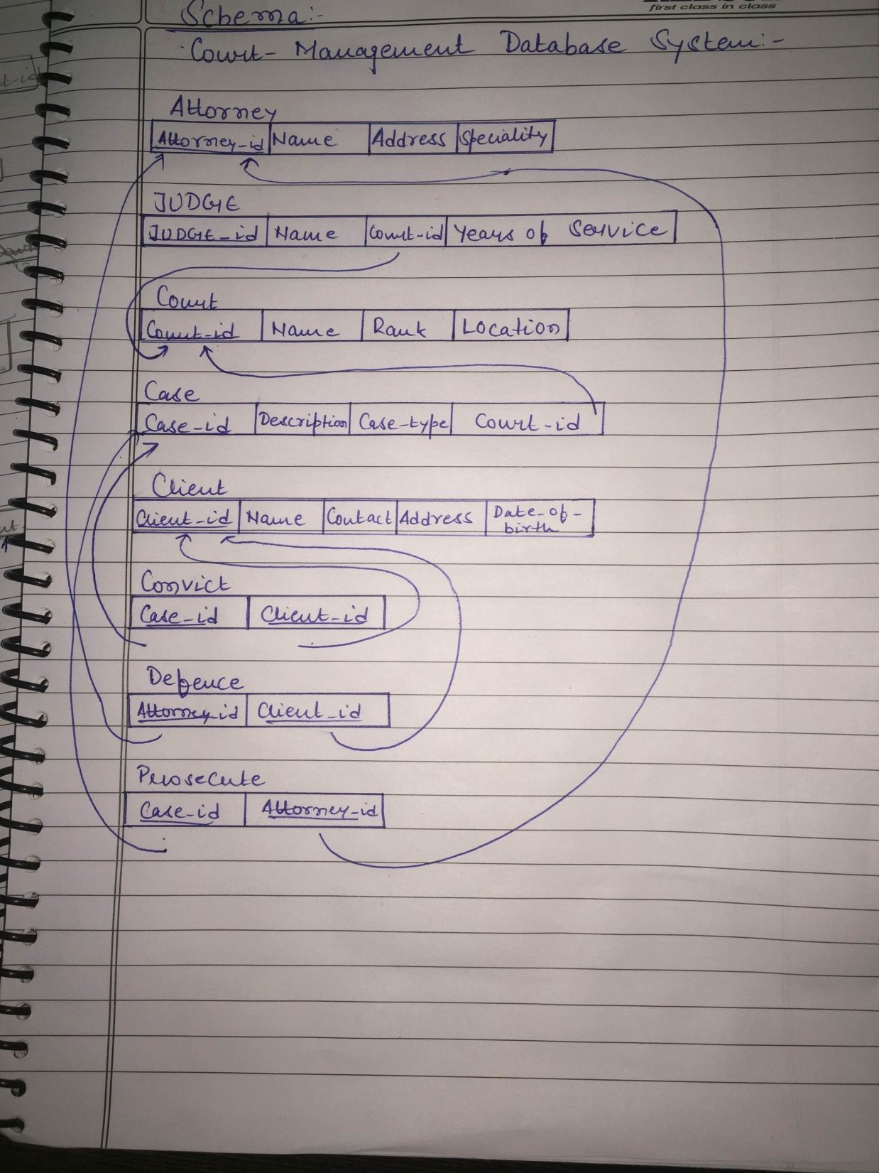
Schema:-

Slide 6
Queries:-
UPDATE:-
1. Update case information
2. Update judge information
INSERT
1. New case in the database
SEARCH
Case information
2. Table based on case type
3. Table with defence and client relation
4 Defence, client and prosecutor for a particular case id
Look for attorneys with their specialization.
Obtain judge information

Slide 7
THANK YOU ALL!
☺

