Slide 1


Consulting Proposal for Padgilwar Corporation
Discover . Learn . Evolve

Slide 2
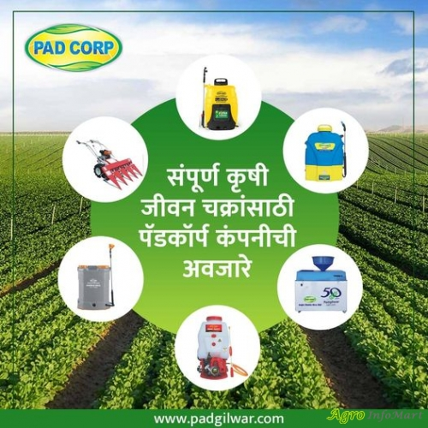
Padgilwar Corporation Overview
PadCorp was aware of acute labour shortage problem faced by small farmers across country. To solve the problems of these farmers, PadCorp introduced Affordable and Purpose serving Agricultural Equipments.
Delivering agricultural equipments for more than 60 years.
Providing Top Quality Agricultural Products
All products are Tested and Checked
Top Quality Finished Accessories
Easily Available Spare Parts
Farmers’ Trusted Brand
1200+ Dealer Across India

Slide 3
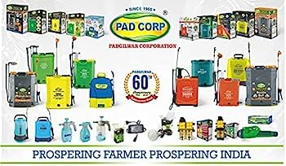
PadCorp Products
Product Category | Product Subcategory
Battery Sprayers | Battery Operated Sprayer 2IN1 Battery Operated Sprayer Double Motor Sprayer Portable Sprayer Cum Car Washer
Manual & Garden Sprayers | Manual Sprayers Manual Garden Sprayers Battery Operated Garden Sprayers
Engine Operated Sprayers | Knapsack Engine Sprayers HTP Engine Sprayers Portable Engine Sprayers
Machinery & Others | Fogging Machine Plant Trimmer & Seeding Machine Earth Auger Crop Cutter
Products Category | Product Subcategory
Accessories | Spare Parts Sprayer Batteries Crop Cutter Accessories Sprayer Gun & Lance
Equipments | Pressure Hose Pipe Tarpaulin Trap Pad Auto Switch Safety Products
Garden & Tools | Gardening Sprayer Gardening Tools

Slide 4
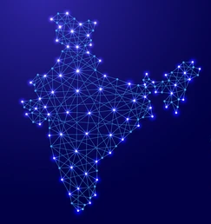
Proposal Objective
Enhance the digital presence and engage more agricultural product dealers for PadCorp across India.
Deliver best digital marketing services to PadCorp and its dealers.

Slide 5
PadCorp Current Online Presence
YouTube | 10.3K Subscribers 229 Videos
LinkedIn | 524 Followers 9 Employees Massive activities 2 yrs back
Facebook | 30K Followers 29K likes Extensive activities on platform
Instagram | 1429 Followers 737 Posts Extensive activities on platform
Twitter | 14 followers Extensive activities on platform

Slide 6

Proposed Solution
360° Digital Marketing Services: Strategy + Comprehensive Approach

Slide 7
Target Clientele
Wholesalers, Retailers, Dealers of Agricultural Products across India
Owners of
Farmlands
Orchard
Gardens
Urban Greening Agencies

Slide 8
Deliverables
PadCorp
Run Digital Campaign for new dealer engagement on all platforms
Google Ads/ Paid Ads on agriculture related platforms
Relevant keywords for stronger SEO to attract organic traffic across geographies
WhatsApp, Email Marketing to potential dealers
Run advertisement on local news channel for better reach in geographies

Slide 9
Deliverables
Existing and New Dealers
Website development and maintenance
SEO in respective geographies
Content creation: Blogs, Posts, Reels, Videos, Infographics
Social media engagement on relevant platforms
Native online advertising
Localized Marketing: Tailor marketing efforts to specific regions in India to address local needs and preferences.

Slide 10
Thank you
Discover . Learn . Evolve
www.globalinfocloud.com

