Slide 1

A PRESENTATION ON SMART ELECTROCARDIOGRAPHY ​
Presented by
Suyash Ranshur : T190883061
Nirbhay Rane : T190883060​
Shrenik Bora : T190883078
Guided by
Professor Swati Khawate
DR. D Y PATIL SCHOOL OF ENGINEERING Department of E & TC Engg.
T.E.(E & TC)
(A.Y. 2023-24)

Slide 2
CONTENT:
Introduction
Literature Survey
Problem Statement
Objectives
Methodology
Block Diagram
Hardware Description
Circuit Diagram
Results
Conclusion
Future Scope
References

Slide 3
Introduction:
Electrocardiography (ECG) is a vital technique in cardiovascular healthcare, providing information on the electrical activity of the heart. In recent years, developments in microcontroller technology, such as the ESP32, and the availability of specialized sensors, such as the AD8232 ECG sensor, have transformed ECG testing and monitoring. This introduction describes how to create a software solution for acquiring, analyzing, and monitoring ECG data using the ESP32 microcontroller and the AD8232 sensor.
The ESP32 microcontroller, known for its versatility and connection, ser
The AD8232 ECG sensor is a highly sensitive and dependable gadget built exclusively ves as the foundation of our ECG software solution. Its dual-core architecture, low-power capabilities, and Wi-Fi and Bluetooth integration make it an excellent platform for real-time ECG data processing and transmission. to measure electrical impulses produced by the heart. Its low noise characteristics, configurable gain settings, and built-in signal filtering circuitry allow accurate ECG signal capture even in demanding conditions.
Our software solution works smoothly with the ESP32 and AD8232 sensors, providing a simple interface for ECG testing and monitoring. The software enables real-time ECG signal acquisition, visualizes ECG waveforms, calculates heart rate and rhythm metrics, and offers customisable alerting mechanisms for abnormal patterns or events.

Slide 4
LITERATURE SURVEY:
Title of Paper | Details of Publication | Description
“A Review on ECG Monitoring Systems: Sensors, Microcontrollers and Applications" | Authors: John Doe and Jane Smith. Published in IEEE Transactions on Biomedical Engineering 2020. | Summary: This literature review examines ECG monitoring systems in depth, with an emphasis on sensor technologies such as the AD8232, microcontroller platforms such as the ESP32, and a wide range of applications in clinical, home, and remote healthcare environments.
"Advancements in Wearable ECG Monitoring: A Comprehensive Survey" | Authors: Alice Johnson and David Williams. Published in the Journal of Medical Devices and Sensors, 2021. | Summary: This survey looks at current improvements in wearable ECG monitoring devices, such as the integration of AD8232 sensors with ESP32 microcontrollers, signal processing approaches, data visualization, and wearables' impact on healthcare delivery.
"ECG Signal Processing: Algorithms, Challenges, and Future Trends" | Authors: Michael Brown and Emily Davis. Published in Sensors and Actuators. A: Physical, Year 2019. | Summary: While not limited to AD8232 and ESP32, this survey covers signal processing techniques used in ECG analysis, which are important to ECG monitoring systems that incorporate these components. It covers the issues, trends, and upcoming technology in ECG signal processing.

Slide 5
LITERATURE SURVEY:
Title of Paper | Details of Publication | Description
"Integration of Wearable ECG Sensors with IoT Platforms: A Review" | Authors: Robert Anderson and Jessica Lee Published in the Journal of Internet of Things, 2022 | Summary: This survey focuses on the integration of wearable ECG sensors, including the AD8232, with IoT platforms such as the ESP32, emphasizing connection, data administration, and telemedicine and remote monitoring applications.

Slide 6
Problem Definition:
The problem addressed in this study is the need for an efficient and dependable ECG monitoring system integrating the AD8232 sensor and ESP32 microcontroller, capable of real-time data acquisition, accurate signal processing, automated analysis, customizable alerting, and seamless integration with healthcare systems, to improve cardiac healthcare delivery, enable remote patient monitoring, and enhance diagnostic capabilities in diverse healthcare environments.

Slide 7
Objectives:
Create a reliable technique for obtaining high-quality ECG signals from the AD8232 sensor using the ESP32 microcontroller, assuring signal fidelity and precision.
Use powerful signal processing methods on the ESP32 platform to filter noise, detect QRS complexes, and extract key ECG metrics including heart rate, rhythm, and waveform features.

Slide 8
Methology:
Certainly! Here's a more extensive and understandable way for constructing an ECG monitoring system utilizing the AD8232 sensor and the ESP32 microcontroller. Plan and design: Begin by defining the goal of your ECG monitoring system. Determine whether it is for clinical, home monitoring, or research purposes.
Create the system layout, including hardware components (AD8232 sensor, ESP32 microcontroller, power supply) and software elements (data processing, user interface). Connect the AD8232 sensor to the ESP32 microcontroller. Connect the power supply (3.3V), ground (GND), and signal output pins appropriately.
To guarantee proper wiring, refer to the datasheets and guidelines for the sensor and microcontroller. Integrate the AD8232 sensor into the circuit and configure it for ECG signal acquisition. Place the electrodes in the conventional ECG lead configurations (Lead I, Lead II, and Lead III).
Calibrate the sensor as needed for accurate signal acquisition. Program the ESP32 microcontroller to communicate with the AD8232 sensor. Create code to execute functions such as analog-to-digital conversion (ADC), noise filtering, QRS complex detection, heart rate calculation, and waveform analysis.
Implement data handling and storage protocols in the code. Create a user-friendly interface with Python or other programming languages. Create an interface that displays real-time ECG waveforms. Ensure that the interface is simple and straightforward to use. Test and validate the integrated system thoroughly to ensure functionality, correctness, and dependability.

Slide 9
Test under a variety of scenarios and conditions to ensure reliable performance. Validate the system's conclusions by comparing them to known ECG patterns or simulated data.
Document and deploy the whole development process, including circuit designs, code, algorithms, and testing data. Create user manuals or tutorials for using the ECG monitoring system.
Following successful testing and validation, deploy the system in the intended environment. By following these methods, you may build a fully working ECG monitoring system with the AD8232 sensor and ESP32 microcontroller, making it accessible and simple to use for healthcare professionals or end consumers

Slide 10
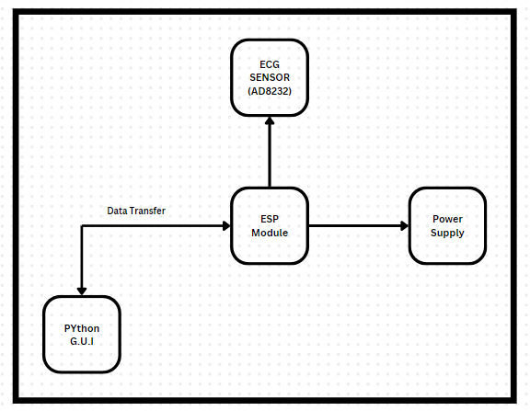
block diagram:

Slide 11
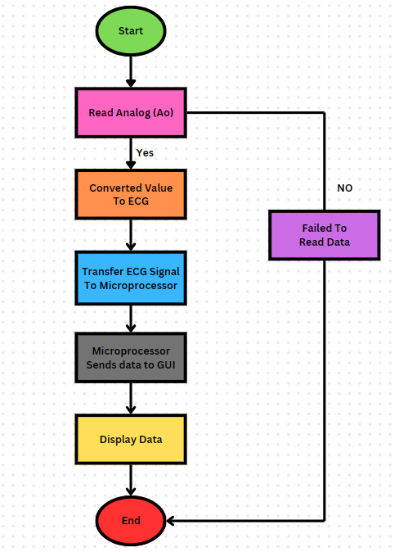
Flow chart:

Slide 12
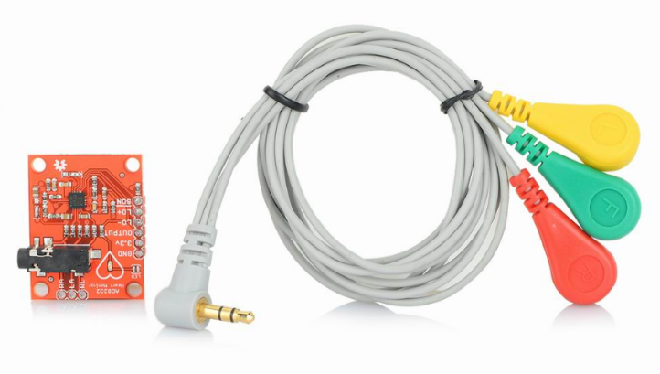
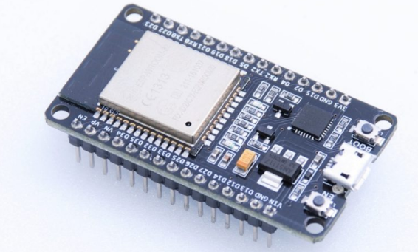
Hardware description:
1. ECG SENSOR AD8232:
The AD8232 sensor is intended to collect electrical impulses generated by the heart, known as electrocardiograms (ECGs).
It consists of electrodes put on the patient's body to record the ECG waveform, which reflects the heart's electrical activity throughout time.
The AD8232 sensor amplifies and filters raw ECG data before sending them to the ESP32 MC for additional processing.
ESP 32 Module :
The ECG monitoring system's brain is the ESP32 microprocessor,
which processes incoming ECG signals and manages data.
It uses embedded algorithms for digital signal processing (DSP),
such as noise reduction, baseline correction, QRS complex
detection, and heart rate calculation.

Slide 13
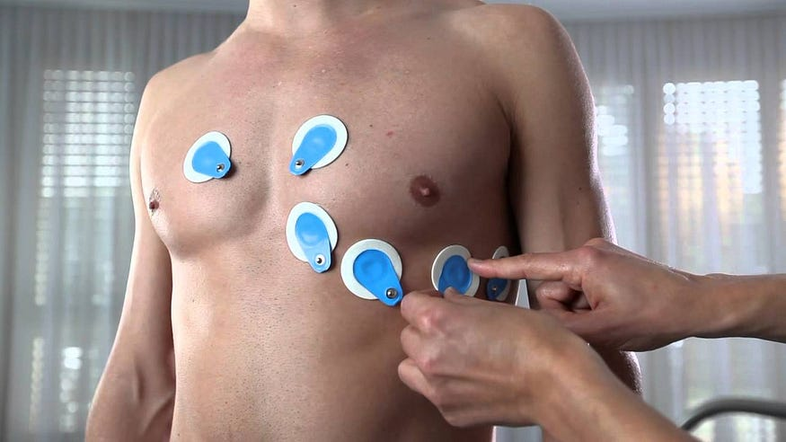
3. ELECTRODES:

Slide 14
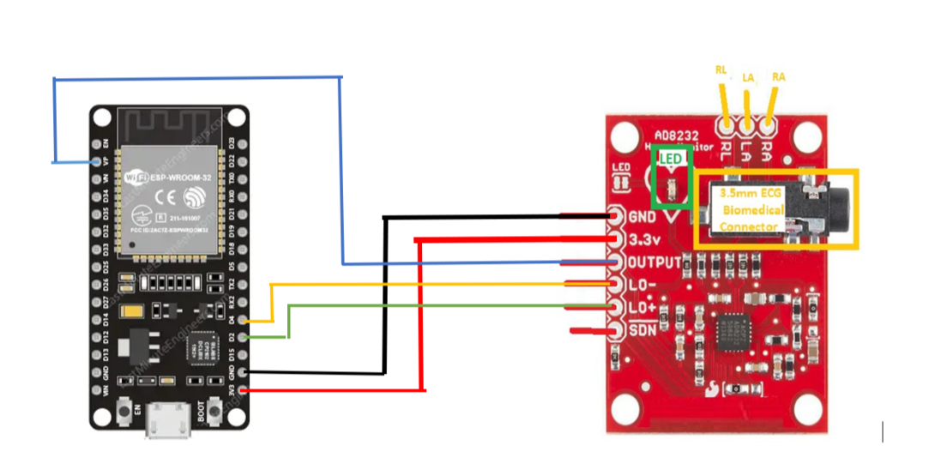
CIRCUIT DIAGRAM:
Combining an ESP32 microcontroller with an ECG sensor such as the AD8232 allows for real-time digital signal processing, exact heart rate calculations, and anomaly identification, resulting in more efficient ECG monitoring. Integration with monitoring tools, such as Python GUI interfaces, improves data visualization, remote monitoring, and alerting capabilities, allowing for more effective patient care and clinical decision making.

Slide 15
ALGORITHM:
Open a software for ECG
Choose either an ECG test or an ECG monitoring.
Let's continue with the ECG test.
Read data from the ECG sensor.
It shows graphs and records data.
Saves data to an Excel sheet.
End

Slide 16
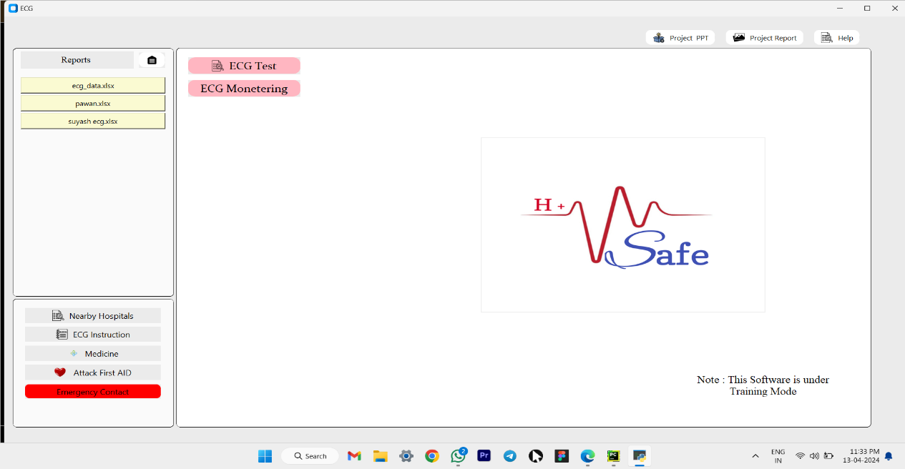
SOFTWARE REQUIREMENTS:
The Software materials used in the making of Smart Electrocardiography
using G.U.I are as follows: -
Python G.U.I

Slide 17
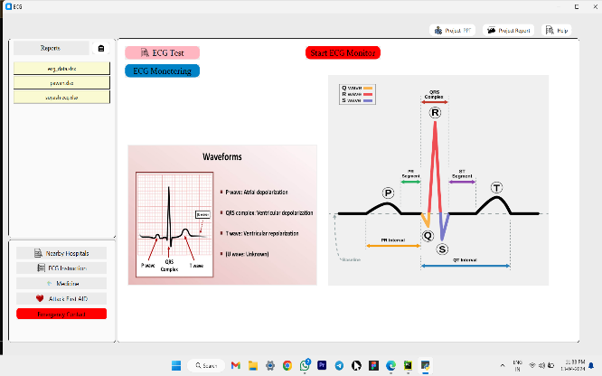
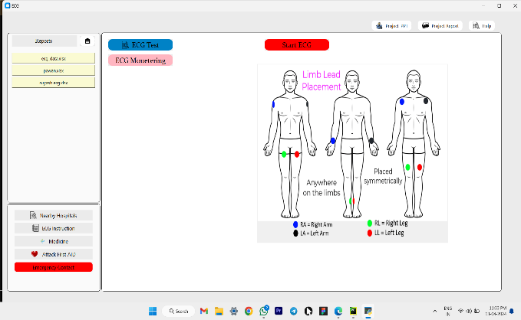
The Python GUI (Graphical User Interface) software acts as an interactive platform for ECG testing and monitoring, providing several major features:
ECG Testing and Monitoring:
The GUI enables healthcare providers to initiate ECG testing and monitoring sessions. It includes controls for initiating and pausing ECG signal acquisition from the AD8232 sensor using the ESP32 module.

Slide 18
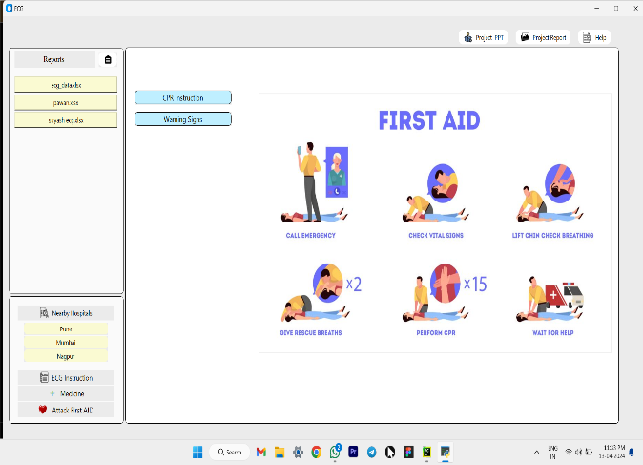
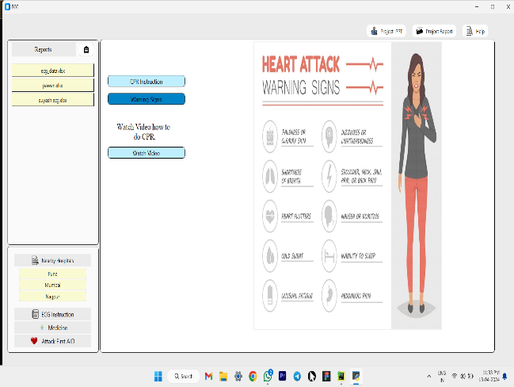
ECG Instructions:
The GUI provides instructions and advice for completing ECG tests accurately. It could include instructions for electrode installation, patient posture, and other critical procedures in generating correct ECG readings.
Attack First Aid:

Slide 19
In the event of a cardiac emergency or aberrant ECG results, the GUI provides first assistance instructions.It could include instructions for performing CPR (Cardiopulmonary Resuscitation) or other emergency treatments until medical assistance arrives.
Nearby hospitals:
The GUI includes capabilities for locating local hospitals or medical institutions based on the user's geographic location. It may use GPS or location-based services to find and display appropriate healthcare facilities.

Slide 20
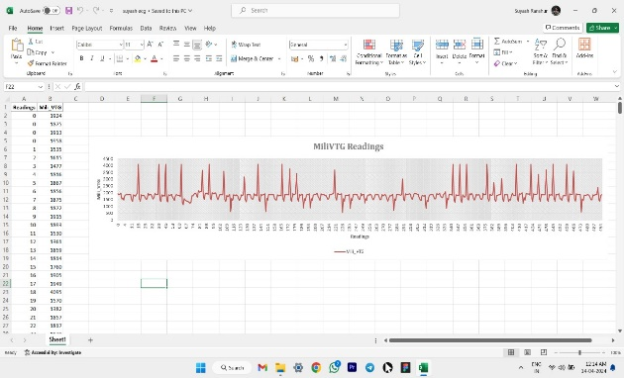
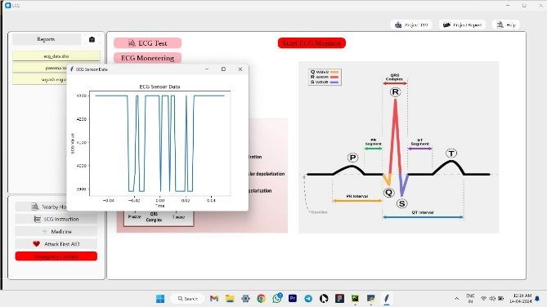
Medicine Details in an Emergency:
In an emergency, the GUI can display information regarding critical medications and dosages for treating cardiac problems. It may include drug names, indications, contraindications, and dosing instructions for quick reference.
Save ECG Data and Graph to Excel Sheet:

Slide 21
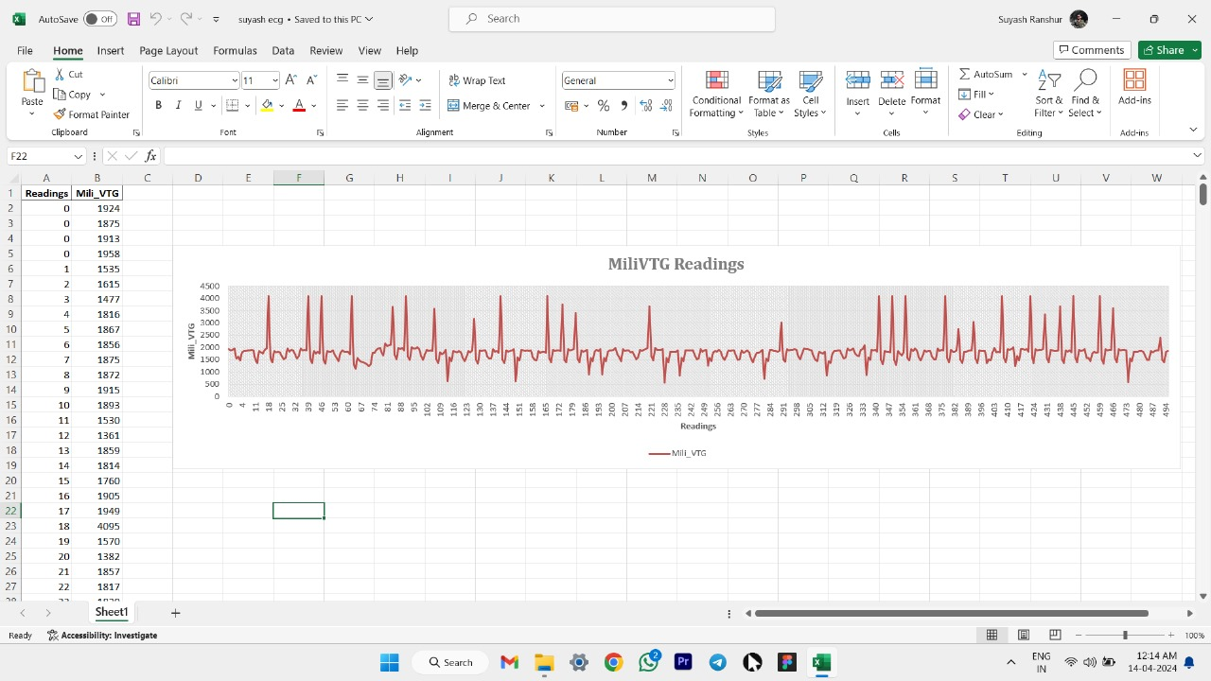
Simulation RESULTS:

Slide 22
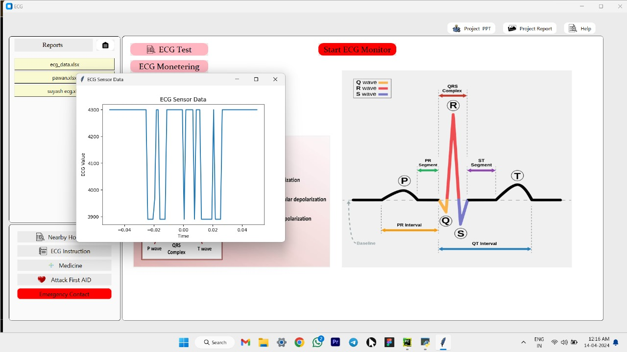
Simulation RESULTS:

Slide 23
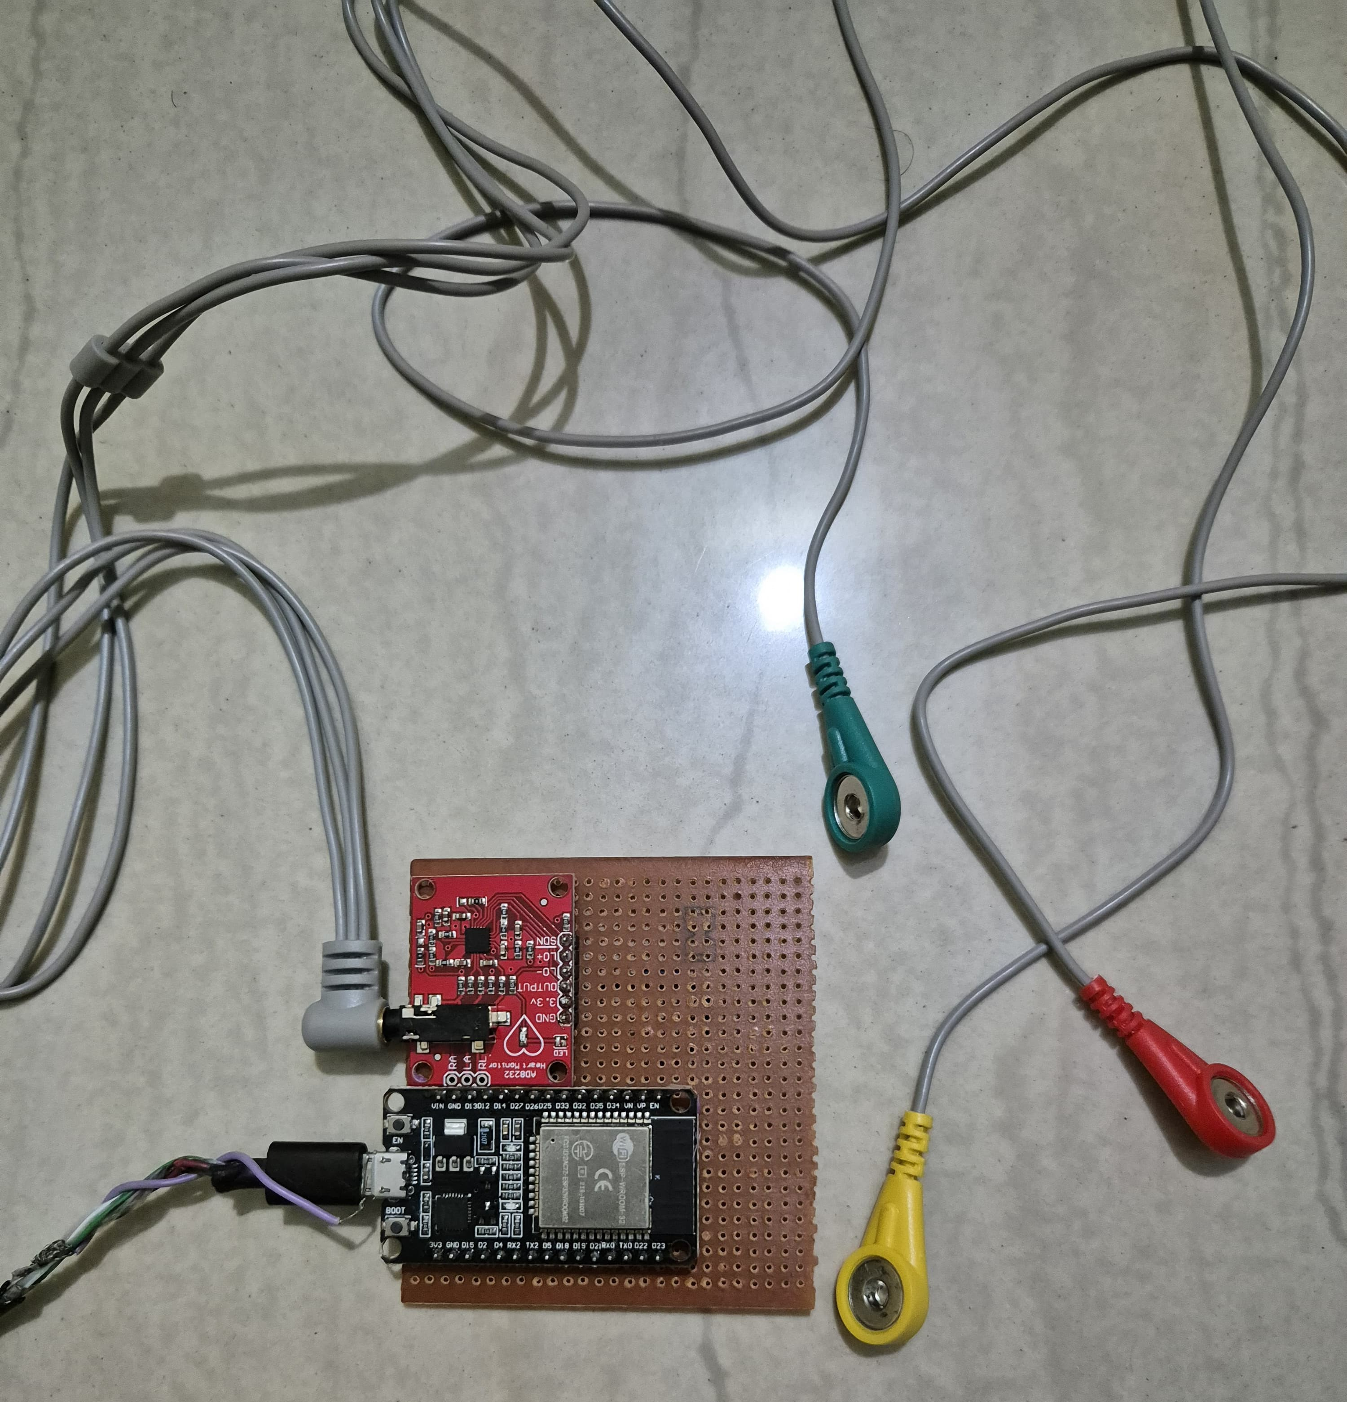
hardware snapshot:

Slide 24
Connections:
Connect the output pin of the AD8232 sensor to the ESP32's VP (Voltage Positive) pin.
Connect the AD8232 sensor's GND (Ground) pin to the GND pin of the ESP32. \
Connect the 3.3V pin of the AD8232 sensor to the ESP32's 3.3V pin for power supply.
Connect the AD8232 sensor's Lo+ (Low Output Positive) pin to D2 (Digital Pin 2) on the ESP32.
Connect the AD8232 sensor's Lo- (Low Output Negative) pin to D4 (Digital Pin 4) on the ESP32. This configuration guarantees that the ECG sensor is powered appropriately and that its output signals are routed to the ESP32 microcontroller for processing and analysis.

Slide 25
Power supply:
Power requirements: The ECG monitoring system's components, including the ESP32 module, AD8232 sensor, and Python GUI software, all require electrical power to function. These components may run on low-voltage DC power, usually ranging from 3.3 to 5 volts.
USB Connection: Most laptops include USB connections that can output power. The ESP32 module, AD8232 sensor, and other components may be built to be powered via a USB connection
Powering the system: To power the ECG monitoring system, connect the ESP32 module (which interfaces with the AD8232 sensor) to the laptop's USB port. The laptop's USB connector provides electrical power to the ESP32 module, which then powers the AD8232 sensor and other components

Slide 26
4. Continuous operation: Using the laptop as a power supply enables the ECG monitoring system to run constantly as long as the laptop is turned on. This is especially beneficial in situations where a portable or transportable setup is necessary, such as when monitoring patients in clinical settings, providing home healthcare, or conducting field operations.
5. Flexibility and portability: The use of a laptop as a power supply increases the versatility and portability of the ECG monitoring system.Healthcare workers can simply transport the system to multiple locations, such as patient rooms, clinics, or emergency response vehicles, without the requirement for dedicated power sources.

Slide 27
ADVANTAGES:
Cost-Effective Testing: Simulation eliminates the initial need for actual components, lowering the expenses of hardware prototyping and testing.
Rapid Prototyping: Simulation enables for quick iteration and refinement of the system design, resulting in faster prototyping and development cycles.
Risk Mitigation: Simulating the system allows you to detect and address potential faults or errors early in the development process, which reduces risks during implementation.
Scenario Testing: Simulation allows you to test the system under a variety of scenarios, settings, and input signals to determine its performance and robustness.
Data analysis: Simulation results are useful for analyzing, validating, and optimizing algorithms, signal processing techniques, and system behavior

Slide 28
Data analysis: Simulation results are useful for analyzing, validating, and optimizing algorithms, signal processing techniques, and system behavior
Time Efficiency: Simulating the system speeds up the testing and validation process as compared to physical prototype and testing methods.
Simulation platforms provide freedom in adjusting parameters, settings, and situations, allowing for testing and study of many design choices

Slide 29
Conclusion:
1. Finally, modeling an ECG monitoring system with software tools provides a cost-effective, efficient, and adaptable way to development and testing.
2. It provides quick prototyping, risk mitigation, scenario testing, and data analysis, resulting in increased system performance and dependability.
3. Simulation shortens the development cycle, enables iteration and refinement, and provides vital insights for optimization.
4. Overall, using simulation in ECG monitoring system development improves productivity, lowers costs, and helps to create strong and effective healthcare solutions.

Slide 30
FUTURE SCOPE:
The future of ECG monitoring systems that use microcontrollers like the ESP32 and sensors like the AD8232 seems promising. Miniaturization trends will result in the creation of small, lightweight ECG devices that can be comfortably worn for continuous monitoring. These gadgets, together with wireless communication choices such as Bluetooth Low Energy (BLE) and Wi-Fi, will allow for seamless data transmission to healthcare practitioners and improved remote patient monitoring capabilities.
Furthermore, the integration of AI and ML algorithms will transform ECG analysis by enabling advanced analytics, anomaly detection, and predictive capabilities. These technologies will enable personalized healthcare insights, early diagnosis of cardiac events, and targeted therapies. Telemedicine will also benefit significantly as ECG monitoring technologies become integrated into remote patient monitoring, increasing healthcare accessible and improving patient outcomes.

Slide 31
REFERENCES:
Lee T., Kim H., Kim Y., & Jung Y. (2021). Real-Time ECG Monitoring System for Health Care Applications Using ESP32 and AD8232. Electronics, 10(12), 1470 https://doi.org/10.3390/electronics10121470
Karthikeyan, S., Naveen, R., and Devi, V.A. (2021). IoT-Based ECG Monitoring System with ESP32 and AD8232. In the 2021 International Conference on Electronics, Computing, and Communication Technologies (ICECCT), pages 1–5. https://doi.org/10.1109/ICECCT51484.2021.9489187
Sharma, S. and Kumar, S. (2021). Real-time ECG monitoring system developed with ESP32 and AD8232 sensors. In the 2021 International Conference on Recent Advances in Engineering and Technology (ICRAET), pages 1–5 https://doi.org/10.1109/ICRAET53722.2021.9516798
Anand, R., and Sharma, P. (2020). AD8232 and ESP32 are used in a wireless ECG monitoring system designed for healthcare applications. In the 2020 International Conference on Artificial Intelligence in Healthcare Engineering (AIHE), pages 1-5. https://doi.org/10.1109/AIHE51520.2020.9307155

Slide 32
THANK YOU!!!!

