Slide 1



Kafka For Developers Using
Spring Boot
Dilip Sundarraj

Slide 2
About Me
Dilip
Building Software’s since 2008
Teaching in UDEMY Since 2016

Slide 3
Whats Covered?
Introduction to Kafka and internals of Kafka
Building Enterprise standard Kafka Clients using Spring-Kafka/ SpringBoot
Resilient Kafka Client applications using Error-Handling/Retry/Recovery
Writing Unit/Integration tests using JUnit

Slide 4
Targeted Audience
Focused for developers
Interested in learning the internals of Kafka
Interested in building Kafka Clients using Spring Boot
Interested in building Enterprise standard Kafka client applications using Spring boot

Slide 5
Source Code

Slide 6
Thank You !

Slide 7
Introduction to Apache Kafka

Slide 8
Prerequisites

Slide 9
Course Prerequisites
Prior Knowledge or Working Experience with Spring Boot/Framework
Knowledge about building Kafka Clients using Producer and Consumer API
Knowledge about building RESTFUL APIs using Spring Boot
Experience working with Spring Data JPA
Automated tests using JUnit
Experience Working with Mockito
Java 11 or Higher is needed
Intellij , Eclipse or any other IDE is needed

Slide 10
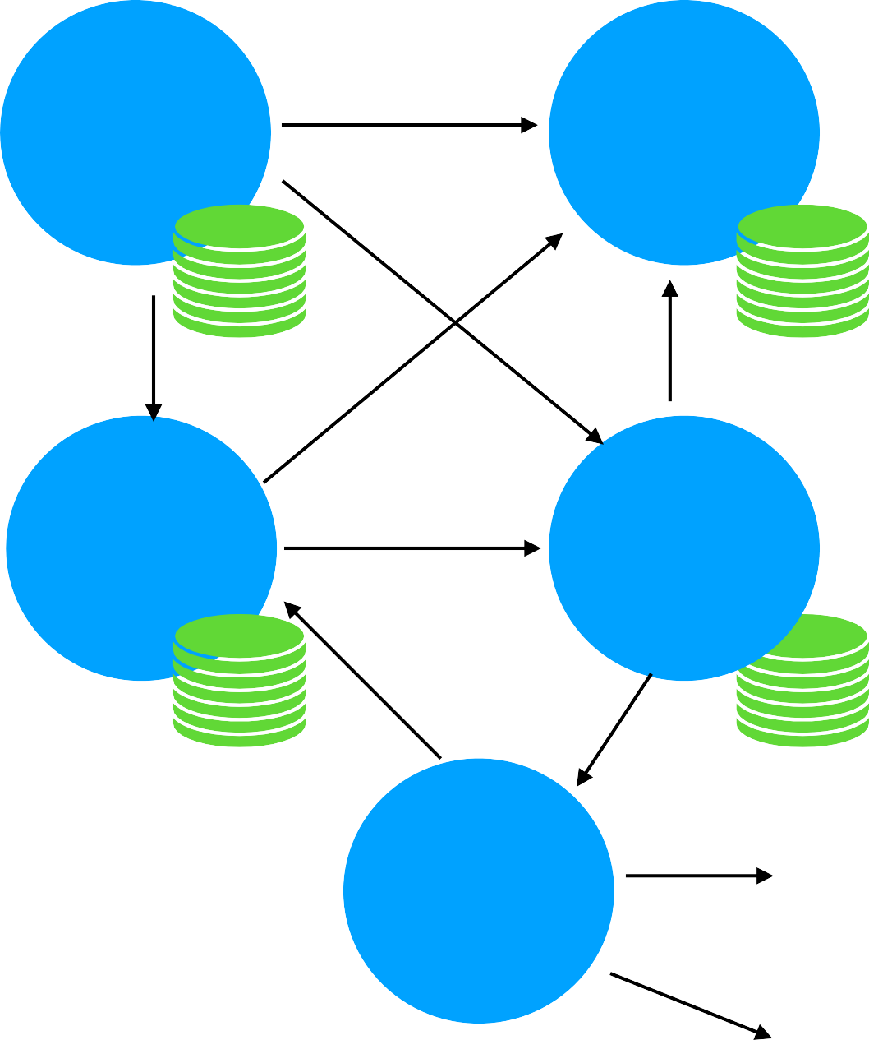
Software Development
Past
Current
Order Service
Payment Service
Order Service
Payment Service
Retail App
Inventory Service
Notification Service
Inventory Service
Delivery Service
Notification Service

Slide 11
MicroServices Architecture
API
API
API
Order Service
Inventory
Cart
Service
Service
Events Interface
Events Interface
Events Interface
Event Streaming Platform
Events Interface
Events Interface
Events Interface
Payment Service
Notification
Delivery Service
Service
API
API
API

Slide 12
What is an Event Streaming Platform?
Producers and Consumers subscribe to a stream of records
Producer
Streaming platform
Consumer
Store stream of Events
1 | 2 | 3 | 4
N
……
…
Analyze and Process Events as they occur

Slide 13
Apache Kafka (Event Streaming Platform)
API
API
API
Order Service
Inventory
Cart
Service
Service
Events Interface
Events Interface
Events Interface
Apache Kafka (Event Streaming Platform)
Events Interface
Events Interface
Payment Service
Notification Service
Delivery Service
API
API

Slide 14
Traditional Messaging System
Kafka Streaming Platform
Stores events based on a retention time. Events are Immutable
Transient Message Persistance
Brokers responsibility to keep track of consumed messages
Target a specific Consumer
Not a distributed system
Consumers Responsibility to keep track of consumed messages
Any Consumer can access a message from the broker
It’s a distributed streaming system

Slide 15



Kafka Use Cases
Transportation
Retail
Banking
Sale Notifications
Driver-Rider Notifications
Fraud Transactions
New Feature/Product notifications
RealTime Purchase recommendations
Food Delivery Notifications
Tracking Online Order Deliveries

Slide 16


Kafka Terminology & Client APIs
Kafka Producers
DB
File System
ProducerAPI
Kafka Cluster
Source Connector
Kafka Cluster
Kafka Kafka
Broker1 Broker2
Kafka Kafka Broker3 Broker4
Kafka Streams
Sink Connector
StreamsAPI
DB
File System
Kafka Consumers
ConsumerAPI
ConnectAPI

Slide 17
Download Kafka

Slide 18
Kafka Topics &
Partitions

Slide 19
Kafka Topics
Topic is an Entity in Kafka with a name

Slide 20
Kafka Topics
Topic is an Entity in Kafka with a name
Kafka Broker
Kafka Producer
TopicA
ABC
Kafka Consumer
Send to TopicA
Poll TopicA
ABC

Slide 21
Topic and Partitions
Partition is where the message lives inside the topic
Each Topic will be create with one or more partitions

Slide 22
Topic and Partitions
TopicA
- Each Partition is an ordered , immutable
sequence of records
Each record is assigned a sequential number called oﬀset
Each partition is independent of each other
Ordering is guaranteed only at the partition level
Partition continuously grows as new records are produced
All the records are persisted in a commit log in the file system where Kafka is installed
ABC 0 | DEF 1 | GHI 2 | JKL 3
Partition 0
………
ABC 0 | DEF 1 | GHI 2 | JKL 3 | BOB 4 | DAD 5 | KIM ⁶……
Partition 1
…

Slide 23
Topics and Partitions
TopicA
0 | 1 | 2 | 3 | 4 5
Kafka Producer
Partition 0
Send to TopicA
So let's say you are sending a new message and it goes to Partition zero.
Now, as you can see, the offset is incremented from 3 to 4 and it gets appended to the existing log.
Partition 1
0 1 2 3 4 5
6 7

Slide 24
Setting up Zookeeper
& Kafka Broker

Slide 25
Setting up Kafka in Local
Broker registered with zookeeper

Slide 26
Sending Kafka Messages
With
Key and Value

Slide 27
Kafka Message
Kafka Message these sent from producer has two properties
Key (optional)
Value

Slide 28
Sending Message Without Key
test-topic
Kafka Producer
Partitioner
Partition 0
Apple
Send to TopicA
Partition 1
Adam
Apple
Adam
Partition 2
Alpha
Alpha
Angel
Partition 3
Angel

Slide 29
Sending Message With Key
test-topic
Kafka Producer
Partitioner
Partition 0
K:A
K: A
K: A K: A
Send to
V:Apple V: Adam V:Alpha V: Angel
test-topic
Partition 1
K:B
V:Boy
K: B
V: Ben
K: B
V:Beta
K: B
V: Becky
Key: A _{Apple}
Key: A
Adam
Partition 2
K:C
V:Cat
K: C
V: Carl
K: C
V:Cam
K: C
V: Cathy
Key: A
Alpha ^{Key: A}Angel
Partition 3
Key: B Boy
Key: B Ben
Key: B _{Beta}
Key: B _{Brcky}

Slide 30
Consumer Offsets

Slide 31
Consumer Offsets
•
Consumer have three options to read
test-topic
•
•
•
from-beginning
latest
ABC 0 | DEF 1 | GHI 2 | JKL 3
Partition 0
………
specific offset
ABC 0 | DEF 1 | GHI 2 | JKL 3 | BOB 4 | DAD 5 | KIM 6
Partition 1
Partition 2
ABC 0 | DEF 1 | GHI 2 | JKL 3 | BOB 4 | DAD 5 | KIM 6
Partition 3
ABC 0 | DEF 1 | GHI 2 | JKL 3 | BOB 4 | DAD 5 | KIM 6

Slide 32
Consumer Offsets
test-topic
ABC 0 | DEF 1 | GHI 2 | JKL 3 |  | DAD 4 | DFF 5 | JKL 6 | OPP 7
Partition 0
From beginning
group.id = group1
Consumer 1
consumer_offsets

Slide 33
Consumer Offsets
test-topic
ABC 0 | DEF 1 | GHI 2 | JKL 3 |  | DAD 4 | DFF 5 | JKL 6 | OPP 7
Partition 0
From beginning
group.id = group1
Consumer 1
consumer_offsets

Slide 34
Consumer Offset
Consumer offsets behaves like a bookmark for the consumer to start reading the messages from the point it left off.

Slide 35
Consumer Groups

Slide 36
Consumer Groups
•
•
group.id is mandatory
test-topic
group.id plays a major role when it comes to scalable message consumption.
ABC 0 | DEF 1 | GHI 2 | JKL ³ ……
Partition 0
…
Partition 1
ABC 0 | DEF 1 | GHI 2 | JKL 3 | BOB 4 | DAD 5 | KIM 6
Partition 2
ABC 0 | DEF 1 | GHI 2 | JKL 3 | BOB 4 | DAD 5 | KIM 6
Partition 3
ABC 0 | DEF 1 | GHI 2 | JKL 3 | BOB 4 | DAD 5 | KIM 6
Consumer 1
group.id = group1

Slide 37
Consumer Groups
test-topic
Producer
Partition 0
Partition 1
Partition 2
Partition 3
group.id = group1
Consumer A
P0
P1
P2
P3

Slide 38
Consumer Groups
test-topic
Partition 0
Partition 1
Partition 2
Partition 3
Consumer A
Consumer A
group.id = group1
group.id = group1
P0
P1
P2
P3

Slide 39
Consumer Groups
test-topic
 | Partition 0 |  | Partition 1 |  |  | Partition 2 |  |  | Partition 3
 | Consumer A |  |  | Consumer A |  |  | Consumer A |  |  | Consumer A
group.id = group1
group.id = group1
group.id = group1
group.id = group1
P0
P1
P2
P3

Slide 40
Consumer Groups
test-topic
 | Partition 0 |  | Partition 1 |  |  | Partition 2 |  |  | Partition 3
 | Consumer A |  |  | Consumer A |  |  | Consumer A |  |  | Consumer A
Consumer A
group.id = group1
group.id = group1
group.id = group1
group.id = group1
group.id = group1
P0
P1
P2
P3
Idle

Slide 41
Consumer Groups
test-topic
Partition 0
Partition 1
Partition 2
Partition 3
Consumer A P0
Consumer A P1
Consumer B P0,P1
Consumer B
P1,P2
Consumer A P2
Consumer A P3
Group2
Group1

Slide 42
Consumer Groups : Summary
Consumer Groups are used for scalable message consumption
Each different application will have a unique consumer group
Who manages the consumer group?
Kafka Broker manages the consumer-groups
Kafka Broker acts as a Group Co-ordinator

Slide 43
Commit Log &
Retention Policy

Slide 44
Commit Log
Kafka Broker
Kafka Producer
TopicA
Kafka Consumer
Send to TopicA
Poll TopicA
ABC
Bytes
File System
log.dirs=/tmp/kafka-logs
00000000000000000000.log

Slide 45
Retention Policy
Determines how long the message is retained ?
Configured using the property log.retention.hours in server.properties
file
Default retention period is 168 hours (7 days)

Slide 46
Kafka as a
Distributed Streaming System

Slide 47
Apache Kafka® is a distributed streaming platform

Slide 48
What is a Distributed System?
Distributed systems are a collection of systems working together to deliver a value
System 1
Client
Client
System 3
System 2

Slide 49
Characteristics of Distributed System
Client
•
Availability and Fault Tolerance
•
Reliable Work Distribution
System 1
•
Easily Scalable
System 2
System 3
•
Handling Concurrency is fairly easy
System 4
Client

Slide 50
Kafka as a Distributed System
Producer
Consumer
Producer
Producer
Consumer
Consumer
Kafka Broker
Producer
Producer
Consumer
Consumer
Producer
Producer
Consumer
Consumer

Slide 51
Kafka as a Distributed System
Producer
Producer
Consumer
Consumer
Kafka Cluster
Kafka Broker 1
Kafka Broker 2
Kafka Broker 3
Consumer
Producer
Consumer
Consumer
Producer
Producer
File System
File System
File System
Client requests are distributed between brokers
Easy to scale by adding more brokers based on the need
- Handles data loss using Replication

Slide 52
SetUp Kafka Cluster
Using Three Brokers

Slide 53
Start Kafka Broker
./kafka-server-start.sh ../config/server.properties

Slide 54
Setting up Kafka Cluster
- New server.properties files with the new broker details.
broker.id=<unique-broker-d>
listeners=PLAINTEXT://localhost:<unique-port>
log.dirs=/tmp/<unique-kafka-folder>
auto.create.topics.enable=false(optional)
Example: server-1.properties
broker.id=1
listeners=PLAINTEXT://localhost:9093
log.dirs=/tmp/kafka-logs-1
auto.create.topics.enable=false(optional)

Slide 55
How Kafka Distributes the Client Requests?

Slide 56
How Topics are distributed?
./kafka-topics.sh -
-create --topic test-topic-replicated
-zookeeper localhost:2181
--replication-factor 3
--partitions 3
Leader of Partition0
Leader of Partition1
Leader of Partition2
Controller Partition-0
Partition-1
Partition-2
test-topic-replicated
Broker 1
Broker 2
Broker 3
Kafka Cluster

Slide 57
How Kafka Distributes Client Requests?
Kafka Producer
Kafka Producer
Partitioner
Partition-0 Partition-1 Partition-2
Send to test-topic- replicated
Leader of Partition0
Leader of Partition1
Leader of Partition2
ABC
GHI
DEF
Partition-0
Partition-1
Partition-2
test-topic-replicated
Broker 1
Broker 2
Broker 3
File System
File System
File System
Kafka Cluster

Slide 58
How Kafka Distributes Client Requests?
Kafka Consumer
Kafka Cluster
Leader of Partition0
Leader of Partition1
Leader of Partition2
Poll test-topic- replicated
Kafka Consumer
Partition-0
Partition-1
Partition-2
Records processed Successfully
test-topic-replicated
Broker 1
Broker 2
Broker 3
File System
File System
File System

Slide 59
How Kafka Distributes Client Requests?
Kafka Consumer Groups
Poll test-topic (partition-0)
Kafka Consumer
group.id=group1
Kafka Cluster
Records processed Successfully
Poll test-topic (partition-1)
Kafka Consumer
group.id=group1
Partition-0
Partition-1
Partition-2
test-topic
Records processed Successfully
Broker 1
Broker 2
Broker 3
Poll test-topic (partition-2)
Kafka Consumer
group.id=group1
File System
File System
File System
Records processed Successfully

Slide 60
Summary : How Kafka Distributes the Client Requests?
Partition leaders are assigned during topic Creation
Clients will only invoke leader of the partition to produce and consume data
Load is evenly distributed between the brokers

Slide 61
How Kafka handles Data Loss ?

Slide 62
How Kafka handles Data loss?
Kafka Cluster
Leader of Partition0
Leader of Partition1
Leader of Partition2
Kafka Producer
Partition-0
Partition-1
Partition-2
Kafka Consumer
test-topic-replicated
Broker 1
Broker 2
Broker 3
File System
File System
File System

Slide 63
Replication
./kafka-topics.sh -
-create --topic test-topic-replicated
-zookeeper localhost:2181
--replication-factor 3
--partitions 3

Slide 64
Replication
Kafka Cluster
Leader of Partition0
Leader of Partition1
Leader of Partition2
Partition-1 (Follower)
Replication factor = 3
Partition-0
Partition-1
Partition-2
Leader Replica Partition-1 (Follower)
Kafka Producer
Partition-0 (Follower)
Partition-0 (Follower)
Partition-0 (Follower)
^{F} Partition-2 (Follower)
Partition-2 (Follower)
ollower Replica
Follower Replica
Partition-2 (Follower)
Partition-1 (Follower)
Broker 1
Broker 2
Broker 3
File System
File System
File System

Slide 65
Replication
Kafka Cluster
Leader of Partition0
Leader of Partition 0 & 1
Leader of Partition2
Leader of
Partition1
Leader of
Partition
Partition-0
Partition-1
Partition-2
Kafka Producer
Partition-1 (Follower)
Partition-0 (Follower)
Partition-0 (Follower)
Kafka Consumer
Partition-2 (Follower)
Partition-2 (Follower)
Partition-1 (Follower)
Broker 1
Broker 2
Broker 3
File System
File System
File System

Slide 66
In-Sync Replica(ISR)
Represents the number of replica in sync with each other in the cluster
Includes both leader and follower replica
Recommended value is always greater than 1
Ideal value is ISR == Replication Factor
This can be controlled by min.insync.replicas property
It can be set at the broker or topic level

Slide 67
Fault Tolerance &
Robustness

Slide 68
Application Overview

Slide 69

Library Inventory

Slide 70

Library Inventory Flow
Library Inventory
Librarian

Slide 71
Library Inventory Architecture
MicroService 1
Librarian
API
Kafka Producer
Library Event Producer
Library-events
MicroService 2
H2
(In-memory)
Kafka Consumer
Library Event Consumer

Slide 72
Library Inventory Domain
Librarian
MicroService 1
Library Event
API
Kafka Producer
Library Events Producer
Library-events
MicroService 2
H2
(In-memory)
Kafka Consumer
Library Events Consumer

Slide 73
Library Event Domain
Librarian
MicroService 1
Library Event
API
Kafka Producer
Library Events Producer
Library-events
MicroService 2
H2
(In-memory)
Kafka Consumer
Library Events Consumer

Slide 74
Library Event Domain
Librarian
MicroService 1
Library Event
API
Kafka Producer
Library Events Producer
Library-events
MicroService 2
H2
(In-memory)
Kafka Consumer
Library Events Consumer

Slide 75
Library Events Producer API
Librarian
MicroService 1
API
POST
Kafka Producer
New Book
PUT
Update Book
Library Events Producer
Library-events

Slide 76
KafkaTemplate
Kafka Producer in Spring

Slide 77
KafkaTemplate
Produce records in to Kafka Topic
Similar to JDBCTemplate for DB

Slide 78
How KafkaTemplate Works ?
KafkaTemplate.send()
Library-events

Slide 79
KafkaTemplate.send()
Behind the Scenes
RecordAccumulator
KafkaTemplate
RecordBatch
batch.size
Send()
Serializer
Partitioner
RecordBatch
batch.size
buffer.memory
key.serializer value.serializer
DefaultPartitioner
linger.ms
RecordBatch
batch.size
test-topic

Slide 80
Configuring KafkaTemplate
Mandatory Values:
bootstrap-servers: localhost:9092,localhost:9093,localhost:9094
key-serializer: org.apache.kafka.common.serialization.IntegerSerializer
value-serializer: org.apache.kafka.common.serialization.StringSerializer

Slide 81
KafkaTemplate AutoConfiguration
application.yml
spring:
profiles: local
kafka:
producer:
bootstrap-servers: localhost:9092,localhost:9093,localhost:9094
key-serializer: org.apache.kafka.common.serialization.IntegerSerializer
value-serializer: org.apache.kafka.common.serialization.StringSerializer

Slide 82
Library Inventory Architecture
Librarian
MicroService 1
Library Event
API
Kafka Producer
Library Events Producer
Library-events
MicroService 2
H2
(In-memory)
Kafka Consumer
Library Events Consumer

Slide 83
KafkaAdmin
Create topics Programmatically
Part of the SpringKafka
How to Create a topic from Code?
Create a Bean of type KafkaAdmin in SpringConfiguration
Create a Bean of type NewTopic in SpringConfiguration

Slide 84
Spring security, microseriveices, api gate way, rest api, connection with multiple db, : sql server, micro service spring template, docker , kubernative, rest template ,
Collection, exception handling, spring boot : rest api , api gateway, eureka ssl certificate, web token , jwt tokens,

Slide 85
Introduction To
Automated Tests

Slide 86
Why Automated Tests ?
Manual testing is time consuming
Manual testing slows down the development
Adding new changes are error prone

Slide 87
What are Automated Tests?
Automated Tests run against your code base
Automated Tests run as part of the build
This is a requirement for todays software development
Easy to capture bugs
Types of Automated Tests:
UnitTest
Integration Tests
End to End Tests

Slide 88
Tools for Automated
JUnit
Spock

Slide 89
Integration Tests Using JUnit5

Slide 90
What is Integration Test?
Test combines the different layers of the code and verify the behavior is working as expected.
MicroService 1
Controller
Kafka Producer
Library-events
1 2
Library Events Producer
3

Slide 91
Integration Test
MicroService 1
Controller
Kafka Producer
Client
Library-events
Library Events Producer

Slide 92
Embedded Kafka

Slide 93
What is EmbeddedKafka?
In-Memory Kafka
Integration Tests can interact with EmbeddedKafka
Library Events Producer
LibraryControllerIntegrationTest
Embedded Kafka

Slide 94
Why Embedded Kafka ?
Library Events Producer
•
Easy to write Integration Tests
LibraryControllerIntegrationTest
Embedded Kafka
•
Test all the code as like you interact with Kafka

Slide 95
Unit Tests Using JUnit5

Slide 96
What is Unit Test?
Test the just focuses on a single unit (method)
Mocks the external dependecies
MicroService 1
Controller
Kafka Producer
Library-events
Library Events Producer

Slide 97
What is Unit Test?
Test the just focuses on a single unit (method)
Mocks the external dependencies
MicroService 1
Controller
Mock
Kafka Producer
Mockito
Library Events Producer

Slide 98
Why Unit Test?
Unit Tests are handy to mock external dependencies
Unit Tests are faster compared to Integration tests
Unit Tests cover scenarios that’s not possible with Integration tests

Slide 99
Library Events Producer API
Librarian
MicroService 1
API
POST
Kafka Producer
New Book
PUT
Update Book
Library Events Producer
Library-events

Slide 100
PUT - “/v1/libraryevent”
libraryEventId is a mandatory field
{
"libraryEventId": 123, "eventStatus": null, "book": {
"bookId": 456,
"bookName": "Kafka Using Spring Boot", "bookAuthor": "Dilip"
}
}

Slide 101
Kafka Producer Configurations

Slide 102
Kafka Producer Configurations
acks
acks = 0, 1 and -1(all)
acks = 1 -> guarantees message is written to a leader
acks = -1(all) -> guarantees message is written to a leader and to all the replicas ( Default)
acks=0 -> no guarantee (Not Recommended)

Slide 103
Kafka Producer Configurations
retries
Integer value = [0 - 2147483647]
In Spring Kafka, the default value is -> 2147483647
retry.backoff.ms
Integer value represented in milliseconds
Default value is 100ms

Slide 104
Library Events Consumer
MicroService 1
Library Event
Library Events Producer
Librarian
API
Kafka Producer
Library-events
MicroService 2
H2
(In-memory)
Kafka Consumer
Library Events Consumer

Slide 105
Spring Kafka Consumer

Slide 106
Kafka Consumer
Poll library-events
Kafka Consumer
Records processed Successfully
Library-events

Slide 107
Spring Kafka Consumer
MessageListenerContainer
KafkaMessageListenerContainer
ConcurrentMessageListenerContainer
@KafkaLisener Annotation
Uses ConcurrentMessageListenerContainer behind the scenes

Slide 108
KafkaMessageListenerContainer
Implementation of MessageListenerContainer
Polls the records
Commits the Offsets
Single Threaded

Slide 109
ConcurrentMessageListenerContainer
Represents multiple KafkaMessageListenerContainer

Slide 110
@KafkaListener
This is the easiest way to build Kafka Consumer
KafkaListener Sample Code
@KafkaListener(topics = {"${spring.kafka.topic}"})
public void onMessage(ConsumerRecord<Integer, String> consumerRecord) {
log.info("OnMessage Record : {} “, consumerRecord);
}
Configuration Sample Code
@Configuration @EnableKafka @Slf4j
public class LibraryEventsConsumerConfig {

Slide 111
KafkaConsumer Config
key-deserializer: org.apache.kafka.common.serialization.IntegerDeserializer
value-deserializer: org.apache.kafka.common.serialization.StringDeserializer
group-id: library-events-listener-group
bootstrap.servers:

Slide 112
Consumer Groups &
Rebalance

Slide 113
Consumer Groups
Multiple instances of the same application with the same group id.

Slide 114
Rebalance
Changing the partition ownership from one consumer to another
Library-events -consumer
group.id : Library-events-listener-group
Library-events
P0 | P1 | P2

Slide 115
Rebalance
Changing the partition ownership from one consumer to another
Library-events -consumer
group.id : Library-events-listener-group
Library-events
P0
P2
Group-Co-ordinator
Triggers Rebalance
Library-events -consumer
group.id : Library-events-listener-group
P1

Slide 116
Committing Offsets
Poll library-events
Kafka Consumer
Records processed Successfully
Library-events
consumer_offsets
Offsets Committed

Slide 117
Now the application is going to process the records one by one. The interesting behavior after processing each record is that the application will need to acknowledge after processing each record.
The meaning for this one is to keep track of the number of records and the offsets that had been processed. Once all the records are processed, then only the offset will be committed.
Until then, the offset tracking will happen behind the scenes for you. From an application perspective, all you got to do is acknowledge after each and every record, once the records are processed successfully
then it's going to commit the offsets to the __consumer_offset topic ,

Slide 118
Library Events Consumer
Library-events
MicroService 2
H2
(In-memory)
Kafka Consumer
Library Events Consumer

Slide 119
Integration Testing For
Real DataBases

Slide 120
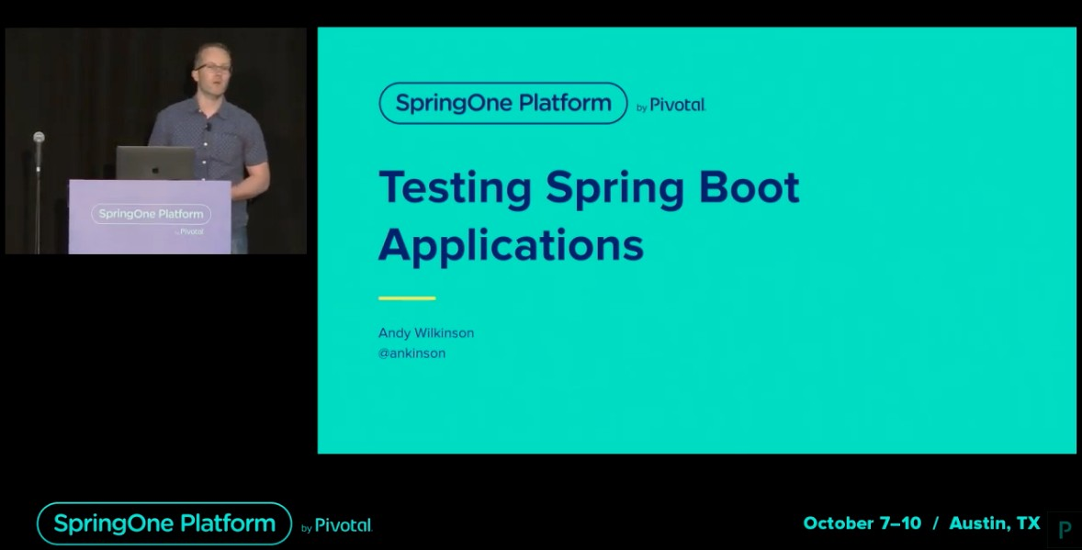
Integration Testing using Real Databases
Different aspects of writing unit and integration testing
Integration testing using
TestContainers

Slide 121
TestContainers
What are TestContainers?
Testcontainers is a Java library that supports JUnit tests, providing lightweight, throwaway instances of common databases, Selenium web browsers, or anything else that can run in a Docker container.
More Info about TestContainers - https://www.testcontainers.org/

Slide 122
Retry in Kafka Consumer

Slide 123
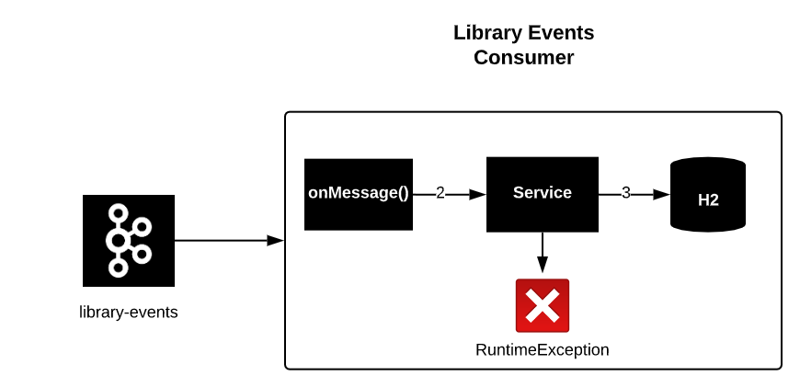
Error in Kafka Consumer

Slide 124

Retry in Kafka Consumer

Slide 125
Recovery in Kafka Consumer

Slide 126
Recovery in Kafka Consumer
Exhausted
RECOVERY

Slide 127
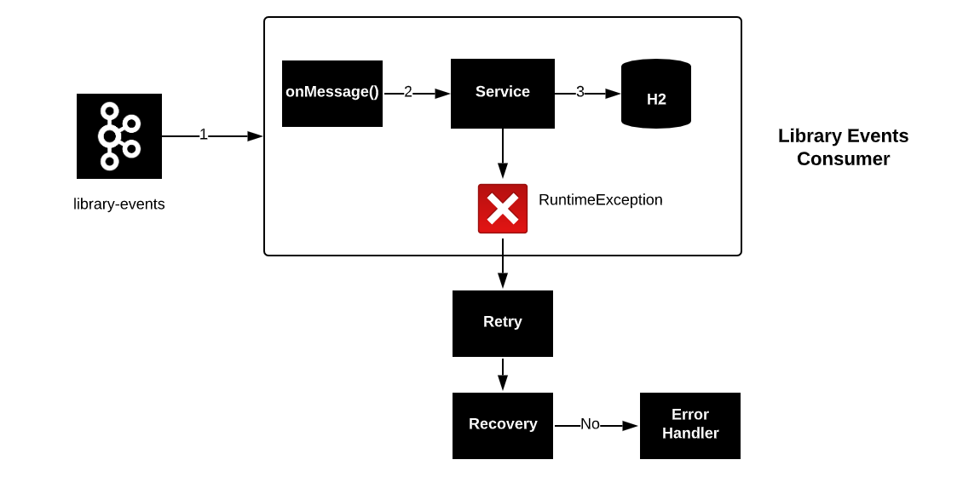
Retry and Recovery

Slide 128
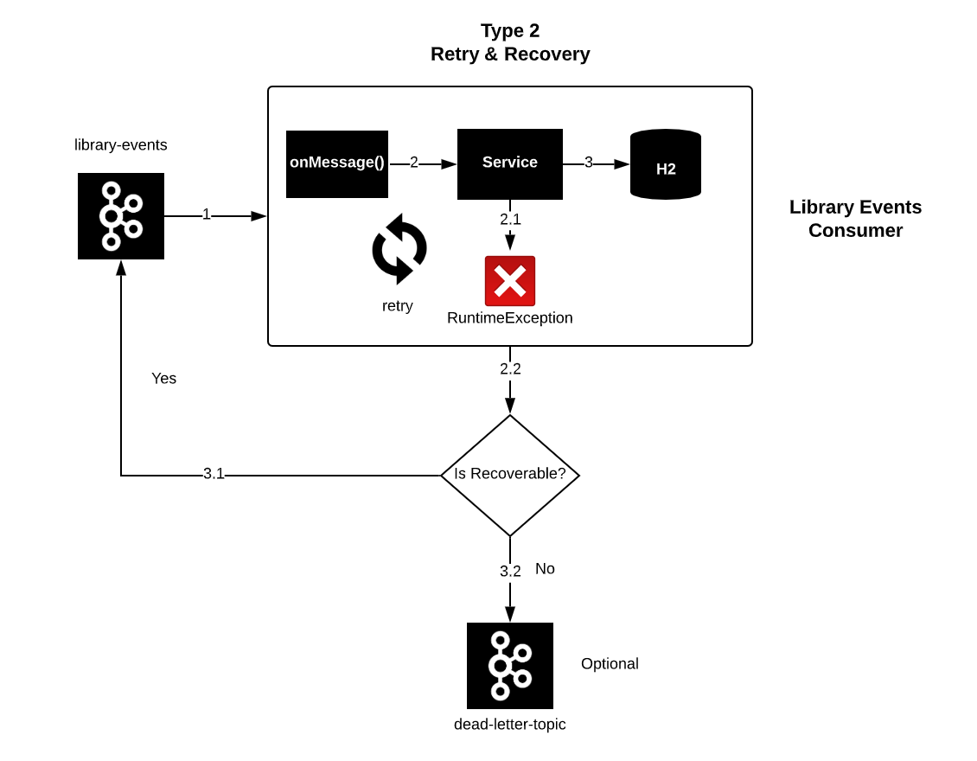
Recovery - Type 1
Exhausted

Slide 129
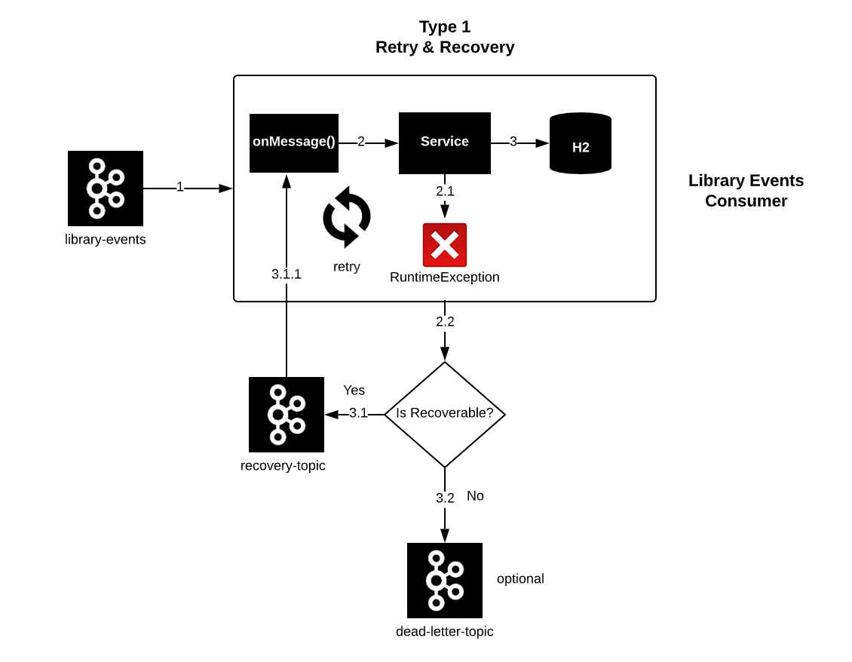
Recovery - Type 2
Exhausted

Slide 130
Issues with Recovery ?
Recovery can alter the order of events

Slide 131
Recovery - Type 1
Producer
Exhausted

Slide 132
Error Handling
in
Kafka Producer

Slide 133
Library Events Producer API
Librarian
MicroService 1
API
POST
Kafka Producer
New Book
Library-events
PUT
Update Book
Library Events Producer

Slide 134
Kafka Producer Errors
•
•
•
Kafka Cluster is not available
If acks= all , some brokers are not available
MicroService 1
min.insync.replicas config
Example : min.insync.replicas = 2, But only one broker is available
API
POST
Kafka Producer
PUT
Library-events
Library Events Producer

Slide 135

min.insync.replicas
min.insync.replicas = 2
Kafka Cluster
Broker 1
Broker 2
Broker 2

Slide 136
Retain/Recover Failed
Records

Slide 137
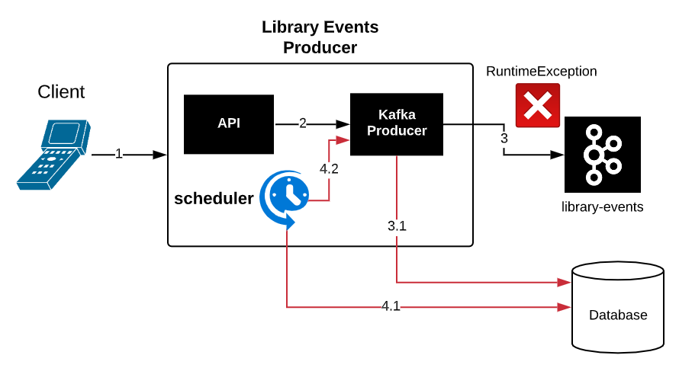
Retain/Recover Failed Records

Slide 138
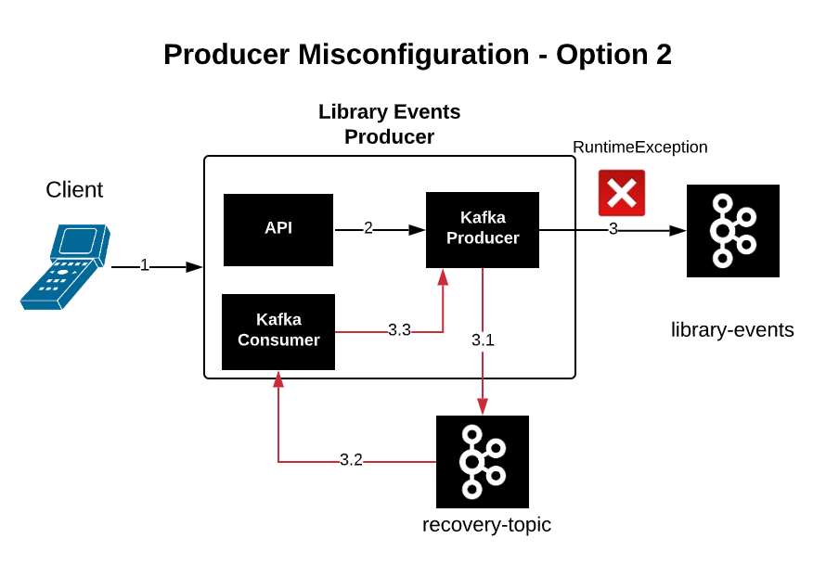
Retain/Recover Failed Records

Slide 139
Kafka Security

Slide 140
Kafka Security
Kafka is used in variety of business:
Banking
Retail
Insurance
Confidential Information:
Credit Card Details
Customer Information and etc.,

Slide 141
What Kafka Security Offers?
Kafka supports two popular protocols:
SSL (Secured Sockets Layer), which is TLS (Transport Layer Security) now
SASL (Simple Authentication and Security Layer)

Slide 142
How SSL works?
SSL used for two things:
Encryption
Authentication

Slide 143

Without SSL Encryption
Client
Server (amazon.com)
Plaintext
Man in the Middle

Slide 144
With SSL Encryption
SSL Layer
Client
Server (amazon.com)
##dkjjh^
%%&
##dkjjh^
%%&
##dkjjh^
%%&
?
private key
Public Key Cryptography

Slide 145
SSL Authentication
SSL Authentication is to make sure you are talking to the correct server
Client
Server (amazon.com)
Hacker (amazon.com)

Slide 146
How SSL Authentication works ?
CARoot Cert
DigiCert Global CA G2
TrustStore
Secure
Server (amazon.com)
SSL cert

Slide 147
SSL Requests by Enterprise
SSL Signed Certificate added
Secure
abc.com
Client
SSl Cert
One Way Authentic
ation
d Certificate
Signe
keystore file
TrustStore
(CA Root Certificate)
Requesting CSR
Certificate Authority

Slide 148
SSL Authentication
TrustStore
Kafka Clients
Secure
Kafka Cluster
One Way Authentication
SSL Signed Certificate

Slide 149
2 Way SSL Authentication
SSL Cert
Kafka Clients
Kafka Cluster
Two Way Authentication
TrustStore
KeyStore
KeyStore
TrustStore

Slide 150
Kafka SSL SetUp

Slide 151
SSL Set Up Steps
1. Generate server.keystore.jks
Kafka Clients
Kafka Cluster
2. SetUp Local Certificate Authority
3. Create CSR(Certificate Signing Request)
client.truststore
server.keystore
4. Sign the SSL Certificate
client.truststore
SSL Signed Certificate
5. Add the Signed SSL Certificate to
server.keystore file
6. Configure the SSL cert in our Kafka Broker
Local Certificate Authority
7. Create client.truststore.jks for the client

Slide 152
Kafka SSL SetUp
Kafka Clients
Kafka Cluster
client.truststore
SSL Signed Certificate
Local Certificate Authority

