Slide 1
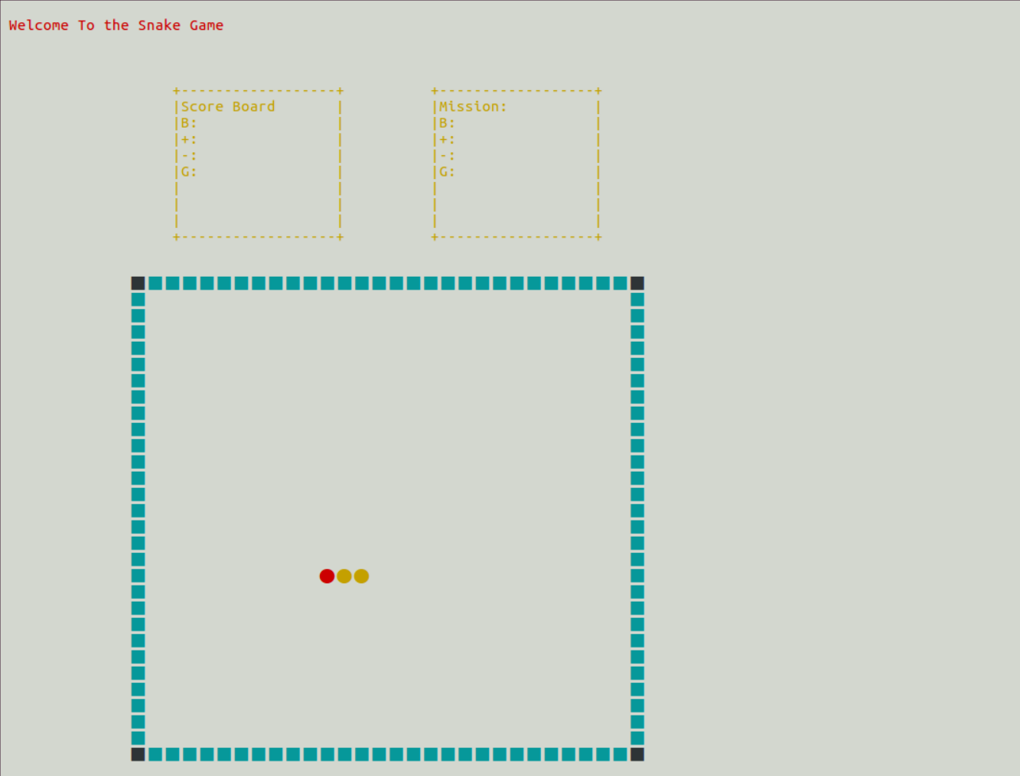
Score Board & Mission
Immune wall
wall
Snake 게임 화면
Snake head
Snake body

