Slide 1
Raspberry Pi - CNN
Mission
The task is to make a facial recognition equipment using Raspberry-pi.
For facial recognition disorder.
Notes:
Download more minimal templates here: https://crmrkt.com/GK9Dwa

Slide 2
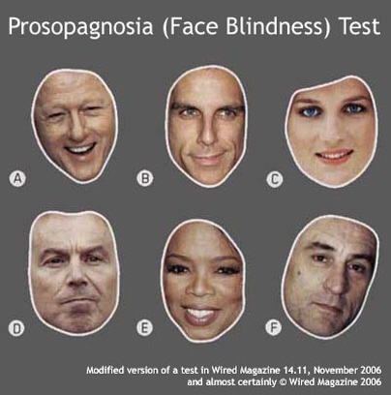
Problem Description
What is facial recognition disorder?
Face Blindness : Prosopagnosia
Who sees a face and says “It’s apple.”
Who sees family and says “Nice to meet you.”
Both of congenital and acquired are possible.
- They distinguish people using hair, clothes, voice.
→ such a big problem to get into society.
Detail
Then… what is lag?
2 out of 100 have the disorder.
if Acquired : can be cured by curing the cause of the disease such as Stroke.
if Congenital : No solution.
Is there any Medical Supplementary Device? : No.
Notes:
Thinking person : Freepik
Congenital

Slide 3



Solution
Tony Stark
Notes:
Thinking person : Freepik
Congenital

Slide 4





Scenario
Tom
Joy
Wearing the glasses
starting the app.
Nothing happens
for unregistered person.
Name appears
If the person is registered.
Notes:
Thinking person : Freepik
Congenital

Slide 5
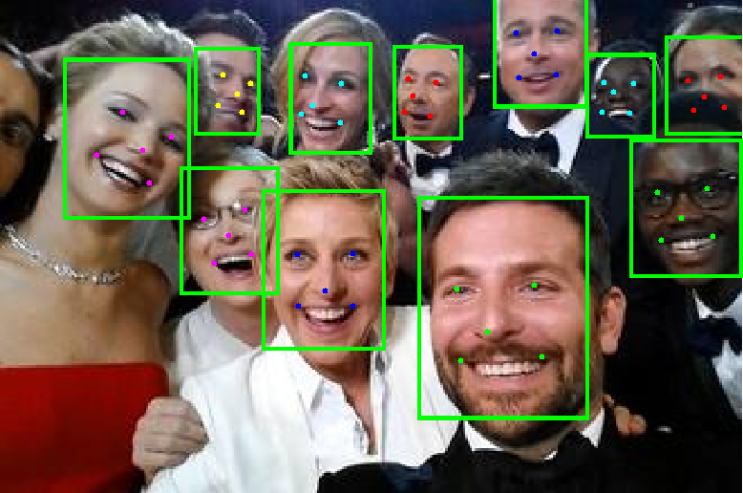
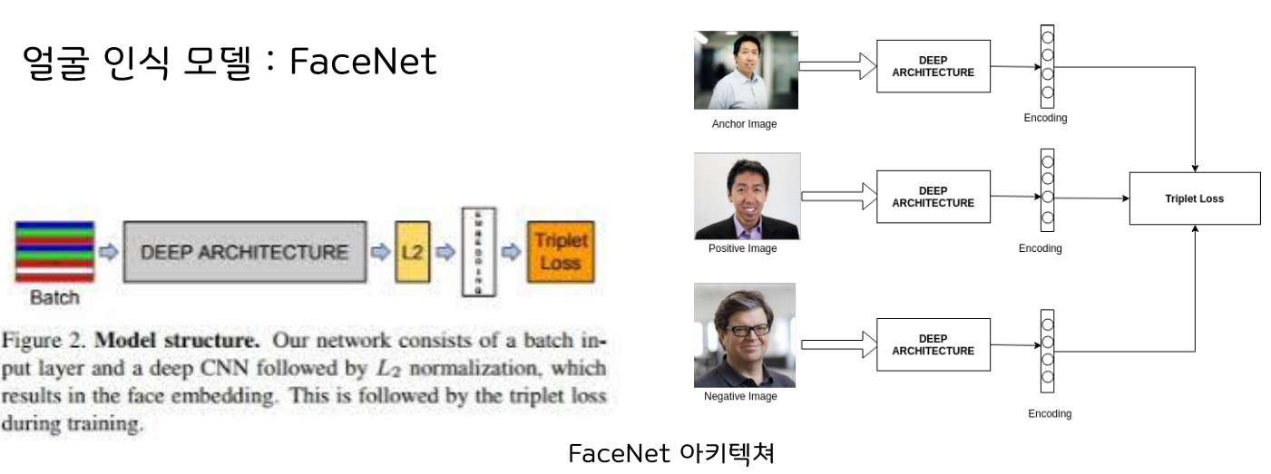
Methods
Preprocessing
OpenCV lib
- Crop the extracted region of face
MTCNN
- Extract face’s landmark
FaceNet
A model for face recognition
FaceNet
FaceNet Architecture
MTCNN
Notes:
Thinking person : Freepik
Congenital

Slide 6
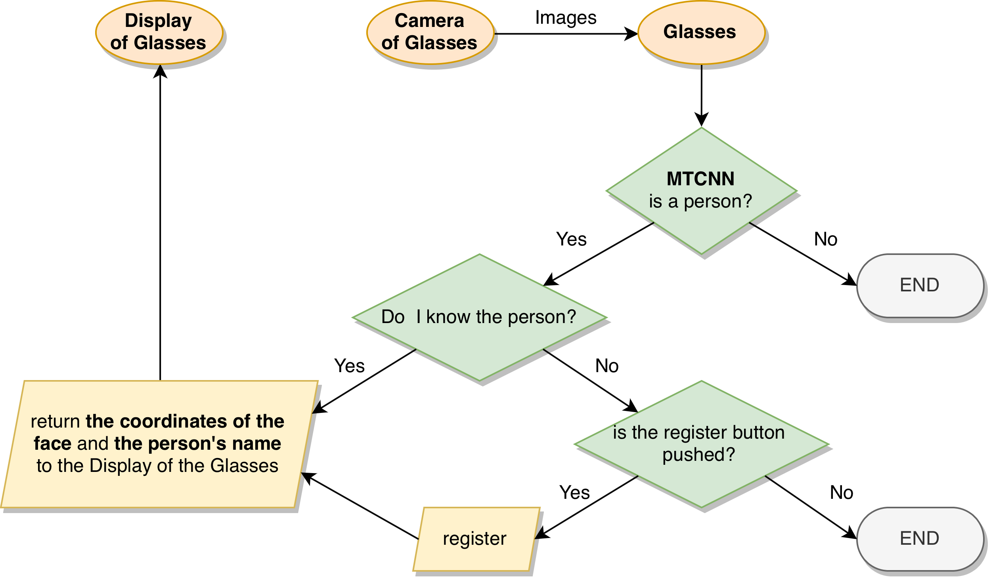
Flowchart
6
1
2
3
4
5
7
Notes:
Thinking person : Freepik
Congenital

Slide 7
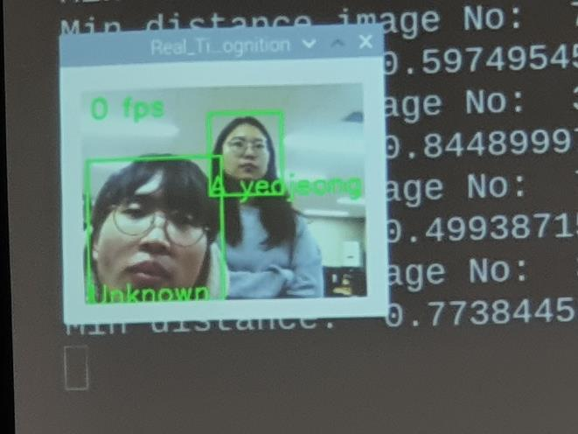
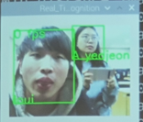
My work and Demo
My work is …
Set up Raspberry pi – Linux
Configure all the required tools and libraries
in the Raspberry pi
3. Put the model into the Raspberry pi
4. Make the model run
Honestly, the CNN part was not my job :(
It’s me!
Notes:
Thinking person : Freepik
Congenital

Slide 8
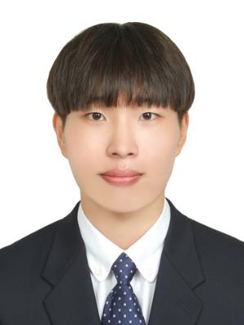
About Me
Profile
Education Histroy
Birth : 1994.04.02
Tel. : (+82)-10-6653-8277
Email : gjsgud2@gmail.com
Github : https://github.com/suyeony0/
Catholic University of Korea (graduated) FEB.2020
Ogeum High School (graduated) FEB.2013
Language Study (London - UK) FEB.2018 ~ AUG.2018
HeonHyung Lee
Computer Engineer
Skills
ExtraCurricular
English : TOEIC(940), OPIC(AL), TEPS(374)
Programming Language : C++, python
[Big Contest] - Champions League Jul.2019 – Sep.2019
[Space Weather] – AI Contest Aug.2019 – Sep.2019
[Kaggle] - Predicting Future Sales Nov.2019 – Dec.2019
https://drive.google.com/drive/folders/1N1QyCkOQW1fPncfWZOcNehhRr2ZDc8Zo?usp=sharing
Undergraduate Research Student Feb.2019 ~ Feb.2020
-Mediation of Color in Odor – Emotion Association (accepted by Kiise)
http://www.dbpia.co.kr/journal/articleDetail?nodeId=NODE08763620
[3D game] – Escape Room(openGL) Oct.2019~Dec.2019
https://suyeony0.github.io/EscapeRoom/
[Algorithm] - https://github.com/suyeony0/Leetcode-Algorithm
Honors
Summa cum laude (the highest honor)
- GPA : 4.45 / 4.5
Notes:
Download more minimal templates here: https://crmrkt.com/GK9Dwa

