Slide 1
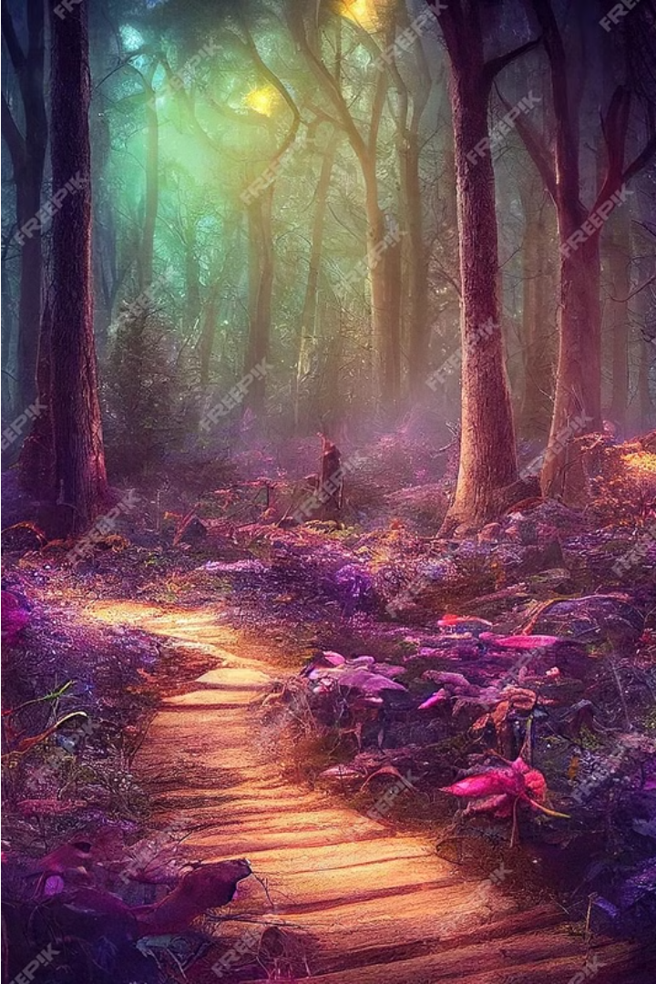
QuestVerse
Welcome to the enchanting world of "Mystic Quest," an action-adventure game that immerses you in a realm of ancient mysteries, mythical creatures, and captivating challenges. Embark on an epic journey through diverse and breathtaking landscapes, where discovery and triumph await the brave.

Slide 2

Unravel the Narrative
1
Compelling Storyline
2
Diverse Environments
3
Memorable Characters
Dive into a rich narrative that follows the brave adventurer's quest to uncover ancient secrets and vanquish powerful foes.
Explore a vast and enchanting world, from dense forests and dark caves to peaceful villages and treacherous mountains.
Encounter a cast of captivating characters, each with their own motivations, abilities, and connections to the unfolding saga.

Slide 3
Embark on Epic Battles
Tactical Combat
Diverse Adversaries
Satisfying Victories
Engage in thrilling battles against a range of mythical creatures, utilizing strategic thinking and quick reflexes to defend yourself and defeat your foes.
Challenge goblins, wolves, dragons, minotaurs, and other formidable enemies, each with unique abilities and weaknesses to uncover and exploit.
Overcome the most daunting adversaries in epic boss battles, requiring careful planning and skillful execution to emerge victorious.

Slide 4
Puzzle Your Way Forward
Mind-Bending Puzzles
Rewarding Exploration
Encounter intriguing puzzles that challenge your logic, memory, and problem-solving skills, unlocking hidden secrets and progressing your quest.
Uncover hidden items, artifacts, and treasures that enhance your abilities and aid you in your journey through the mystical lands.
Satisfying Progression
Diverse Challenges
Solve puzzles and overcome obstacles to unlock new areas, gain powerful upgrades, and witness the unfolding of the captivating narrative.
From deciphering ancient codes to manipulating the environment, each puzzle offers a unique and engaging test of your wits.

Slide 5




Immerse Yourself in the Journey
Explore
Battle
Puzzle
Loot
Venture through diverse and captivating environments, uncovering hidden treasures and unlocking new paths.
Engage in thrilling combat against a wide array of mythical creatures, honing your skills and strategy.
Tackle mind-bending challenges that test your logic and problem-solving abilities.
Discover valuable items, artifacts, and upgrades to enhance your character and progress on your quest.

Slide 6
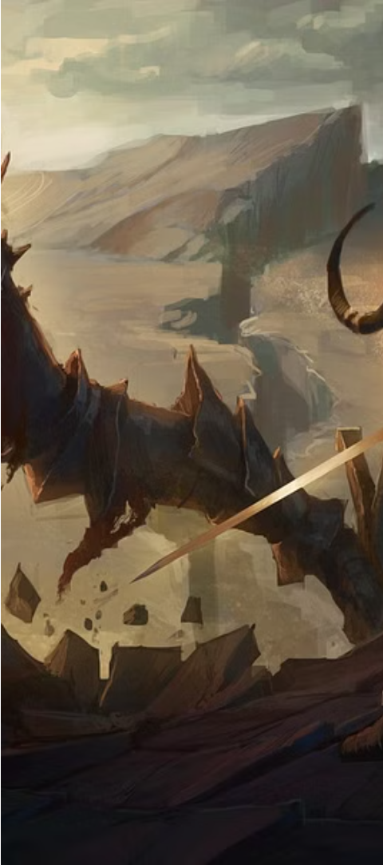



Confront the Darkness
Encounter Formidable Foes
Face off against powerful bosses, each with unique abilities and weaknesses, testing your combat skills and strategies.
Uncover Hidden Truths
Delve deeper into the game's lore and uncover the secrets behind the challenges you face, guiding you towards your ultimate goal.
Emerge Victorious
Triumph over the most daunting adversaries, claiming your place as a true hero and shaping the fate of the mystical world.

Slide 7
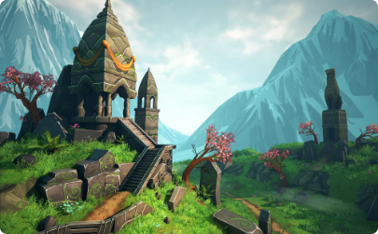
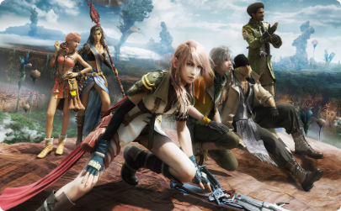

Captivating Visuals and Sounds
Stunning Environments
Dynamic Animations
Immersive Soundscape
Lose yourself in the breathtaking visuals of the game, from lush forests to treacherous mountains, each location meticulously crafted to immerse you in the mystical realm.
Experience the thrill of battle through fluid and captivating animations, as your character and the mythical creatures come to life on the screen.
Enhance your journey with a captivating soundtrack that sets the mood, from rousing battle themes to serene environmental sounds, amplifying the sense of adventure and wonder.

Slide 8
Embark on Your QuestVerse
Genres
Action-Adventure, Fantasy, Exploration
Platform
PC, PlayStation, Xbox, Nintendo Switch
Release Date
Coming Soon
Rating
E10+ (Everyone 10+)
Prepare to immerse yourself in the captivating world of "Mystic Quest," where adventure, challenge, and enchantment await. Discover the secrets of the mystical realms, overcome formidable foes, and uncover the truth that lies at the heart of this epic journey. Are you ready to embark on your own Mystic Quest?

