Slide 1
TEAM 5D12
Suyog Bhat 01FE17BCS225
Shreyas Katagi 01FE17BCS196
Shrinivas Miskin 01FE17BCS197
Shrivardhan Kamble 01FE17BCS198

Slide 2
Challenge
Building Insurance Claim prediction(5DMACP08)
Start Date: 01-Jan-2019
Last Date : 01-Jan-2020

Slide 3
Problem Statement
To predict if a building will have an insurance claim during a certain period

Slide 4
Challenge Goals
To predict a probability of having at least one claim over the insured period of a building. The model will be based on the building characteristics. The target variable is
1 if the building has at least a claim over the insured period.
0 if the building doesn’t have a claim over the insured period.

Slide 5
Data
Training data is 10229 X 26
Testing data is 3411 X 25
Important attributes
superficief:size in m^2 of the building.
Insee: French geographical code to locate the building.
target: Target variable. (0: no claim, 1: at least one claim over insured period).

Slide 6
Data contd.
EXPO: Time insured in Generali on the year. (Ex: Full year insurance EXPO = 1; 6 months EXPO = 0.5 ) Numerical variable.
ft_2_categ: Year of observation for the insured policy.
ft_i_categ: Anonymous characteristics of the building. Categorical variables.

Slide 7
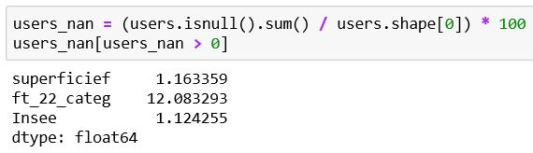
Data Exploration & Preprocessing
NaN Values.
1 % of location and size is missing.
ft_22_categ missing values are highest.

Slide 8
Handling Null Values
Attributes containing NULL values are ft_22_categ,Insee,superficief.
NULL values are replaced by mean for superficief.
Data Cleaning
EXPO(time period) attribute, values are csv type converted into float value.
Dropping Row number columns.
ft_22_categ (construction year) converted into numerical values.
Minimum is 1.Better to plot and infer.

Slide 9
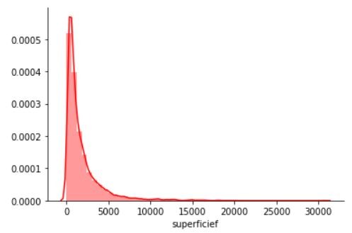
Area greater than 10000 m^2 are very less.
Extends upto 30000 which seems odd.
Area greater than 10000 are replaced by 10000.
Area smaller than 5 are replaced by 5.

Slide 10
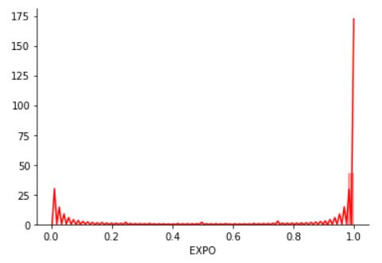
Insurance period (EXPO) distribution.
Starts from 0 which is impossible. Highest buildings have 1, means a whole year term.
Value 0 are removed and replaced by minimum value.

Slide 11
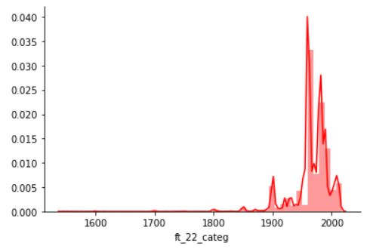
Ft_22_categ(construction year) starts from 1545. Values which are less than 1800 are replaced by 1800.

Slide 12
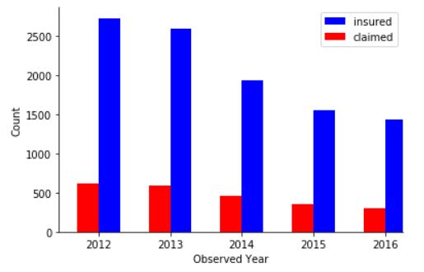
Observed Year and number of insured vs claimed.
Claim and insured number is decreasing.

Slide 13
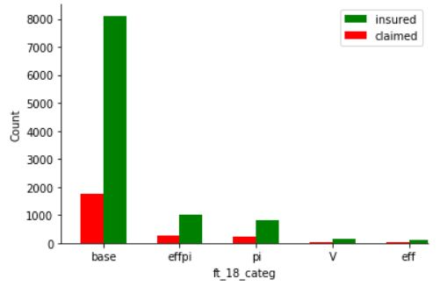
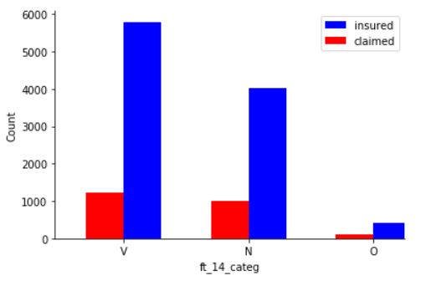
Other categorical values and plots.
Anonymized variables which needs to be resolved.

Slide 14
Data transformation
Categorical features(ft_i_categ) are one hot encoded.
Some of categorical features seem random and less important.
Identifiant(ID) is labeled as True because they don't contribute for model.

Slide 15
Data Integration
Insee codes and its region names are added.(using external data by INSEE data sets)
Data Reduction
Postal code, and other unnecessary columns are dropped.
Data joinig,(left join) dropping unnecessary rows of external data.

Slide 16
Important Attributes
EXPO(Insurance period)
superficief(size)
ft_22_categ(construction year)
Insee(location code)
Region
ft_2_categ(observed year)
ft_6_categ(anonymous attribute)

Slide 17
References
https://challengedata.ens.fr/challenges/19
https://github.com/Shankarsetty/DMA2019
https://www.data.gouv.fr/fr/
Thank You

