Slide 1
Jabalpur AQI Dashboard & Analysis
Multi-Station Air Pollution Trends | 2025 | Power BI Project

Slide 2
CONTENTS
Introduction
Dataset and Study Area
KPI 1 : Average AQI
KPI 2 : Average Worst AQI
KPI 3 : Maximum AQI
Dominating Pollutants
AQI Category
Key Insights And Observations
Dashboard Demonstration
Recommendations

Slide 3
INTRODUCTION
This project presents a data-driven analysis of air quality in Jabalpur (Madhya Pradesh) using data from four monitoring stations for the year 2025.
The objective is to understand overall air quality trends, dominant pollutants, and seasonal variations across the city.
Using Excel, Power BI and SQL, the dataset was cleaned, combined, and transformed to build an interactive dashboard for analysis.
The project demonstrates how data analytics can support urban air quality monitoring and decision-making

Slide 4
DATASET
Dataset | Jabalpur_AQI_Data
No. of Stations | 04
Stations | Gupteshwar, Marhatal, Govind Bhavan Colony, Suhagi
No. of Rows | 1426
No. of Columns | 25
Time Period | Year 2025
File Format | CSV
Data Source | CPCB Monitoring Stations

Slide 5
TOOLS USED
EXCEL
SQL
POWER BI
Data Exploration Data Cleaning Using Power Query Data Preparation
Joining Multiple Files Data Exploration And Cleaning Dax Calculations Dashboard Creation Visual Analysis
Validated KPI’s Cross Checked Results Performed Query Based Analysis

Slide 6
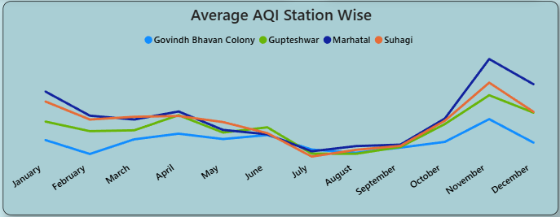
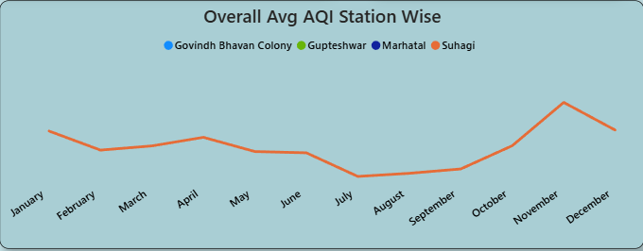
KPI – 1 AVERAGE AQI TREND
By observing the visual we can clearly see the Average AQI Trend of all the four stations as well as an Overall Avg AQI Trend.
Station wise Marhatal is most polluted station in Jabalpur based on AVG AQI while Govind Bhavan Colony records the lowest pollution levels among all the 4 monitoring stations.
AQI Levels remain lowest during the monsoon months and rise significantly in winter , with November recording the highest average AQI.

Slide 7
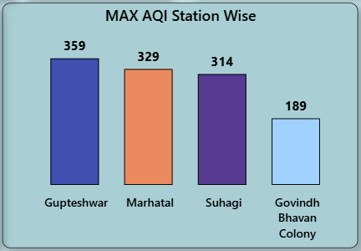
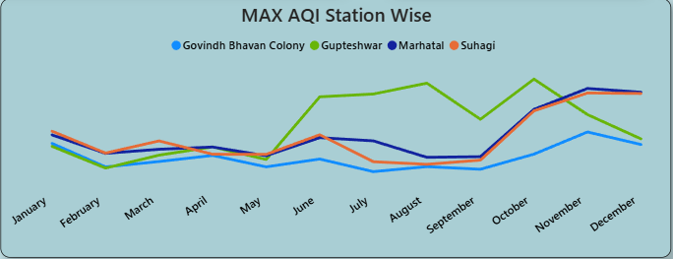
KPI – 2 MAXIMUM AQI
From the visuals we can clearly see that from January to May MAXIMUM AQI remains relatively stable ranging between 117 - 191 .
A sharp increase was observed from June to December, with most peak values falling between 230–359.
The last quarter (Oct–Dec) recorded the most severe pollution spikes.

Slide 8
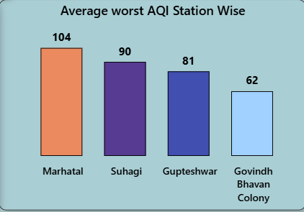
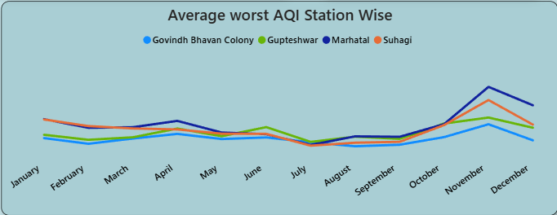
KPI – 3 AVERAGE WORST AQI
The overall Average Worst AQI across all stations is around 84, indicating that the dominant pollutant on most days falls in the Satisfactory to Moderate range.
Average Worst AQI remains moderate overall but increases significantly in the winter months, with Marhatal showing the highest pollution intensity among all stations, mainly driven by Pollutants PM10 and PM2.5 .

Slide 9
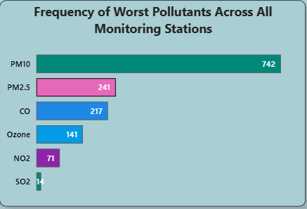
DOMINATING POLLUTANTS
The most dominant pollutant throughout the year is PM10, followed by PM2.5.
Seasonal Pattern
      Winter (Oct–Dec): PM2.5 and PM10 dominate due to dust accumulation and low wind movement.
      Summer : Ozone (O₃) levels increase because of strong sunlight and higher temperatures.
      Monsoon : CO appears more frequently, while particulate matter slightly reduces due to rainfall.

Slide 10
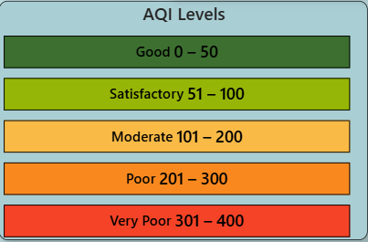
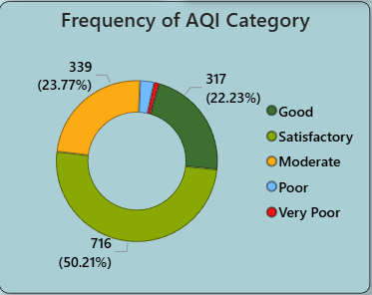
AQI CATEGORY
Jabalpur’s air quality is generally Good to Satisfactory for most of the year, but conditions worsen in the winter months when Moderate to Poor categories become more frequent.

Slide 11
KEY INSIGHTS AND OBSERVATIONS
The overall air quality in Jabalpur remains mostly Good to Satisfactory, with a yearly average AQI of around 39.
Winter months show a noticeable rise in pollution levels, while the monsoon period records the cleanest air.
PM10 is the most dominant pollutant throughout the year, followed by PM2.5, making particulate matter the primary driver of AQI.
Among all stations, Marhatal records the highest pollution levels, whereas Govind Bhavan Colony shows relatively better air quality.
Peak pollution events (high Max AQI) occur mainly in the last quarter, indicating seasonal accumulation of pollutants.
AQI values across weekdays remain fairly stable, showing no major day-specific spikes, which suggests pollution is driven more by seasonal and environmental factors than by specific days.

Slide 12
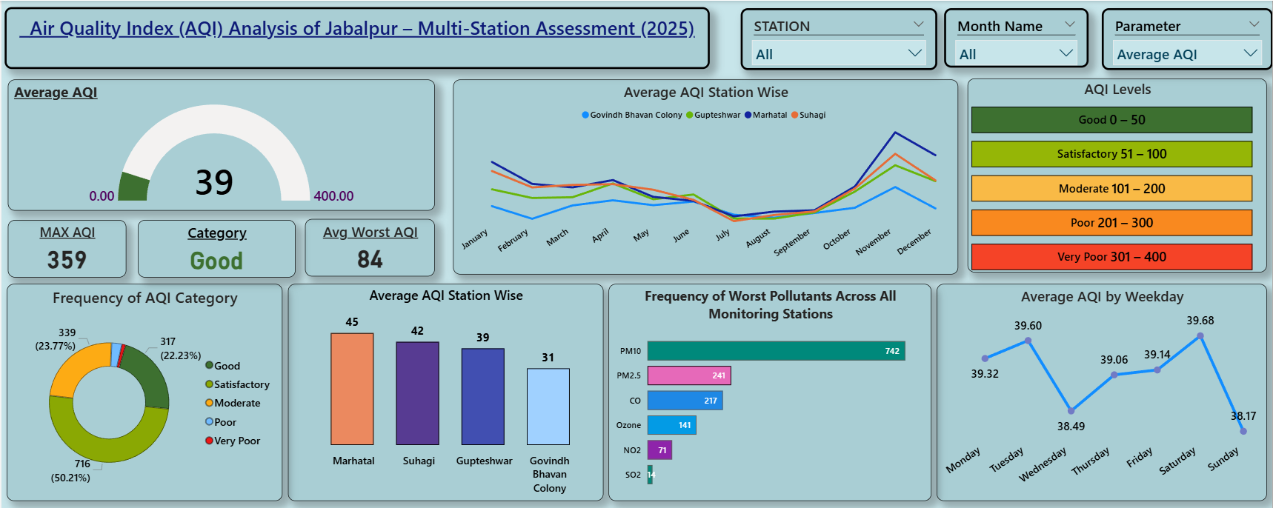
POWER BI DASHBOARD

Slide 13
RECOMMENDATIONS
1. Stricter construction dust control :
  Covering of construction sites , mandatory water sprinkling
2. Road dust management :
  Increase frequency of mechanical road sweeping and water spraying on major roads and near traffic-heavy zones like Marhatal and Suhagi.
3. Traffic emission control:
  Promote public transport usage , car pooling
  Conduct Regular vehicle emission checks
4. Seasonal action plan for winter:
  Limiting construction hours
  Avoid waste burning

Slide 14
THANK YOU…

