Slide 1
Bank Customer Churn & Financial Risk Analysis
Customer Behaviour • Financial Risk
Product Usage • Churn Impact
2026 | Power BI Project

Slide 2
CONTENTS
Introduction
Dataset and Study Area
Bank Churn Analysis Overview
Churn Analysis
Financial Analysis
Bank Product Analysis
Customer Engagement and Loyalty
Churn Impact Analysis
Key Insights And Observations
Dashboard Demonstration (6 slides)
Recommendations

Slide 3
INTRODUCTION
This project analyzes 10,000 bank customers from different Countries to identify Churn Drivers and Financial Risk.
The objective is to identify Customer Behaviour, Product Relationships, and Balance Exposure.
The analysis was conducted using Power BI, SQL, Excel, and DAX .

Slide 4
DATASET
Dataset | Bank Customer Churn Dataset
File Structure and Format | 1 CSV
Dataset Structure | 1 CSV file ~ 10K Rows ~ 13 Columns
Data Source | Maven Analytics

Slide 5
TOOLS USED
EXCEL
SQL
POWER BI
Data Cleaning and Preprocessing. Initial Data Exploration. Handling Missing Values and Blanks. Data Transformation.
Data Modelling. Created Calculated columns and DAX Measures. Designed Dashboards and Visuals. Visual Analysis.
Data Validation and KPI Verification. Query based Data Analysis.

Slide 6
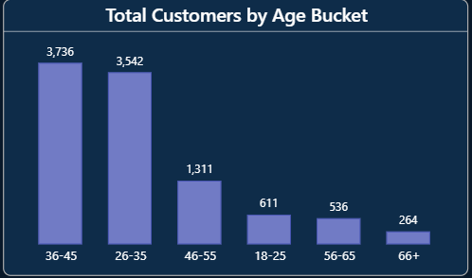
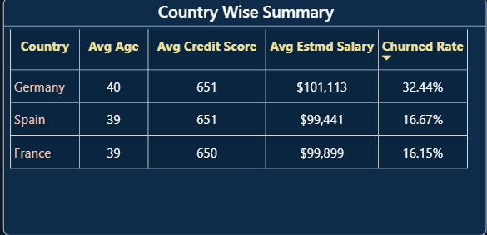
Bank Churn Analysis Overview
The bank has 10,000 customers with a 20% churn rate (2,037 customers), indicating a significant customer retention challenge.
The majority of customers belong to the 26–45 age group, making it the bank’s core customer segment.
Germany shows the highest churn rate (32.44%) compared to France and Spain, highlighting it as the highest risk region.

Slide 7
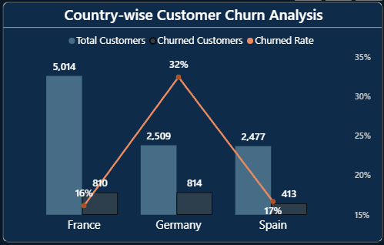
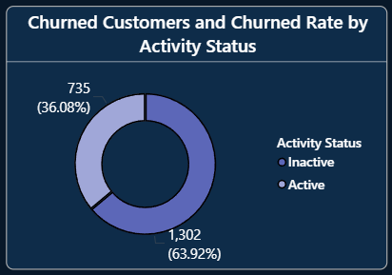
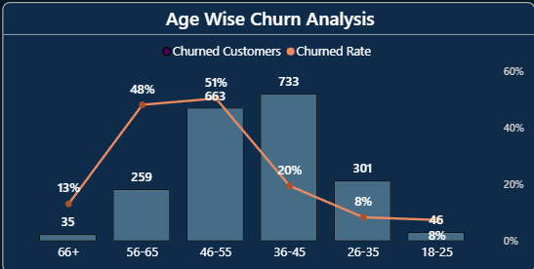
Churn Analysis
Customer inactivity is the strongest churn driver, with inactive customers churning at much higher rates.
Customers with weaker product relationships (1 product) are more likely to leave the bank.
Middle-aged customers (36–55) represent a key churn risk segment due to higher financial value.

Slide 8
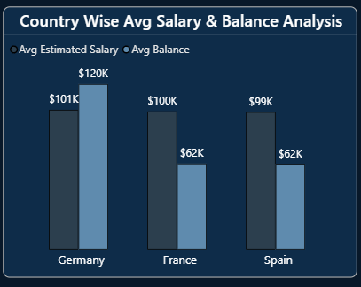
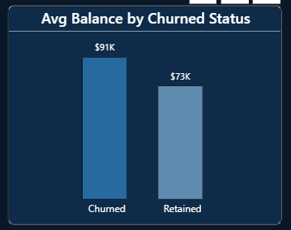
Financial Analysis
Churned customers account for a significant portion of total bank balance, showing churn is a major financial risk.
Churned customers have higher average balances compared to retained customers, indicating loss of high-value customers.
Germany has the highest average customer balance, making it the most financially exposed region.

Slide 9
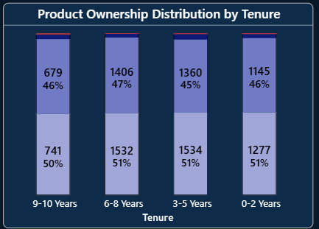
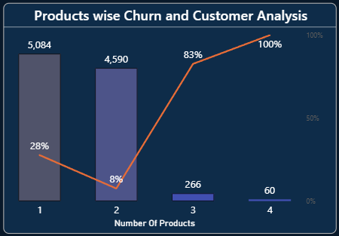
Bank Product Analysis
Most customers have 1 or 2 bank products, showing limited product engagement.
Customers with only 1 product show higher churn, indicating weak customer relationships.
Customers with multiple products show better retention, highlighting cross-selling opportunities.

Slide 10
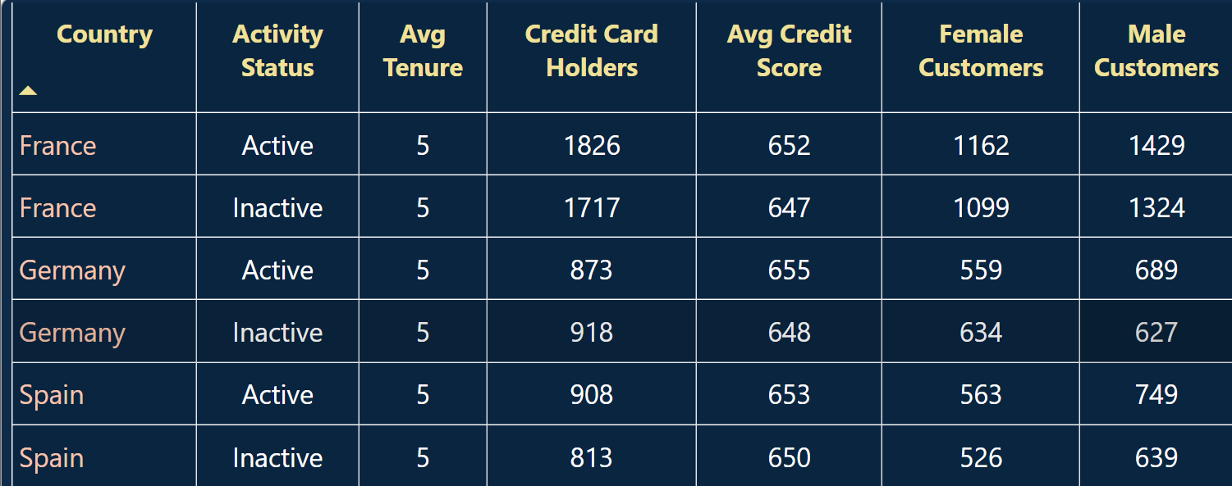
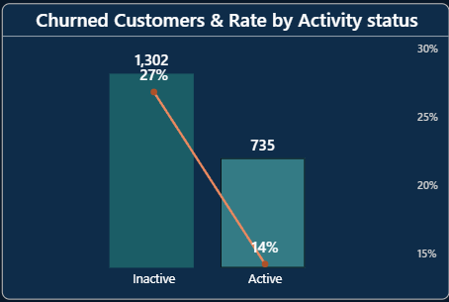
Customer Engagement and Loyalty
Customers with longer tenure do not always guarantee loyalty, showing engagement matters more than duration.
Active customers show much better retention, highlighting the importance of customer interaction.
Inactive customers have significantly higher churn, proving engagement is critical for retention.

Slide 11
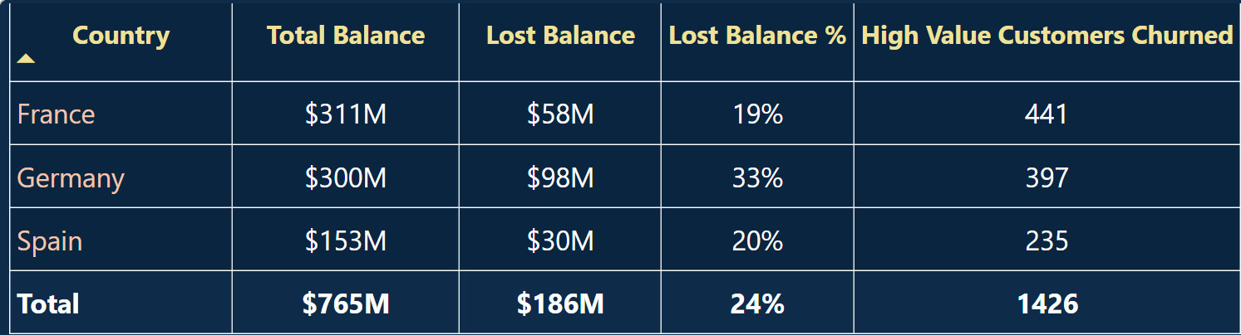
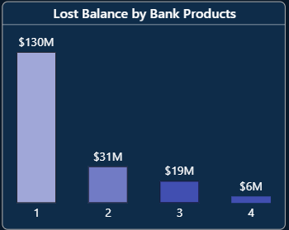
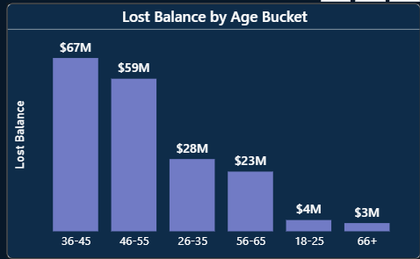
Churn Impact Analysis
Customer churn resulted in a total balance loss of $186M (24% of total bank balance), showing significant financial exposure.
Germany has the highest financial impact, losing $98M (33%), making it the highest risk country.
High-value customers contribute major churn loss, with 1,426 high-balance customers churning
The 36–55 age group contributes the highest lost balance, indicating financially mature customers create the biggest churn impact.
Low product engagement customers create maximum financial loss.

Slide 12
KEY INSIGHTS AND OBSERVATIONS
1 in 5 customers churned, showing a clear retention problem.
Inactive customers are the highest Churn segment .
High-value customers form a major portion of financial loss.
Customers with multiple products show better retention, highlighting cross-sell opportunities.
Active customers are significantly more loyal, proving engagement improves retention.
The 36–55 age group contributes the highest financial loss, making them a key risk segment.
Customer churn has resulted in $186M balance loss (24%), showing major financial impact.
Customer tenure alone does not guarantee loyalty, showing engagement matters more than duration.

Slide 13
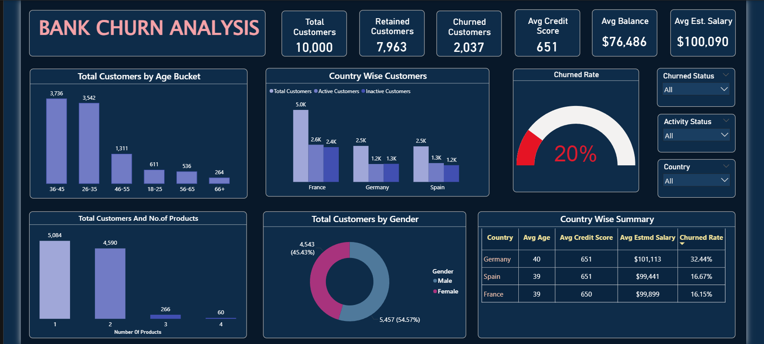
1. Bank Churn Overview Dashboard

Slide 14
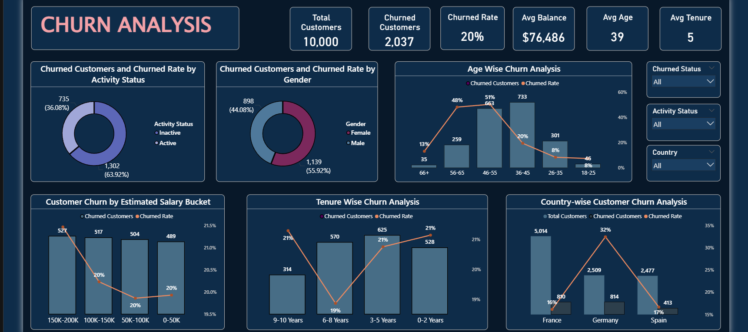
2.Churn Analysis

Slide 15
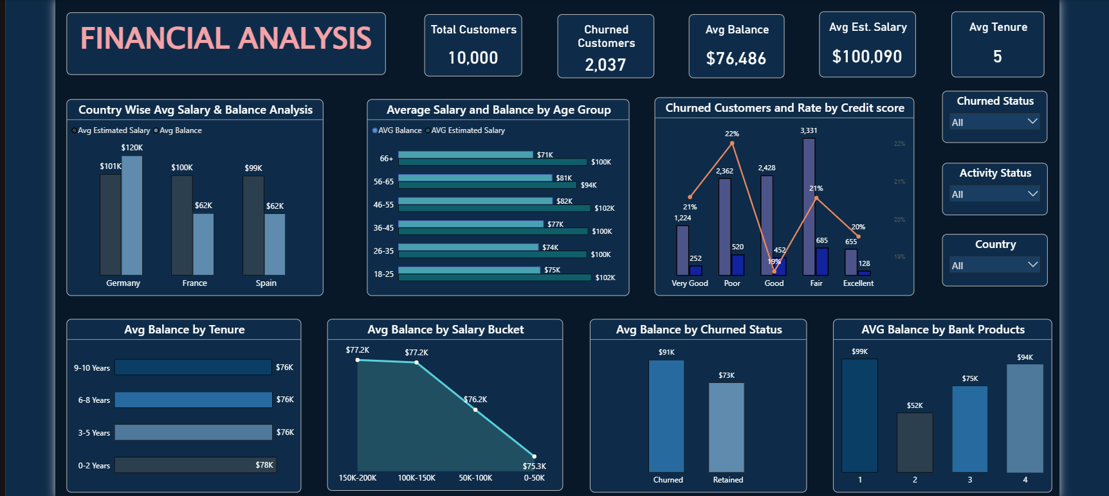
3. Financial Analysis

Slide 16
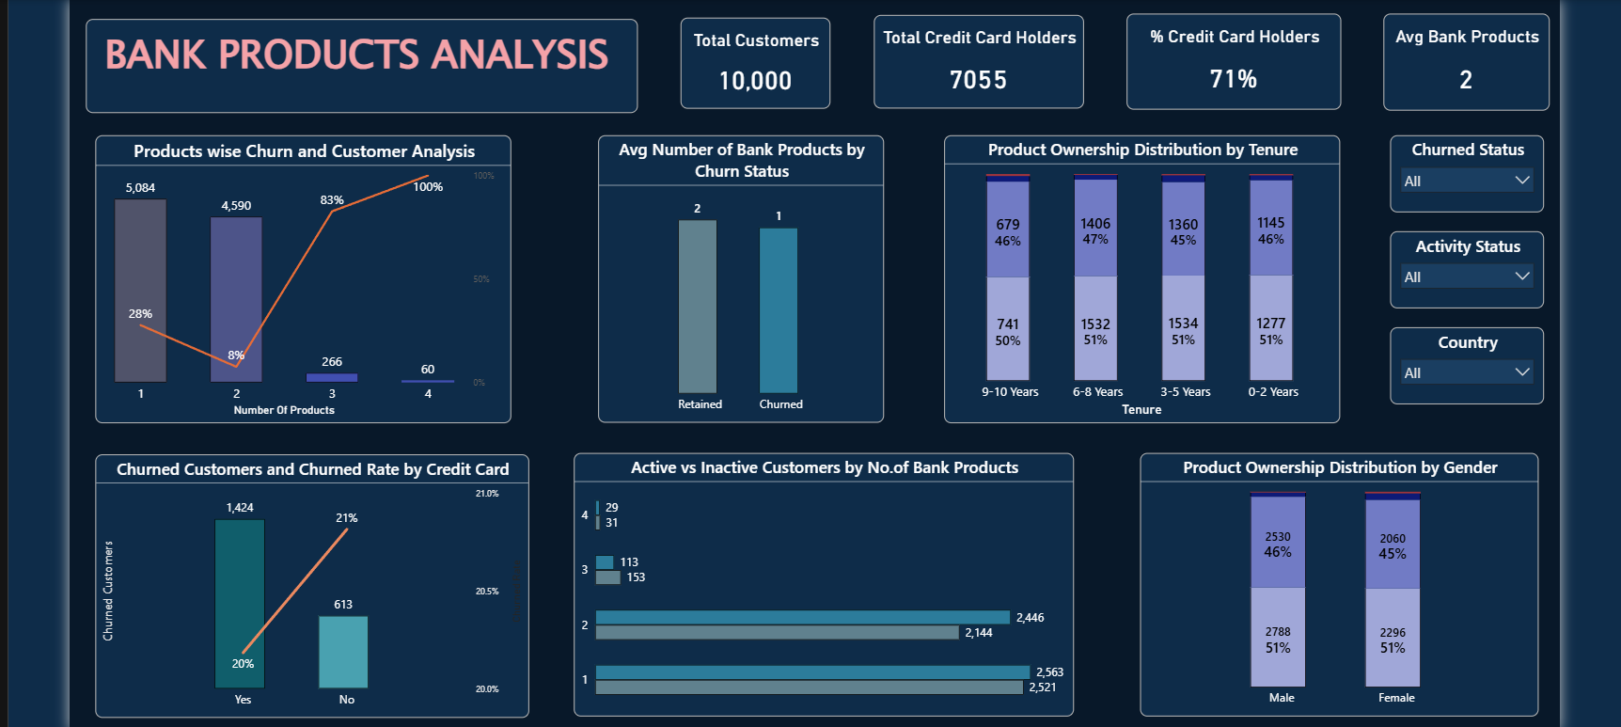
4. Bank Products Analysis

Slide 17
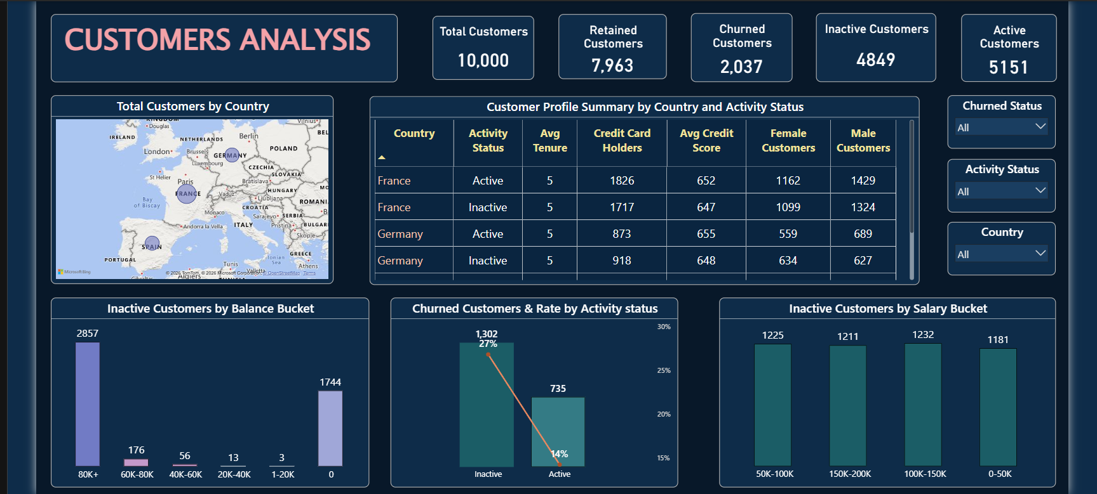
5. Customer Engagement and Loyalty

Slide 18
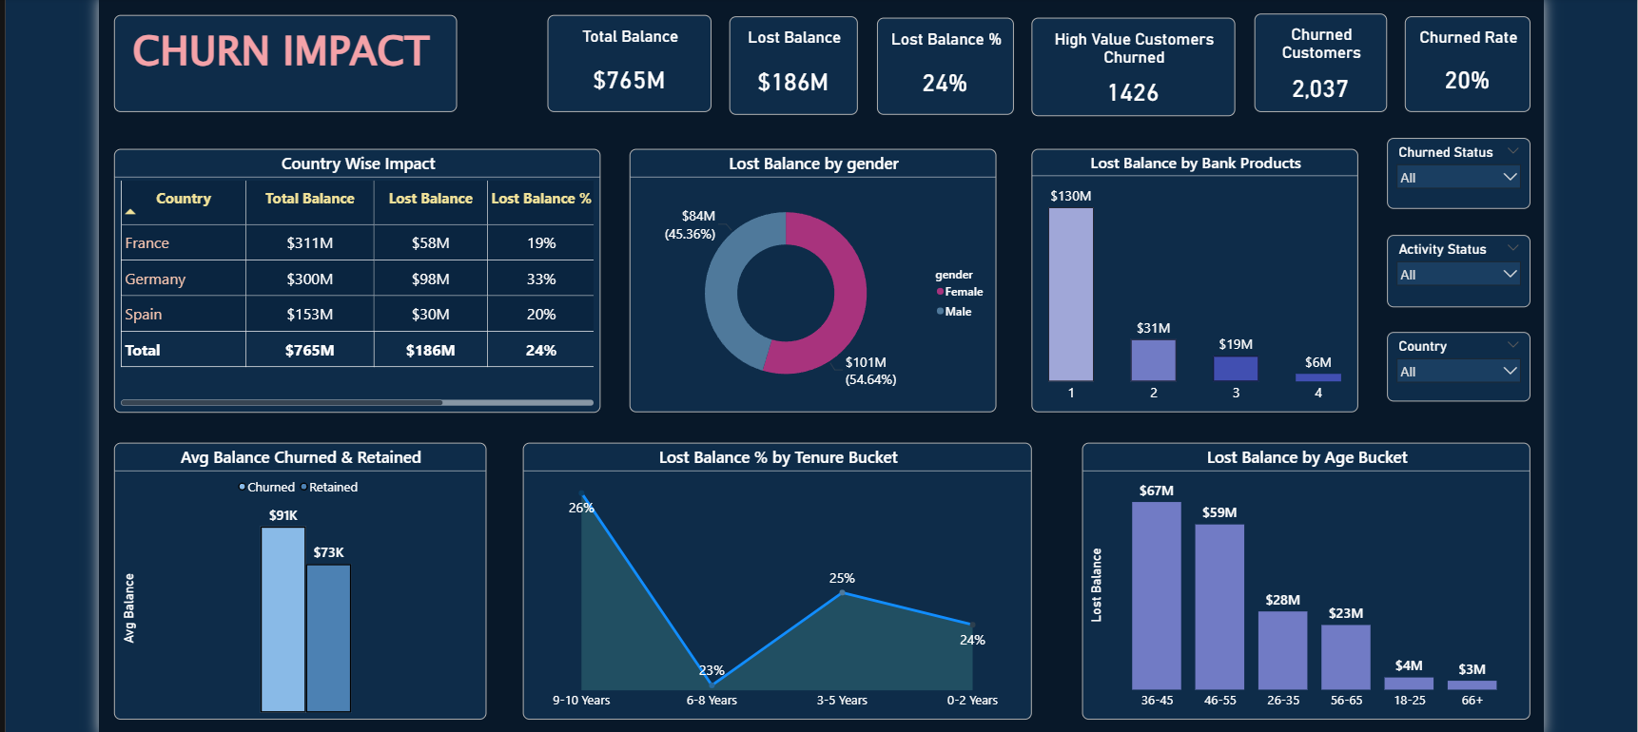
6. Churn Impact Analysis

Slide 19
RECOMMENDATIONS
1. Improve customer engagement by targeting inactive customers through personalized offers and communication.
2. Increase cross-selling strategies to encourage customers to adopt multiple bank products and improve retention.
3. Focus on high-value customers by implementing special retention programs to reduce financial loss.
4. Develop region-specific retention strategies, especially for Germany where churn risk is highest.
5. Introduce early churn detection using activity level and product usage patterns.
6. Strengthen loyalty programs to retain customers in the high-risk age group (36–55 years).
7. Provide targeted financial incentives (offers, benefits) to customers showing churn signals.

Slide 20
THANK YOU…

