Slide 1
Brazil E-Commerce Marketplace Performance Analysis
Sales • category• Sellers • Payments • Delivery
2025 | Power BI Project

Slide 2
CONTENTS
Introduction
Dataset and Study Area
Revenue and Sales Overview
Category Analysis
Sellers Performance
State – Level Market Place Performance
Payment Behaviour Insights
Delivery and Logistics Performance
Key Insights And Observations
Dashboard Demonstration (7 slides)
Recommendations

Slide 3
INTRODUCTION
This project analyzes a Brazilian e-commerce marketplace dataset from 2016 to 2018 to evaluate overall business performance across sales, sellers, payments, and delivery operations
The objective is to identify key revenue drivers, customer payment behavior, regional trends, and logistics efficiency using data-driven insights.
The analysis was conducted using Power BI, SQL, Excel, and DAX to simulate a real-world marketplace performance dashboard.

Slide 4
DATASET
Dataset | Brazilian E-Commerce Public Dataset by Olist
File Structure and Format | 9 CSV Relational dataset (multiple linked tables
Dataset Structure | 9 CSV files ~ 1.5 Million Rows ~ 52 Columns
Time Period | Year 2016 (September to December) Year 2017 (January to December) Year 2018 (January to October)
Data Source | Kaggle

Slide 5
TOOLS USED
EXCEL
SQL
POWER BI
Initial data exploration (columns, structure, content review). Cross - verification of SQL queries. Manual validation for duplicates and blanked values.
Built data model and relationships. Created Calculated columns and DAX Measures. Designed Dashboards and Visuals. Visual Analysis.
Major data cleaning and transformations. Handled missing values and duplicates. Updated and Structured tables. Created Joins between relational tables.

Slide 6
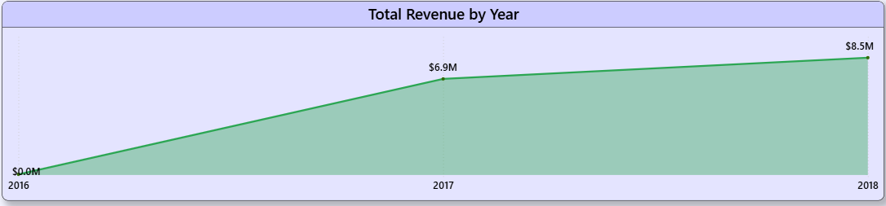
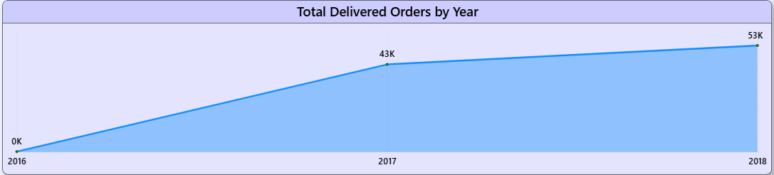
Revenue and Sales Overview
Consistent Revenue Growth (2016–2018): Sales showed a steady upward trend, with 2018 generating the highest revenue, indicating strong marketplace expansion and increasing customer trust.
Revenue Growth Driven by More Orders, Not Higher Spending: The increase in revenue was mainly due to a higher number of orders placed, rather than customers spending more per order.
Revenue Directly Linked to Order Volume: Revenue trends were strongly proportional to order placements — periods of higher orders resulted in higher revenue, while revenue declined during months with lower order volume.

Slide 7
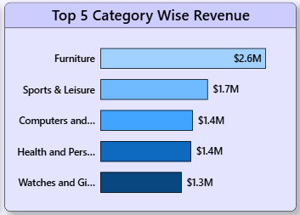
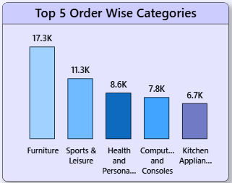
Category Analysis
Revenue Concentration in Top Categories: The top 6 product categories contribute 58.7% of total revenue and account for 48.7% of total orders, indicating that a small group of categories drives overall marketplace performance.
Minimal Contribution from Bottom Categories: The bottom 6 categories contribute only 1.03% of total revenue and 1.01% of total orders, highlighting a significant performance gap across product segments.
High AOV Category – Watches & Gifts: Although Watches & Gifts contributes 8.2% of total revenue, it has a higher Average Order Value (AOV) of 231, compared to categories like Furniture (AOV 150), indicating higher per-order spending despite lower order volume.

Slide 8
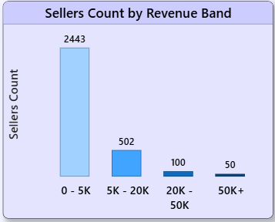
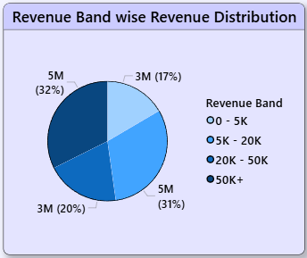
Sellers Performance
Majority Sellers Generate Minimal Revenue: Sellers in the 0–5K revenue band account for 78% of total sellers (3,095) but contribute only 16.8% of total revenue, indicating low productivity among a large portion of sellers.
Small Group Driving Major Revenue: Sellers in the 50K+ revenue band represent just 1.6% of total sellers, yet contribute 32% of total revenue, showing strong revenue concentration among top performers.
Significant Gap in Seller Productivity: The average orders per seller in the 50K+ band is 569, compared to just 8 orders in the 0–5K band, highlighting a major performance imbalance across seller segments.

Slide 9
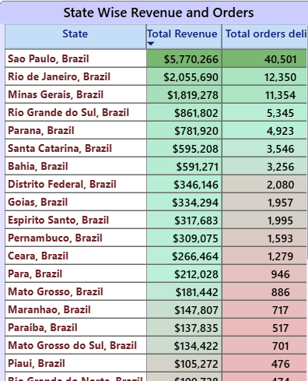
State-Level Marketplace Performance
Revenue Concentration in Top 3 States: Out of 27 states, São Paulo, Minas Gerais, and Rio de Janeiro contribute 62.5% of total revenue, with São Paulo alone generating 37%, establishing it as the core marketplace.
Order Volume Dominated by Key States: These same three states account for approximately 66–68% of total orders, with São Paulo alone contributing 42% of overall order placements, indicating strong demand concentration.
High Business Dependency on São Paulo: Both revenue and order share show heavy reliance on São Paulo, making it the primary growth driver and most critical regional market.

Slide 10
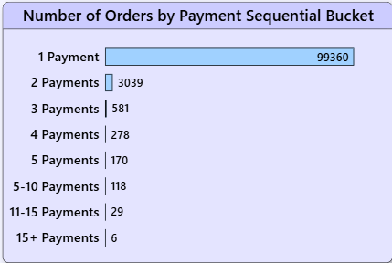
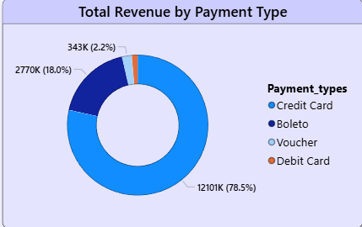
Payment Behaviour Insights
Credit Card Dominates Transactions: Credit card payments contribute 78.5% of total revenue and account for approximately 70–72% of total delivered orders, making it the most preferred payment method.
Average Payment Sequential = 1: The average payment sequence per order is approximately 1, indicating that most customers complete their purchase in a single payment transaction.
Majority Choose Single Installment: Average installment is 3, although nearly 45% of payments are made in 1 full installment, showing strong preference for immediate full payment over multiple installments.

Slide 11
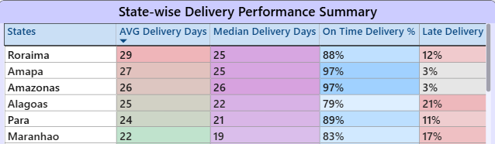
Delivery and Logistics Performance
Highly Efficient Delivery System: 97% of total orders were successfully delivered, with only 0.63% cancellations, reflecting strong operational performance. The average delivery time is 12 days (median 10 days), indicating consistent fulfillment timelines.
Stable Delivery Across Time & Categories: Monthly average delivery time ranges between 8–14 days, and category-wise between 8–12 days, showing relatively stable logistics performance across product segments and seasons.
Regional Delivery Variation with Strong Reliability: States like Roraima, Amapá, and Amazonas have higher average delivery times (25–30 days). However, Amapá and Amazonas maintain a 97% on-time delivery rate, the highest among all states. In contrast, the top-performing market São Paulo records a fast average delivery time of 8.7 days with a 95% on-time rate, balancing speed and consistency.

Slide 12
KEY INSIGHTS AND OBSERVATIONS
Revenue & Orders Are Highly Concentrated: Top 6 product categories contribute 58.7% of total revenue, and the top 3 states generate 62.5% of total revenue, showing strong business concentration.
Small Group Drives Marketplace Revenue: Only 1.6% of sellers (50K+ revenue band) contribute 32% of total revenue, while 78% of sellers generate just 16.8%, highlighting major seller performance imbalance.
Revenue Growth Is Volume-Driven: Revenue trends are directly proportional to order volume, indicating growth is driven by higher order placements rather than higher spending per order.
Credit Card Is the Dominant Payment Mode: Credit cards account for 78.5% of revenue and ~70%+ of total delivered orders, with most customers preferring single-installment payments.
Strong Operational Efficiency: 97% of orders are delivered successfully with an average delivery time of 12 days and only 0.63% cancellations, reflecting reliable logistics performance. Even states with higher delivery times (25–30 days) maintain high on-time rates, showing accurate delivery planning.

Slide 13
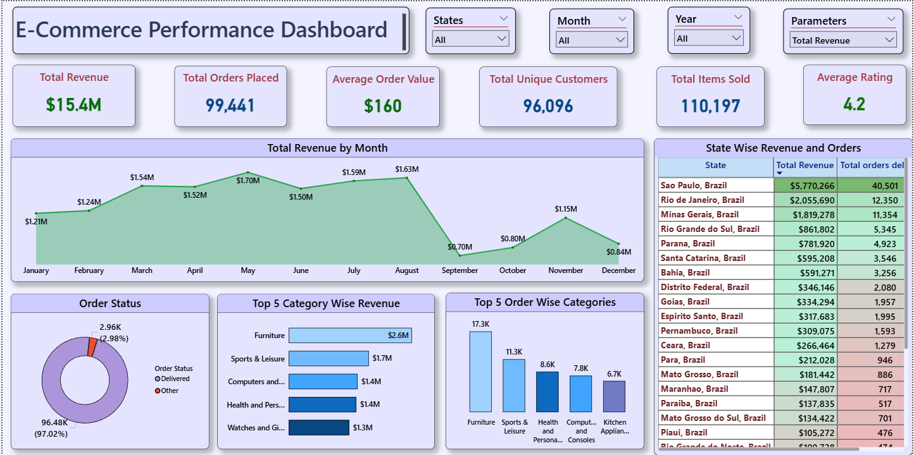
1. Performance Overview Dashboard
Provides a high-level summary of key KPIs including total revenue, total orders, total sellers, average order value, and overall marketplace performance.

Slide 14
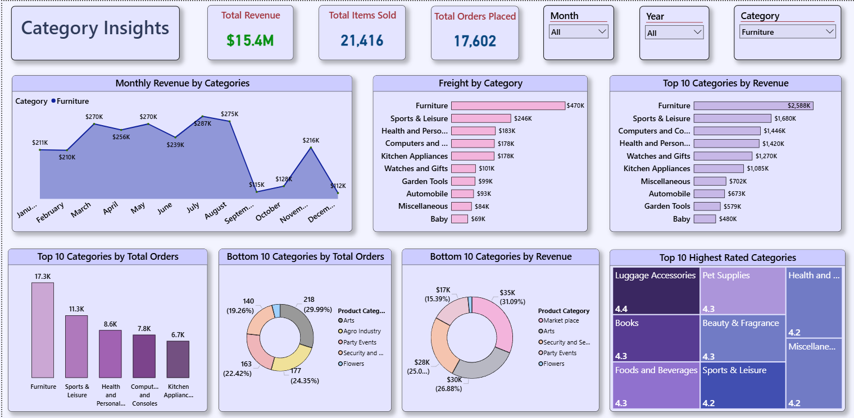
2.Category Analysis
Shows revenue concentration, order distribution, and AOV comparison across product categories.

Slide 15
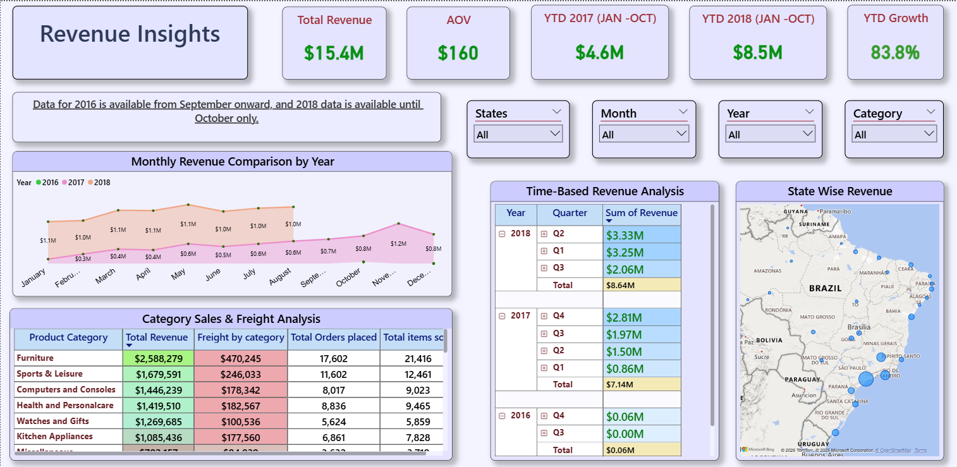
3. Revenue Analysis
Highlights revenue trends over time, growth patterns, and revenue contribution by key segments.

Slide 16
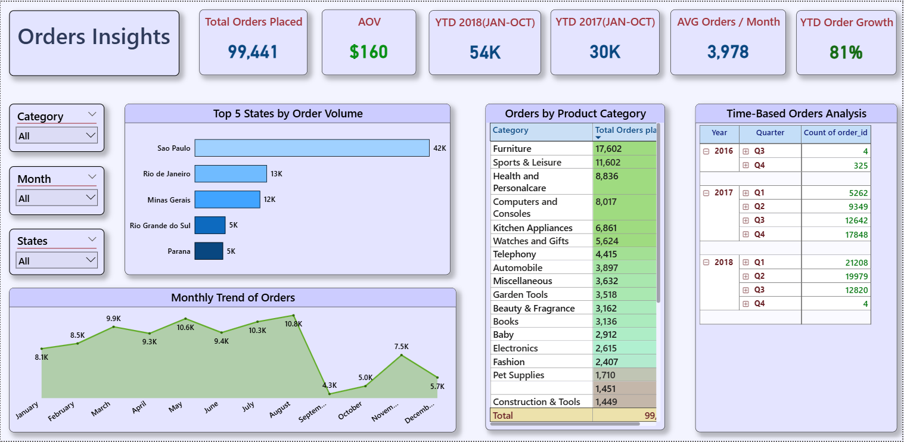
4. Order Analysis
Examines order volume trends, regional order distribution, and order performance metrics.

Slide 17
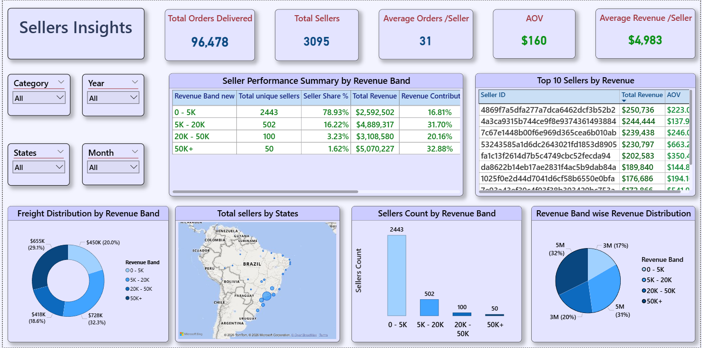
5. Seller Performance
Segments sellers by revenue bands to analyze contribution imbalance and productivity differences.

Slide 18
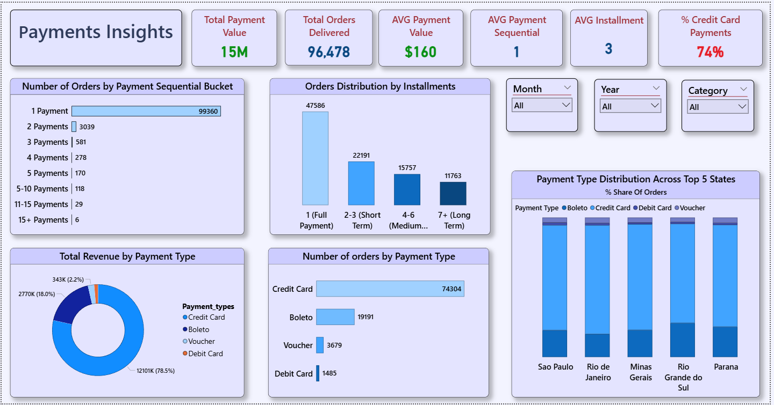
6. Payment Analysis
Breaks down payment methods, installment behavior, and revenue contribution by payment type.

Slide 19
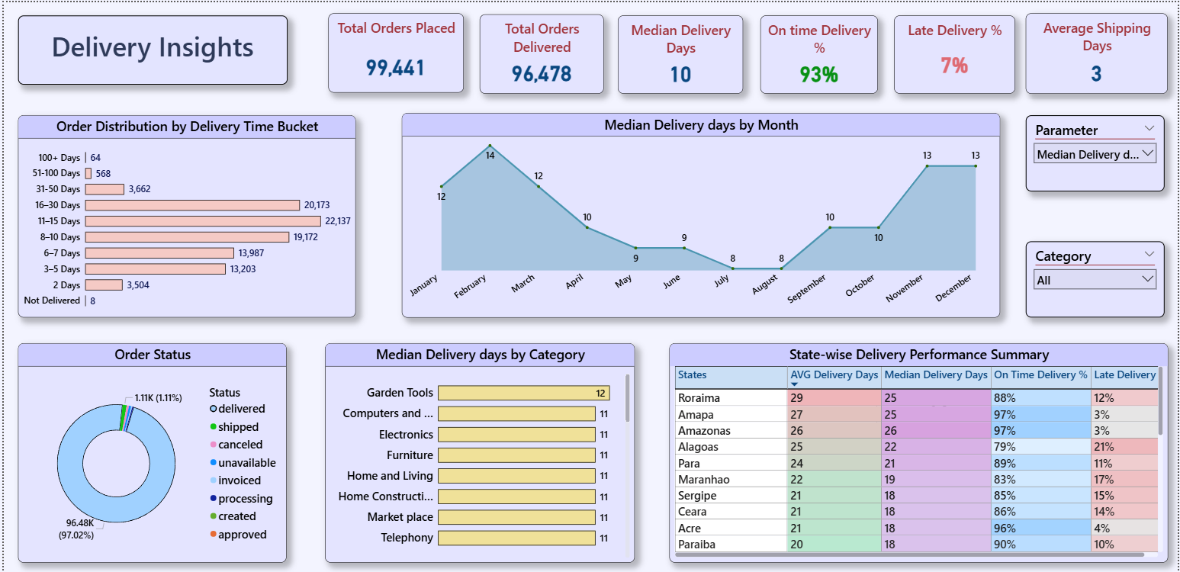
7. Delivery Performance
Evaluates delivery timelines, on-time performance, cancellations, and state-wise logistics efficiency.

Slide 20
RECOMMENDATIONS
1. Improve Low-Performing Seller Productivity:
Provide Support And Promotional Visibility To Increase Contribution From The 0-5k Revenue Band Sellers.
2. Expand Beyond Core States:
Reduce heavy dependence on São Paulo and other top states by strengthening presence in underperforming regions.
3. Promote High AOV Categories:
Focus marketing efforts on high-value categories like Watches & Gifts to drive revenue without relying only on order volume.
4. Optimize Payment Incentives:
As credit cards dominate transactions, offering targeted incentives (cashbacks, EMI benefits) could further strengthen high-value transactions.
5. Maintain Strong Delivery Standards

Slide 21
THANK YOU…

