Slide 1

Prakritik Compost : A Smart Compost Manure System
Team : TechTitans(Ncit)
Yunika Bhandari
Suyog Lamsal
Kuber Pathak
Akhil Joshi

Slide 2
Introduction
In recent years,sustainable agricultural practices have become crucial in addressing environmental challenges.
One of the key aspects of sustainable farming is efficient composting.
As traditional manner , landfilling is the most commonly used method but this leads to spread excessive amount of carbon dioxide and methane biogas in air .
To reduce it smart composting is the best solution to reduce the negative effects that result from the propagation of organic waste on soils by transforming organic waste into mature compost .

Slide 3
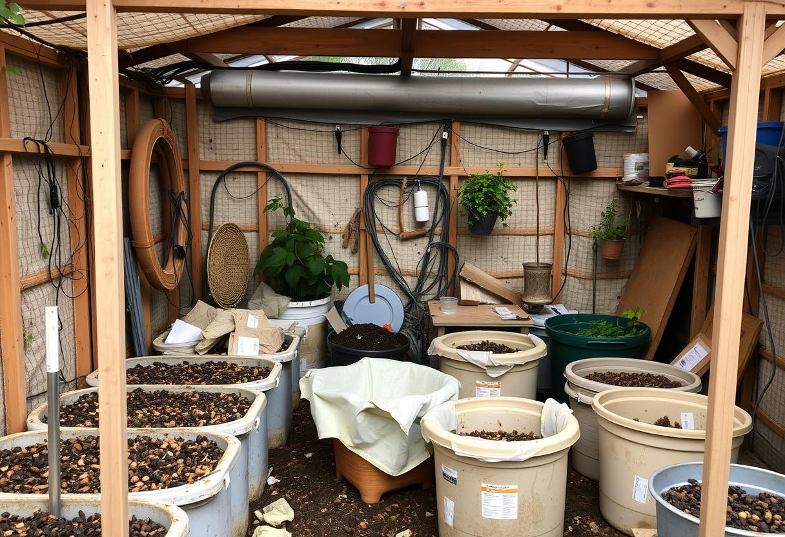
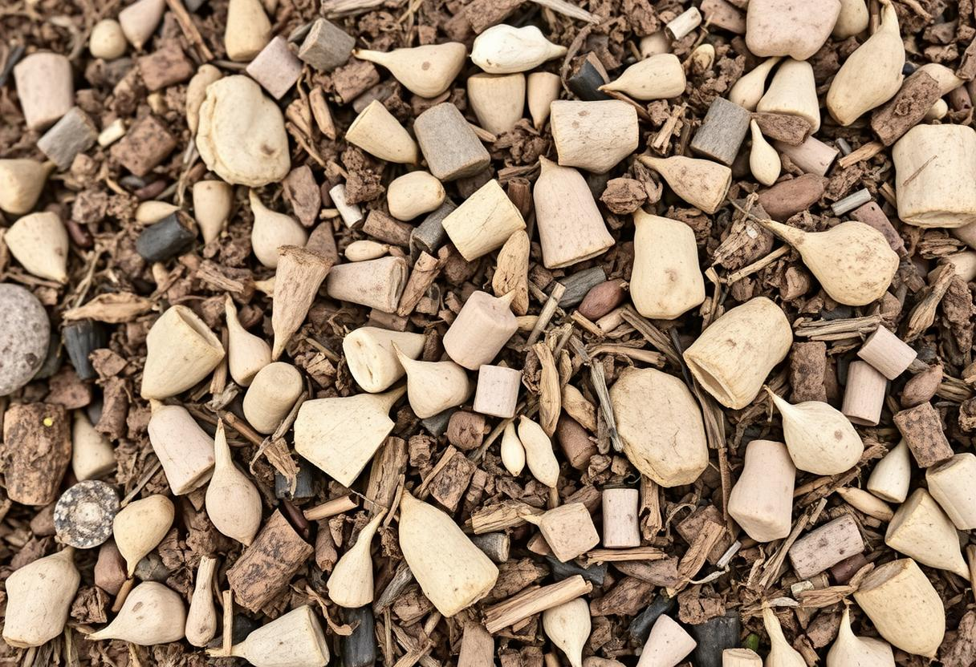
Problem Identification
Inefficient Monitoring: Manual monitoring is time-consuming and prone to errors.
Inconsistent Compost Quality: Lack of automation leads to variable compost quality.

Slide 4
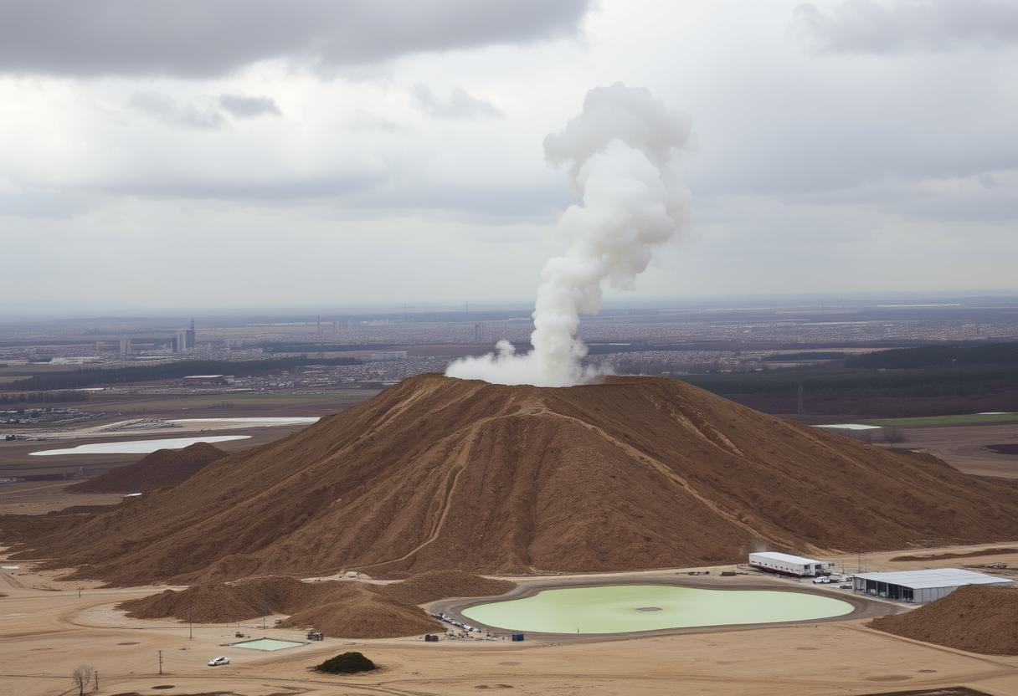
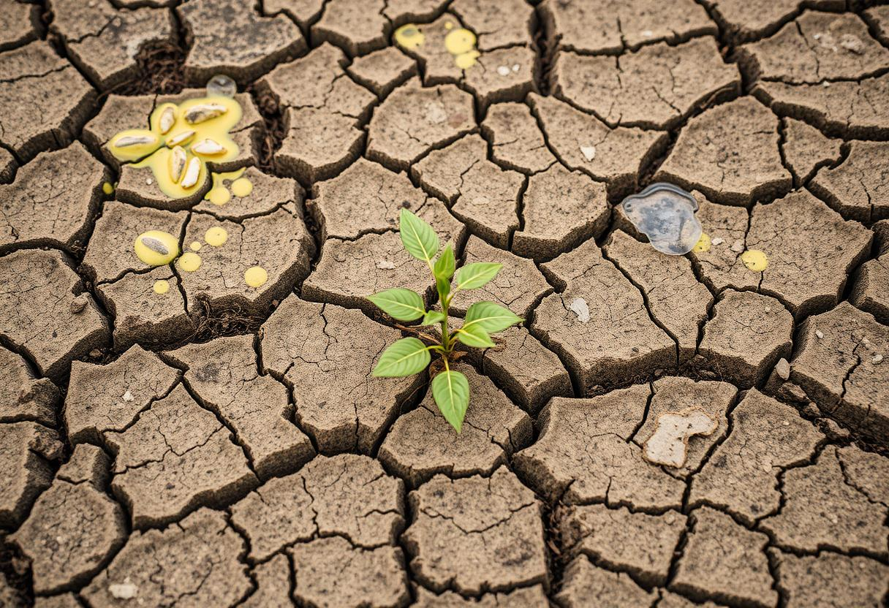
Problem Identification
Methane Emission Risks: Methane emissions contribute to global warming.
Soil Degradation : Toxic leachate contaminates soil and groundwater.

Slide 5
Solution And Execution
It predicts estimated compost readiness time using AI and innovative real-time monitoring of the composting system .
The system uses sensors to monitor temperature, humidity, and methane levels, optimizing the composting process and reducing methane emissions.
It produces high quality compost and captures methane gas for energy production .

Slide 6
Execution
Organic waste is processed in the composting unit.
Sensors continuously monitor conditions, sending data to an AI-based system that predicts compost readiness.
The waste composting starts to decompose and produces methane gas , that is captured and stored in a safe container for energy use.
User can monitor data via mobile app.
High-quality compost is produced for use in agriculture .

Slide 7
Technical Implementation
Sensors: Measure temperature, humidity, and methane levels to ensure optimal composting conditions.
AI Integration: Predicts compost readiness based on sensor data, optimizing the process.
Mobile App: Captures and represent the live statistics.
Gas Collection: Methane is captured and stored in a container.

Slide 8
Scalability
The system can be scaled from individual farmers to larger farms .
Partnerships with local governments and agricultural cooperatives can expand reach.
It can be integrated into urban waste management solutions, reducing landfill burden and turning waste into valuable resources.

Slide 9
Innovation
The integration of smart sensors and AI into the composting process.
Provides Dual Output both (Compost +Biogas).
Methane Collection for Biogas adds a revenue-generating aspect to composting.
Creativity
Focuses on environment sustainability and address agricultural needs.
Harmful methane gas is utilized to new energy source.
Customizable for various scales households, farms, or municipalities, allowing broad applications.

Slide 10
Challanges
Initial Investment: The upfront cost of the system may be a barrier for small farmers.
Technical Maintenance: Regular maintenance of sensors and gas collection systems may be required.
Future Scope
Expansion to farms and municipalities for broader waste management.
Collaborating with government initiatives on sustainable agriculture and waste management.

Slide 11

Why Prakritik ?
Real-Time Monitoring System
Dual Output
Targets Zero-Waste
Supports SDGs
Optimized Composting process
Less Composting Time

Slide 12


