Slide 1




PROJECT M2: PREDICT GLOBAL TRENDS FROM SOCIAL MEDIA
TEAM NP
CSGS HACKATHON

Slide 2



THE IDEA
TOPIC MODELING AND SENTIMENT TRENDS ANALYSIS IN SOCIAL MEDIA DISCOURSE BETWEEN OPPOSING FORCES
In this hackathon project, we aim to uncover the stories behind social media debates between opposing groups. By analyzing shared topics and tracking how sentiments change over time, we will explore how people on different sides react to and evolve their views on key issues. Through topic modeling and sentiment analysis, we’re not just crunching data; we’re gaining insight into the real emotions and perspectives that drive these online conversations. Our goal is to understand what shapes and shifts public opinion.

Slide 3

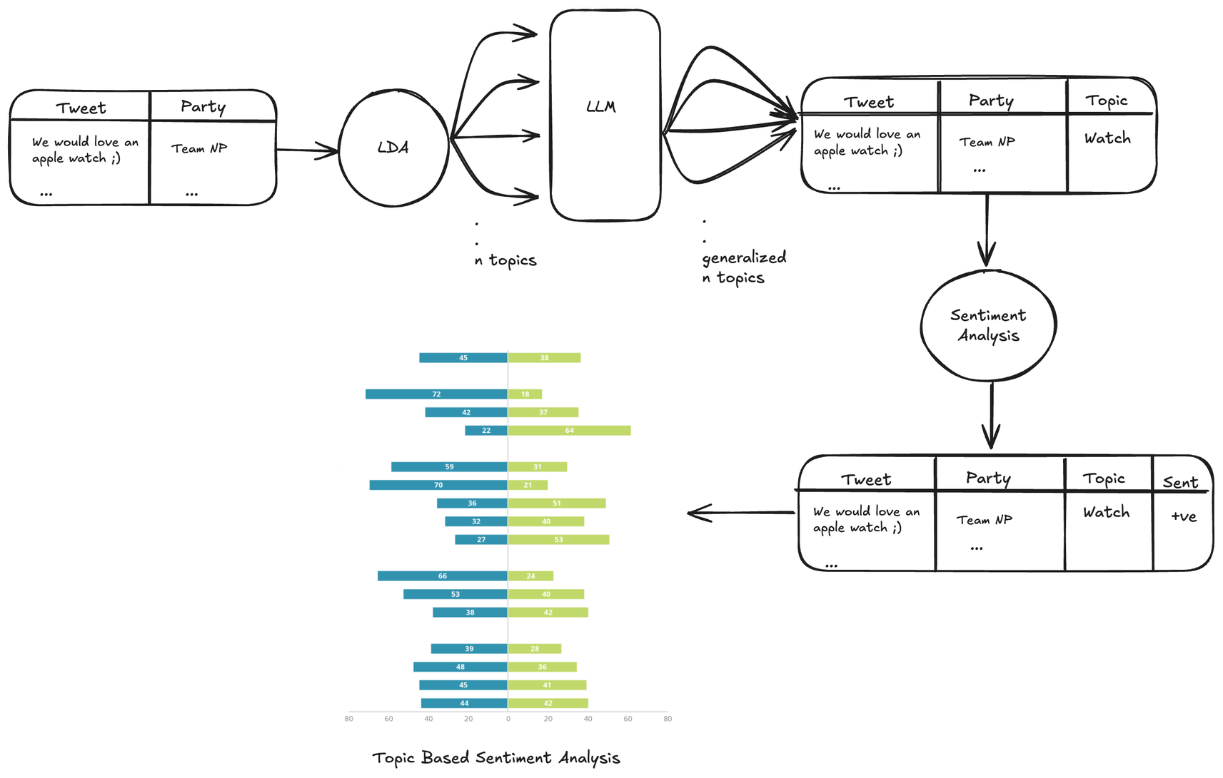
THE PROCESS

Slide 4





USE CASES
THIS PROJECT GOES BEYOND JUST FINDING OUT WHAT PEOPLE ARE TALKING ABOUT—IT REVEALS HOW THEY FEEL ABOUT THE KEY ISSUES.
SPOT COMMON GROUNDS
TRACK SHIFTS OVER TIME
PREDICT TRENDS
Are there topics where both sides actually feel positive? This can help bridge divides and focus on shared values
See how big events, policies, or news impact each side's mood on certain issues, showing real-time public reaction.
By watching how sentiments evolve, we might even predict which topics will become more polarized or find areas where opinions could soften.

Slide 5


