Slide 1
Database Management System
Instructed By
Bikul Raj Koirala (Associate Program Head, Level 5)

Slide 2
What is Database?
Before we learn Database Management System (DBMS) Software, let's understand- what a database is?
A database is a collection of related data which represents some aspect of the real world. A database system is designed to be built and populated with data for a certain task.
System or application that manages database is database management system.
Overall, a database is nothing but a collection of information that is organized so that it can be easily accessed, managed and updated. A database is usually controlled by a database management system.

Slide 3
Introduction to DBMS::
Database Management System (DBMS) is a software for storing and retrieving users' data while considering appropriate security measures. It consists of a group of programs which manipulate the database. The DBMS accepts the request for data from an application and instructs the operating system to provide the specific data. In large systems, a DBMS helps users and other third-party software to store and retrieve data.
DBMS allows users to create their own databases as per their requirement. The term “DBMS” includes the user of the database and other application programs. It provides an interface between the data and the software application.

Slide 4
Characteristics of DBMS
Helps to store and manipulate data
Provides security and removes redundancy
Interface for other software applications
Support of multiple views of the data
Sharing of data and multi user transaction processing
DBMS allows entities and relations among them to form tables.
DBMS supports multi-user environment that allows users to access and manipulate data in parallel.

Slide 5
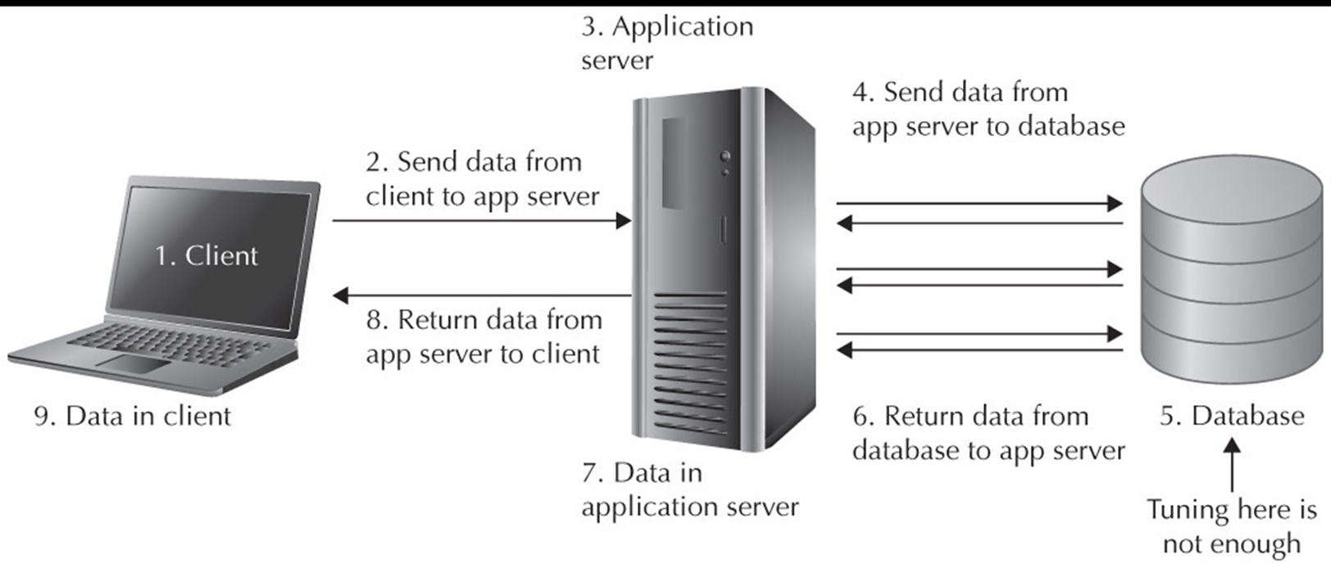
Client and Server

Slide 6
Advantages of DBMS
DBMS offers a variety of techniques to store & retrieve data
DBMS serves as an efficient handler to balance the needs of multiple applications using the same data
Uniform administration procedures for data
Application programmers never exposed to details of data representation and storage.
A DBMS uses various powerful functions to store and retrieve data efficiently.
Offers Data Integrity and Security
The DBMS implies integrity constraints to get a high level of protection against prohibited access to data.
A DBMS schedules concurrent access to the data in such a manner that only one user can access the same data at a time
Reduced Application Development Time

Slide 7
Disadvantages of DBMS
DBMS may offer plenty of advantages but, it has certain flaws-
Cost of Hardware and Software of a DBMS is quite high which increases the budget of your organization.
Most database management systems are often complex systems, so the training for users to use the DBMS is required.
In some organizations, all data is integrated into a single database which can be damaged because of electric failure or database is corrupted on the storage media
Use of the same program at a time by many users sometimes lead to the loss of some data.
DBMS can't perform sophisticated calculations

Slide 8
When not to use DBMS?
Although, DBMS system is useful. It is still not suited for specific task mentioned below:
Simply to store and retrieve data.
In a simple application where we don’t need to execute a query (SQL) or not to integrate any relation.
Not recommended when you do not have the budget or the expertise to operate a DBMS. In such cases, Excel/CSV/Flat Files could do just fine.

Slide 9
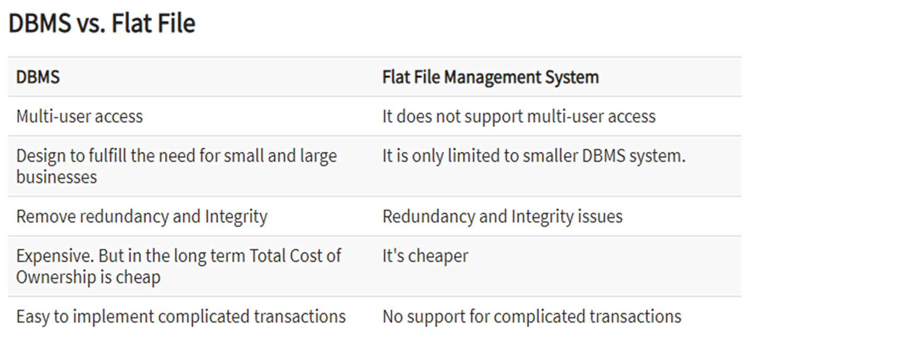
DBMS vs Flat-file

Slide 10
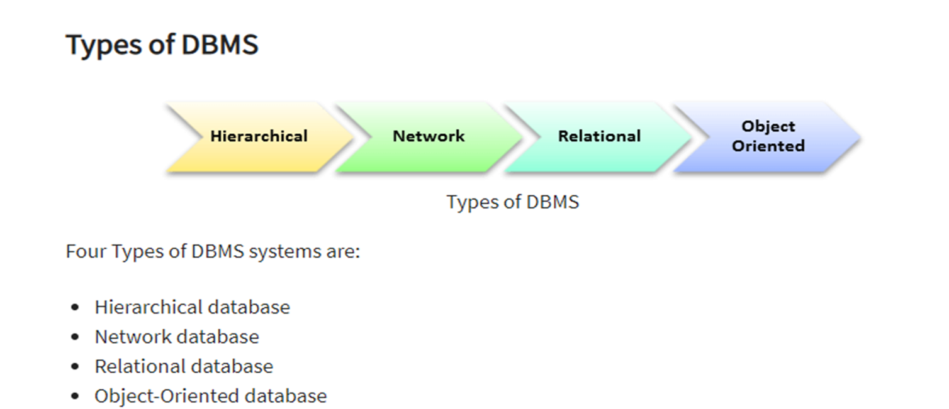
Types of DBMS models:: A Database model defines the logical design and structure of a database and defines how data will be stored, accessed and updated in a database management system

Slide 11
Discuss - Any Questions?
Database
Security, Large Applications and systems.
Flat file
Small requirements

Slide 12
Task::
Research about types of Database Models
Make a brief report

