Slide 1
SSMS – Define Foreign Key
CREATE TABLE Employee
(
Eid INT PRIMARY KEY,
Ename VARCHAR(30),
Salary MONEY,
Dno INT FOREIGN KEY REFERENCES Dept(Dno)
)

Slide 2
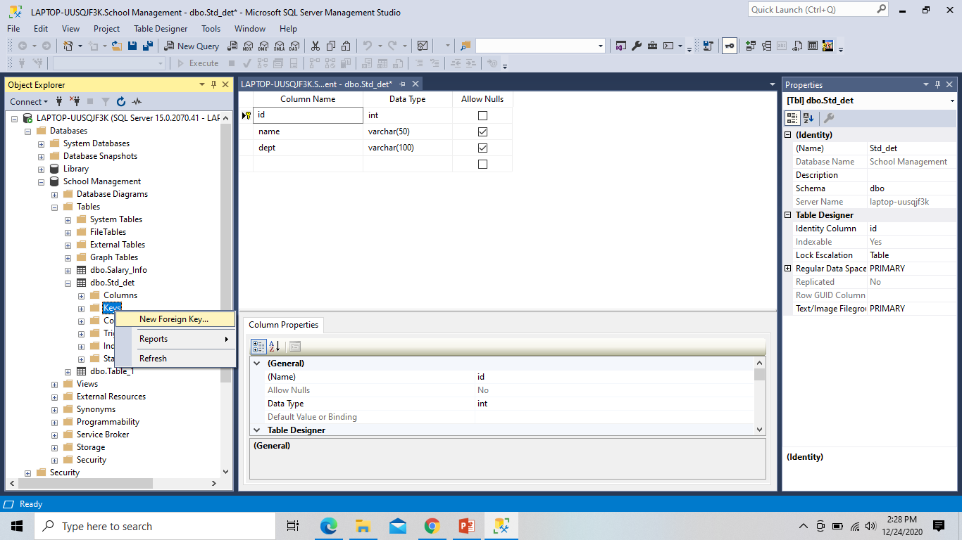
SSMS – Foreign Key

Slide 3
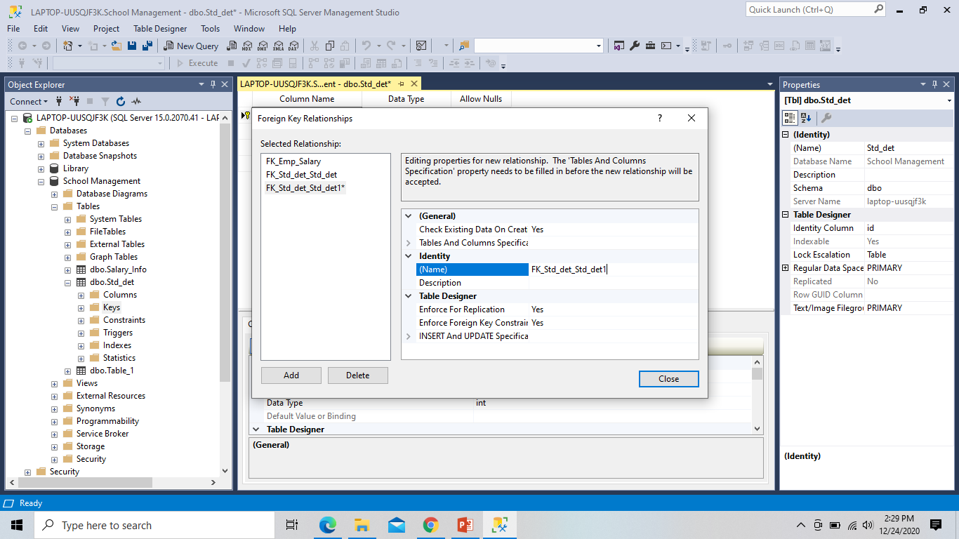
Unique Constraint::

Slide 4
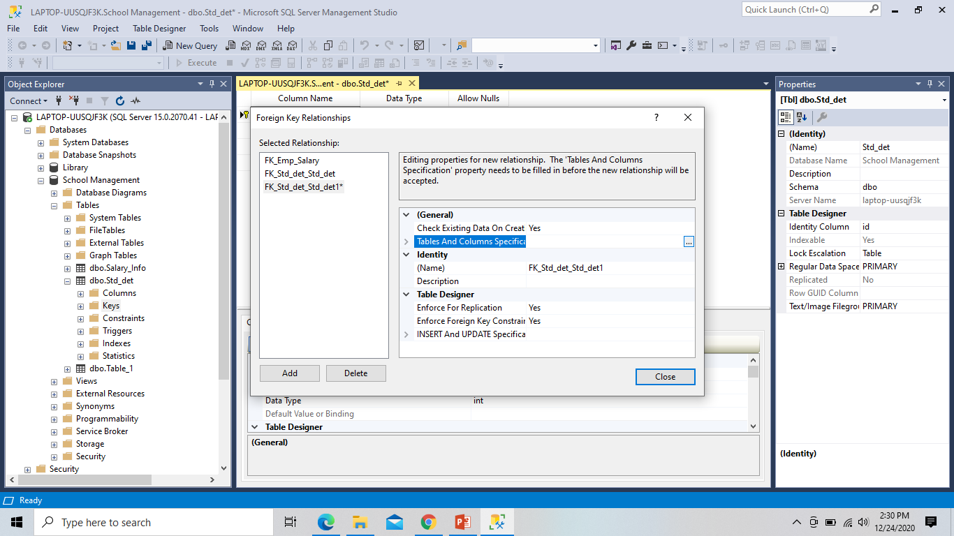
FK Constraint

Slide 5
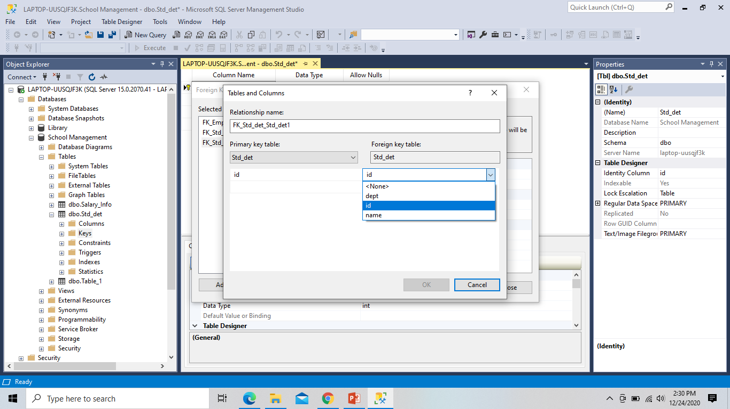
Adding FK Table

Slide 6
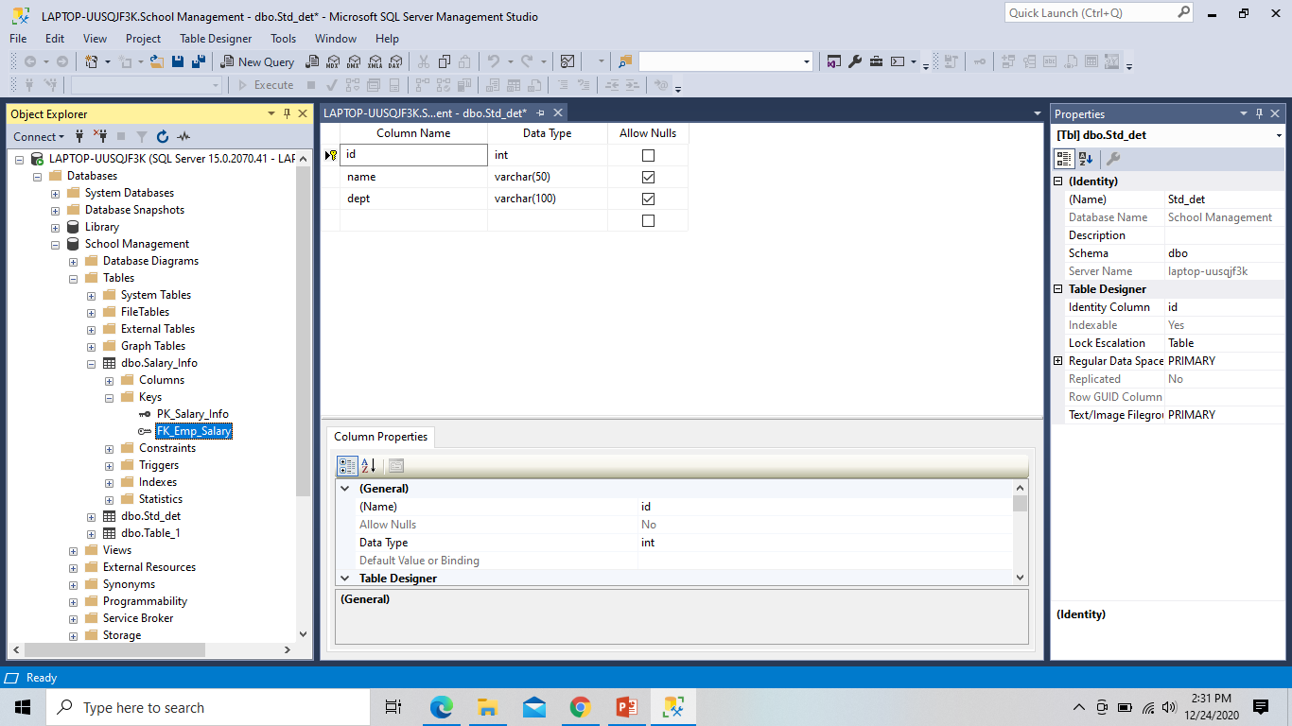
Check FK Defined ?

Slide 7
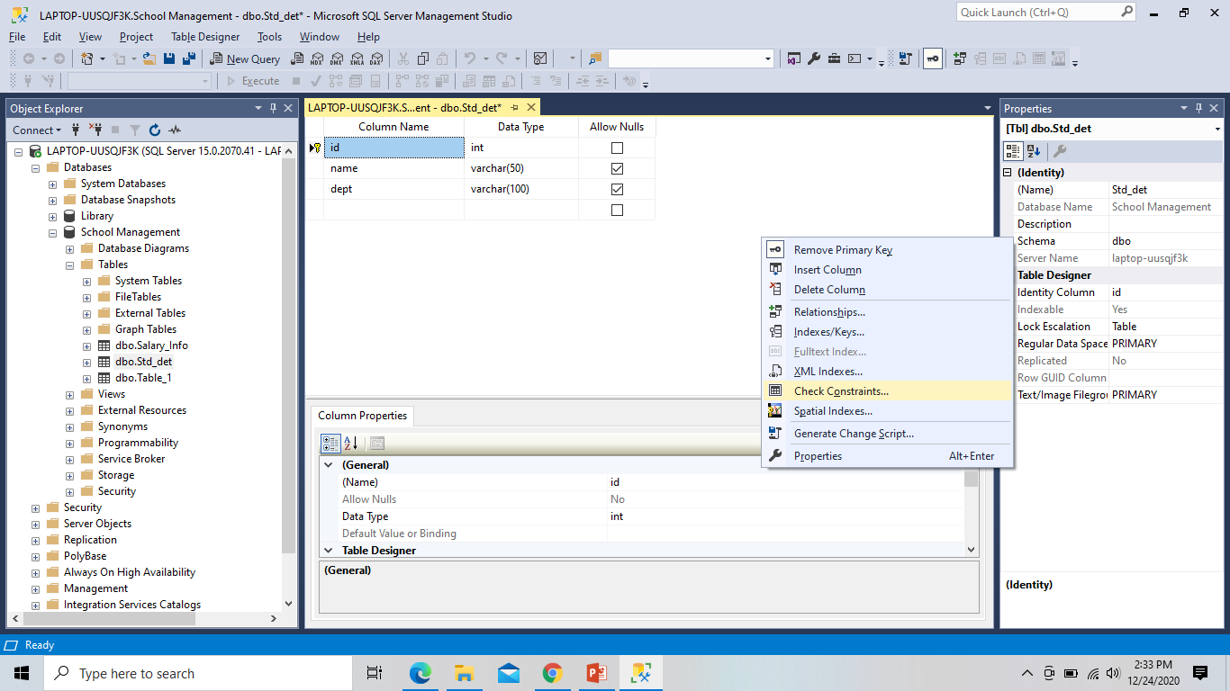
Add Domain Constraint::

Slide 8
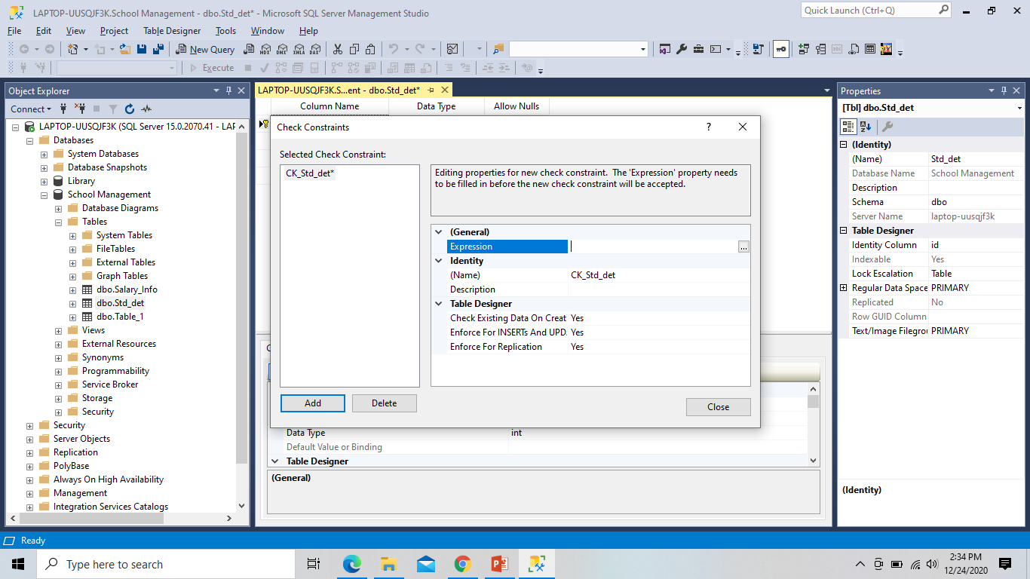
Add Domain Expression

Slide 9
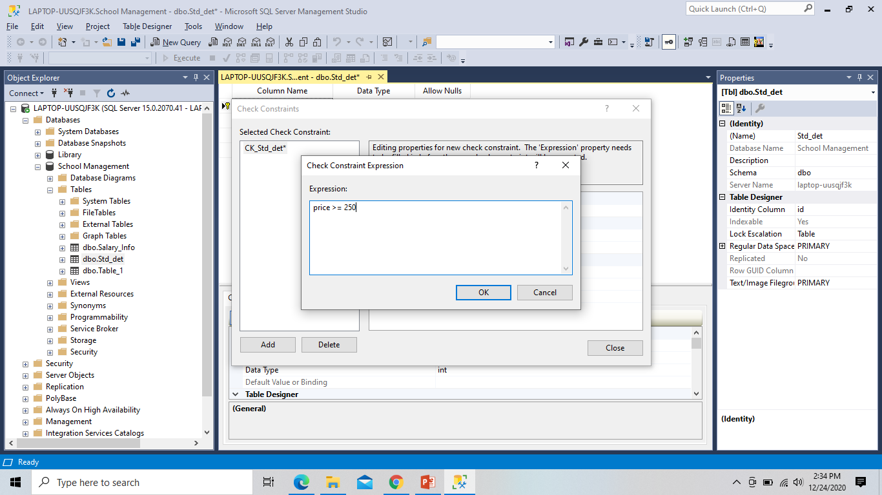
Add Domain Condition::

Slide 10
Add domain constraint using query::
CREATE TABLE Persons ( ID int NOT NULL, LastName varchar(255) NOT NULL, FirstName varchar(255), Age int CHECK (Age>=18) );

Slide 11
Task::
Create a database “Library”
Create multiple tables
Define Primary Key Index to all
Add relation FK, and check the conditions
Add Unique, Not Null indexes
Add Default Index Value
Add Domain Constraint
Now create a test plan and match the expected result with the output.

