Slide 1
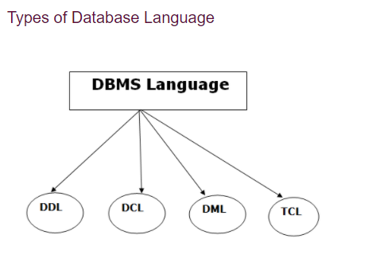
Database Language::
A DBMS has appropriate languages and interfaces to express database queries and updates.
Database languages can be used to read, store and update the data in the database.

Slide 2
Data Definition Language::
DDL stands for Data Definition Language. It is used to define database structure or pattern.
It is used to create schema, tables, indexes, constraints, etc. in the database.
Using the DDL statements, you can create the skeleton of the database.
Data definition language is used to store the information of metadata like the number of tables and schemas, their names, indexes, columns in each table, constraints, etc.

Slide 3
DDL Statements::
Create: It is used to create objects in the database.
Alter: It is used to alter the structure of the database.
Drop: It is used to delete objects from the database.
Truncate: It is used to remove all records from a table.
Rename: It is used to rename an object.
Comment: It is used to comment on the data dictionary.

Slide 4
Data Manipulation Language
It is used for accessing and manipulating data in a database. It handles user requests.
Here are some tasks that come under DML:
Select: It is used to retrieve data from a database. (Data Retrieval Language)
Insert: It is used to insert data into a table.
Update: It is used to update existing data within a table.
Delete: It is used to delete all records from a table.

Slide 5
Data Control Language
DCL stands for Data Control Language. It is used to retrieve the stored or saved data.
The DCL execution is transactional. It also has rollback parameters.
Here are some tasks that come under DCL:
Grant: It is used to give user access privileges to a database.
Revoke: It is used to take back permissions from the user.
There are the following operations which have the authorization of Revoke:
CONNECT, INSERT, EXECUTE, DELETE, UPDATE and SELECT.

Slide 6
Transaction Control Language
TCL is used to run the changes made by the DML statement. TCL can be grouped into a logical transaction.
Here are some tasks that come under TCL:
Commit: It is used to save the transaction on the database permanently.
Rollback: It is used to restore the database to original since the last Commit.
Savepoint: It is used to save the transaction on the database temporarily.

Slide 7
Example of Languages::
CREATE DATABASE Test;
// DDL - helps to define a database
INSERT INTO students (RollNo, FIrstName, LastName) VALUES ('60', 'Tom', Erichsen');
// DML – helps to add a record
GRANT SELECT, UPDATE ON MY_TABLE TO SOME_USER, ANOTHER_USER; // DCL – helps to grant permission to user on a table
DELETE FROM Students WHERE RollNo =25; COMMIT; // TCL – helps to permanently keep the changes in this transaction

