Slide 1
Reducing Missed Appointments in Brazilian Public Health Clinics
A data-driven analysis of appointment no-shows in Vitória, Brazil — and what clinics can do about them.
Prepared by: Suyog Wagle

Slide 2
A problem wasting resources every day
Missed appointments waste clinic resources, strain staff capacity, and delay critical care for patients waiting in line.
Total Records – 110K+
Appointments recorded from Vitoria, Brazil
Mised appointments- 22K+
out of approx. 110K total records
No-show rate- 20.19%
1 in 5 patients misses their appointment

Slide 3
Dataset
Kaggle Medical Appointment No-Shows – 110,527 records from Vitoria, Brazil (2016)
Tools
MySQL for data cleaning and preparation
Python for Exploratory Data Analysis
Tableau for data visualization and reporting
Key variables analysed
Age, neighbourhood, waiting days, SMS reminders, and Bolsa Família scholarship status — structured around 4 stakeholder questions.

Slide 4
Key Findings

Slide 5
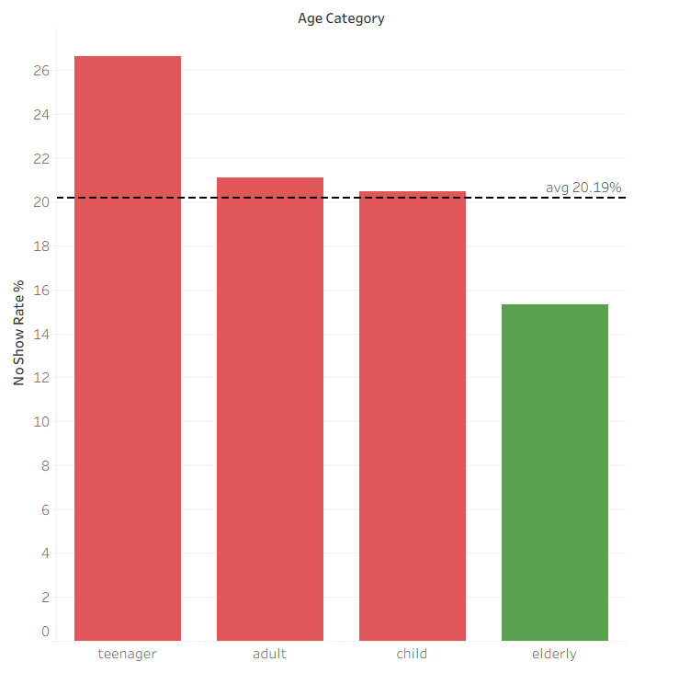
Teenagers miss the most appointments
Younger patients — particularly those under 20 — show the highest appointment no-show rates.
School schedules, lack of autonomy, lower perceived urgency of preventive care might be the reasons for such high no-show rate.

Slide 6
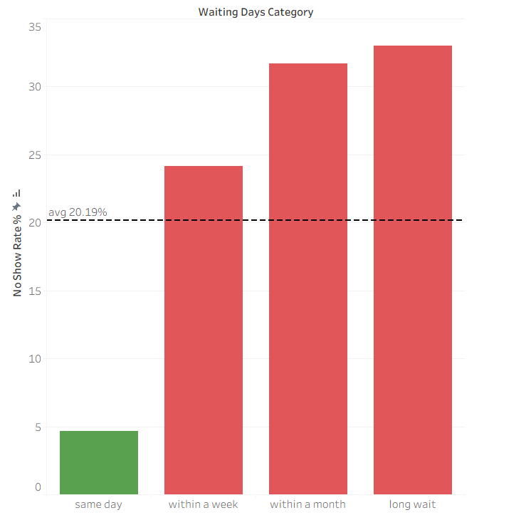
Longer wait times drive higher no-show rates
As the gap between scheduled date and appointment date increases, so does the likelihood a patient will not show up.
Same day appointments have less than 5% no show rate which drastically increases to 24% for within a week appointments which signifies the need for more same day appointments.

Slide 7
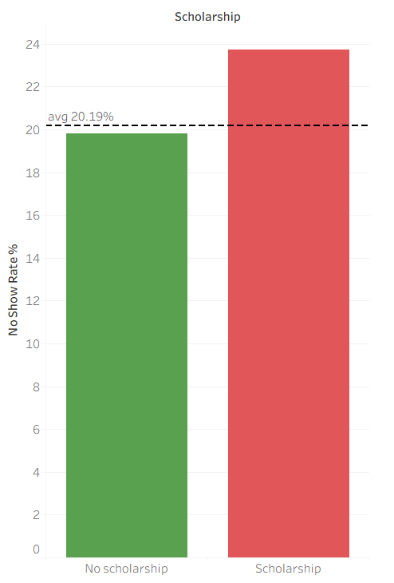
Bolsia Familia patients miss more appointments
Patients enrolled in Bolsa Família — Brazil's conditional cash transfer program — show consistently higher no-show rates. Structural barriers: transportation costs, work conflicts, childcare, or limited access to communication might be causing them to miss appointments.

Slide 8
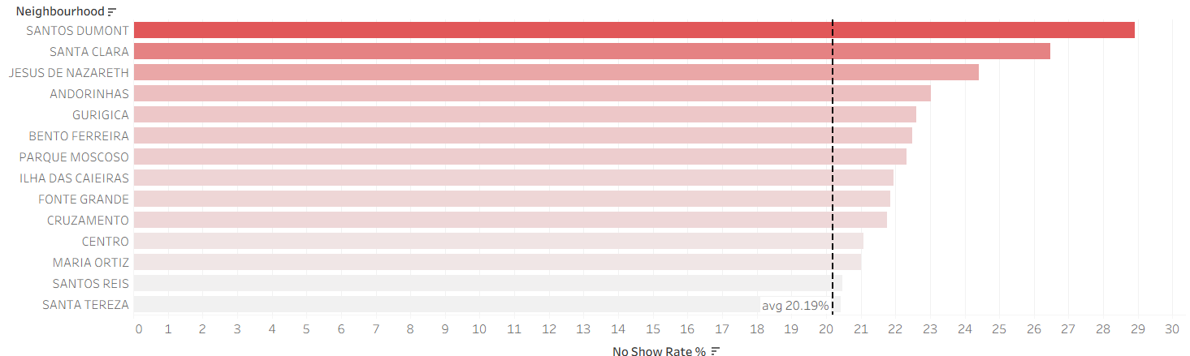
Neighborhoods Show Dramatic Variation
Santos Dumont leads with a 29% no-show rate — nearly 50% higher than the overall average. Nearby neighborhoods like Santa Clara also show elevated rates, suggesting localized barriers such as transportation access, safety concerns, or clinic proximity.

Slide 9
What can the clinic do?
Target Teenagers
Launch dedicated SMS campaigns and follow-up calls for patients under 20, possibly involving parents or guardians.
Reduce Wait Times
Schedule appointments same-day or within 7 days. Longer gaps erode patient commitment and increase no-shows.
Support Bolsa Família Patients
Proactively identify socioeconomic barriers — transportation, scheduling conflicts — and offer tailored support.
Focus on High-Risk Neighborhoods
Direct additional outreach and resources to Santos Dumont and Santa Clara, where no-show rates are highest.

Slide 10
Limitations and Next Steps
Limitations Next Steps
Note:A predictive, patient-centered approach can transform no-show reduction from reactive to proactive — saving resources and improving care access.
Data is from 2016 – demographics may have since shifted
Build a predictive model to flag high-risk patients before appointments
No information on root causes of missed appointments
Collect patient feedback to understand why appointments are missed
Covers only a few months of data, limiting seasonal insights
Expand analysis to other cities for broader comparison and generalizability

