Slide 1
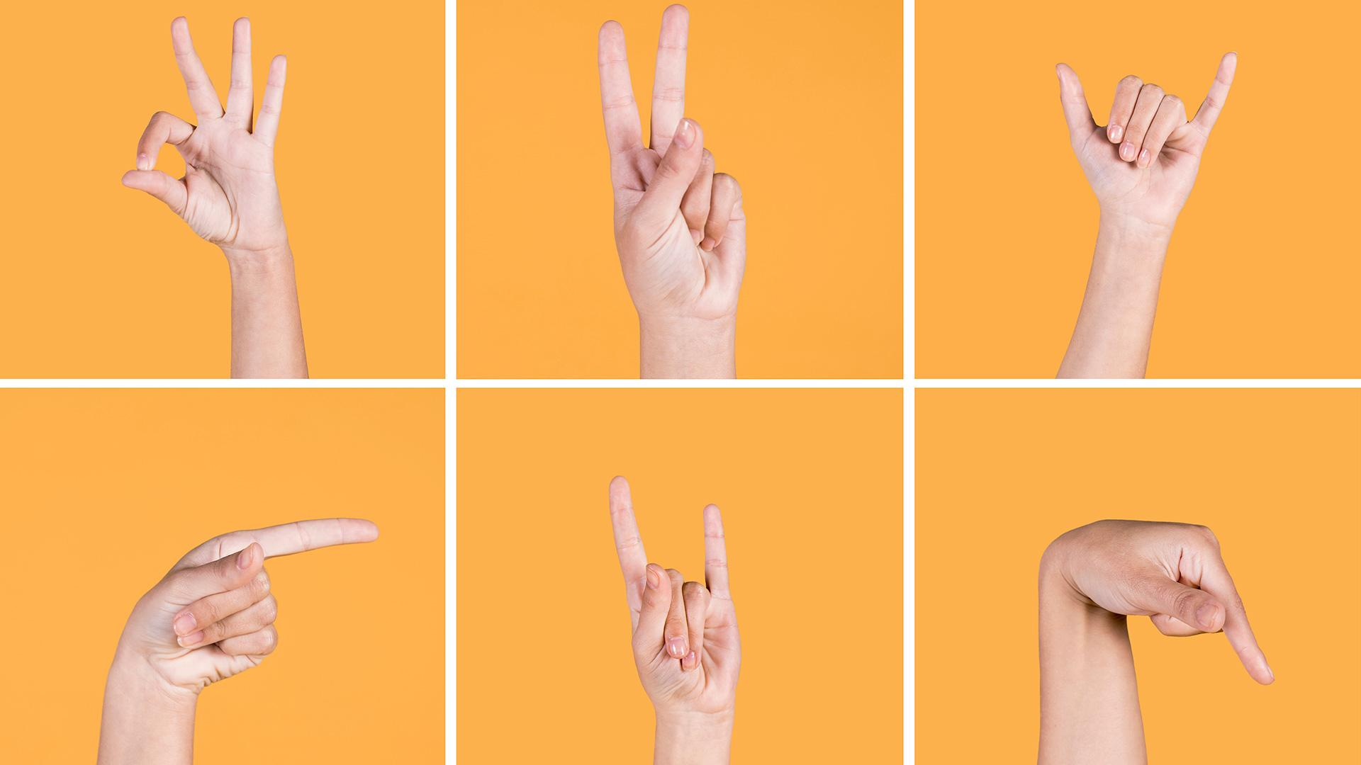
Deep Learning for Sign Language Recognition
Template from Slidesgo
Zimu Su
Metis Data Science Machine learning Bootcamp

Slide 2
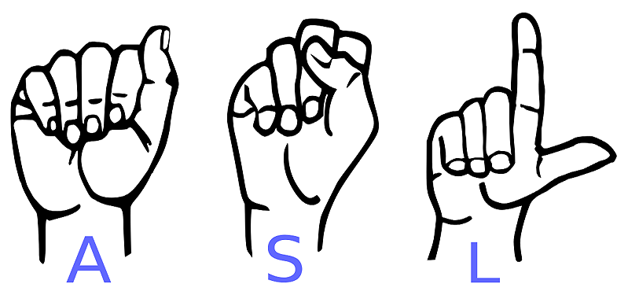
Objective and Background
Use deep learning to translate sign language to text, providing a more convenient communication approach for deaf people.
This project tests on American sign language (ASL).
Fontvilla.com

Slide 3
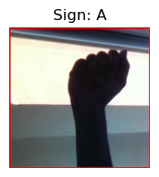
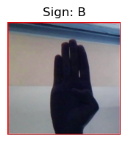
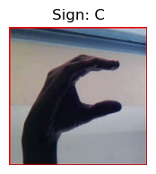
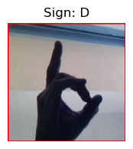
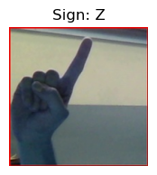
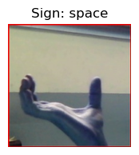
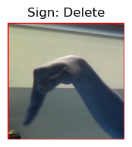
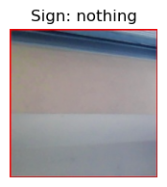
Dataset
Source: https://www.kaggle.com/datasets/grassknoted/asl-alphabet
29 Classes: letters A-Z, SPACE, DELETE and Nothing (Nothing for no sign)
87,000 images in total. 3000 images for each class.
…

Slide 4




Workflow and tool
Generate batches of image data with keras.imagedatagenerator
Validation using test image from dataset and custom images (photo by my own)
Get image array with Opencv, Numpy
Training:
Custom 3 layers CNN (1 channel, in google colab)
MobileNetV2, EfficientNetB0 (3 channels, embedded in keras)

Slide 5
Custom CNN layer setup (1 channel)
conv2d (Conv2D)
batch_normalization (Batch Normalization)
max_pooling2d (MaxPooling2D)
dropout (Dropout)
conv2d_1 (Conv2D)
batch_normalization_1 (Batch Normalization)
max_pooling2d_1 (MaxPooling2D)
dropout_1 (Dropout)
conv2d_2 (Conv2D)
batch_normalization_2 (Batch Normalization)
max_pooling2d_2 (MaxPooling2D)
dropout_2 (Dropout)
global_average_pooling2d (Global Average Pooling 2D)
flatten (Flatten)
dense (Dense)
dense_1 (Dense)
Notes:
Batch normalization for image information generlaization; dropout for preventing overfitting;

Slide 6
 | Training accuracy | Validation accuracy
Custom CNN | 0.9306 | 0.9690
MobileNetV2 | 0.8455 | 0.7731
EfficientNetB0 | 0.9859 | 0.9922

Slide 7
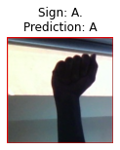
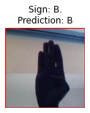
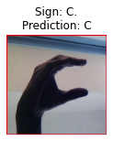
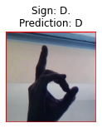
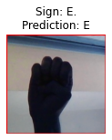
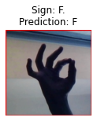
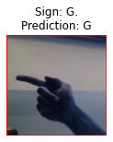
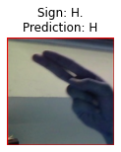
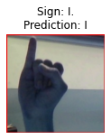
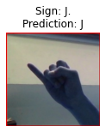
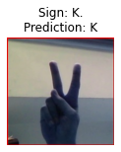
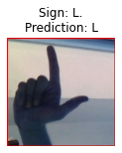
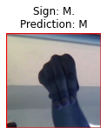
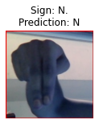
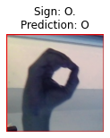
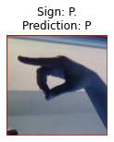
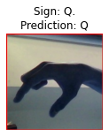
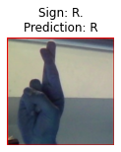
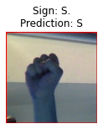
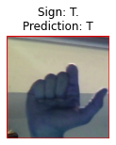
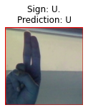





















Custom CNN Test results
Test image provided by datasets
Test image provided by myself

Slide 8
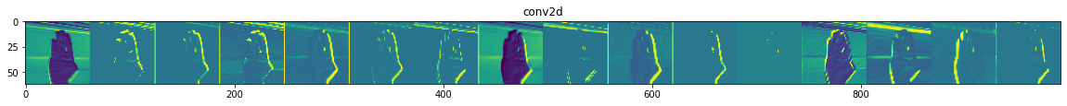
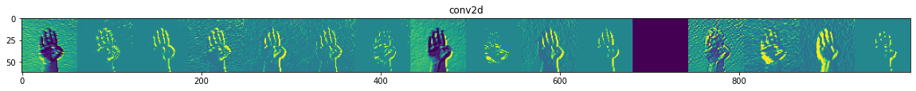
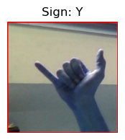
Feature map in CNN layers

Slide 9
Take away points
3 layer CNN model or transfer modeling EfficientNetB0 is adequate for ASL translation (hand gesture recognition).
Training dataset should contain more details of hand or fingers and diversify the image background. Unified images could generate bias.

Slide 10
Thank you for the attention!

