Slide 1

Research Article Recommender
Created by Zimu Su
Metis NLP project

Slide 2

Project Background
Recommendation:
Purpose: Build a recommendation system to be embedded into academic citation software like Mendeley, Endnote, Zotero, etc.
Function: The recommender can provide potential interesting research papers to the user once they select certain article.
Impact: The system can facilitate academic article searching and attract more users to utilize the software.
Article 1
Article 2
Article 1
Article 3
Article 2
Article 4
Article 3
…
…
Notes:
The initial motivation of this project originates from the moment when I tries to find adequate citation in my PhD thesis, because writing introduction requires great amount of literature search and reading, which takes really large amount of time.
So I think if there is a recommendation system which is embedded within the citation software, that would be great. Actually I haven’t seen similar product in those software like Mendeley, endnote, Zotero,
I saw a similar one in researchgate. It provides the new research articles by feed which is related to user’s research topic. I benefit from it a lot because there are some interesting papers.
This system would be similar and I think it would facilitate academic paper searching and broaden research’s view over the academic domain.

Slide 3

Modeling procedure
Topic Modeling
Recommendation system
Parse article abstracts and discriminate various topics among the database.
Select the top X articles with similar topic scores to the selected article.
Data source: https://www.kaggle.com/datasets/abisheksudarshan/topic-modeling-for-research-articles?select=Test.csv, including 14004 article abstracts.
Tool: Pandas, sklearns, nltk, numpy.

Slide 4
Topic Modeling
Preprocessing: select noun as parts of speech;
Word counting: Term Frequency-Inverse Document Frequency (TF-IDF); 1-3 grams; hyper parameters are tuned to exclude the word with too low or large frequencies;
Topic Modeling: Non-Negative Matrix Factorization (NMF).
Topic 1 learning, task, tasks, classification, word, machine, features, language, state, art
Topic 2 phase, spin, temperature, field, transition, state, quantum, states, energy, order
Topic 3 algorithm, problem, optimization, problems, algorithms, convergence, convex, functions, gradient, solution
Topic 4 galaxies, mass, star, gas, formation, galaxy, stars, emission, observations, cluster
Topic 5 network, networks, nodes, layer, layers, architecture, structure, training, node, networks networks
Machine Learning Problem
Quantum physics
Optimization algorithm
Astronomical physics
Network theory

Slide 5
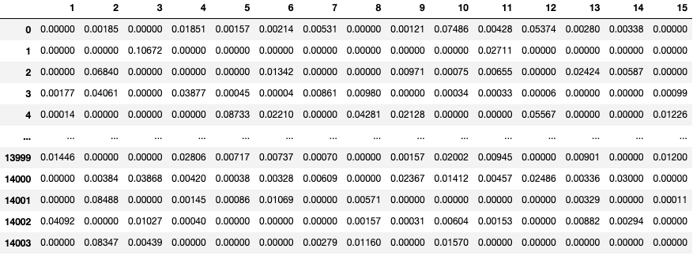
Recommendation system is built using cosine similarity computed based on the topic scores (obtained by NMF):
Topic
Documents(Research articles)

Slide 6
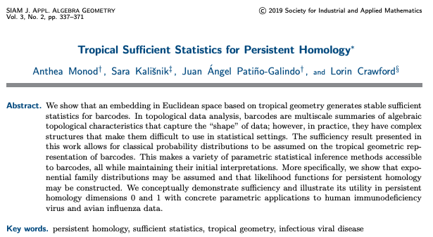
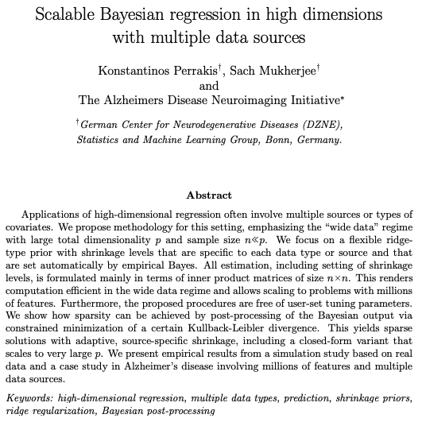
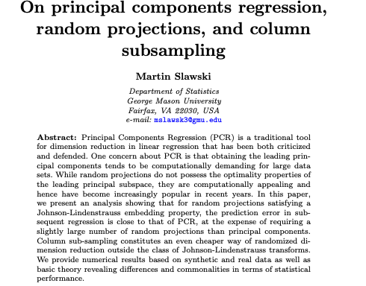
Example 1:
Recommendation 2:
Recommendation 1:
Topic: data, analysis, help, sets, data sets, data analysis, privacy, learning, information
Topic: distribution, estimator, approximation, function, distributions, estimators, regression, probability, inference
Topic: math, group, space, solutions, equation, equations, curvature, manifolds, case, groups
Notes:
They are all about processing technique dealing with large datasets using different statistical theory. The selected paper is about tropical geometry representation of barcodes, which is a certain mathematical characteristics to capture the shape of the data. The first recommended paper is about dimension reduction technique in linear regression. The second one is about using Bayesian regression for high dimensional datasets.

Slide 7
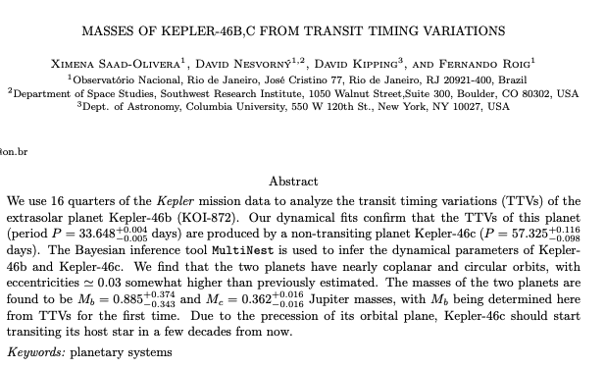
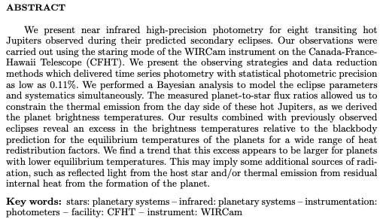
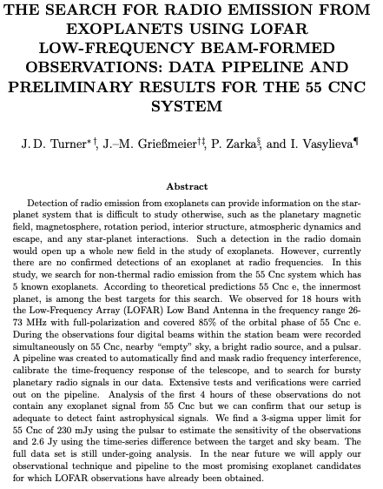
Example 2:
Recommendation 2:
Recommendation 1:
Topic: galaxies, mass, star, gas, formation, galaxy, stars, emission, observations, cluster
Topic: time, series, time series, dynamics, flow, time series data, series data, frequency, traffic, events
Topic: data, analysis, help, sets, data analysis,
Notes:
The second example focuses on the exoplanets studies using some sort of data processing method, like Bayesian analysis in the selected paper. Exoplanet is the planet outside the solar system. The recommended papers are also related to exoplanet. The first one is about building a data pipeline to discriminate the source of signal from potential exoplanets, because the telescopic cannot cover the sky range at one time. It needs to slowly capture the region and then a certain program is required to automatically monitor the sky region. The second paper is about time series analysis for obtaining the mass of exoplanet.

Slide 8

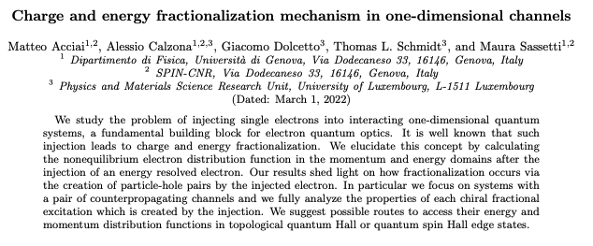
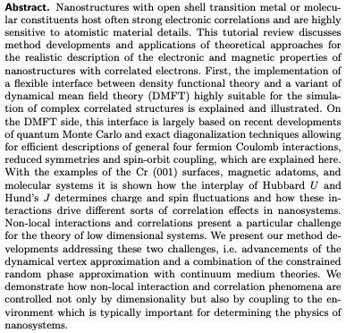
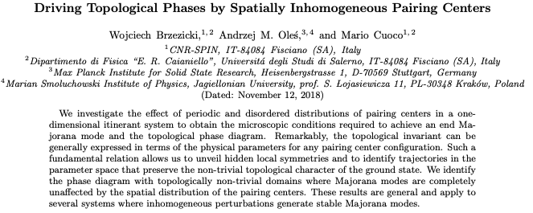
Example 2:
Recommendation 2:
Topic: phase, spin, temperature, field, transition, state, energy, quantum, states, order
Topic: control, systems, controller, design, power, dynamics, feedback, stability, paper, controllers
Topic: distribution, estimator, approximation, function, distributions, estimators, regression, probability, inference, error
Recommendation 1:
Notes:
The third example is related to physics at quantum scale. The recommended papers are somewhat similar as related to quantum physics, but they are absolutely studying very different topics.

Slide 9
Conclusions
The recommendation system works fine within a broad direction.
The recommended papers are related to a common general topic, like planet, quantum physics.
The system can be improved by refining research subdirection.
Specific research topic or direction are not related in the recommended papers, much because the topic modeling is not refined enough.
Most relevant recommended paper should be about principal components regression.
Notes:
If I choose principal components regression for high dimensional datasets, the system can offer the paper related to PCR at highest relevance, but not other data processing method.

