Slide 1
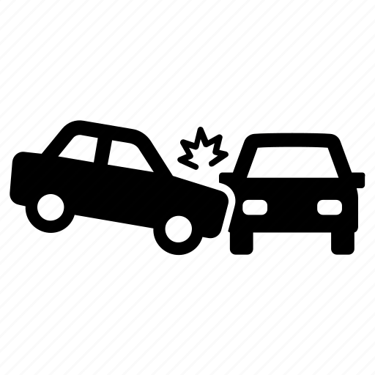
Prediction of Hit-and-run accidents in Nashville, TN
Zimu Su, Metis DSML bootcamp classification project

Slide 2
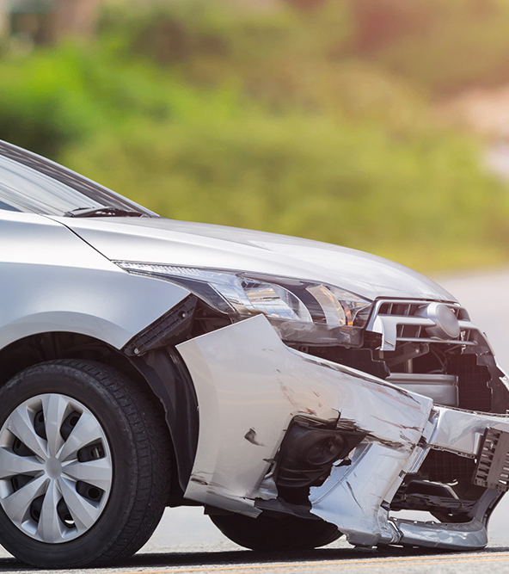
https://www.smudailycampus.com/sponsoredcontent/promoted/7-things-to-do-after-a-hit-and-run-car-accident
Hit-and-run accidents
occur if someone who causes the accident leaves the scene without providing personnel information.
cause severe injuries and properties damage without any penalty or blame.
are considered as supplemental crimes.

Slide 3
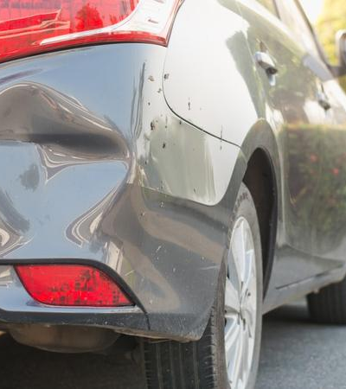
The project aims at…
identifying the significant factors to hit-and-run accidents in Nashville area.
predicting probability of hit-and-run accident based on accident feature (collision type, location, etc.)
Providing suggestion for Nashville Metro Police to decrease rate of hit-and-run accidents.
https://www.insurancehotline.com/resources/how-to-handle-a-hit-and-run/

Slide 4
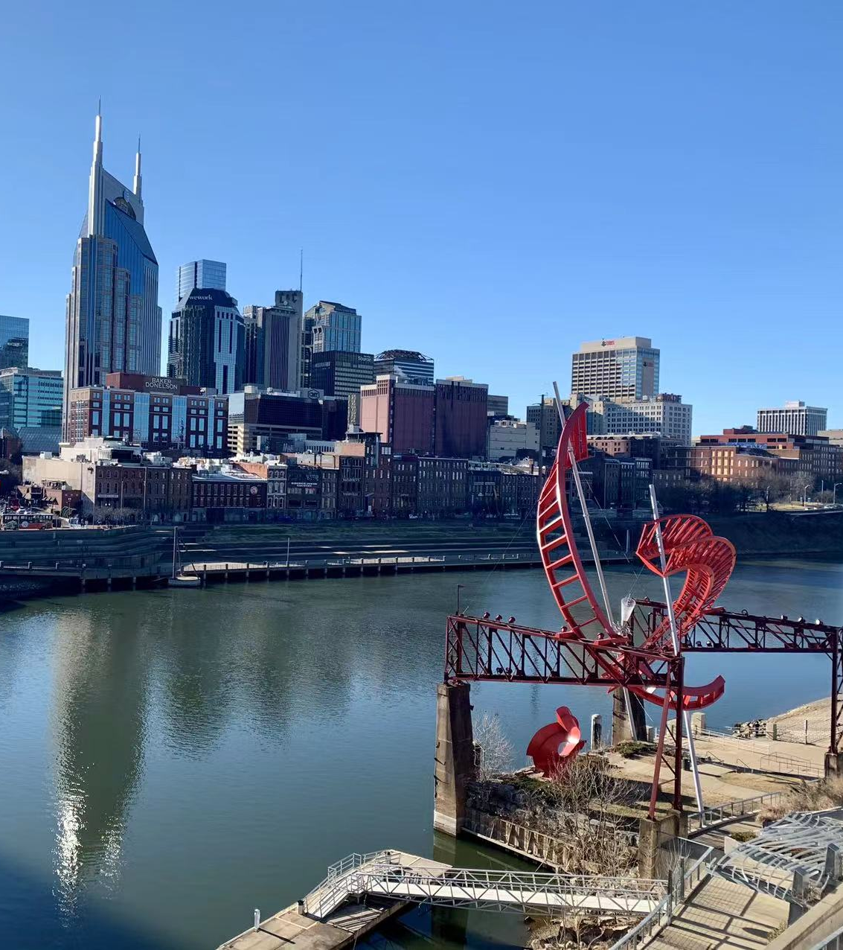

Nashville Downtown (photo by myself)
Data Source:
Nashville Open Data Portal:
https://data.nashville.gov/Police/Traffic-Accidents/6v6w-hpcw
Data range:
01/01/2015 – 04/10/2022
213424 accidents information in total
Main Features:
Date and Time, Number of Motor Vehicles, Number of Injuries, Number of Fatalities,
Property Damage, Hit and Run, Collision Type, Harm type
Weather, Illumination.
Street Address, ZIP, Latitude, Longitude

Slide 5
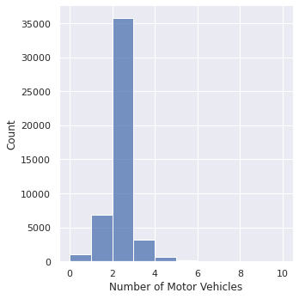
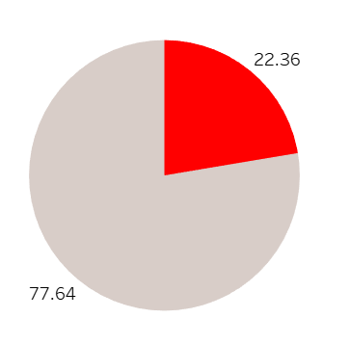
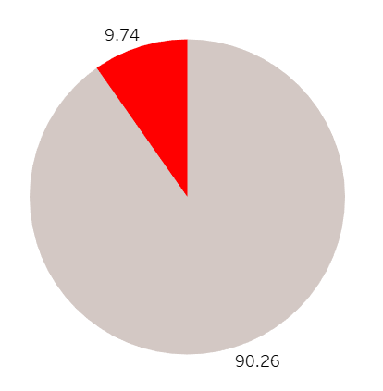
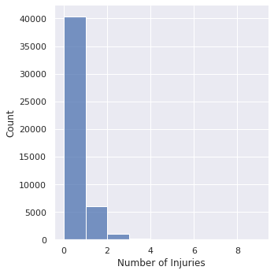
Hit-and-run accidents Statistics:
Ratio of hit-and-run accidents:
Mostly 2 vehicles involved in hit-and-run accidents:
Ratio of property damage in hit-and-run accidents:
~1/8 hit-and-run accidents have injuries:

Slide 6
Algorithm and test scores
Feature selection:
Number of Motor Vehicles, Number of Injuries;
Property Damage, Collision Type, Harm type;
Weather, Illumination condition.
Feature engineering:
One hot encoder for the features of collision type, weather, illumination, harm type.
Standardize the continuous features: Number of Motor Vehicles, Number of Injuries.
83 feature in total.
Logistic regression algorithm with regularization (C=0.1) and balanced weight.
Optimal f1 scores: 0.456 at prob decision of threshold >=0.503, ROC AUC score: 0.73. Accuracy: 0.71.
Random forest algorithm.
Optimal f1 scores: 0.456 at prob decision of threshold >=0.249, ROC AUC score: 0.73. Accuracy: 0.71.

Slide 7
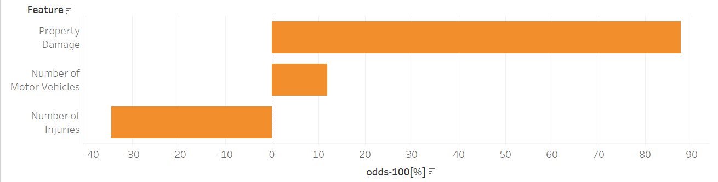
Hit-and-run accidents are more likely to
be caused with property damage (~1.9 odds)
involve more vehicles (~1.1 odds)

Slide 8
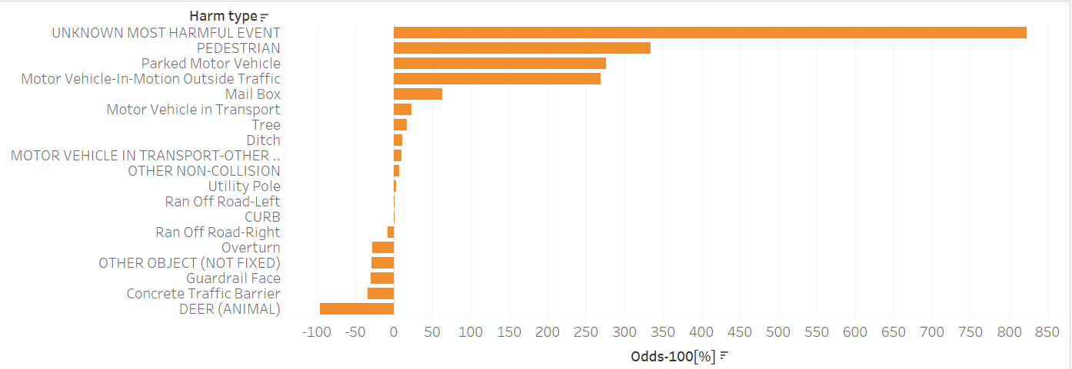
Hit-and-run accidents are more likely that
have unknown type of harm (~9 odds)
Pedestrian are hit (~4.5 odds)
occur for parked motor vehicles (~3.5 odds)
auto in outside traffic (~3.5 odds)

Slide 9
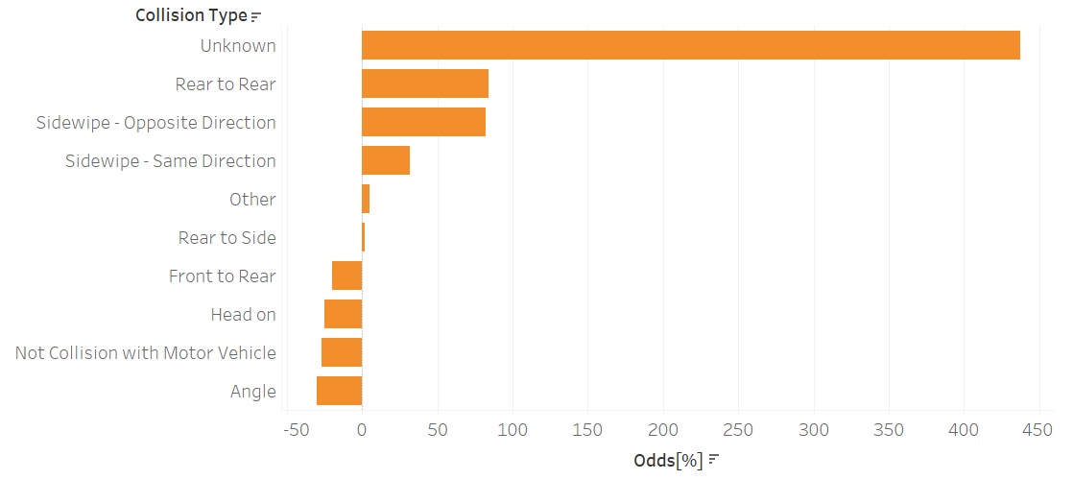
The collision type of hit-and-run accidents are mostly unknown(5.5 odds), rear to rear (~2 odds), opposite sidewipe(~2 odds).
The unknown type might be responsible for pedestrian or collision with parked motor.

Slide 10
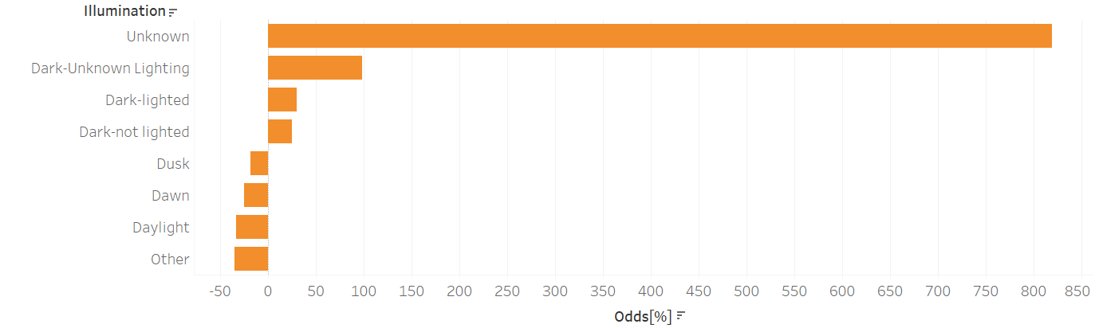
Besides unknown illumination, dark illumination is more likely to lead to hit-and-run accidents.

Slide 11
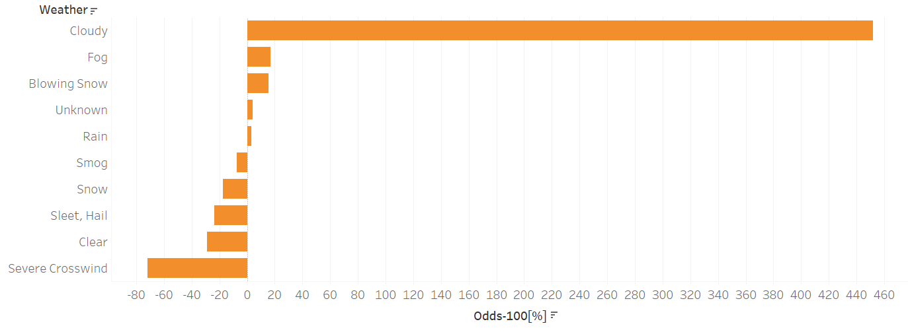
Cloudy, fog, blowing snow are more likely to cause hit-and-run accidents.

Slide 12

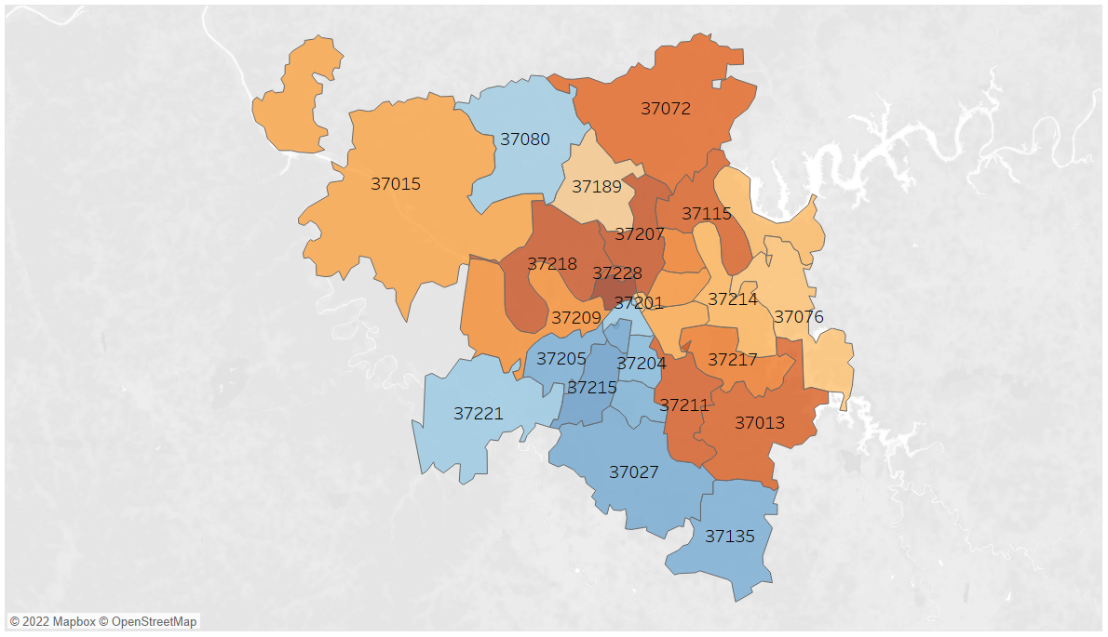
Odds of hit-and-run accidents

Slide 13
Next step:
Check exact the meaning of each feature (such as unknown illumination condition);
Do more feature engineering to improve f1 score.
Check exact location of hit-and-run accidents (crime rate, road condition, etc.) and related to illumination condition (light or not at night)

Slide 14
Thank you!

