Slide 1
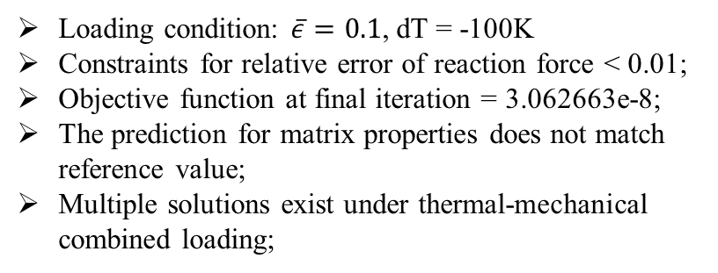
One-dimensional characterization
Matlab code generated for one-D optimization problem; Characterization is based on reference simulation results using IM7/8552 properties(nominal);
Interior point algorithm or sequential quadratic programming is used for optimization.
Consider the properties within the matrix part between fiber is homogenized but vary for different parts of matrix;
U(0)=0
Fiber
Matrix
Loading condition: $\overline{ε}=0.1$, dT = -100K
Constraints for relative error of reaction force < 0.01;
Objective function at final iteration = 3.062663e-8;
The prediction for matrix properties does not match reference value;
Multiple solutions exist under thermal-mechanical combined loading;

Slide 2

One-dimensional characterization
U(0)=0
Fiber
Matrix
dT = -100K
$\overline{ε}=0.1$
Nominal
Ref
Nominal
Ref
Nominal
Ref
Nominal
Ref

