Slide 1
F2G-Telco
One Command to Set Up Your AI Coding Environment
npx f2g-telco init
MIT Licensed • Node 18+ • Supports Crush & Kiro
github.com/suzannekouemou/f2g-telco

Slide 2
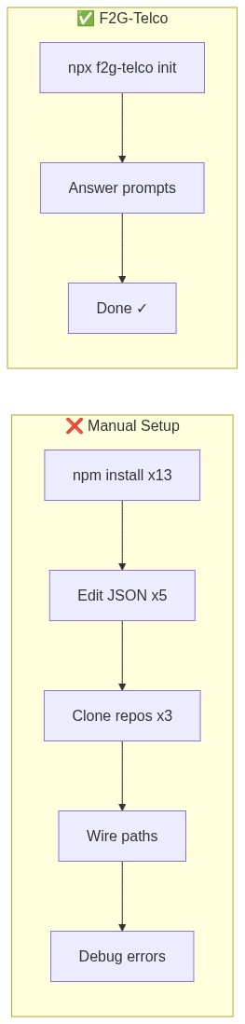
The Problem
Setting up an AI coding environment today is painful:
🔧 Install 13+ MCP servers one by one (npm, pip, permissions, sudo issues)
📝 Hand-edit multiple JSON config files with different schemas
🔑 Collect API keys from 7 different provider dashboards
📦 Clone skill repositories, symlink paths, wire orchestrators
🏥 Debug cryptic errors when something doesn't connect
⏱️ Repeat the entire process for each new machine or teammate
A senior developer spends 2–4 hours on manual setup. A junior developer may never finish.

Slide 3
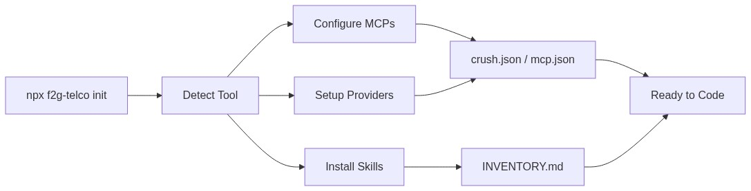
The Solution: F2G-Telco
One command. Full environment. Under 5 minutes.
1️⃣ Run npx f2g-telco init
2️⃣ Select your AI tool (Crush or Kiro)
3️⃣ Choose providers (Copilot, Ollama, NIM, Groq...)
4️⃣ Enter API keys (guided prompts, skip what you don't have)
5️⃣ All 13 MCPs configured automatically
6️⃣ Skills cloned and wired
7️⃣ INVENTORY.md generated for agent discovery
✅ Done — start coding with AI

Slide 4
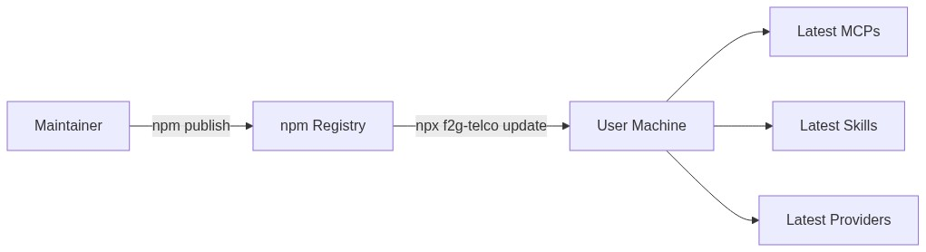
Published on npm — Install Like an App
F2G-Telco is a published npm package. No cloning, no building.
📦 Published at npmjs.com/package/f2g-telco
⚡ Install: npx f2g-telco init — one command, like downloading an app
🔄 Update: npx f2g-telco update — pulls latest registries, like a Play Store update
🌍 Anyone with Node.js can use it — no special access needed
🏗️ Actively maintained — CI on Node 18/20/22, semantic versioning
📋 Current version: v0.1.3 (13 MCPs, 7 providers, 3 skill sources)
Think of it like an APK for your AI coding environment. Type one command → get a fully configured setup. Type another command → get the latest version.

Slide 5
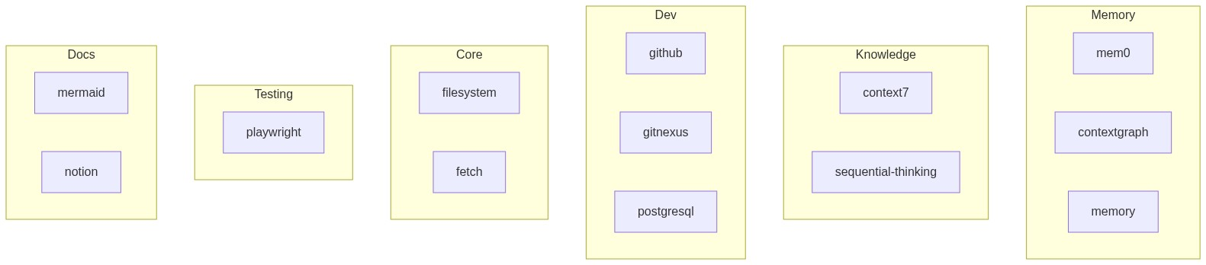
What You Get
Category | MCPs | Purpose
Memory | mem0, contextgraph, memory | Long-term memory, provenance, knowledge graph
Knowledge | context7, sequential-thinking | Library docs, multi-step reasoning
Dev Tools | github, gitnexus, postgresql | PRs/issues, codebase graph, DB queries
Core | filesystem, fetch | File ops, HTTP requests
Testing | playwright | Browser automation, E2E
Docs | mermaid, notion | Diagram rendering, Notion pages
Plus: 3 skill sources (awesome-copilot, agency-agents, claude-best-practices) and 7 providers

Slide 6
7 Providers — All Free Options Available
Provider | Free? | Models | Best For
GitHub Copilot | Subscription | Claude, GPT, Gemini, Grok | Full catalog, enterprise
Ollama | ✅ Free | Qwen3, Llama, Mistral | Local, private, offline
NVIDIA NIM | ✅ Free tier | Llama 3.3 70B, DeepSeek | Fast cloud inference
Google AI Studio | ✅ Free tier | Gemini 2.5 Pro/Flash | Google ecosystem
Groq | ✅ Free tier | Llama 3.3 70B | Ultra-fast inference
Cerebras | ✅ Free tier | Llama 3.3 70B | Fastest inference
OpenAI-Compatible | Varies | Any compatible model | LM Studio, vLLM, custom
Users choose which providers to configure — skip any they don't need. No vendor lock-in.

Slide 7
Command Reference
Command | Description
npx f2g-telco init | Interactive setup wizard — tools, providers, MCPs, skills, configs
npx f2g-telco add <mcp> | Install and configure a single MCP by id
npx f2g-telco remove <mcp> | Uninstall and remove a single MCP by id
npx f2g-telco list | Show available components and installed status
npx f2g-telco update | Pull latest registries and refresh configs
npx f2g-telco doctor | Health check — Node, git, PATH, MCP binaries
npx f2g-telco status | Show current environment configuration

Slide 8
Manual Setup vs. F2G-Telco
Step | Manual | F2G-Telco
Install MCP servers | 13 npm/pip commands, sudo issues | Auto-configured via npx
Tool config | Hand-edit JSON, multiple schemas | Generated automatically
Skills & orchestrator | git clone + manual path wiring | Cloned, symlinked, wired
Provider keys | Ad hoc env collection | Guided prompts with skip/retry
Inventory | Write docs manually | INVENTORY.md auto-generated
Recovery | Debug on your own | doctor command + verbose mode
Time | 2–4 hours | Under 5 minutes

Slide 9
How It Works
The init wizard follows a 5-step pipeline:
Step 1: Detect Tool — Checks for Crush or Kiro installation
Step 2: Select Providers — Interactive prompts for API keys
Step 3: Configure MCPs — 12 Node MCPs via npx (zero install), 1 Python MCP via pip
Step 4: Install Skills — Clones 3 curated skill sources, symlinks into tool paths
Step 5: Generate Config — Writes crush.json/mcp.json + INVENTORY.md
Key design decision: Node MCPs use npx -y at runtime. No npm install, no permissions, no failures. The tool writes config — npx downloads on first use.

Slide 10
Supported AI Coding Tools
Crush (charmbracelet/crush)
Kiro CLI (AWS)
• Continuation of OpenCode (22k stars)
• MCP servers with env vars
• Provider + model mappings (large/small)
• 38+ tools auto-approved
• LSP servers (pyright, typescript-language-server)
• Skills paths + orchestrator agent
• Metrics/notifications disabled
• MCP servers with autoApprove arrays
• Env vars per MCP
• Orchestrator settings
• Skills in ~/.kiro/skills/
• Code intelligence integration
• Subagent delegation
Same MCPs, same skills, same providers — different config formats handled automatically.

Slide 11
Current Model: Individual Setup
Today, each team member runs the setup independently:
1️⃣ Each person runs npx f2g-telco init on their machine
2️⃣ Each person enters their own API keys (Copilot, NIM, Groq, etc.)
3️⃣ Keys stay local — never shared, never uploaded
4️⃣ Each person gets the same MCPs, skills, and configs
5️⃣ No central control plane — no tracking of who installed what
✅ Advantages:
• Zero infrastructure needed
• Each developer owns their keys
• Works offline after setup
• No admin overhead
⚠️ Limitation:
• Each developer's AI context is isolated
• What Developer A learns, Developer B's AI doesn't know

Slide 12
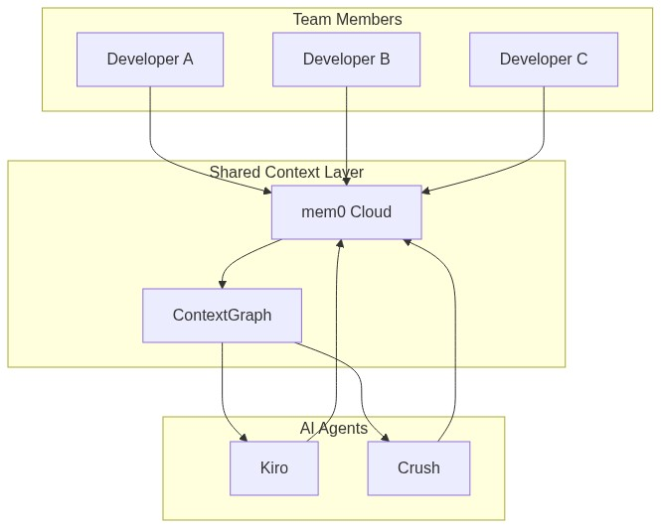
Vision: Unified Team Context
The next evolution — shared AI memory across the team:
🔑 Create a shared service account (e.g. f2g-team@gmail.com)
🧠 Connect it to mem0 + ContextGraph MCP servers
👥 All team members point to the same memory backend
What this enables:
• Developer A fixes a bug → AI saves the context
• Developer B starts working → AI recalls what A did
• Unified knowledge graph across the entire team
• No repeated explanations, no lost context between handoffs
Two paths to get there:
1. Shared mem0 API key — centralized cloud memory
2. Claude Team subscription — centralized model + keys
The CLI already supports this — just configure the same mem0 key for all team members. No code changes needed. The infrastructure is ready.

Slide 13
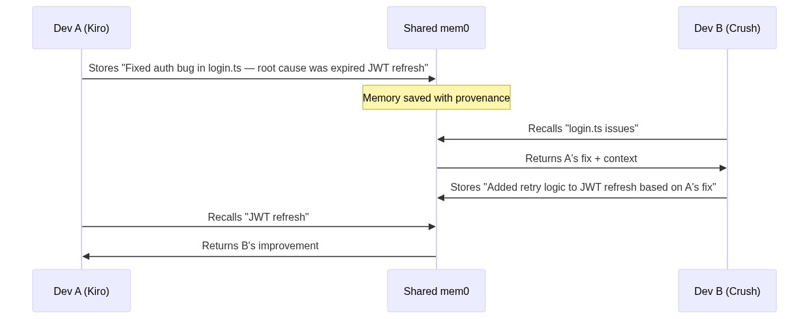
Why This Matters for the F2G-Telco Team
One shared AI brain across every team member:
🧠 Global context — what one developer learns, every AI instance knows
🔄 No repeated explanations — onboard a new member, the AI already has the history
🤝 Seamless handoffs — Dev A starts a task, Dev B picks it up with full context
📈 Compound knowledge — every fix, every decision, every insight accumulates
⚡ Faster debugging — AI recalls past solutions across the whole team's experience
🏗️ Consistent architecture — AI enforces the same patterns team-wide
🔒 Each member still owns their own API keys and local setup

Slide 14
Real Scenario: Shared Context in Action
Monday morning — Developer A (using Kiro):
→ Fixes a critical bug in the payment module
→ AI stores: "Root cause was race condition in transaction queue"
Monday afternoon — Developer B (using Crush):
→ Starts working on the same module
→ AI recalls A's fix automatically — no Slack message needed
→ Builds on top of it instead of duplicating effort
Tuesday — Developer C (new team member):
→ Runs npx f2g-telco init — full environment in 5 minutes
→ AI already knows the entire team's history
→ Productive from day one, not week two
The AI becomes the team's institutional memory.
No one has to write handoff docs. No context is ever lost.

Slide 15
How We Enable Shared Context
✅ Already Possible Today
🔜 Coming Next
• Create a shared mem0 API key
• F2G-Telco configures it for all members
• All AI instances read/write to same memory
• ContextGraph hydrates from shared mem0
• Works across Kiro AND Crush
Zero code changes needed.
Just one shared key in the config.
• Team profiles in F2G-Telco CLI
• f2g-telco init --team <name>
• Pre-configured shared keys
• Role-based context visibility
• Admin dashboard for team memory
One command to join the team's
AI knowledge network.
The infrastructure is ready. The shared context vision is a configuration change, not a rebuild.

Slide 16
Seamless Updates — Like a Play Store
When we publish a new version to npm:
$ npx f2g-telco update
What happens:
• Pulls the latest MCP registry (new servers, updated versions)
• Pulls the latest provider registry (new models, new providers)
• Pulls the latest skill sources (new agents, new instructions)
• Refreshes local configs without losing user's API keys
Users don't need to:
❌ Reinstall anything
❌ Re-enter their API keys
❌ Manually edit config files
They just run one command and they're on the latest.

Slide 17
Technical Details
Language: TypeScript (compiled to ESM)
License: MIT
Node: 18+ required
Distribution: npm (npx f2g-telco init — zero global install)
CI: GitHub Actions on Node 18, 20, 22
Tests: 13 test cases covering registry, config generation, CLI commands
Registry: JSON files (mcps.json, providers.json, skills.json) — easy to extend
Logging: All commands log to ~/.f2g-telco/f2g-telco.log
Error handling: Ctrl+C safe, --verbose flag for debugging
Repo: github.com/suzannekouemou/f2g-telco

Slide 18
Live Demo Flow
$ npx f2g-telco init
Step 1/5 Detecting AI tools...
✔ Crush v0.51.3 detected
Step 2/5 Select providers:
✔ GitHub Copilot (already authenticated)
✔ NVIDIA NIM (key entered)
⊘ Groq (skipped)
Step 3/5 Configuring MCP servers...
✔ mem0 configured (via npx)
✔ context7 configured (via npx)
✔ contextgraph installed
... 10 more ...
Step 4/5 Installing skills...
✔ awesome-copilot (16 agents, 16 skills)
Step 5/5 Writing configs...
✔ crush.json written
✔ INVENTORY.md generated
🎉 Done! Restart your terminal and start coding.

Slide 19
Roadmap & Next Steps
✅ v0.1.3 — Published on npm, 13 MCPs, 7 providers, 3 skill sources
🔜 v0.2.0 — Planned
• f2g-telco update — pull latest registries, refresh configs
• f2g-telco doctor — deeper health checks (MCP connectivity, model availability)
• More skill sources from the community
🔮 Future
• Team profiles — share configs across an organization
• Plugin system — third-party MCP registries
• VS Code / Cursor extension integration
• Telemetry-free usage analytics (opt-in)

Slide 20
F2G-Telco
One command. Full AI coding environment.
npx f2g-telco init
github.com/suzannekouemou/f2g-telco
MIT Licensed • Open Source • Free

