Slide 1
ENTRAGUARD
01 / THE HUMAN GAP
EntraGuard
A VALID CREDENTIAL
The code can be right.
The situation can be wrong.
NUMBER MATCH
47
AN UNSAFE CONVERSATION
Voice-aware identity verification
for Microsoft Entra ID.
“Just enter the number.
I’ll stay on the line.”
Correct code ≠ trusted intent
VERIFY THE PERSON. ASSESS THE PRESSURE.
MICROSOFT GARAGE HACKATHON / MVP
01 / 06
Notes:
00:00–00:25 · 25 seconds
Imagine an employee enters the right MFA code while a convincing caller tells them exactly what to do. The credential is valid. The situation is not. EntraGuard brings evidence from that conversation into the verification decision.
PRESENTER CUE
Pause after “the situation is not.” The number and quotation are an illustrative scenario, not a recording of a real victim.
EVIDENCE / BOUNDARIES
Grounded in the repository’s outbound verification and coercion-adjudication flow. Do not describe EntraGuard as proof of intent or a guarantee that coercion is absent.

Slide 2
ENTRAGUARD
02 / WHAT WE SOLVE
A valid sign-in can hide
an unsafe conversation.
Social engineering can turn legitimate authentication into an attacker’s advantage.
01
02
03
Impersonation
MFA coaching
Payment pressure
“I’m from your IT team.”
“Just approve the prompt.”
“Change the beneficiary.”
Authority becomes pressure.
The user follows instructions.
An unsafe approval looks legitimate.
Credentials are validated. The conversation still needs scrutiny.
MICROSOFT GARAGE HACKATHON / MVP
02 / 06
Notes:
00:25–01:05 · 40 seconds
The gap is not just another stolen password. A help-desk impersonator, a caller coaching an MFA approval, or someone pressuring a payment change can work through the legitimate user. Identity controls see the authentication. EntraGuard adds conversation evidence at the moment an approval is being made.
PRESENTER CUE
Point to one scenario that resonates with the judges. Do not spend time reading all three quotations.
EVIDENCE / BOUNDARIES
Scam taxonomy in src/EntraGuard.Shared/Detection/ScamVector.cs. Scope is calls deliberately routed through monitored ACS identities and calls EntraGuard originates. It does not listen to every phone or Teams call. No breach statistics are asserted.

Slide 3
ENTRAGUARD
03 / THE EXPERIENCE
One call. More context.
A governed decision.
1
2
3
4
Start with
work identity
Match the number.
Answer in context.
Assess the
conversation.
Return a
governed result.
Entra SSO.
Teams or browser call.
Number matching.
Available identity facts.
Coaching detection.
Optional voice comparison.
Allow, step up or refuse
with an auditable reason.
Correct digits are necessary. Detected coercion can still stop the attempt.
MICROSOFT GARAGE HACKATHON / MVP
03 / 06
Notes:
01:05–02:00 · 55 seconds
The user signs in with a Microsoft work account and receives a verification call. They match a number and answer questions drawn from the identity or activity sources available to their tenant. During the call, the Analyst looks for coaching. Optional voice comparison adds speaker-similarity evidence. The result is governed: access, an additional check, or refusal—with an explanation.
PRESENTER CUE
Emphasize “available” sources and “optional” voice. These are distinct signals, not four independently certified authentication factors.
EVIDENCE / BOUNDARIES
VerificationEndpoint / VerificationLauncher / VerificationCoordinator, EvidenceAssurance and VerificationAdjudicator. Coercion refusal threshold: risk ≥60 and confidence ≥0.75. Voice observation is the default. Enforced weak voice matches require server-validated fresh MFA; no voice-clone or PAD claim.

Slide 4
ENTRAGUARD
04 / HOW IT INTEGRATES
Fits the Microsoft stack.
Extends the decision.
TWO INTEGRATION ROUTES
Application API
EntraGuard
App access
AZURE CONTAINER APPS
Grant / step up / refuse
Entra SSO → Treasury step-up
ACS / Teams
AI Speech
Azure OpenAI
Microsoft Graph
Permission-gated containment
Entra EAM / OIDC
Deterministic gate + verified sessions
Microsoft Sentinel
Optional tenant integration
Incidents + audit evidence
Graph context • Optional voiceprint • Table receipts
Entra-first identity. Azure-native services. Evidence in Sentinel.
EAM is opt-in; tenant consent, policy and calling prerequisites apply. Graph actions depend on licensing and permissions.
MICROSOFT GARAGE HACKATHON / MVP
04 / 06
Notes:
02:00–03:05 · 65 seconds
There are two integration routes. An application such as Treasury can explicitly request step-up after Entra sign-in. The optional External Authentication Method uses OIDC to fit into Entra’s MFA flow, when configured by a tenant. Both use the call pipeline: ACS and Teams, AI Speech, and Azure OpenAI. Deterministic rules govern the result. The appropriate flow can return an application decision, execute permitted Graph containment, and send evidence to Microsoft Sentinel.
PRESENTER CUE
Trace the diagram left to right once. Say “optional and configuration-dependent” when pointing to EAM. Distinguish verification decisions from containment actions on monitored attack calls.
EVIDENCE / BOUNDARIES
Sources: README.md; docs/architecture.md; docs/external-auth-method.md; infra/modules/*.bicep. EAM is implemented but not established as a live-validated cross-tenant rollout by this deck. Requires tenant configuration/licensing and deliverable calls. Voice scorer is open-source SpeechBrain/PyTorch on Azure, not a Microsoft biometric service. Managed identity is used for Azure service access; encryption/signing keys still exist.

Slide 5
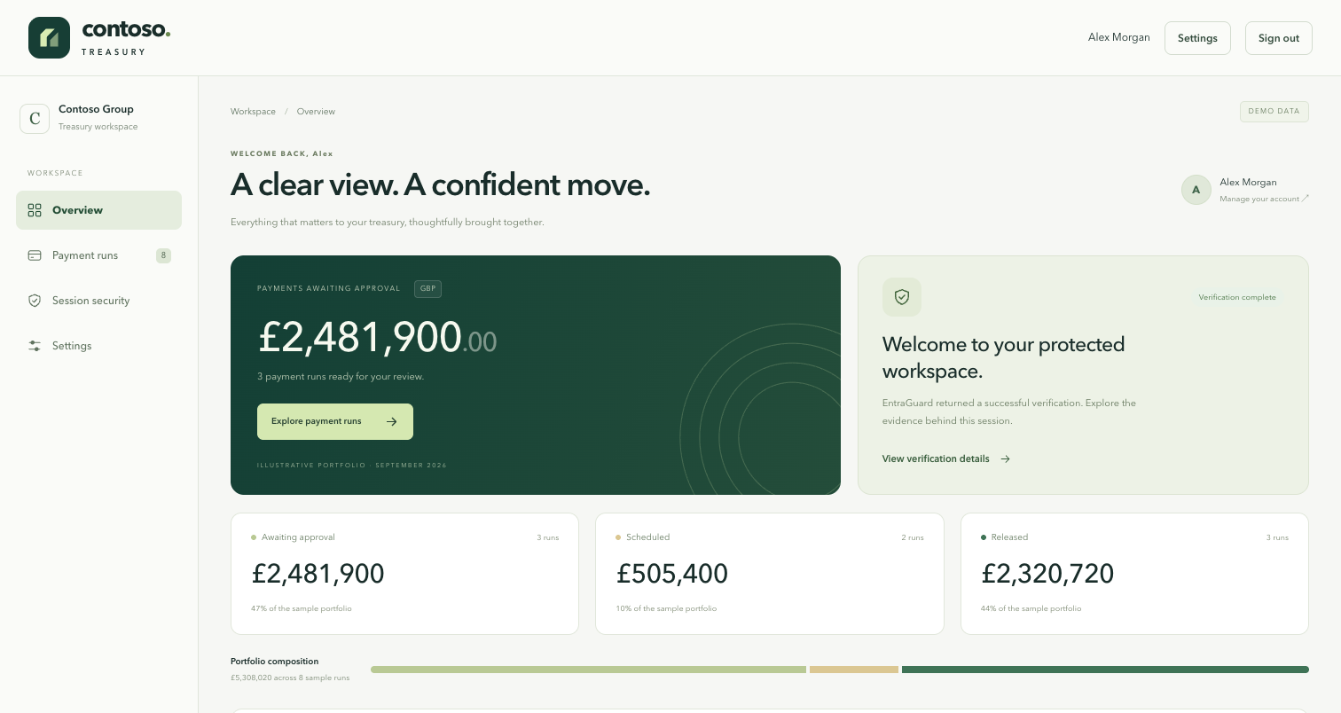
ENTRAGUARD
05 / PRODUCT + DIFFERENTIATION
See why access was granted.
Or why it was refused.
CONTOSO TREASURY DEMO
01
AI advises.
Policy decides.
A model assessment does not
directly grant access or contain users.
02
Bind trust to the action.
Fresh verification binds to
exact demo-payment details.
03
Keep an evidence trail.
Durable receipts, policy versions
and owner-scoped history.
MICROSOFT GARAGE HACKATHON / MVP
05 / 06
Notes:
03:05–04:10 · 65 seconds
This is Contoso Treasury, our relying-party demonstration. What matters is not just the risk meter. The model supplies evidence while policy owns authority. A demo-payment approval can require verification bound to the exact payment details. And the outcome is explainable through receipts, policy versions and owner-scoped history. The decisive demo beat is a correct number match that is still refused when coaching is detected.
PRESENTER CUE
The screenshot is the Treasury prototype with illustrative data. For a five-minute slot, show a short rehearsed recording or stay on this slide; a full verification call can take substantially longer. In a longer slot, switch to a prepared benign/coerced pair and show the actual returned receipt. Never promise a particular live model verdict.
EVIDENCE / BOUNDARIES
Sources: TreasuryDashboard.tsx; GrantService.cs; PaymentService.cs; VerificationLedger.cs; TenantPolicyService.cs. Approval is implemented for a protected demo ledger, not a bank connector. Local tests cover ownership, replay, concurrency and policy checks; local tests are not proof of live Azure/Entra deployment readiness. The screenshot demonstrates UI design, not the completion of a specific transaction.

Slide 6

ENTRAGUARD
06 / THE NEXT STEP
Protect the approval.
Not just the credential.
BUILT
NEXT: A CONTROLLED TENANT PILOT
Voice-aware verification
Calls, context and coercion analysis.
Completion rate
Durable trust + policy
False refusals
Sessions, receipts and bound demo approvals.
Two integration routes
Time to intervention
Application API + opt-in Entra EAM.
Measure on real calling channels.
MVP · Demo ledger only · Voice scoring observes by default · No voice-clone / PAD claim
Looking for an identity / SOC partner
and a test tenant.
Explore the solution
docs.entraguard.my
MICROSOFT GARAGE HACKATHON / MVP
06 / 06
Notes:
04:10–04:45 · 35 seconds, then pause for questions
We have built the verification pipeline and the trust controls around it: sessions, durable receipts, policy and transaction-bound demo approvals. The next step is a controlled tenant pilot. We want to measure completion, false refusals and time to intervention on real calling channels. We are looking for an identity or SOC partner and a test tenant. Protect the approval—not just the credential.
PRESENTER CUE
End on the ask. The QR code opens the public handbook. Keep any live-demo segment separate from this five-minute pitch. Do not call the prototype production-ready.
EVIDENCE / BOUNDARIES
Q&A: This is not voice-clone detection; ECAPA compares speaker similarity and has no PAD. It does not monitor every call. Tenant policies and permissions constrain actions. EAM is opt-in and has deployment prerequisites. Demo approvals move no funds. Media remains single-replica until distributed live-call routing is implemented. Repository sources: docs/security-migration.md, docs/standards-and-threat-model.md, docs/external-auth-method.md. No unvalidated breach, accuracy, latency or ROI statistic appears on these slides.

