Slide 1
ENTRAGUARD
00–10s / HACKATHON FILM
The code is right.
The situation isn’t.
NUMBER MATCH
47
A valid credential can still hide
a coached approval.
“Just enter the number.
I’ll stay on the line.”
VERIFY THE PERSON. ASSESS THE PRESSURE.
Illustrative scenario
MICROSOFT GARAGE HACKATHON
01 / 06
Notes:
0–10 seconds
0.4s: The code is correct. The person has the phone. But someone pretending to be IT is telling them what to do.
VISUAL
Polished opening slide; the number and scenario are illustrative.
FINAL EDIT
Use this title slide. No claim of a recorded incident.
Claims checked against the current source architecture. Demo sections are storyboard placeholders, not recorded evidence. Voice scoring observes by default. Treasury is a demo ledger.

Slide 2



ENTRAGUARD
10–18s / HACKATHON FILM
Verify the person.
Assess the pressure.
Work identity
Available context
Conversation evidence
Start with Microsoft Entra ID.
Ask about recent activity.
Assess signs of coaching.
AI supplies evidence. Code controls the outcome.
MICROSOFT GARAGE HACKATHON
02 / 06
Notes:
10–18 seconds
10.3s: Meet EntraGuard: verification that combines work identity, recent activity, and evidence from the conversation.
VISUAL
Three signals: work identity, available activity, conversation evidence.
FINAL EDIT
Use the solution slide; cut before it turns into a feature inventory.
Claims checked against the current source architecture. Demo sections are storyboard placeholders, not recorded evidence. Voice scoring observes by default. Treasury is a demo ledger.

Slide 3
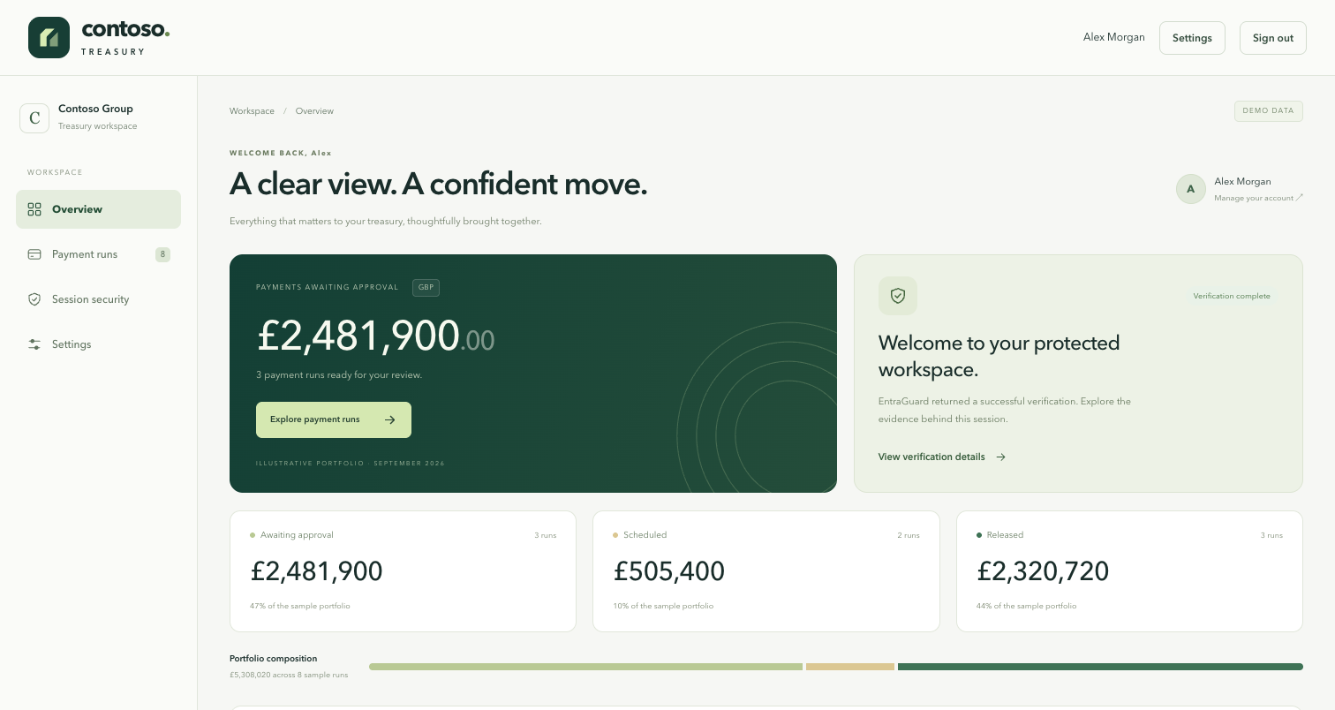
ENTRAGUARD
18–48s / HACKATHON FILM
A familiar sign-in. A richer verification.
DEMO INSERT / 00:18–00:48
RECORD THESE MOMENTS
01 Work-account sign-in
02 Match the number
03 One contextual question
04 Result + server grant
Reference screenshot.
Replace with actual footage.
MICROSOFT GARAGE HACKATHON
03 / 06
Notes:
18–48 seconds
18.6s: In our Contoso Treasury demo, a user signs in with Microsoft Entra ID and starts a verification call.
32s: They match the number on screen, then answer questions drawn from available recent activity. A separate server check decides whether the application grants access.
VISUAL
Reference Treasury screenshot and shot list until actual footage arrives.
FINAL EDIT
Replace the entire storyboard slate with recorded sign-in, number match, one question and the actual result. Keep 4–6 seconds of original call audio.
Claims checked against the current source architecture. Demo sections are storyboard placeholders, not recorded evidence. Voice scoring observes by default. Treasury is a demo ledger.

Slide 4

ENTRAGUARD
48–88s / HACKATHON FILM
Correct digits.
Coaching still matters.
DEMO INSERT / 00:48–01:28
Conversation
Analysis
Decision
Coaching evidence
Risk + confidence
Can refuse verification
Show the actual returned result and reason.
Conceptual sequence — not a recorded detection or result.
MICROSOFT GARAGE HACKATHON
04 / 06
Notes:
48–88 seconds
49s: Now consider a controlled coaching test. The user can enter the right number while someone else guides their answers.
65s: EntraGuard analyses the transcript for manipulation. When coaching is detected with sufficient confidence, verification can be refused, even when the code is correct.
81s: The operator can inspect the assessment, evidence, and recorded verification outcome.
VISUAL
Conceptual evidence-to-decision sequence, explicitly not a recorded result.
FINAL EDIT
Replace with the controlled coaching test. Show correct code, a short coaching excerpt, actual assessment, returned result and reason. Keep 6–8 seconds of original audio. If no refusal occurred, revise the story rather than inventing a result.
Claims checked against the current source architecture. Demo sections are storyboard placeholders, not recorded evidence. Voice scoring observes by default. Treasury is a demo ledger.

Slide 5


ENTRAGUARD
88–105s / HACKATHON FILM
AI supplies evidence.
Code owns the decision.
Call
Transcribe
Assess risk
Decide
Azure Communication
Services
Azure AI Speech
Azure OpenAI
Deterministic
verification code
Built on Microsoft Azure
Microsoft Graph: context · Durable receipts: Treasury policy · Azure monitoring: evidence
MICROSOFT GARAGE HACKATHON
05 / 06
Notes:
88–105 seconds
88.5s: Azure Communication Services carries the call. Speech transcribes it. Azure OpenAI assesses risk. Deterministic code controls the outcome. Microsoft Graph provides context, and Azure monitoring records the evidence.
VISUAL
Simple four-stage architecture using official Azure service icons.
FINAL EDIT
Use this simplified architecture slide instead of the dense engineering diagrams.
Claims checked against the current source architecture. Demo sections are storyboard placeholders, not recorded evidence. Voice scoring observes by default. Treasury is a demo ledger.

Slide 6
ENTRAGUARD
105–115s / HACKATHON FILM
Protect the approval.
Not just the credential.
EntraGuard
Conversation evidence for identity verification.
NEXT: A CONTROLLED TENANT PILOT
entraguard.my · docs.entraguard.my
MICROSOFT GARAGE HACKATHON
06 / 06
Notes:
105–115 seconds
105.4s: EntraGuard. The right code should not be the only question. Bring conversation evidence into the verification decision.
VISUAL
EntraGuard closing title and a controlled-pilot next step.
FINAL EDIT
Use this closing slide. Leave a short clean tail; do not add a long logo animation.
Claims checked against the current source architecture. Demo sections are storyboard placeholders, not recorded evidence. Voice scoring observes by default. Treasury is a demo ledger.

