Slide 1
AgriChain
Blockchain-Based Agricultural Supply Chain Transparency
Blockchain Supply Chain Hackathon · From Farm to Fork — Verified, Transparent, Traceable

Slide 2
The Problem
• Agricultural supply chains are opaque once produce leaves the farm.
– Food fraud: fake 'organic' claims, mislabelled origin, counterfeits
– No accountability: contamination can't be traced to its source
– Consumer distrust: no reliable way to verify what you buy
– Unfair farmer margins: middlemen obscure true origin and price
• Records live in siloed spreadsheets and forgeable paper certificates.

Slide 3
Why Existing Systems Fail
• Centralised databases can be edited silently — no tamper-evidence.
• Paper certificates are trivially forged or lost.
• Siloed data: each actor keeps its own records; no shared truth.
• No consumer-facing verification at the point of purchase.

Slide 4
Our Solution — AgriChain
• Every batch gets a unique Batch ID (RICE-KONASE-2026-0001).
• Each supply-chain event is an immutable, hash-linked block.
• Any later edit breaks the chain and is detected instantly.
• Compact record + data_hash on-chain; full data off-chain (scalable).
• Consumers scan a QR code to verify the full journey.
• AI scores risk + flags IoT anomalies; documents are hash-anchored.

Slide 5
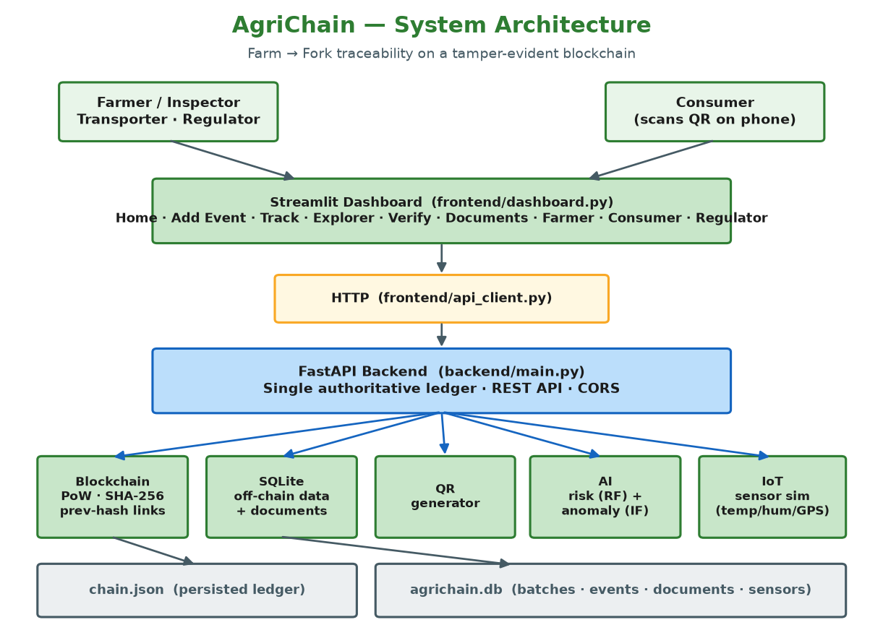
System Architecture
One authoritative ledger in the FastAPI backend; UI talks only over HTTP.

Slide 6
Technology Stack
• Backend / API: FastAPI, Uvicorn, Pydantic v2
• Blockchain: custom Proof-of-Work engine (SHA-256, Python)
• Off-chain store: SQLite (WAL mode)
• Frontend: Streamlit + Plotly (9 role-based pages)
• AI/ML: scikit-learn — RandomForest (risk) + IsolationForest (anomaly)
• IoT: NumPy sensor simulation · QR: qrcode + Pillow
• Testing: pytest + httpx (21 tests) · Deck: python-pptx

Slide 7
How It Works — Batch Lifecycle
• 1. Register batch → HARVEST block mined + off-chain batch row.
• 2. Record events: QUALITY_CHECK → TRANSPORT → WAREHOUSE → PROCESSING → DISTRIBUTION → RETAIL.
• 3. Stream IoT telemetry → IsolationForest flags anomalies.
• 4. Generate QR → consumer scans → verify page.
• 5. Consumer sees Origin / Quality / Supply-chain / Blockchain ✓.
• Each event is its own mined block; batch status advances automatically.

Slide 8
Blockchain Design
• hash = SHA-256(index, timestamp, transactions, previous_hash, nonce).
– Stored hash is excluded from its own digest; canonical JSON (sort_keys).
• Proof-of-Work: mine until hash has DIFFICULTY (=3) leading zeros.
• Previous-hash linking chains every block to its predecessor.
• is_chain_valid() re-derives every hash + checks all links.
– Editing a stored tx without re-mining → validation fails.

Slide 9
Live Demo Flow
• 1. Register a Rice batch on the dashboard.
• 2. Add QUALITY_CHECK + TRANSPORT events (watch blocks grow).
• 3. Stream IoT sensors with an injected 89°C spike → anomaly flagged.
• 4. Show the Blockchain Explorer (hashes, nonces, links).
• 5. Generate + scan the QR → Consumer verify page shows VERIFIED ✓.
• 6. Upload a certificate → hash recorded on-chain.
• 7. Then the money shot →

Slide 10
The Money Shot — Tamper Detection
• Silently edit a stored value WITHOUT re-mining:
– quantity_kg: 2500 → 9,999,999
• Re-verify the chain:
– chain_valid: TRUE → FALSE
• ⚠ INTEGRITY COMPROMISED — the recomputed hash no longer matches.
• Reset restores a clean, valid ledger. Reproduced offline in tamper_demo.py.

Slide 11
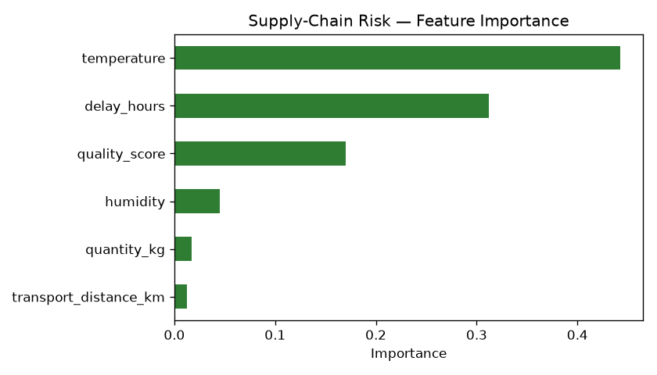
Explainable AI + IoT
Risk is driven mostly by temperature (0.44), delay (0.31), quality (0.17).

Slide 12
Results
• 36-block seeded chain · 5 batches · 35 events · chain valid ✓.
• 21/21 automated tests passing (blockchain + API end-to-end).
• Tamper detection demonstrably flips chain_valid to false on any edit.
• Document verification: MATCH vs MODIFIED on a single changed byte.
• All mandatory features + bonus (AI, IoT, documents) delivered.

Slide 13
Security — Q&A Highlights
• Tamper prevention: content hashing + PoW + prev-hash links.
• On-chain = compact record + data_hash; off-chain = full data (bound by hash).
• Documents: SHA-256 anchored on-chain → re-hash to detect edits.
• Fake QR: only a pointer; the blockchain is the trust anchor.
• Honest limits: single-node ledger + self-asserted identity (roadmap).

Slide 14
Future Scope
• Permissioned multi-node network (e.g. Hyperledger Fabric) for consensus.
• Per-actor digital signatures → non-repudiable events.
• Real IoT hardware (LoRaWAN cold-chain sensors).
• Mobile-first consumer PWA + multilingual QR landing pages.
• Smart-contract-style automated compliance rules.

Slide 15
Thank You
AgriChain — Farm to Fork, Verified on the Blockchain
Questions? · Live demo + code + docs available

