Slide 1
Finite-size effects in AdS/CFT correspondence
Ryo Suzuki
(Trinity College Dublin)
Based on arXiv:0801.0747, with Y. Hatsuda (U. Tokyo)
May 16, IQFT Meeting 2008

Slide 2
Plan of Talk
Introduction
Integrable structure
Spectrum at infinite-size
Finite-size effects
Summary

Slide 3

Introduction

Slide 4


A String and Branes
Open string on N-coincident D3-branes
Low energy
Adjoint fields of SYM in 4D
Tension of D3-branes bends the spacetime

Slide 5
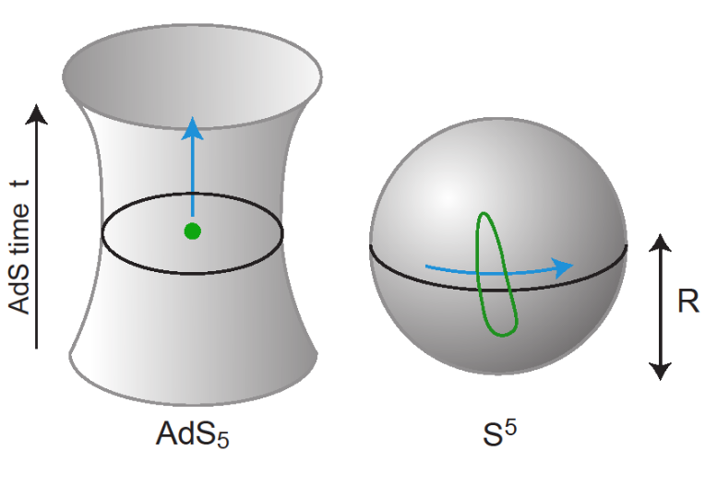
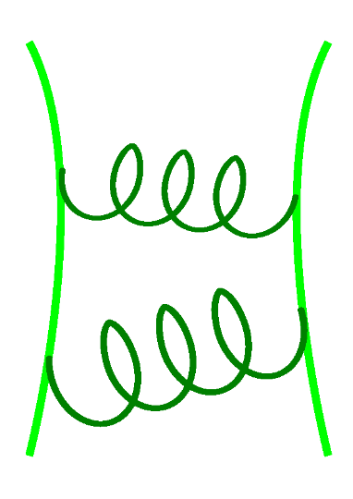






Maldacena Conjecture
[Maldacena, 1997]
dual

Slide 6


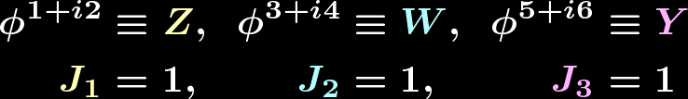
Check of AdS/CFT (1)
Same global symmetry:
Bosonic subgroup:
Conformal Symmetry/ Isometry of AdS
R-Symmetry/ Isometry of Sphere

Slide 7



Check of AdS/CFT (2)
Correspondence of the physical spectrum
Closed string state
Gauge-invariant
Local operator
Coupling on brane
How to determine the physical spectrum ?

Slide 8

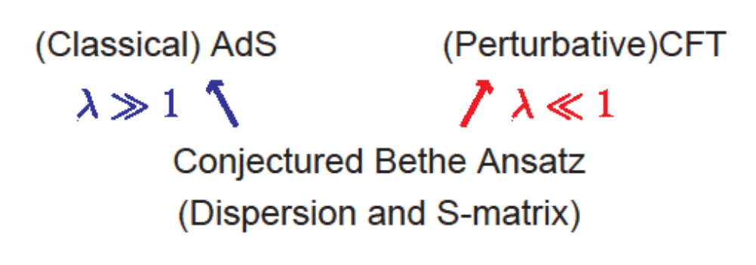
Discovery of Integrability
Dilatation operator of N=4 SYM is “integrable”
Also for classical strings on
Can compute the spectra
If both are integrable to all orders in λ,

Slide 9

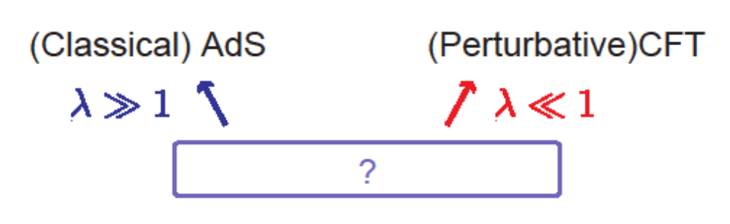
In This Talk
But there’s a problem!
Any “integrable” method for finite-L spectrum?

Slide 10
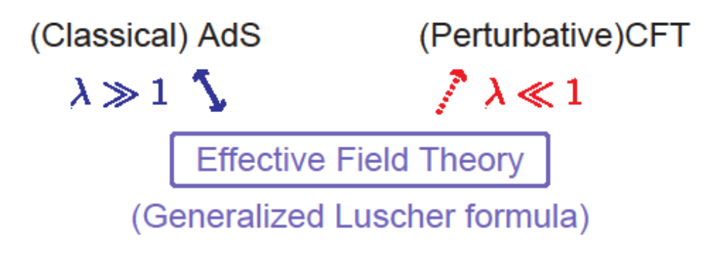
In This Talk
But there’s a problem!
Partial answer (the leading exponential correction only):

Slide 11

Integrable structure

Slide 12

From operator to spin chain
Conformal dimension Δ(λ) of a composite operator
Operator mixing:
Need to diagonalize the dilatation “matrix”
{Z, W} su(2) sector of SYM = {up, down} of a spin chain

Slide 13


Example of eigenstates (1)
0. Vacuum (ferromagnetic state = BPS state)
1. One magnon state (superposition of plane-wave)
Dispersion relation

Slide 14

Example of eigenstates (2)
2. Two magnon state (almost plane-wave)
S-matrix
S₁₂
p₁
p₂

Slide 15

Bethe Ansatz Equation
Δ(λ) = Hamiltonian of an integrable spin chain
[Minahan-Zarembo, 2002]
Infinite number of conserved charges
Scattering of “spins” is elastic and factorized
Easily generalized to M-magnon cases:
Bethe Ansatz Equation

Slide 16

Spectrum at Infinite-size

Slide 17
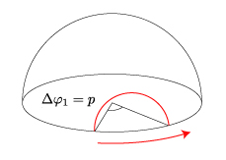

Giant Magnon Solution
[Hofman-Maldacena, 2006]
Giant Magnon behaves like a sine-Gordon soliton
Two Giant Magnons scatter on worldsheet

Slide 18
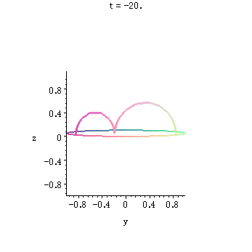
Giant Magnon Scattering

Slide 19

Infinite Spin Chain
[Beisert, 2005]
Operators with an infinite length:
Ground state (…ZZZ…) breaks global symmetry
Decomposition of N=4 SYM (bosonic) fields

Slide 20
(P) SU (2|2)² symmetry
Obtain new central charges if we identify states
modulo insertion or removal of Z
Severe constrains on the dispersion and S-matrix
Agree with Giant Magnon’s at strong coupling

Slide 21



Magnon Boundstates
[Dorey, Chen-Dorey-Okamura, 2006]
The S-matrix has a simple pole for boundstates
Boundstate pole
Boundstate dispersion:
On string theory side, Q-magnon boundstate is
Giant magnon with spins

Slide 22
Finite-size effects

Slide 23
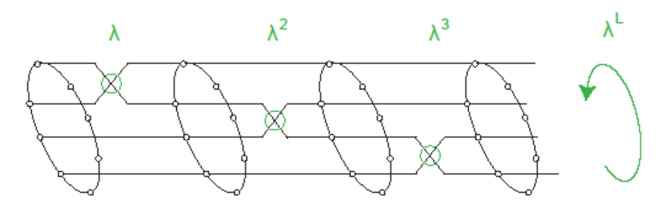
Finite-size Problem
Wrapping destroys Asymptotic Bethe Ansatz
Wrapping effect = Exponential correction
[Ambjorn-Janik-Kristjansen, 2005]

Slide 24
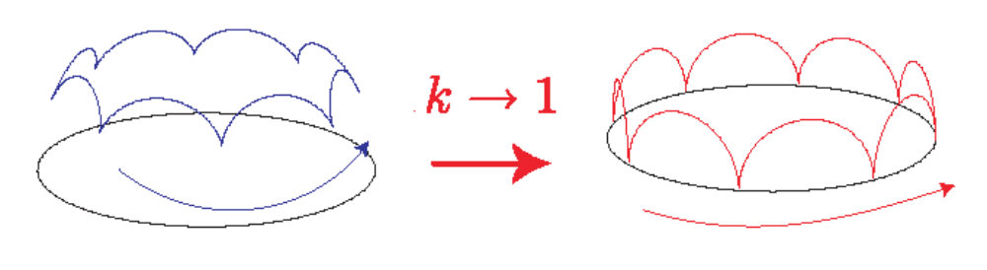
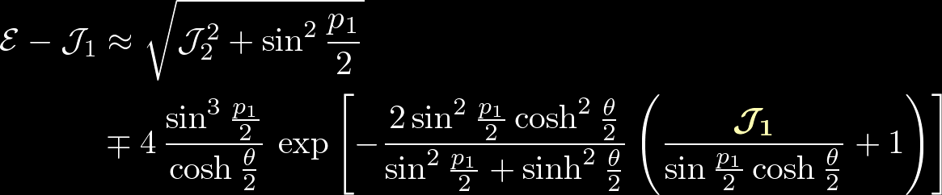

Exponential Correction
Finite-size Giant Magnon receives such correction
Exponentially supressed in J₁

Slide 25
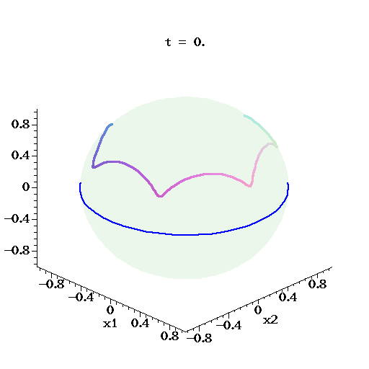
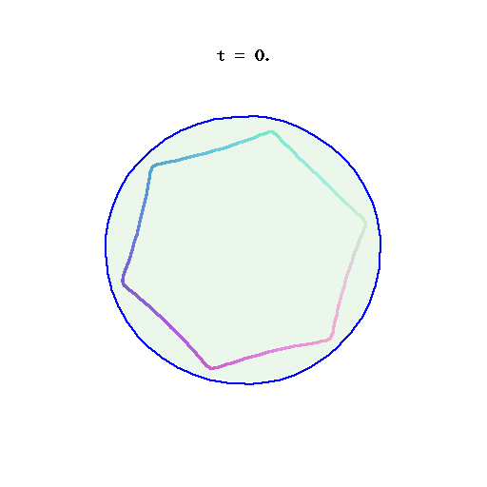
Finite-J string solutions
[Ryang 2005; Arutyunov-Frolov-Zamaklar, Okamura-R.S. 2006]

Slide 26

Luscher’s formula (1)
Finite-size correction to 1-particle state
virtual particle winding around the world
[Luscher, 1986]
Generalized & applied to “worldsheet” theory
[Janik-Lukowski. 2007]
Dispersion and S-matrix of infinite-size theory
All-loop conjecture

Slide 27
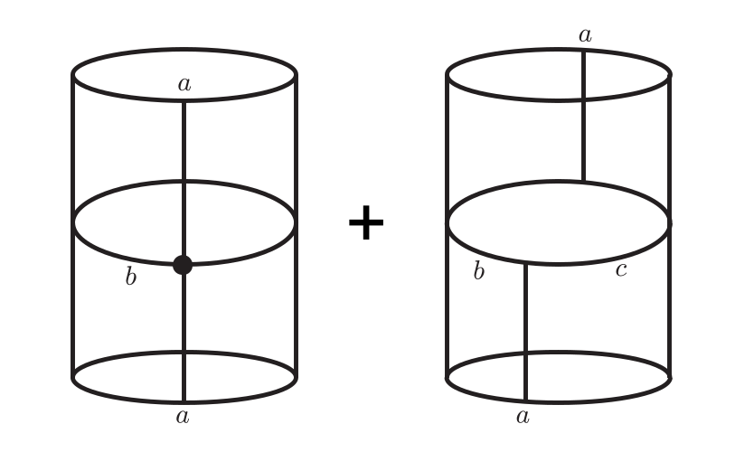

Luscher’s formula (2)
F-term: 1-loop
mu-term: classical
An incoming particle splits into two on-shell particles

Slide 28
Details and Result
Pick up poles for physical splitting process
[JL] incoming particle is an elementary magnon
[HS] incoming particle is a boundstate
[JL] need data to all orders in λ
[Hatsuda-R.S. 2008]
[HS] classical part dominates at strong coupling
The answer agrees with string’s computation

Slide 29
Summary

Slide 30
Summary of Talk
Recent progress of AdS/CFT with integrability
Infinite-size spectrum
Finite-size corrections
Future directions:
Relation to wrapping?
Flavor dependence
Finite-size scattering state
[Klose-McLoughlin, 2008]

Slide 31
Thank you for listening

Slide 32



Dispersion and S-matrix
Conjectured “all-loop” expressions
[Beisert-Dippel-Staudacher, Arutyunov-Frolov-Staudacher, 2004]
Dispersion
2-body
S-matrix
dressing phase

