Slide 1
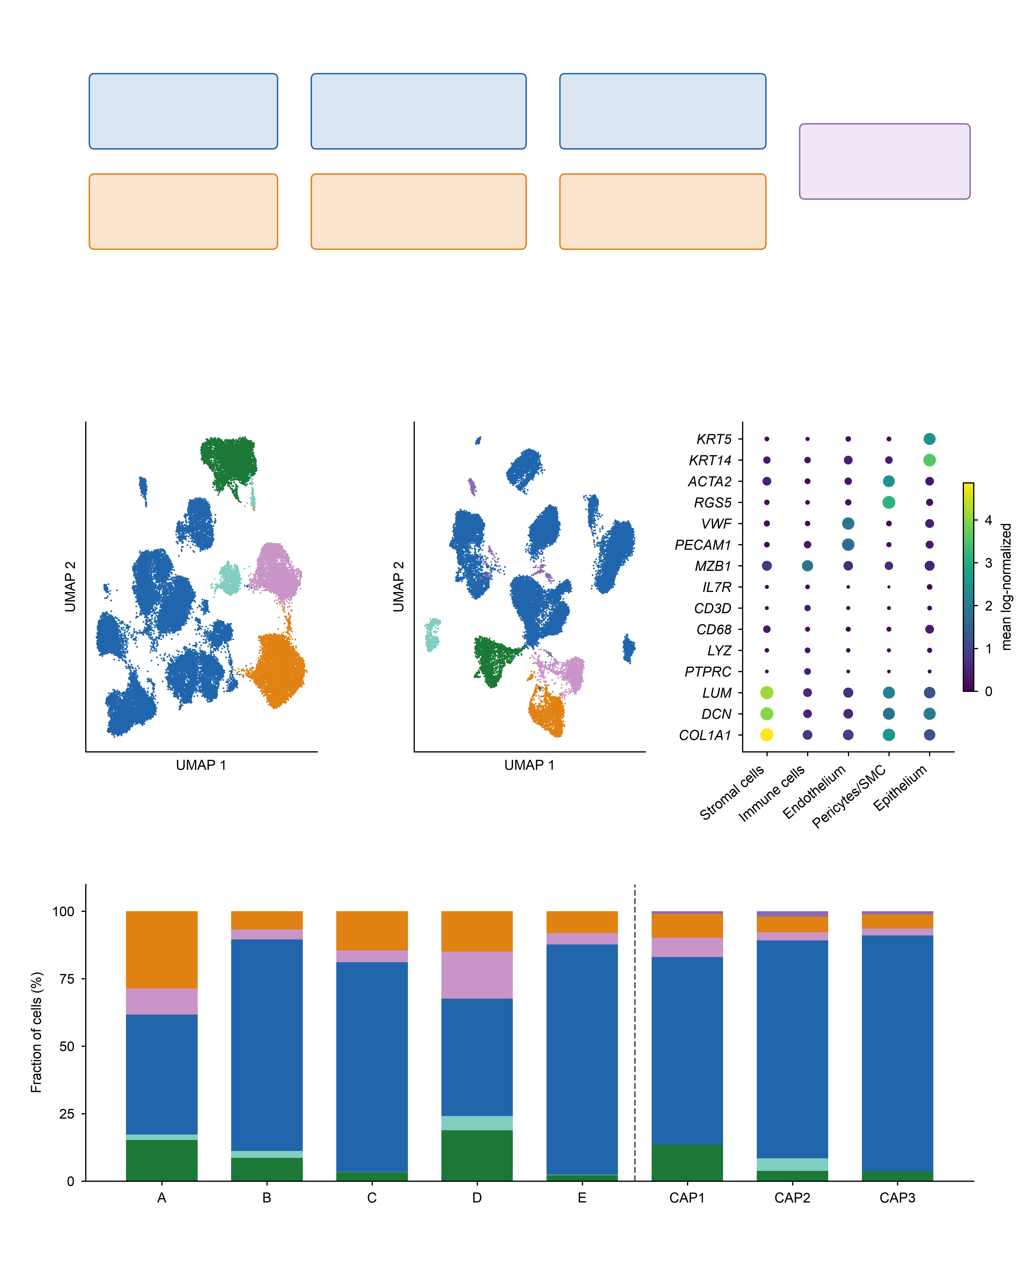
a
Discovery
5 lesions
Programme scores
TF activity screen
Candidate factors
and thresholds
Independent
cohort
(GSE164241)
Validation
3 lesions
Same pipeline,
cohort-internal cuts
Sign confirmation
only
b
Discovery, 5 lesions n=44,433
c
Validation, 3 lesions n=26,090
d
Compartment markers
Endothelium (4,375)
Endothelium (1,916)
Epithelium (968)
Epithelium (463)
e
Immune cells (29,358)
Immune cells (20,413)
Pericytes/SMC (3,517)
Pericytes/SMC (1,154)
Stromal cells (6,215)
Discovery
Schwann / neural (365)
Validation
Stromal cells (1,779)
Endothelium
Epithelium
Immune cells
Pericytes/SMC
Stromal cells
Schwann / neural

Slide 2
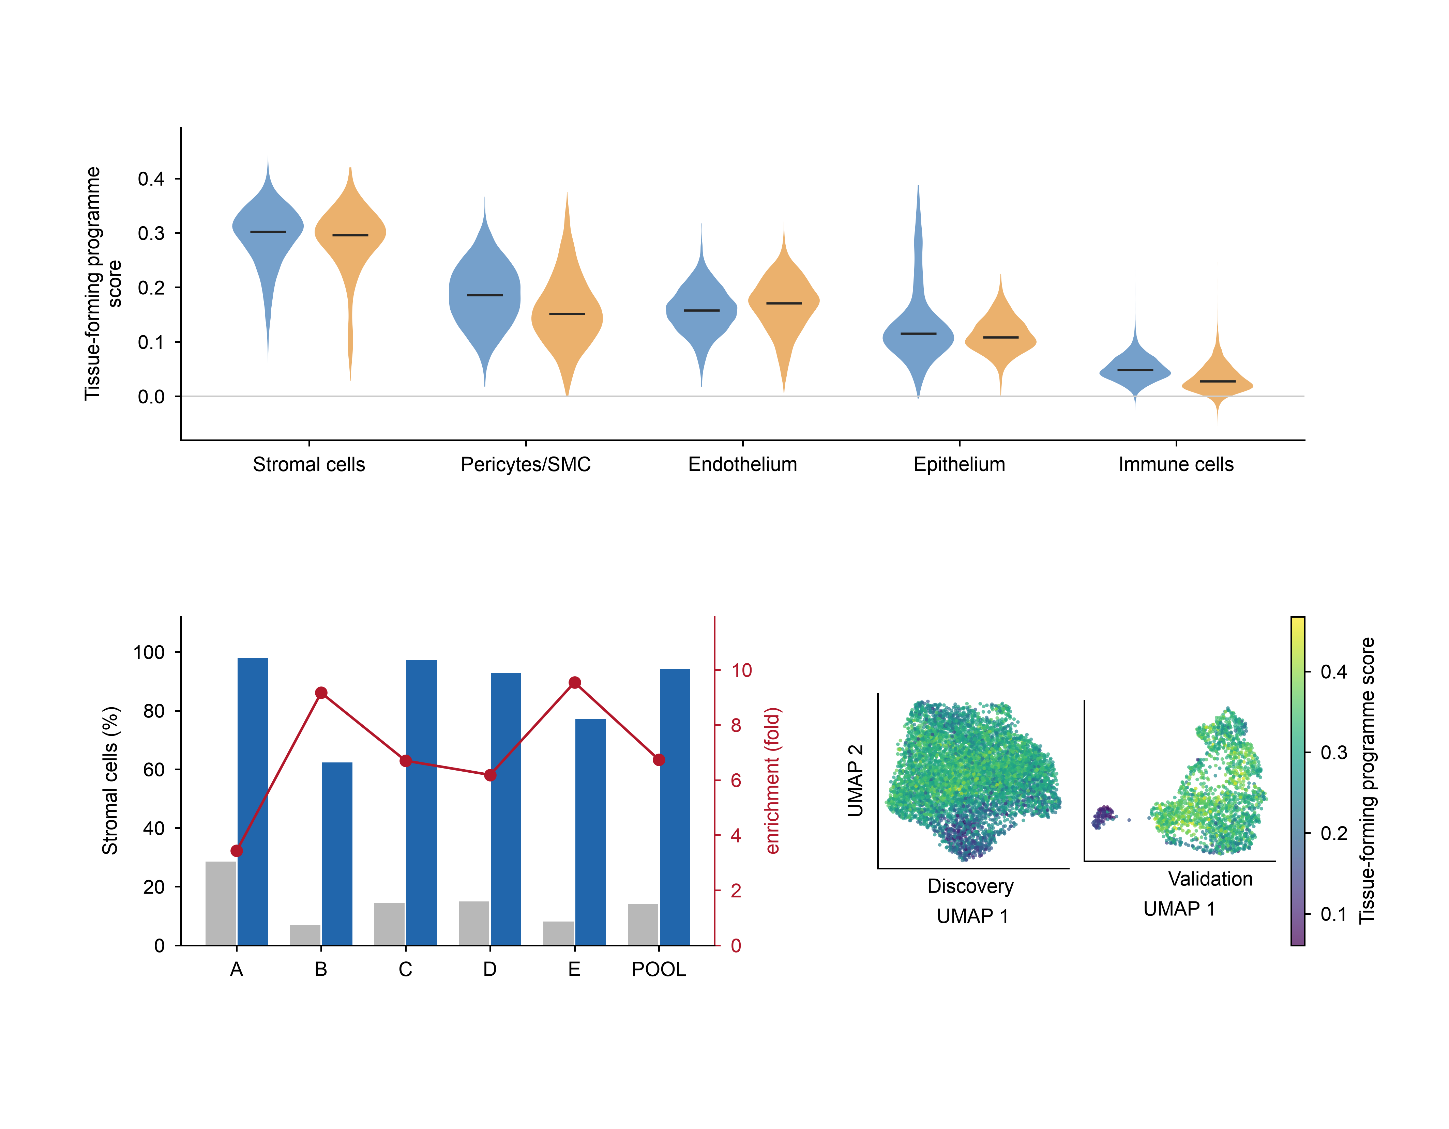
a
Programme score by compartment
Discovery (5 lesions)
Validation (3 lesions)
b
c
top decile of
tissue-forming score
all cells

Slide 3
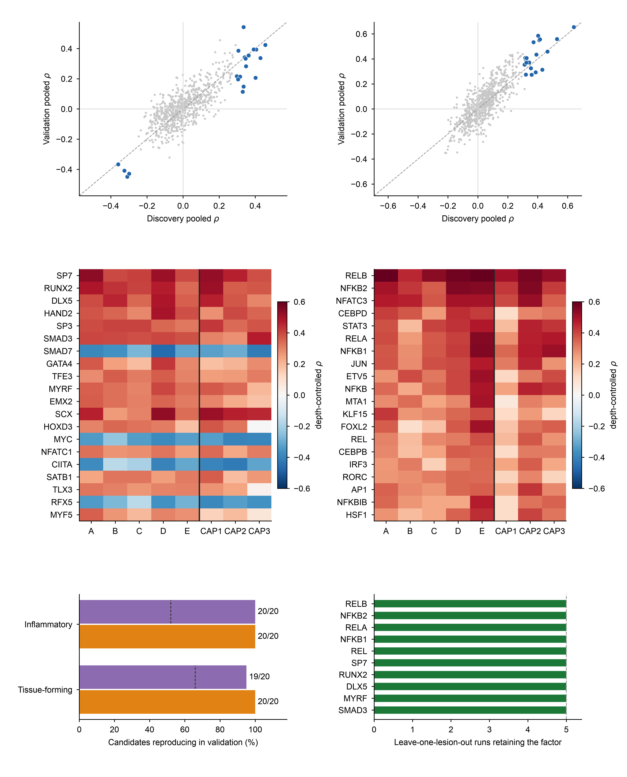
a
Tissue-forming programme
SP7
b
Inflammatory programme
NFKB1
DLX5
RELA
RELB
RUNX2
REL
NFKB2
MYRF
SMAD3
c
Top-20 candidates, Tissue-forming programme
d
Top-20 candidates, Inflammatory programme
Discovery
Validation
Discovery
Validation
e
f
random 20 factors, mean
pooled ρ same sign
same sign in all 3 lesions

Slide 4
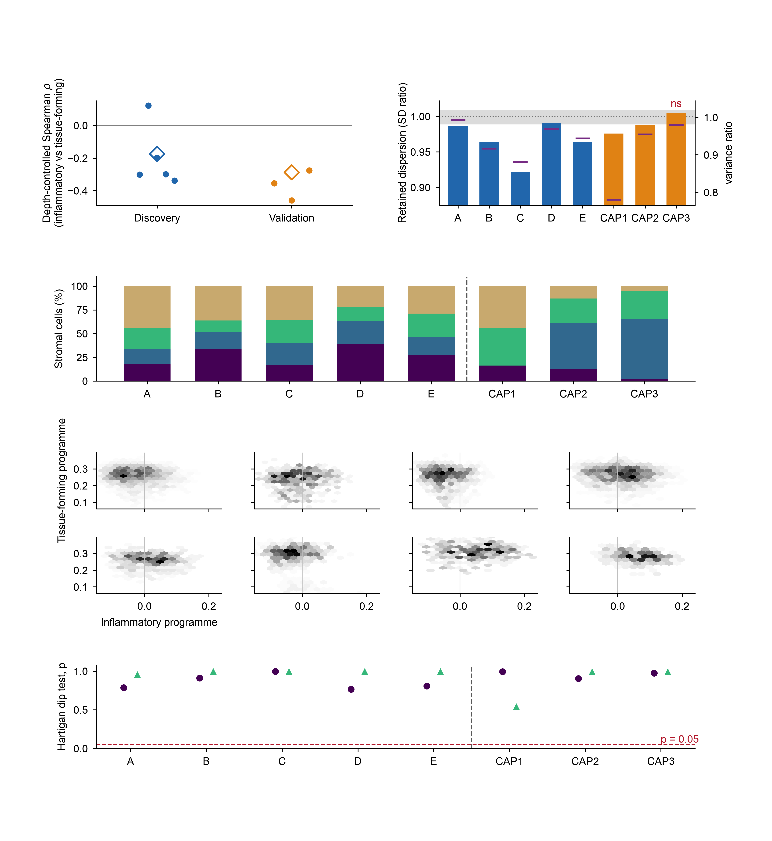
a
B
b
A
C
CAP3
D
E
CAP1
(n=5)
CAP2
(n=3)
Cell states
permutation null (95%)
null mean
c
Discovery lesions
Validation lesions
unrelated factors (mean of 10)
Discovery pooled
Discovery
Validation
Validation pooled
(2,314)
(739)
(1,018)
(1,418)
(726)
(860)
(566)
(353)
d
A n=2,314
B n=739
C n=1,018
D n=1,418
inflammatory
intermediate
tissue-forming
other
E n=726
CAP1 n=860
CAP2 n=566
CAP3 n=353
e
Inflammatory programme
Tissue-forming programme

Slide 5
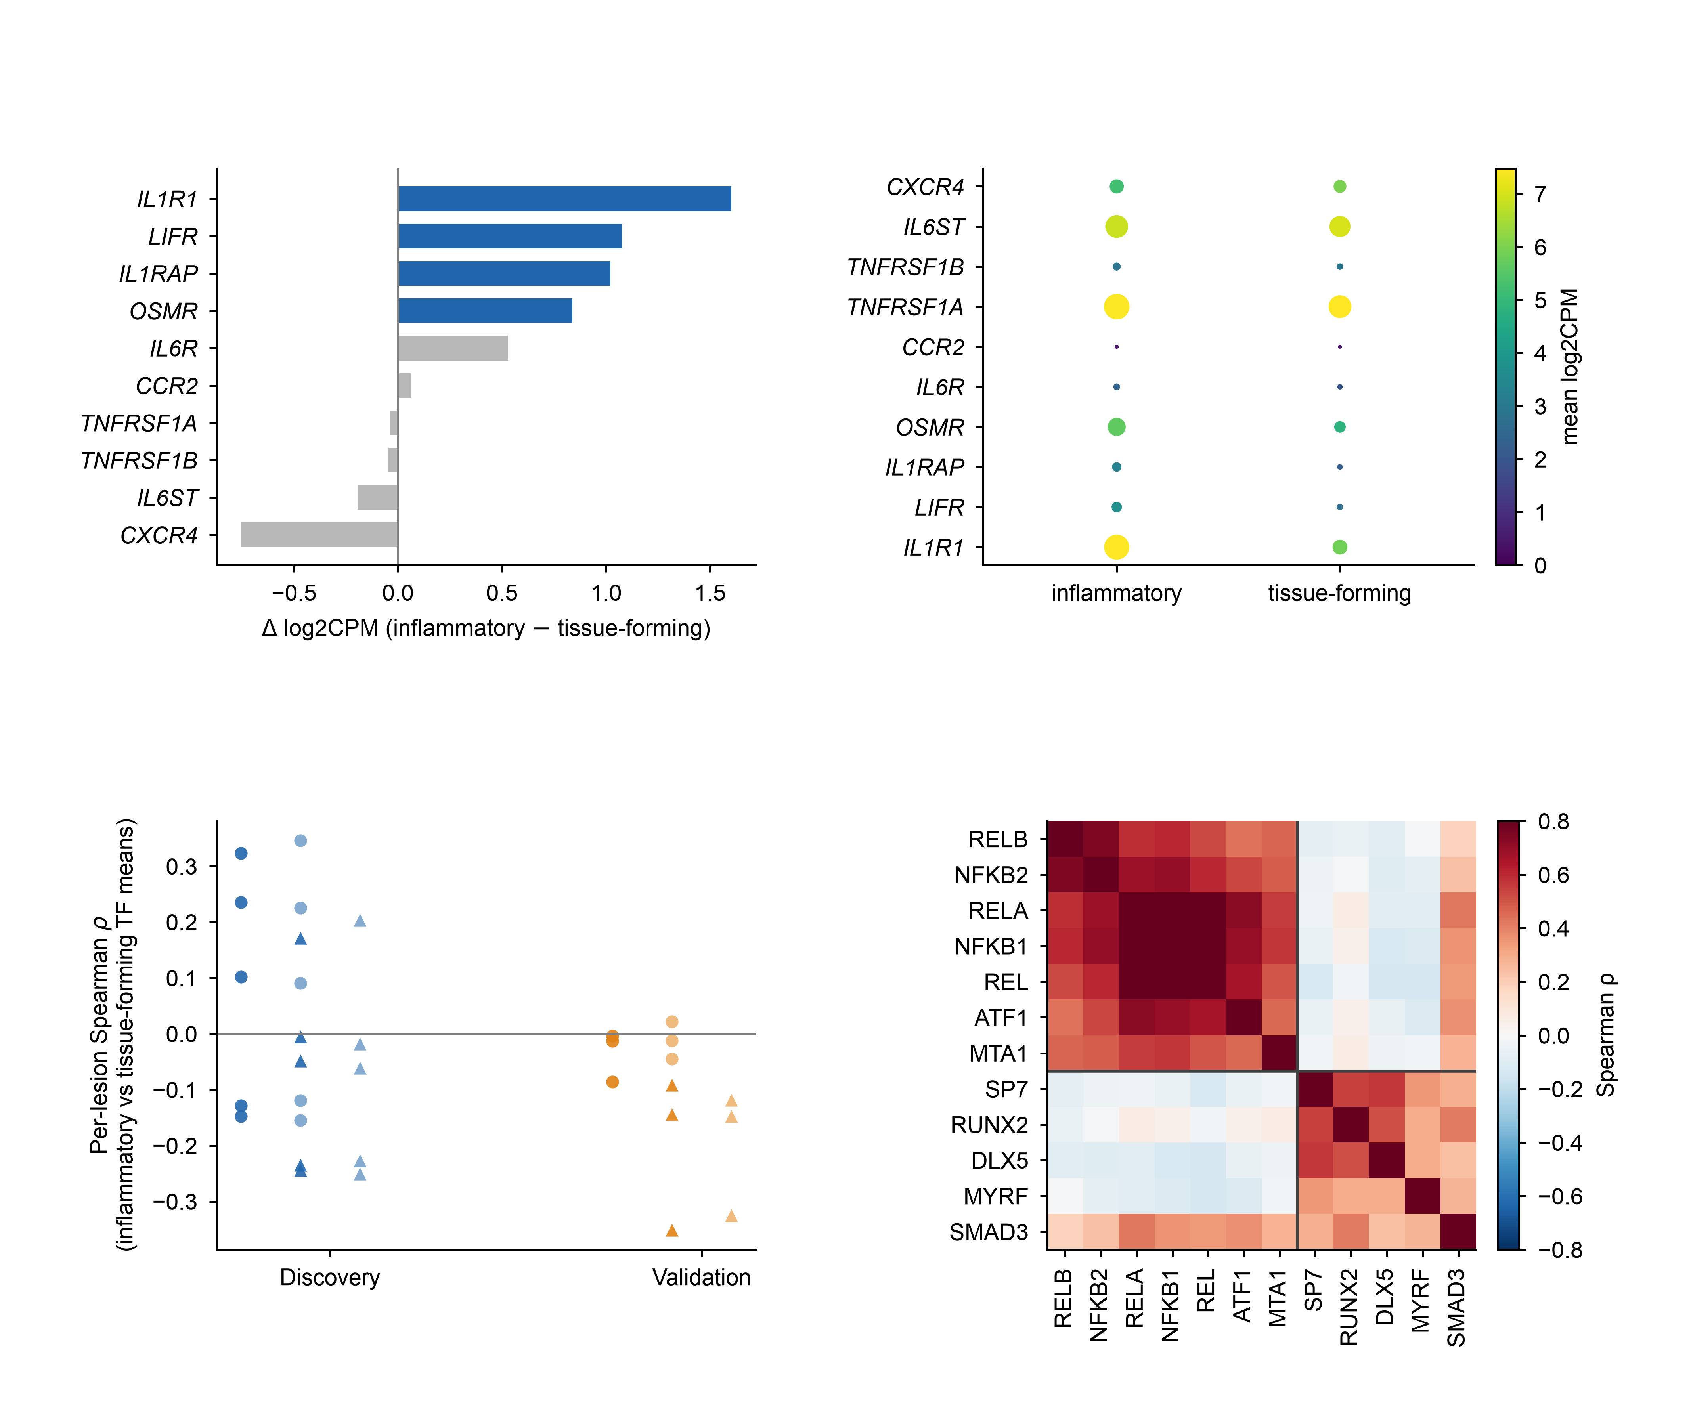
a
Discovery, pseudobulk (5 lesions)
b
c
d
TF activity correlation (discovery)
NF-κB family set / with SMAD3
alternative set (ATF1, MTA1) / with SMAD3
NF-κB family set / without SMAD3
alternative set (ATF1, MTA1) / without SMAD3
(n=5)
(n=3)

Slide 6
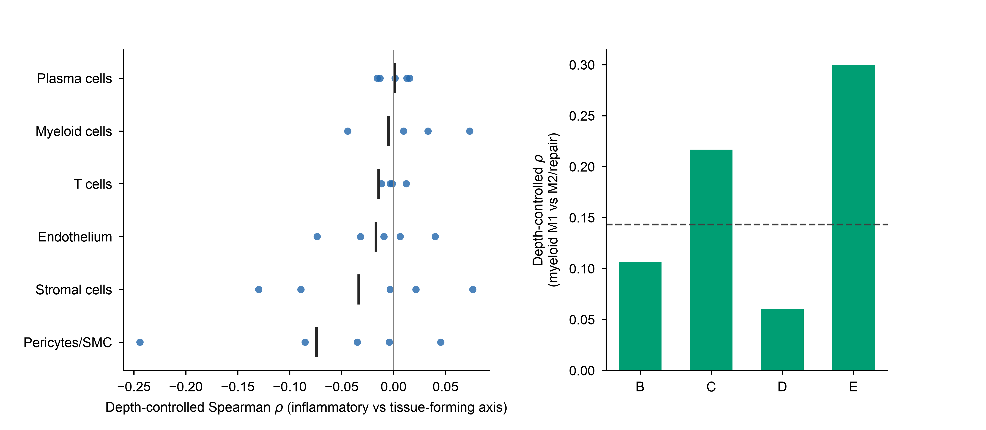
a
b
Myeloid cells: intrinsic axes

Slide 7
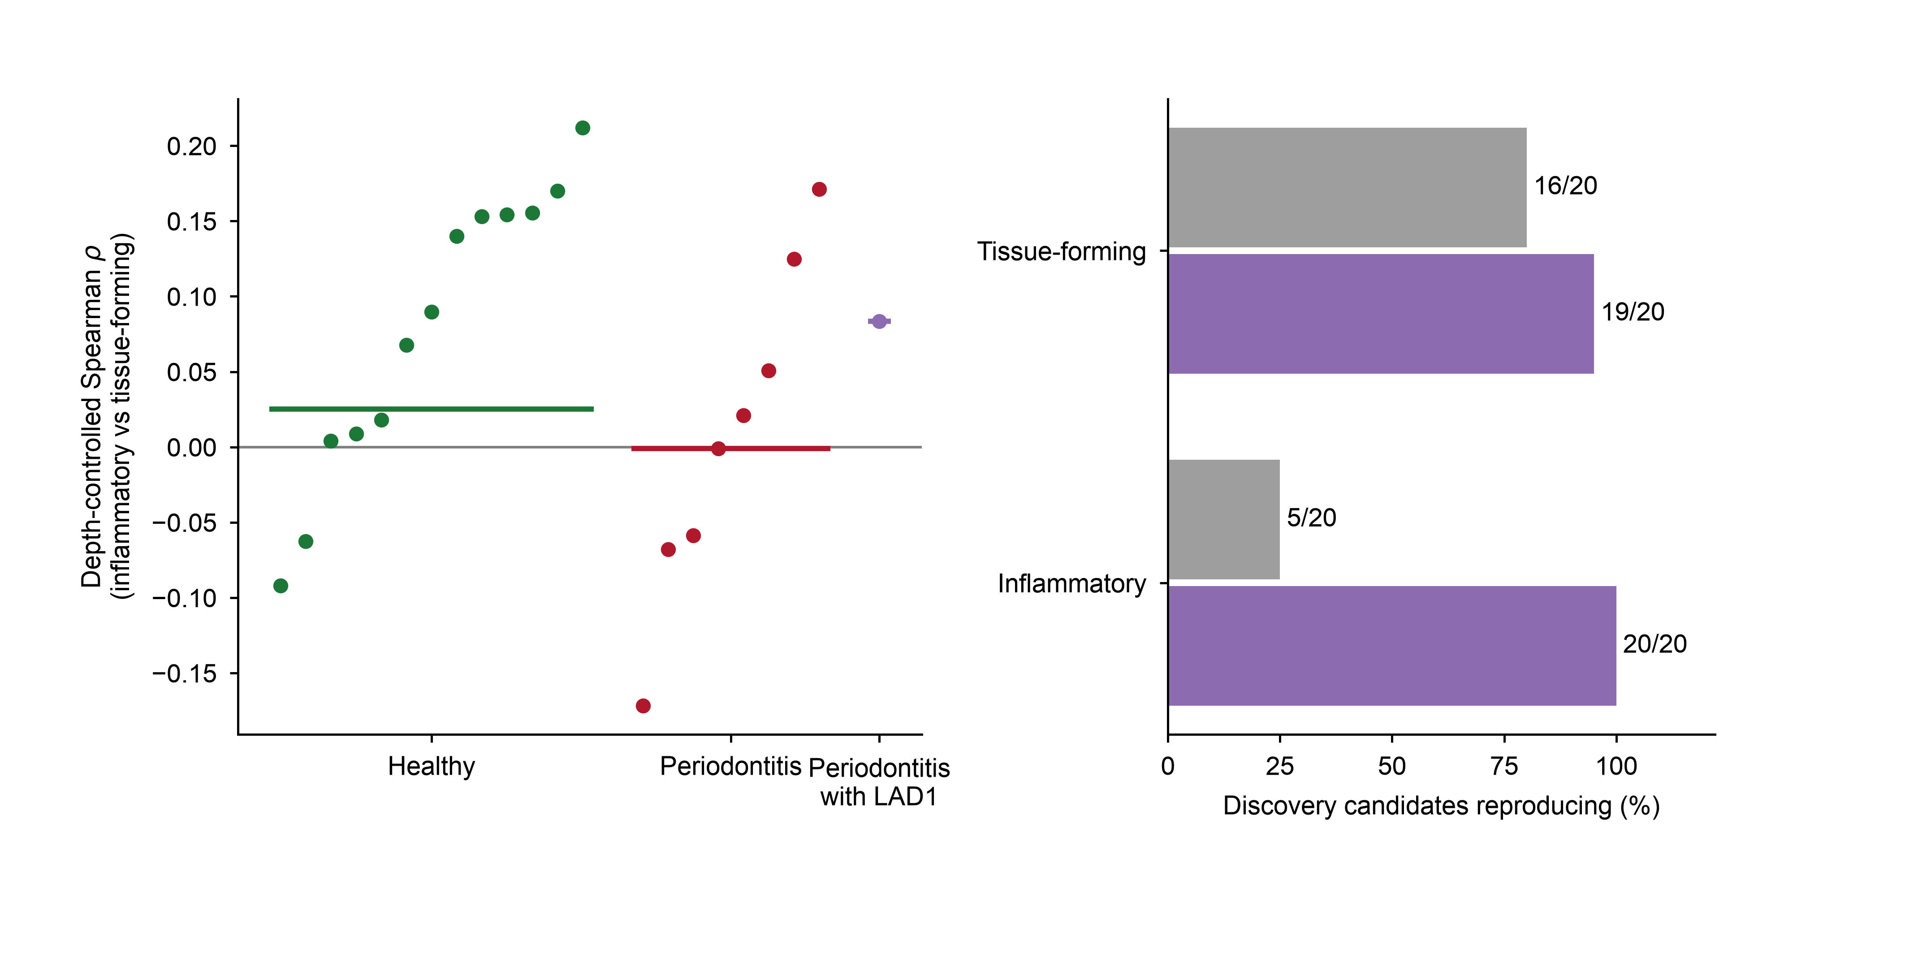
a
GSE164241 gingiva
b
Candidate reproduction
+0.08
pooled +0.03
pooled −0.00
(13 donors)
(8 donors)
(1 donor)
same sign as discovery
consistent across all donors

Slide 8
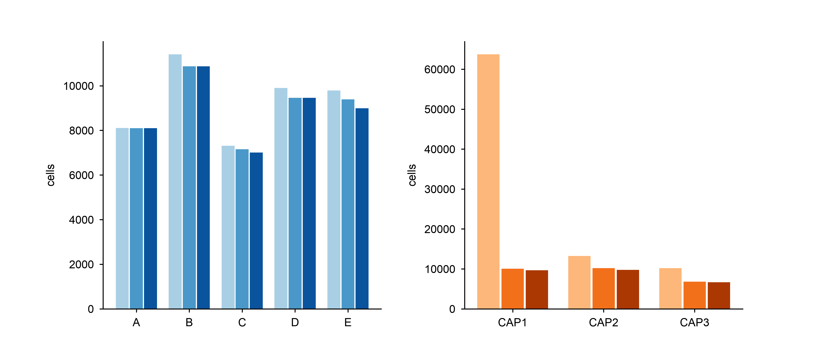
a
Discovery (5 lesions)
b
Validation (3 lesions)
raw
raw (≥100 UMIs)
QC pass
QC pass
singlets
singlets

Slide 9
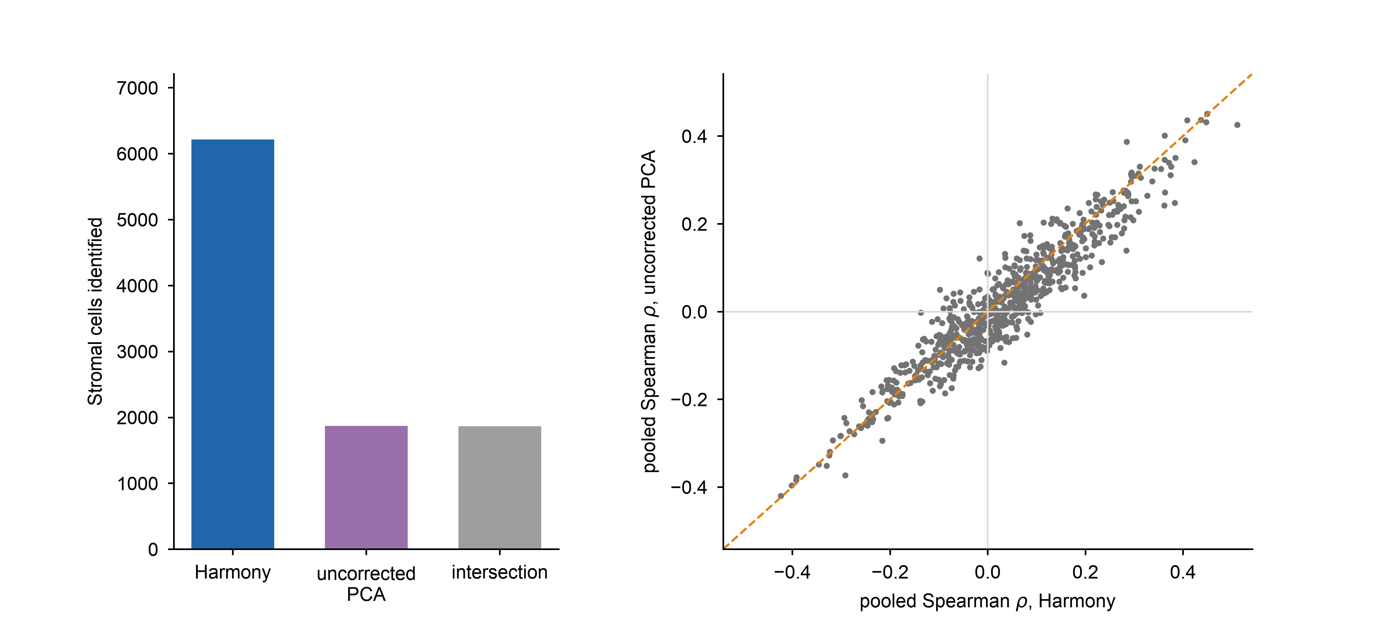
a
b
6,215
1,868
1,865

Slide 10
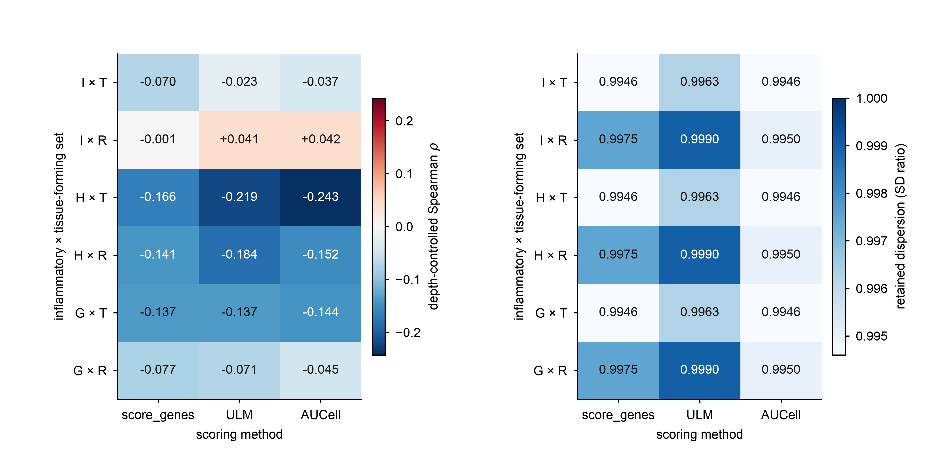
a
b

Slide 11
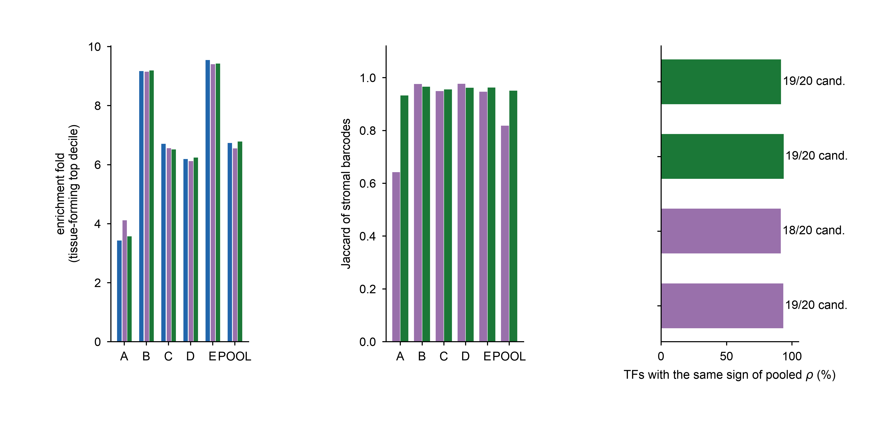
a
Enrichment
b
Stromal-set agreement
c
TF screen agreement
Tissue-forming programme
matrix barcodes
author matrix
Inflammatory programme
matrix barcodes
re-quantified, all barcodes
re-quantified, matrix barcodes
Tissue-forming programme
all barcodes
Inflammatory programme
all barcodes
vs re-quantified, all barcodes
vs re-quantified, matrix barcodes

Slide 12
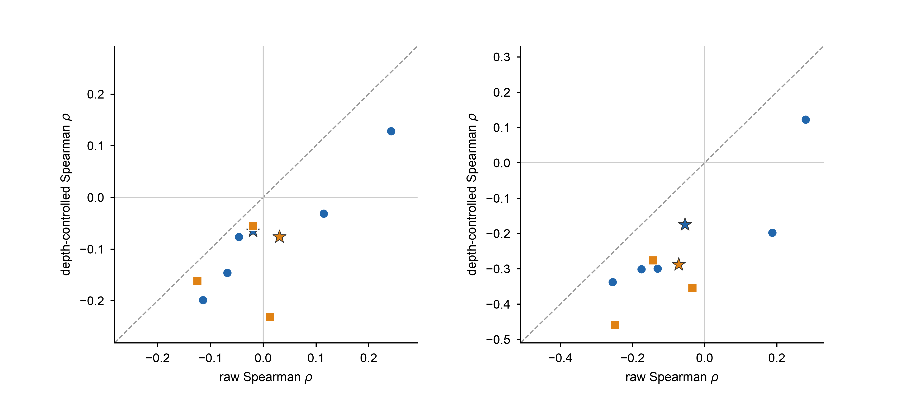
a
single-axis definition
b
composite definition
discovery (per lesion)
discovery (pooled)
validation (per lesion)
validation (pooled)

Slide 13
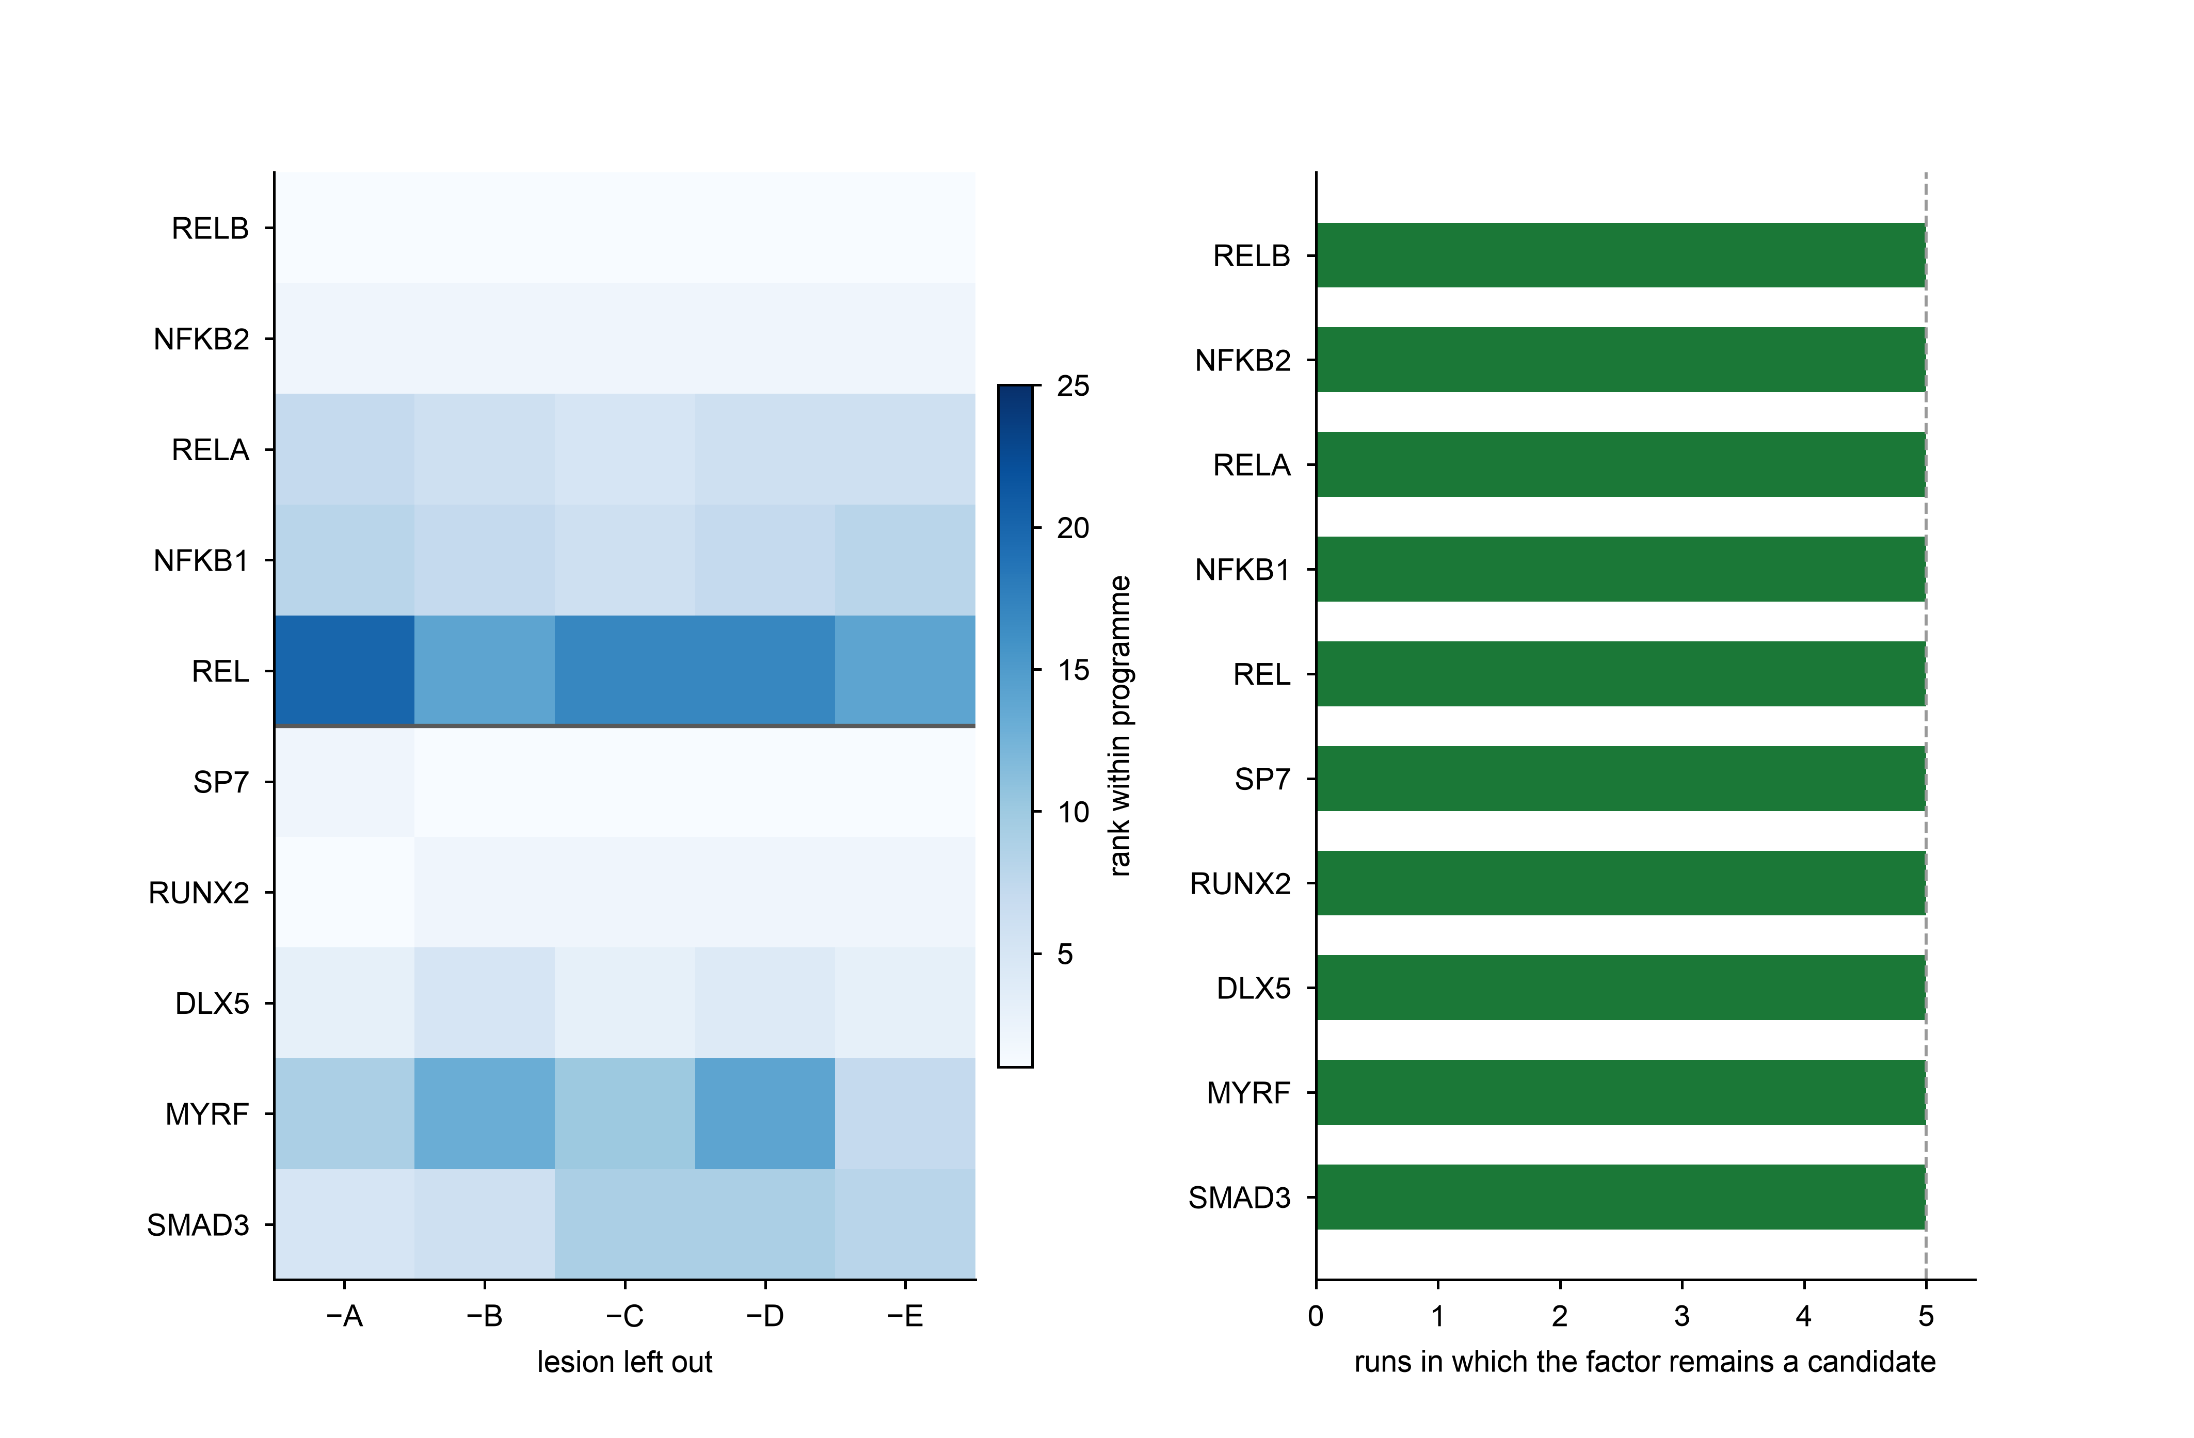
a
b
1
1
1
1
1
2
2
2
2
2
7
6
5
6
6
8
7
6
7
8
20
14
17
17
14
2
1
1
1
1
1
2
2
2
2
3
5
3
4
3
9
13
10
14
7
5
6
9
9
8

Slide 14
a
projected
projected
projected
b
Cell-level confusion
within
within
within
13
85
120
3
402
83
10
3
0
48
344
78
40
92
171
287
c
Validation projected onto the discovery embedding
inflammatory
intermediate
tissue-forming
other
Discovery (6,215)
Validation (1,779)

Slide 15
a
Validation cohort (3 lesions)
b
Independent cohort GSE164241
Proliferation + migration programme
Proliferation + migration programme
Migration programme
Migration programme
Proliferation programme
Proliferation programme
Survival / anti-apoptotic programme
Survival / anti-apoptotic programme

