Slide 1
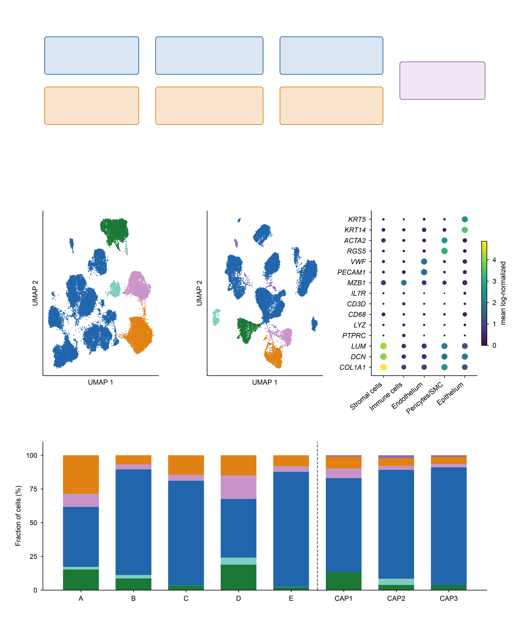
a
Discovery
5 lesions
Programme scores
TF activity screen
Candidate factors
and thresholds
Independent
cohort
(GSE164241)
Validation
3 lesions
Same pipeline,
cohort-internal cuts
Sign confirmation
only
b
Discovery, 5 lesions n=44,433
c
Validation, 3 lesions n=26,090
d
Compartment markers
Endothelium (4,375)
Endothelium (1,916)
Epithelium (968)
Epithelium (463)
e
Immune cells (29,358)
Immune cells (20,413)
Pericytes/SMC (3,517)
Pericytes/SMC (1,154)
Stromal cells (6,215)
Schwann / neural (365)
Discovery
Stromal cells (1,779)
Validation
Endothelium
Epithelium
Immune cells
Pericytes/SMC
Stromal cells
Schwann / neural

