Slide 1
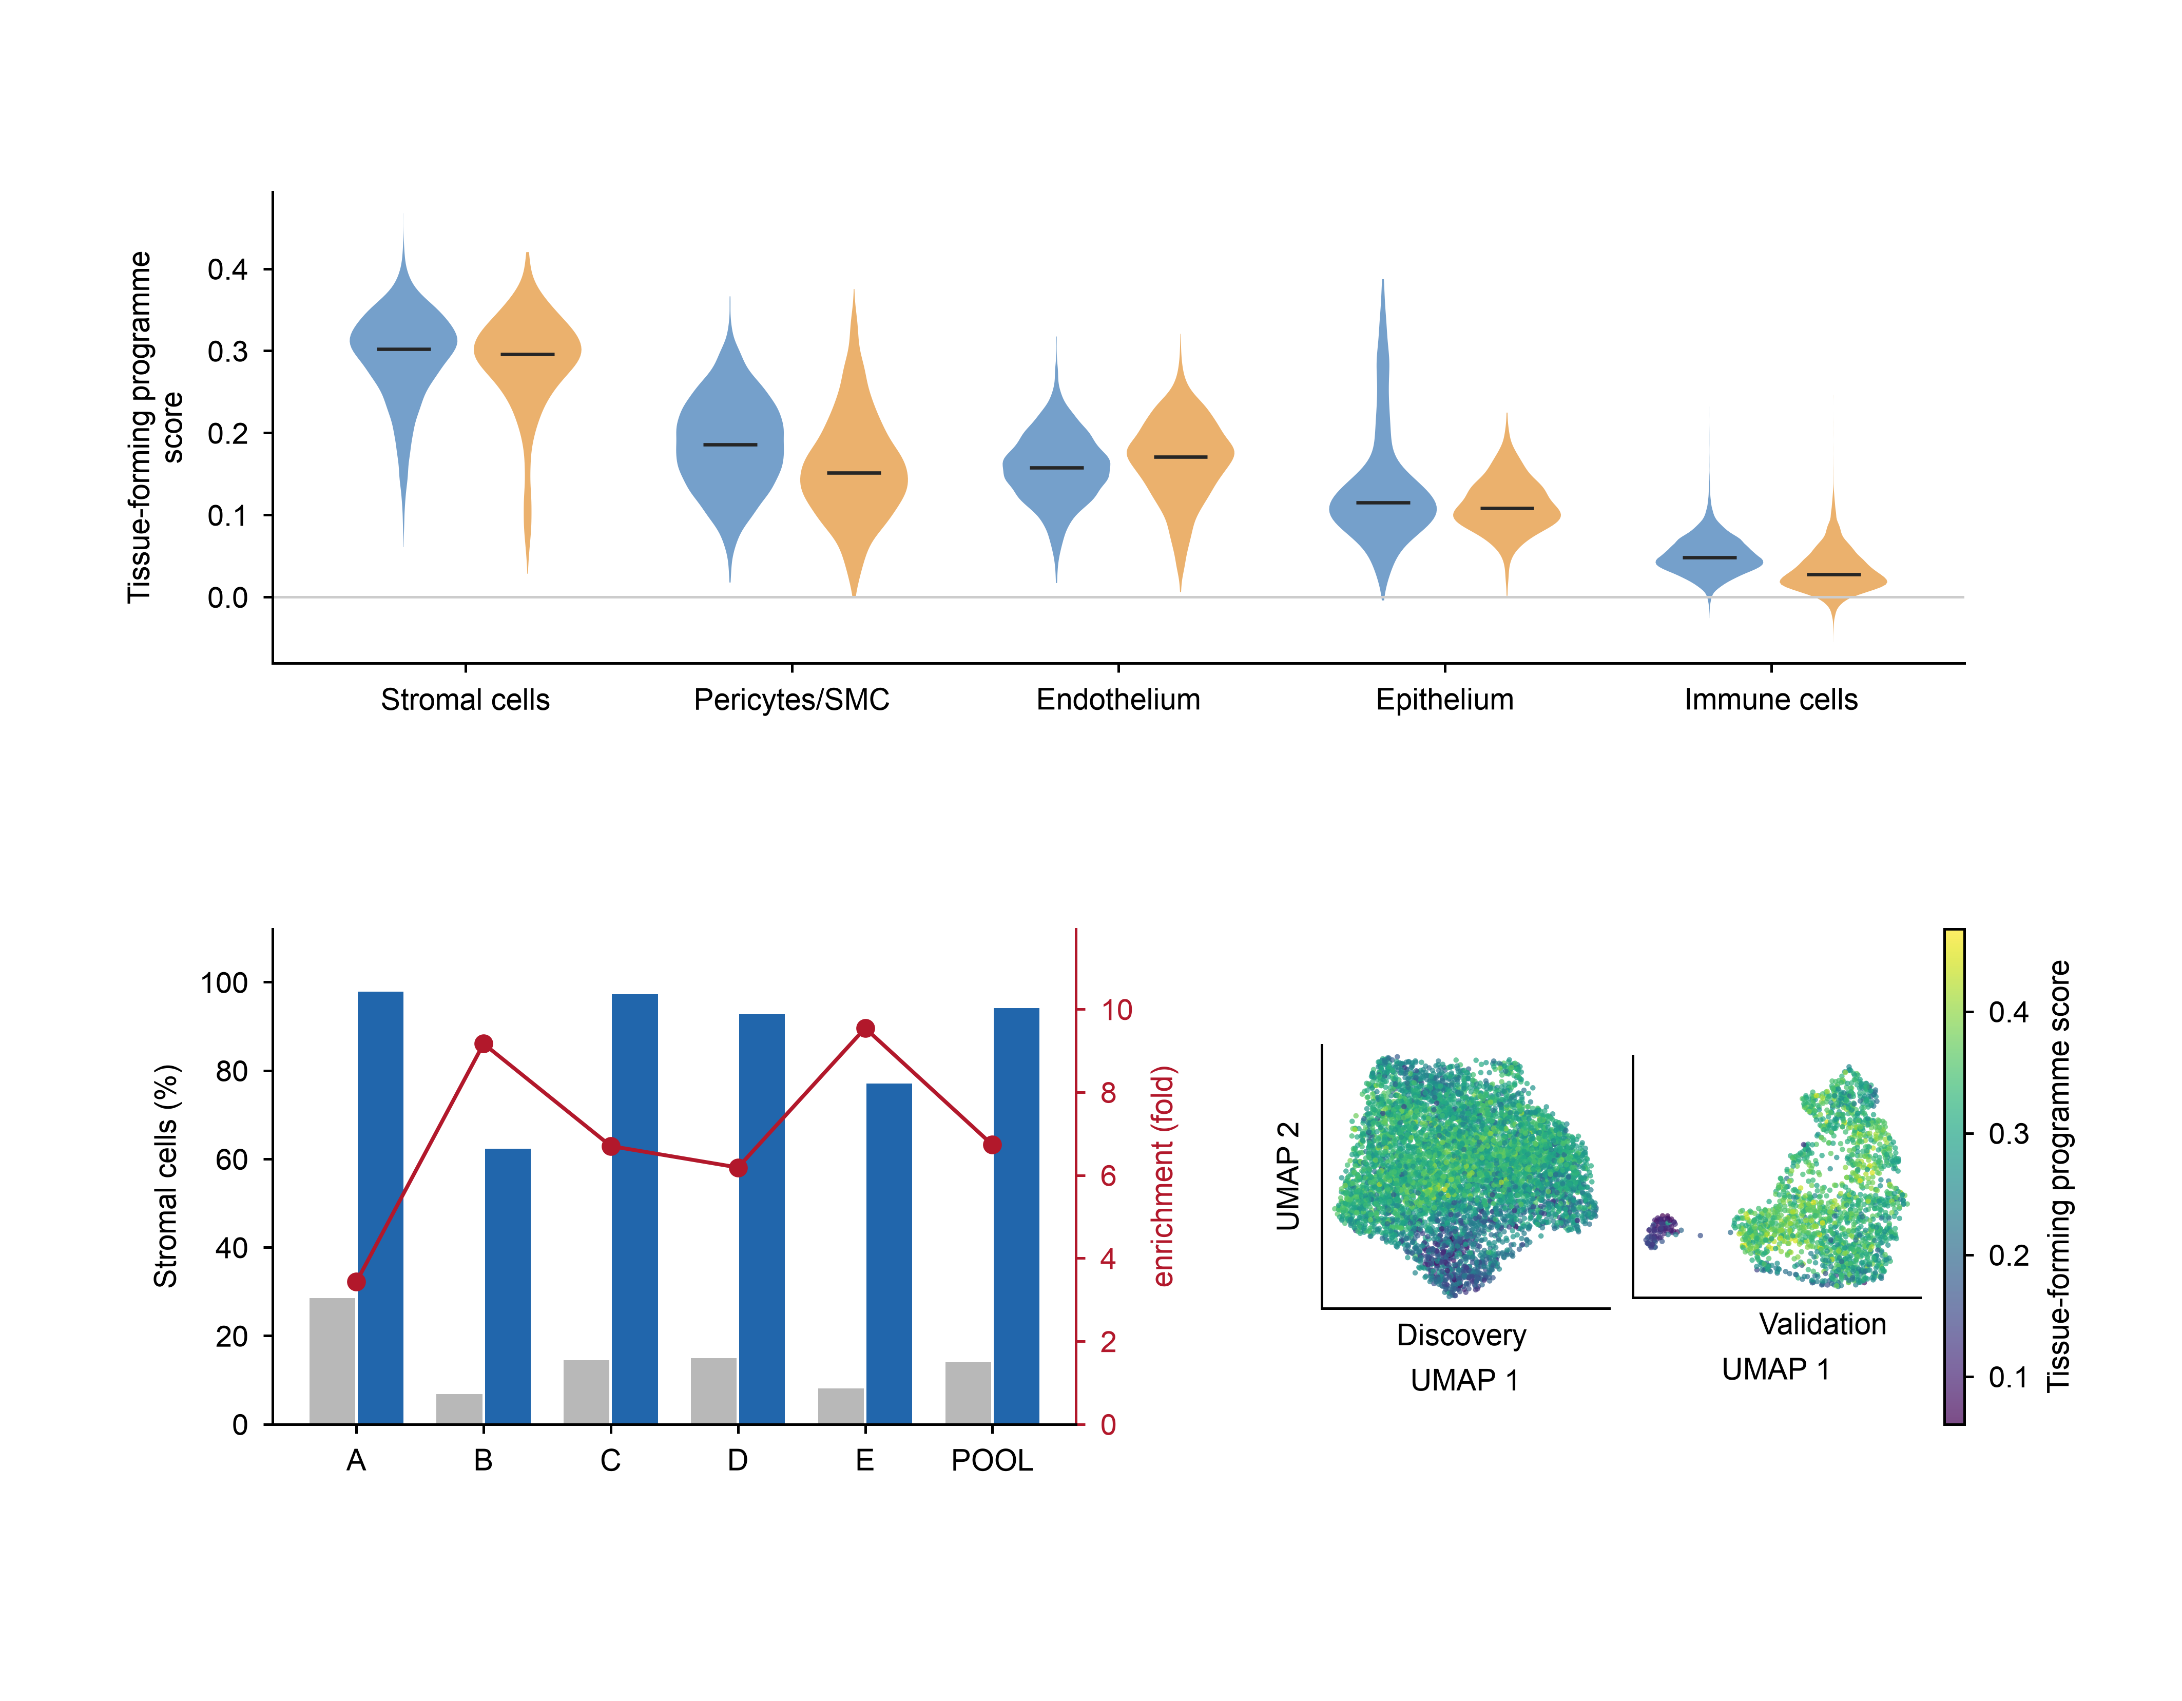
a
Programme score by compartment
Discovery (5 lesions)
Validation (3 lesions)
b
c
all cells
top decile of
tissue-forming score

