Slide 1
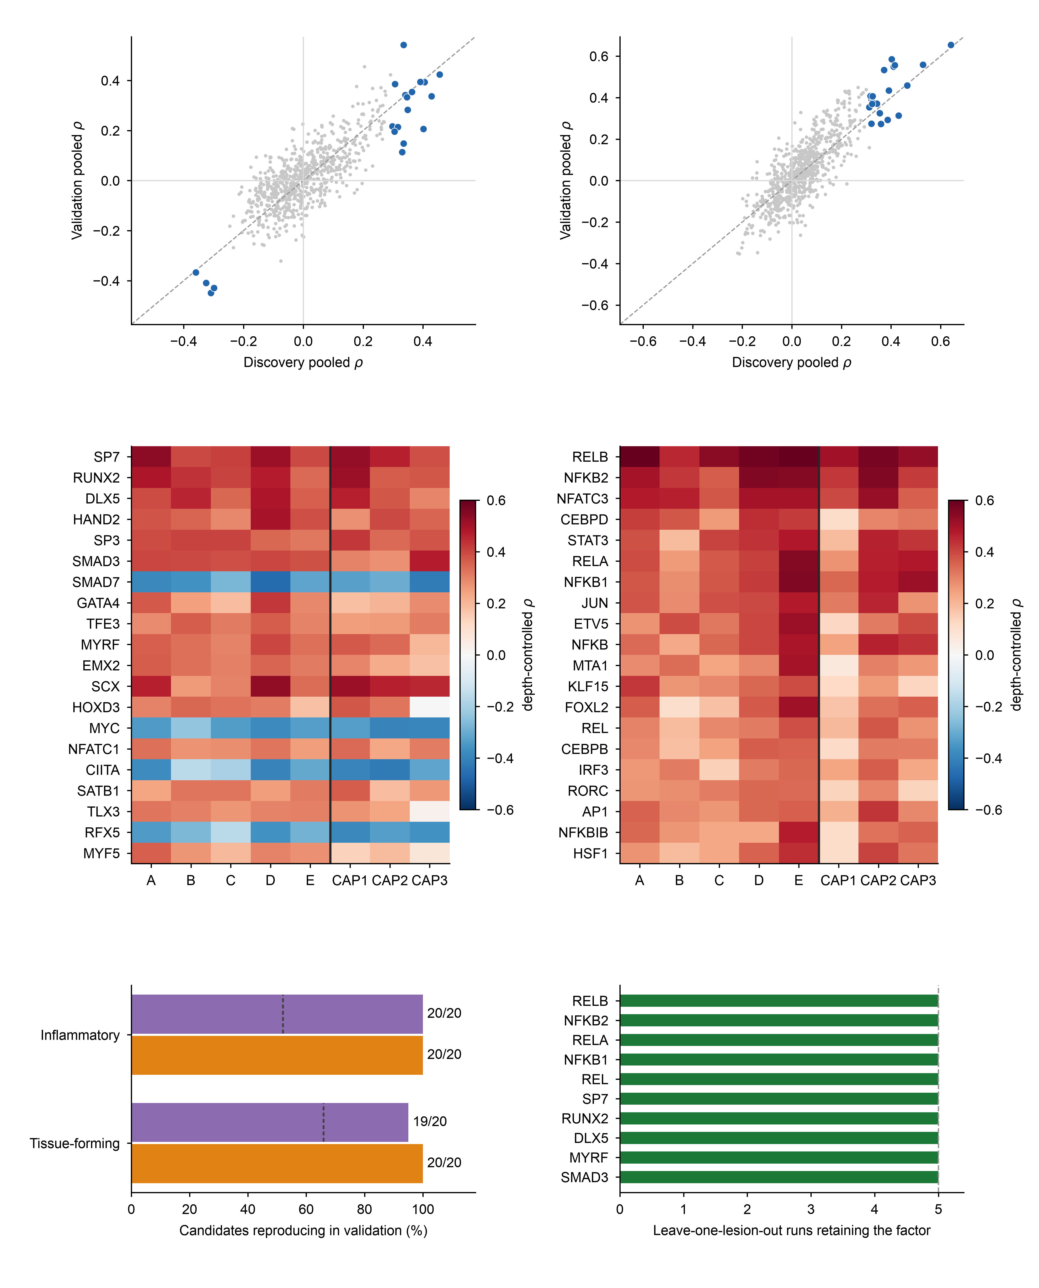
a
Tissue-forming programme
SP7
b
Inflammatory programme
NFKB1
DLX5
RELA
RELB
RUNX2
REL
NFKB2
MYRF
SMAD3
c
Top-20 candidates, Tissue-forming programme
d
Top-20 candidates, Inflammatory programme
Discovery
Validation
Discovery
Validation
e
f
random 20 factors, mean
pooled ρ same sign
same sign in all 3 lesions

